Slide 1

Global Cooling Prize
Evaluation and Testing
May 6, 2019
Rajan Rawal, Yash Shukla
CEPT University, Ahmedabad
Promoting an Innovative Culture in Cooling & Refrigeration by Developing a Robust Research and Development Eco-system

Slide 2
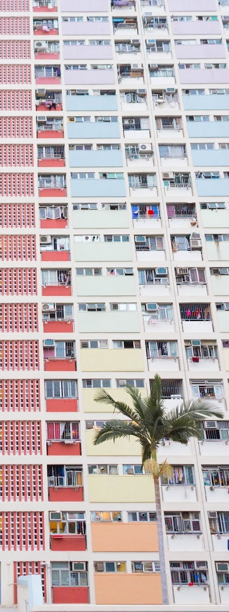
Agenda
About the Global Cooling Prize: Overview and Where we are
Testing of prototypes – Phase 2 of the Global Cooling Prize
ISEER test
Field test
Lab simulated year-round performance test

Slide 3
About the Global Cooling Prize
Overview and Where we are

Slide 4
First-of-its-kind Innovation Challenge
Aims to identify a residential cooling solution that has five times lower climate impact
Provides a common platform to incumbents, start-ups, innovators, experts and research institutes working in air conditioning space to innovate and accelerate the transition to the next generation cooling technology
A Global Competition
Attracts talent from across sectors and around the world to design a residential cooling solution that leapfrogs existing technologies
Starting in India, the Prize aims to expand to major air conditioning growth markets including China, Indonesia, and Brazil
Focus on Commercialization and Mass Adoption
Led by a global coalition of partners to drive the incubation, commercialization and ultimately mass adoption of the climate friendly residential cooling solution across the potential markets
Support from Leading National and International Institutions
Supported by Government of India and endorsed by Mission Innovation
Notes:
with representation from Department of Science and Technology, Ministry of Environment Forest and Climate Change, NITI Aayog, Ministry of Power, BEE

Slide 5
Prize Timeline and Key Milestones
Technical Application Deadline
Testing & Evaluation of Prototypes
Prize Launch
Announcement of Finalists
June 2019
July - Oct 2019
Nov 2019 - April 2020
Nov 2020
Nov 2018
Aug 2019
Nov 2019
May - Sept 2020
Intent to Apply Deadline
Applications Evaluated
Prototype Development
Final Award Ceremony

Slide 6








Our Prize Criteria will ensure that the next generation room air conditioners can meet the challenging conditions across all markets
Primary criteria used to determine final award
Supplementary criteria used to shortlist finalists
CLIMATE
One-fifth of the life-time climate impact (electricity and refrigerant) of the baseline AC unit
AFFORDABILITY
At manufacturing scale of 100,000 units, costs no more than twice the cost of the baseline AC unit to consumers
POWER
Consumes less than 700W from the grid at rated cooling capacity or during test period
EMISSIONS
Zero onsite emissions from any captive power or
heat source
SCALABILITY
Usable in existing homes, no “designed in” solution; less than 2x volumetric size of the baseline unit
OPERATION
Designed to have 1.5 TR cooling capacity at standard
outdoor conditions and Maintains below 27ºC DBT
and 60% RH indoors for the duration of test period
WATER (if any is used)
Consumes an yearly average of 14 liters/day with daily maximum limit of 28 liters
REFRIGERANTS (if any is used)
Zero ODP, lower toxicity, and compliance with safety standards
MATERIALS
Minimal usage of high embodied carbon or rare earth materials
Notes:
Climate Impact: Must have at least five times less climate impact than the climate impact of the baseline unit.
Power: Cannot draw more than 700 W at full load.
Water: Consumes less than 14 liters of water per day.
Scalability: Usable in existing homes, rather than requiring a “designed in” engineering solution.
Renewables: Technology may use a 3x5 ft. footprint on the wall or roof area of the house to place any renewable technology to offset the total energy consumption. This energy offset is only accounted for if it is used directly by the cooling equipment. Any energy unused by the equipment and fed to the grid through net metering will not be counted against the system’s total energy consumption.
Materials: nontoxic, no rare earth materials required.
Refrigerants: Zero scope 1 emissions; LOW TOXICITY, ZERO ODP
Operation: Must maintain efficiency and operate within emerging market environments, encompassing air pollution, grid power quality, humidity and local building types.
Industrialization potential: Must demonstrate cost potential at full industrialization of no more than twice the baseline solution

Slide 7

Evaluation of the cooling solutions will occur across three stages in this competition
Application Review & Screening
Participants will submit Detailed Technical Application detailing how they meet prize criteria
Initial assessment of solution cost (at manufacturing scale) will be completed alongside
Score will be given based on achievement of climate impact and affordability criteria
Up to 10 finalists will be selected for testing stage
1
A combination of lab and real world testing will allow further filtering and evaluation of each cooling solution based on performance against the prize criteria
2
Lab & Field Testing
Results from field and lab testing will be used to update the score of competing solutions in order of performance on technical criteria
The winner will be selected based on updated score on the climate impact and affordability criteria
Final Assessment
3
Notes:
Technical committee will review

Slide 8
Testing of prototypes
Global Cooling Prize – Phase 2

Slide 9




Phase 2: Selected finalists will be required to ship two prototypes to India by May 2020 for testing
Finalists announced in November 2019 after evaluation of the Detailed Technical Applications by the Technical Review Committee
Finalists will be eligible to receive an interim award of up to US $200,000
US $100,000 on announcement of finalists
US $100,000 on delivery of prototypes
Finalists will undertake prototype development and production between November 2019 and April 2020
Finalists will ship two prototypes to India by May 2020 for testing

Slide 10
Once the prototypes are received from all the finalists, Testing will be conducted by three different methods
ISEER testing
Field testing
(up to 60 days)
Prototype 1
Two prototypes of the cooling solution received in India
Final evaluation:
Updated score based on testing results combined with cost assessment
Prototypes that do not come under the purview of ISEER test method will be considered on case by case basis by the Technical Review Committee
Lab simulated full-year testing (up to 12 days)
Prototype 2

Slide 11
Indian Seasonal Energy Efficiency Ratio (ISEER) test
Performance test of variable capacity systems based on vapor compression technology
Cooling Capacity
Cooling at full capacity
Cooling at 50% capacity
Power Consumption
Power consumption at full capacity
Power consumption at 50% capacity
ISEER rating
Annual seasonal cooling load
Annual seasonal energy consumption
Test Parameters
Test conditions
Outdoor Conditions – 35°C DBT and 24°C WBT
Indoor Conditions – 27°C DBT and 19°C WBT
Outdoor temperature varying from 24-43°C
Standard followed
IS 1391: Part 1 – 2017 (unitary air conditioners)
IS 1391: Part 2 – 2018 (split air conditioners)
ISO 16358-1: 2013

Slide 12
Indian Seasonal Energy Efficiency Ratio (ISEER) test (2/3)
Determining the ISEER rating of the cooling solutions
Temperature in ℃ | Average annual hours | Fraction | Bin hours
24 | 527 | 9.1% | 146
25 | 590 | 10.2% | 163
26 | 639 | 11.1% | 177
27 | 660 | 11.4% | 183
28 | 603 | 10.4% | 167
29 | 543 | 9.4% | 150
30 | 451 | 7.8% | 125
31 | 377 | 6.5% | 104
32 | 309 | 5.4% | 86
33 | 240 | 4.2% | 67
34 | 196 | 3.4% | 54
35 | 165 | 2.9% | 46
36 | 130 | 2.3% | 36
37 | 101 | 1.7% | 28
38 | 79 | 1.4% | 22
39 | 59 | 1.0% | 16
40 | 44 | 0.8% | 12
41 | 31 | 0.5% | 9
42 | 20 | 0.3% | 6
43 | 10 | 0.2% | 3
Total | 5774 | 100% | 1600
1600 Annual cooling hours divided into bin hours for a outdoor temperature range of 24 – 43 °C.
Determining the cooling seasonal total load (CSTL) and cooling seasonal energy consumption (CSEC) based on the bin temperature range and hours of operation.
Determining the ratio of CSTL and CSEC to evaluate the ISEER value.
For more information about this testing method, visit https://www.beestarlabel.com/content/files/inverter%20ac%20schedule%20final.pdf

Slide 13
Indian Seasonal Energy Efficiency Ratio (ISEER) test (3/3)
Protocol to be followed for ISEER test
One prototype of each finalist sent to a NABL (National Accreditation Board for Testing and Calibration Laboratories) accredited lab for evaluation of standard test parameters.
Prototypes should have a standard cooling capacity of 1.5 TR (5.3 kW).
Prototypes should have an ISEER rating of greater than 7.
Prototypes that cannot be assessed under IS 1391 standard or cannot be given an ISEER rating will be considered on a case-by-case basis by the Technical Review Committee.
If the prototype meets all the prize criteria during the other two testing methods i.e. lab simulated year-round test and field test, the Technical Review Committee may allow such prototype to compete in the competition.

Slide 14
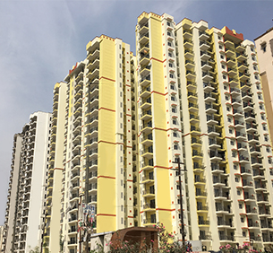
Field test
Following the ISEER test, prototypes will be installed in actual residential apartments
Newly built mid to high rise residential apartment building in a heat stressed city in India.
Selected apartment units to occupy middle floors of the building.
Selected apartment units to be materially equivalent in size, envelope characteristics, solar heat gain, shading etc.
Selected apartment units to have cooling loads that can be met by the baseline AC unit of 1.5 TR (5.3 kW) cooling capacity under standard conditions i.e. outdoor conditions 35°C DBT and indoor conditions 27°C DBT/60%RH.
Disclaimer – The actual apartments during the field test may not resemble this apartment building

Slide 15
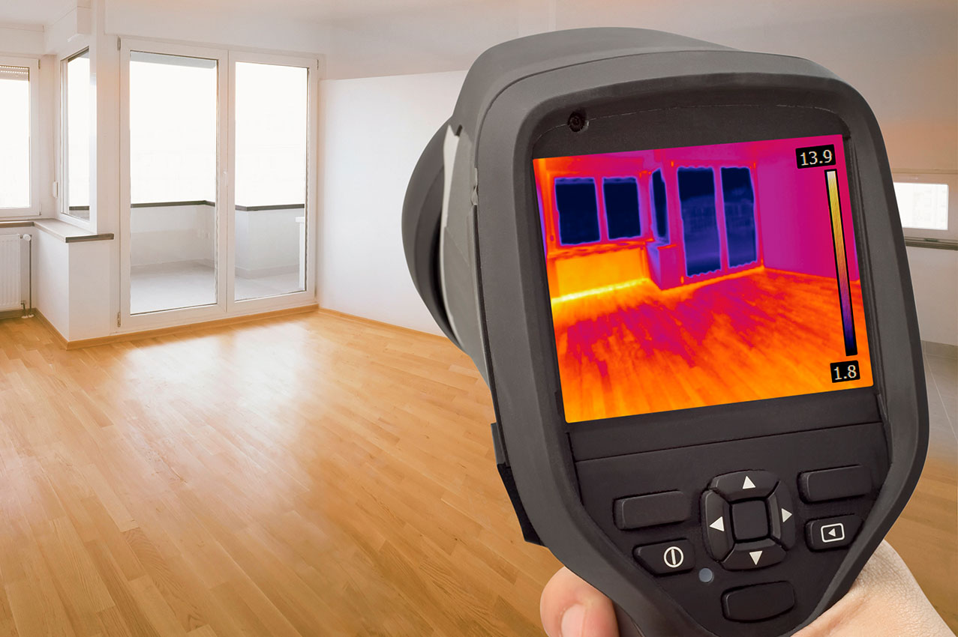
Field test (2/6)
Measures will be taken to verify that apartment units are materially equivalent
Apartment units to remain unoccupied to limit variation in loads due to human behavior.
Thermal imaging and characteristics test to be performed to ensure similar envelope characteristics across the apartment units.
Blower door test to be conducted to ensure an equivalent air tightness.
Wherever necessary, envelope will be properly sealed or leaked to ensure that air tightness characteristics are equivalent across all the apartment units.
Airflow measurements to be taken for kitchen and exhaust fans, and adjustments be made to ensure even flow rates across the apartment units.

Slide 16
Field test (3/6)
Protocol to be followed during the field test
Prototypes to be installed and tested for a period of up to 60 days in residential apartment units.
A team member can be present on site to support the installation and observe the performance of the prototype.
Baseline AC unit to be installed and tested in parallel with the prototypes– ensuring similar conditions during testing.
Prototypes with integrated PV panels to be installed such that the panels uniformly face between a southwest or southeast orientation – no rooftop access allowed.
Internal load profiles to be simulated based on the typical daily sensible and latent gains observed in a home from lighting, appliances and occupants using electric resistance and humidifier.
Prototypes and baseline AC unit to be operated continuously for all the test days i.e. up to 60 days.
Performance parameters of the prototypes and baseline AC unit to be recorded at every 15-minute interval.
Grid electricity consumption, Power demand, Water usage etc.
Indoor conditions where the prototype is installed - below 27°C DBT and 60% RH at all times
Notes:
The middle days of the testing period represent the aggregate seasonal variation in DBT and RH and will account for the majority of the weighting for annual days. The weighting for the mild day (starting day), where prototypes will commence operation, is likely to have a weighting of no more than 5% and each extreme day, which represent the most challenging conditions, is likely to have a weighting of no more than 1% when extrapolating to annual performance

Slide 17
Field test (4/6)
Allowance and other consideration for the prototypes during the field test
Unmet hours allowance for not maintaining the indoor conditions will be considered:
To the extent of the number of hours the baseline AC unit does not maintain the indoor conditions below 27°C DBT and 60% RH
Additional allowance of up to 3.4% of the test hours that the prototype operates i.e. a maximum allowance of 49 unmet hours if the prototype operates for all 60 days of the field test
Use of existing plumbing line will be allowed, but without any major modifications to the piping network of the apartment unit.
Non Structural modification to the apartment unit or electrical upgrades may be allowed if it is not materially different from that required for installation and operation of the baseline AC unit.
The decision of the Technical Review Committee will be final when qualifying any modification or upgrade as “major” and thus violating the “Scalability” criteria of the Prize
Notes:
The middle days of the testing period represent the aggregate seasonal variation in DBT and RH and will account for the majority of the weighting for annual days. The weighting for the mild day (starting day), where prototypes will commence operation, is likely to have a weighting of no more than 5% and each extreme day, which represent the most challenging conditions, is likely to have a weighting of no more than 1% when extrapolating to annual performance

Slide 18
Field test (5/6)
Example calculation of the additional allowance for unmet hours
Consider that
Prototype operates for a total of 30 days of the field test
Baseline AC unit does not maintain the desired indoor conditions of below 27°C DBT and 60% RH for 15 hours
Prototype does not maintain the desired indoor conditions of below 27°C DBT and 60% RH for 30 hours
A | B | C | D | E | F | G
Example | Number of days prototype operates [days] | Total Unmet hours allowance for the prototype [hours] | Number of hours the baseline unit does not maintain desired indoor conditions [hours] | Number of unmet hours prototype does not maintain desired indoor conditions [hours] | Number of unmet hours of prototype in addition to that of baseline unit [hours] | Is the prototype within the unmet hours allowance limit?
1 | 30 | 24.5 (3.4%*30 days*24) | 15 | 30 | 15 (E – D i.e. 30 – 15 = 15) | Yes as F<C i.e. 15<24.5

Slide 19
Field test (6/6)
Addressing a component failure of the prototype during the field test
Global Cooling Prize team communicates the issue to the concerned finalist’s team leader and/or its onsite representative.
Opportunity to either replace or perform necessary repairs to the prototype at own discretion and cost.
Up to a maximum of three on site replacements or repair opportunities provided.
Each repair opportunity will be for a duration of up to 5 days following notification
Failure to do so within the 5 day window will count as one lost opportunity
If repair takes more than 15 days from notification, this will be counted as all three opportunities lost.
Once all the three opportunities are lost and the failure is not addressed or a component fails again -
Provide Technical Review Committee with the performance analysis for the successful test days and a brief write-up on failure analysis.
Has the prototype been successfully tested for at least 72 hours in continuous operation mode
YES
Assess possibility of any further attempts based on prize timelines and provide Technical Review Committee with a brief write-up on failure analysis.
NO

Slide 20
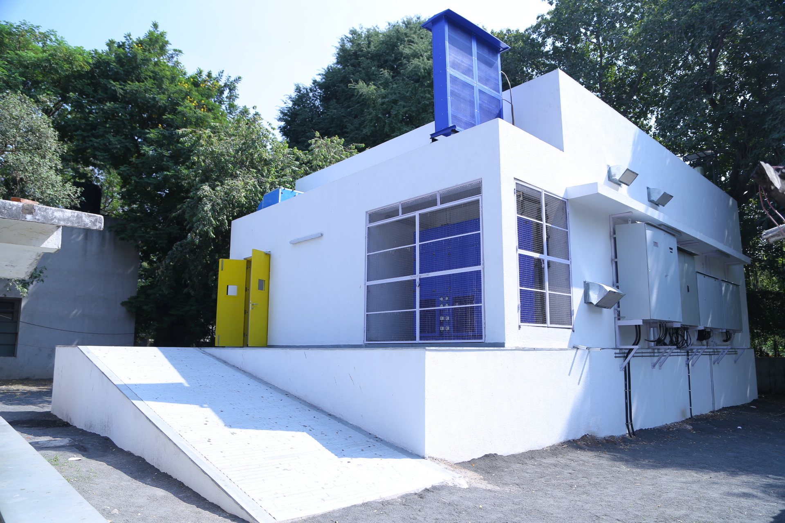
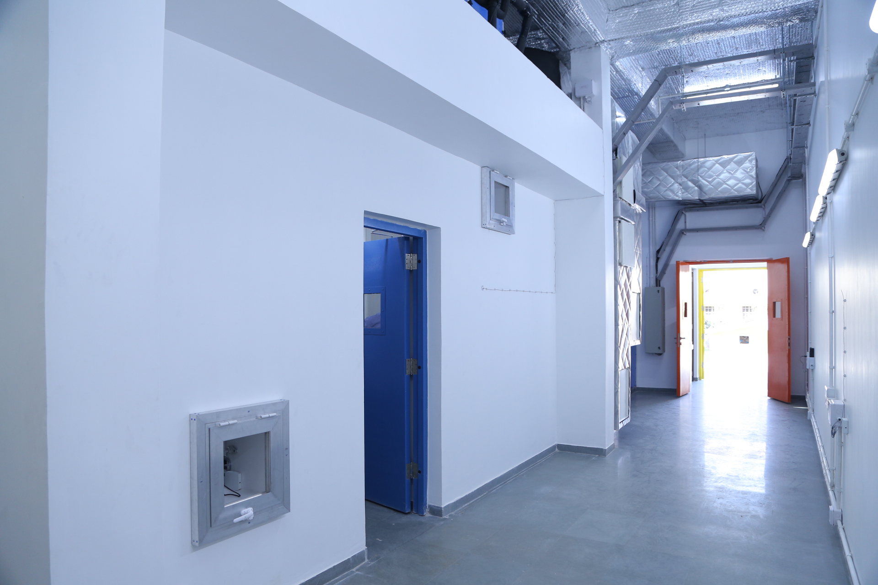
Lab simulated year-round performance test (1/3)
Second prototype of each finalist will be tested at CEPT University’s state-of-the-art facility
Designed to assess energy use, demand, and water use for a wide variety of air conditioning system technologies - traditional and low energy cooling systems
Design comprises of External and Internal rooms (Room within a room) to simulate energy use in buildings
External Chamber maintains a wide range of daily outdoor condition profiles (5 to 45 °C, 20 to 80% Relative Humidity)
Internal Chamber maintains accurate indoor conditions (15 to 35 °C, 10 to 90% Relative Humidity)
Notes:
The middle days of the testing period represent the aggregate seasonal variation in DBT and RH and will account for the majority of the weighting for annual days. The weighting for the mild day (starting day), where prototypes will commence operation, is likely to have a weighting of no more than 5% and each extreme day, which represent the most challenging conditions, is likely to have a weighting of no more than 1% when extrapolating to annual performance

Slide 21
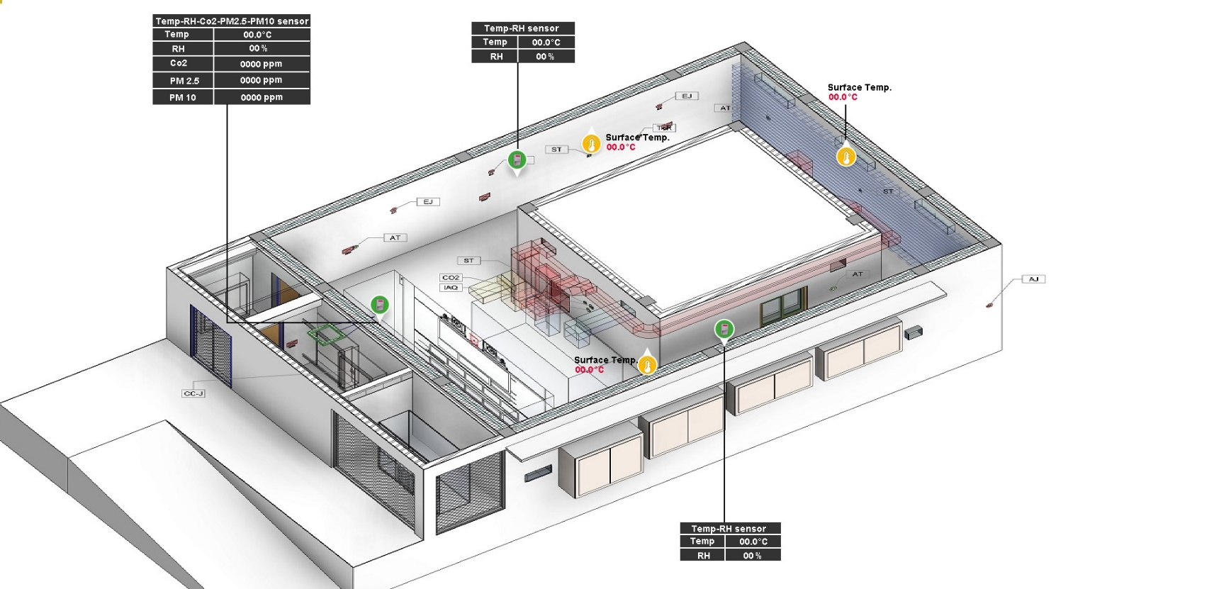
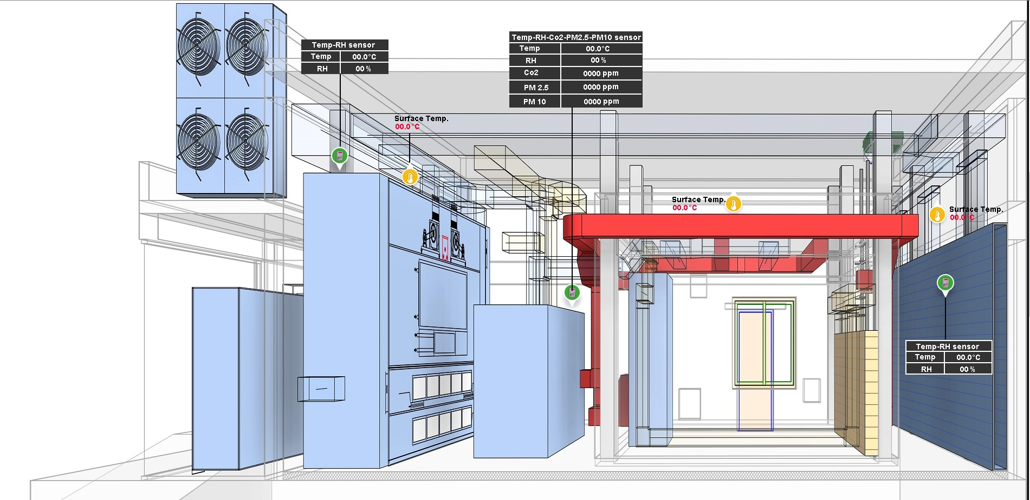
Lab simulated year-round performance test (2/3)
Capability to simulate real world environmental conditions as well as internal heat gains
Fully integrated with Building Management System (BMS) for flexible programming of building operations, chamber interactions, and artificial heat loads
Accurate monitoring of air temperatures, relative humidity, carbon dioxide level, PM 10 and PM 2.5 levels inside the facility
Simulates interaction between indoor and outdoor rooms through controlled air exchange rates
Comfort stations and thermal mannequin to scientifically understand thermal comfort in the facility

Slide 22
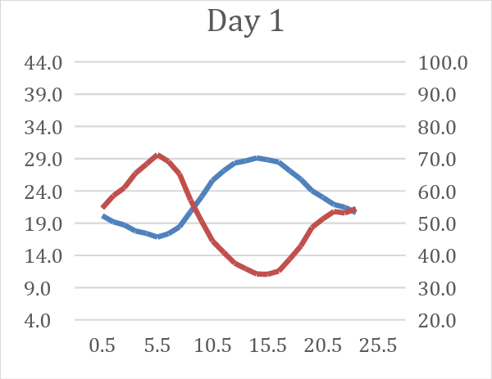
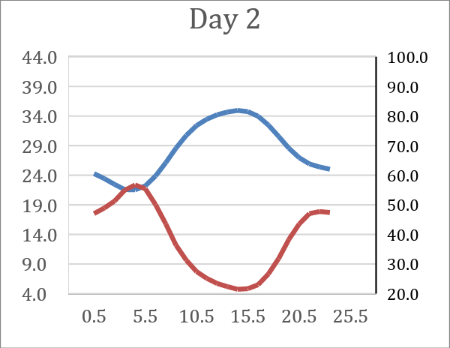
Lab simulated year-round performance test (3/3)
Testing the prototypes for 10 continuous days under varying outdoor conditions to estimate the full-year performance
Selected 10 typical daily profiles representing all climate zones of India under which a cooling technology is expected to be operated in India.
Warm and Dry day
Warm and Humid day
Hot and Dry day
Hot and Humid day
Extreme humid day
Extreme hot and dry day
Warm and Dry days
Dry bulb temperature
Relative humidity
Notes:
The middle days of the testing period represent the aggregate seasonal variation in DBT and RH and will account for the majority of the weighting for annual days. The weighting for the mild day (starting day), where prototypes will commence operation, is likely to have a weighting of no more than 5% and each extreme day, which represent the most challenging conditions, is likely to have a weighting of no more than 1% when extrapolating to annual performance

Slide 23
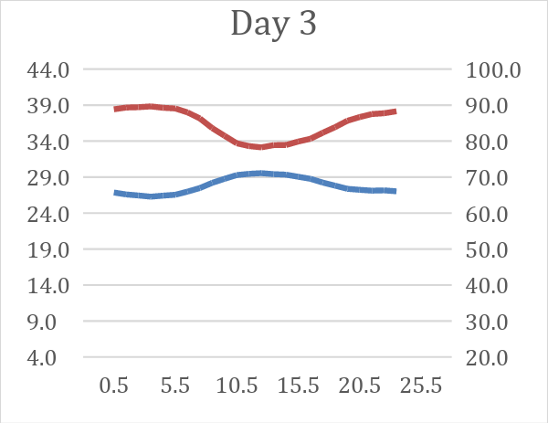
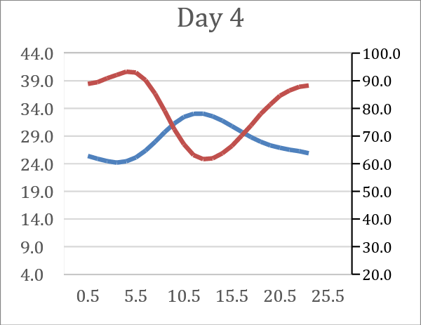
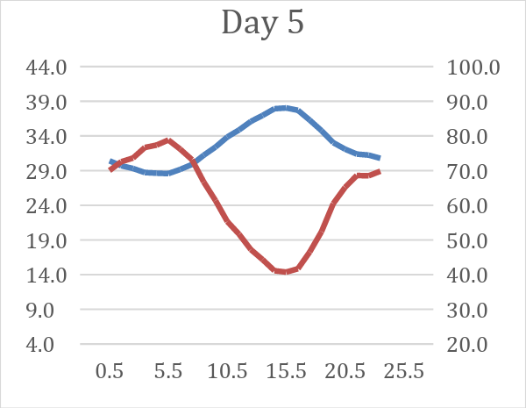
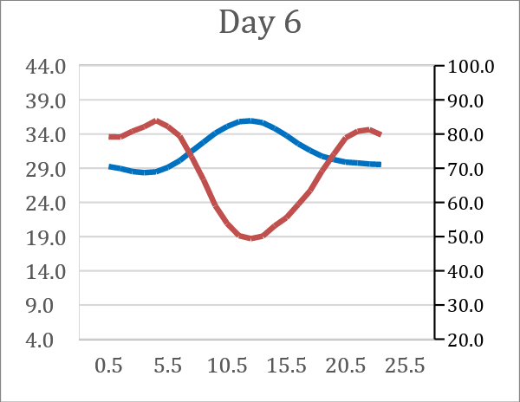
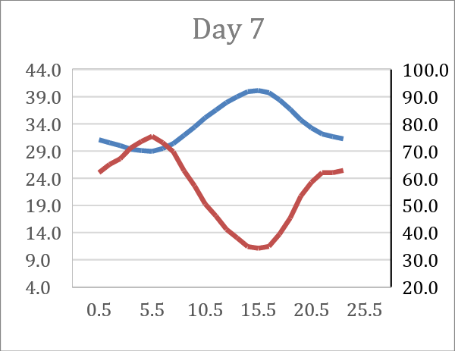
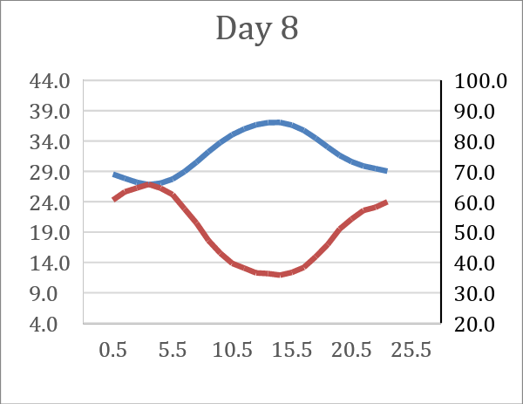
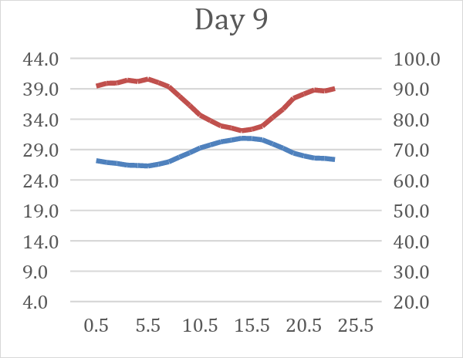
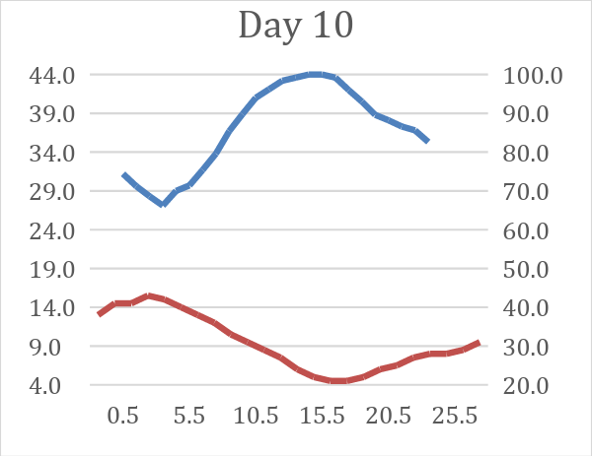
Lab simulated year-round performance test (4/9)
Warm and humid days
Hot and humid days
Hot and dry days
Extreme humid day
Extreme hot and dry day
Dry bulb temperature
Relative humidity

Slide 24
Lab simulated year-round performance test (5/9)
Weighting factors are assigned to each of the 10 test days to evaluate the year-round performance of the prototypes
Weighting factors represent the fraction of days in a year in New Delhi, India that are similar to each of the selected day for testing
Day Type | Sequence of days | Weighting factor*
Warm and Dry | Day 1 | 8%
Warm and Dry | Day 2 | 12%
Warm and Humid | Day 3 | 5%
Warm and Humid | Day 4 | 18%
Hot and Dry | Day 5 | 1%
Hot and Dry | Day 6 | 10%
Hot and Humid | Day 7 | 4%
Hot and Humid | Day 8 | 6%
Warm and Extreme Humid | Day 9 | 6%
Extreme Hot and Dry | Day 10 | 2%
Example calculation - Using weighting factor to determine annual performance
Test day | Operating hours [hours/day] | Measured cooling electricity consumption [kWh/day] | Weighting factor* | Annualized energy consumption [kWh/year]
Day 10 - Extreme Hot and Dry | 24 | 25 | 2% | 182.5 [25* (2%*365)]
Sum of the weighting factors: 72% after eliminating the days when the prototype is not expected to operate in New Delhi, India
*Note: The above weighting factors can be used by the participants for estimating the annual performance of their cooling solution during the lab simulated year-round performance test. In an unlikely scenario where any changes are made, all the participants will be updated about the same. These weights will also be updated on the Global Cooling Prize website and shared with the participants.

Slide 25
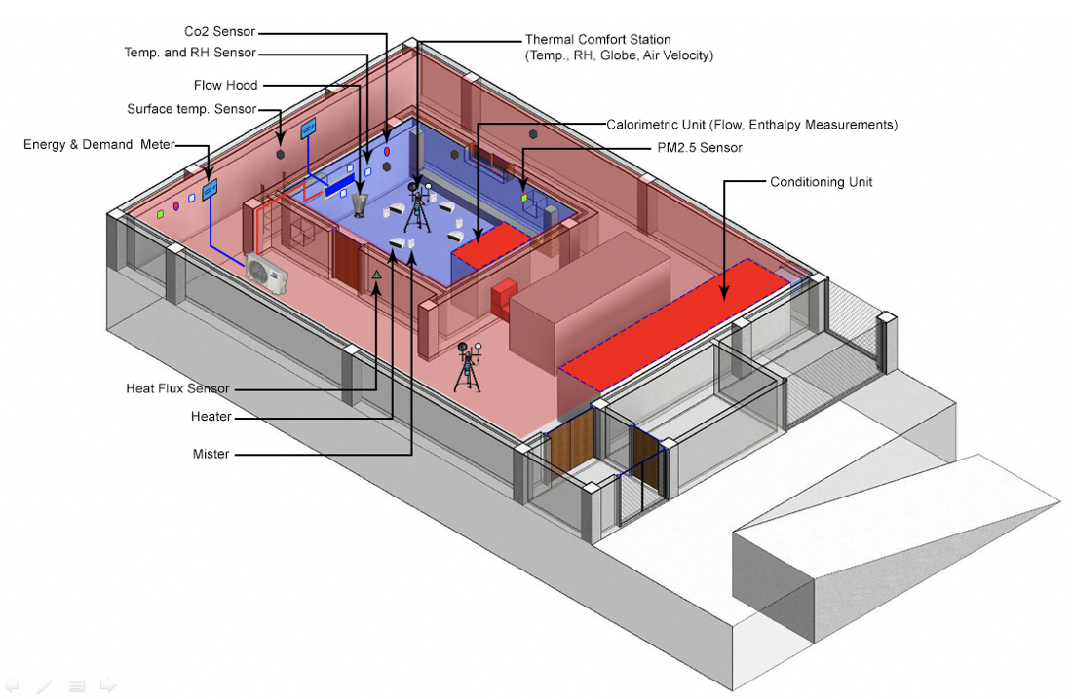
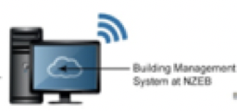
Lab simulated year-round performance test (6/9)
Protocol to be followed during the lab test
Prototypes to be installed and tested for up to 12 days in the simulated lab environment.
A team member can be present on site to support the installation and observe the performance.
Prototypes to be operated for 10 days in continuous operation mode i.e. all 24 hours, excluding time for stabilization and transition.
External (envelope heat gains and infiltration) and internal gains (lighting and occupants) will be simulated in the chamber.
Performance parameters of the prototypes to be recorded at every 15-minute interval.
Grid electricity consumption, Power demand, Water usage etc.
Indoor conditions of the internal chamber - below 27°C DBT and 60% RH at all times.
Temp and RH sensor
Thermal comfort sensor
Surface temp sensor and flow hood
Calorimetric unit
Energy demand meter
PM 2.5 sensor
Conditioning unit
Heat flux sensor
Heater
Mister
Internet
Building Energy Management system
Disclaimer – The layout and exact location of any equipment or any instrument may be different in the actual lab set-up.
Notes:
The middle days of the testing period represent the aggregate seasonal variation in DBT and RH and will account for the majority of the weighting for annual days. The weighting for the mild day (starting day), where prototypes will commence operation, is likely to have a weighting of no more than 5% and each extreme day, which represent the most challenging conditions, is likely to have a weighting of no more than 1% when extrapolating to annual performance

Slide 26
Lab simulated year-round performance test (7/9)
Allowance and other consideration for the prototypes during the lab test
Unmet hours allowance for not maintaining the indoor conditions will be considered:
To the extent of the number of hours the baseline AC unit does not maintain the indoor conditions below 27°C DBT and 60% RH
Additional allowance of up to 3.4% of test hours that the prototype operates
Credit will be given to the prototypes that have integrated renewable energy technology
Evaluating the energy generation using test day weather profile data and standard component efficiencies.
Non Structural modification to the lab, electrical upgrades, piping modifications may be allowed if it is not materially different from that required for installation and operation of typical room air conditioner unit.
The decision of the Technical Review Committee will be final on any modification or upgrade which they consider to be “major” and thus violating the “Scalability” criteria of the Prize
Notes:
i.e. if the prototype does not operate for 2 hours on an extreme day, its weighted unmet hours will be lower.

Slide 27
Lab simulated year-round performance test (8/9)
Example calculation of the additional allowance for unmet hours
Weighting factor corresponding to the test day will be used to determine the unmet hours that the prototype does not maintain the indoor conditions below 27°C DBT and 60% RH.
Weighted unmet hours of a test day = Actual no. of unmet hours on a test day X test day weighting X no. of test days.
Test Day | Actual number of unmet on a test day [hours/day] | Weighting factor* | Weighted number of unmet hours on a test day [hours/day]
Day 4 – Warm and Humid day | 1 | 18% | 1.8
Day 10 - Extreme Hot and Dry | 5 | 2% | 1
Total weighted number of unmet hours should not exceed a maximum of 8.2 hours if the prototype operates for all 10 days of the lab test
31

Slide 28
Lab simulated year-round performance test (9/9)
Addressing a component failure of the prototype during the lab test
Global Cooling Prize team provides a 30 day advance notice of the dates over which prototype will be tested.
Opportunity to either replace or perform necessary repairs to the prototype at own discretion and cost.
Up to a maximum of three on site replacements or repair opportunities provided.
Each repair opportunity will be for a duration of up to 24 hours following notification
Failure to do so within the 24 hour window will count as one lost opportunity
If repair takes more than 72 hours from notification, this will be counted as all three opportunities lost.
Once all the three opportunities are lost and the failure is not addressed or a component fails again -
Provide Technical Review Committee with the performance analysis for the successful test days and a brief write-up on failure analysis.
Has the prototype been successfully tested for a cumulative period of at least 72 hours
YES
Assess possibility of any further attempts based on prize timelines and provide Technical Review Committee with a brief write-up on failure analysis.
NO

Slide 29
Phase 3: Final evaluation of the prototypes and selection of winner
After consideration of the full suite of test results Technical Review Committee will provide an updated score to the prototypes following the same scoring methodology as the Detailed Technical Application and provide a rank to each solution.
Performance of the prototypes will be recorded against each testing method.
Final score of the prototypes will be based on overall performance across all three testing methods.
Score obtained in the lab simulated full-year test and field test along with any limitations will be considered in adjusting the final score and ranking by the Technical Review Committee.
Supervisory Board ratifies the recommendations after ensuring the winning participant(s) fully meet the intent of the Prize’s technical criteria.
Announcement of the final winner at a day-long international award ceremony with Mission Innovation, as well as participating country ministerial and funder presence.

Slide 30
































Initiated by
Sponsored by
Lead Implementation Partner
Administered by
Lead Supporting Partners
Outreach Partners
Thank you to our Prize supporters

Slide 31
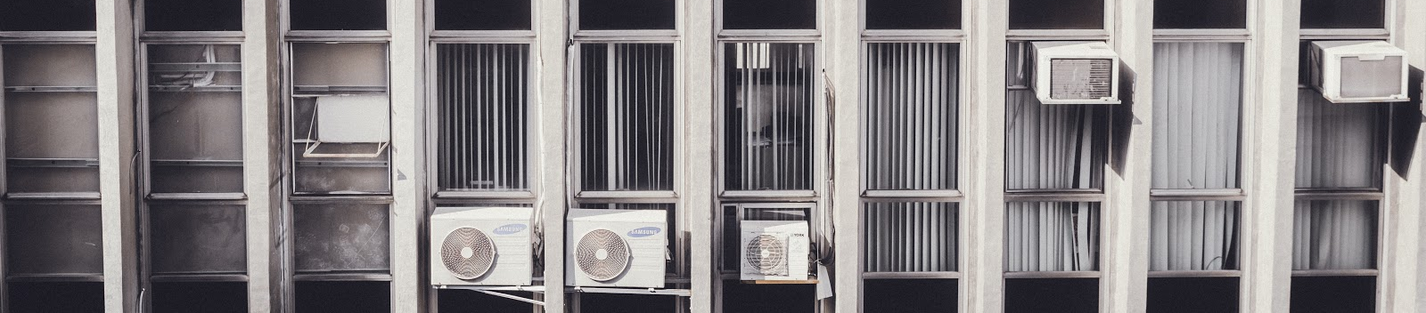
Thank you! rajanrawal@cept.ac.in yash.Shukla@cept.ac.in
Please check out the FAQ page on our website for answers to commonly asked questions: https://globalcoolingprize.org/prize-details/faq/

