Slide 1

Innovation in cooling & Refrigeration an Industry perspective
J M Bhambure RAMA 6th May 2019

Slide 2
Topic of the day
Promoting an Innovative Culture in Cooling & Refrigeration
by Developing
a Robust Research and Development Eco-system"

Slide 3
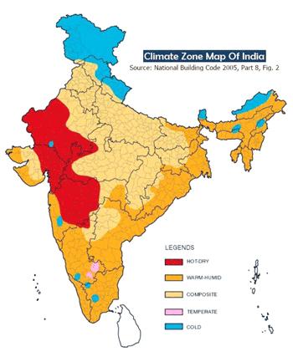
India Climate Zones
60 % of the population resides in Hot & Dry and Composite zone

Slide 4
Cooling in India
The cooling needs of India are met depending on the economic status and climate conditions, through Ceiling Fans, Air coolers and Air conditioners
Ceiling fan is the most widely used appliance, is of low cost , but limited control over temperature and no control over humidity
Air cooler is effective in dry climate are of low cost both first and the running
Air conditioner controls temperature and humidity over a wide range, but has high first and running cost

Slide 5
Refrigeration demand in India
Refrigeration demand is across the cold chain
There are gaps > 80 % in Pack-houses, Reefer trucks and Ripening chambers. Cold storage both bulk and hub are well established
Meeting Pack house demand is expected to grow with initiatives taken to double the farmers income.
The challenge is to keep the running cost low, Government has taken steps to incentivize the demand by offering tax exemption

Slide 6
Status of housing and cooling means
60 to 70 % of household fall in 1 or 2 room category
Fans are the most widely used with penetration > 70%
8% of current households have Room AC, in next 20 years it is expected to rise to ~ 40%
A large population continues to use Air coolers specially in Hot & Dry and composite climate. Air coolers consume 1/4th of energy as compared to AC, however water is a requirement
Air cooler as product category has potential to be major cooling solution

Slide 7
Status : Technology adoption & Innovation
Room AC
  Known technologies are adopted
  At par with the developed countries in terms of efficiencies
Air coolers
  Technology is at lower end in terms of adoption
  Customer concerns are not addressed such as consumption of water and control of humidity
  There is scope for innovation
  Need to innovate and develop new technologies

Slide 8
Emerging technologies in short term
Solar : PV cells and heating
  PV cells can be used as complementary to AC power, specifically when the load is less such as lower ambient periods.
  Heating has potential to be used as booster in vapor compression system
Desiccant
  Will be effective in Humid and Composite climate zones
The emerging technologies need to be commercially converted to use in products

Slide 9
Commercialization of Technology
Combination
of
Technologies
Incentives & Promotion
Technologies
Product
design
Product
Manufacturing
Technology
Standards
Acceptance
By
Consumers
Application
Industrial design
Distribution
Installation
Service
Creating an ECO SYSTEM is essential across the development cycle

Slide 10
Direction to conserve energy demand
Room AC conventional technology has reached saturation, will require investment in Solar and desiccant technology to augment efficiency
Alternative cooling solutions to Room AC
Air coolers is ideal product to invest in adopting innovative technologies, expected to meet majority of Indian climatic conditions, costs will be less and will be affordable.
Research is required in lower consumption of water and humidity management

Slide 11
Next steps
New technologies take long time to get accepted
The process can be accelerated by developing an eco system in all stages of commercialization of product
Developing supply chain is crucial for implementing innovation
Holistic approach is essential for success, only developing technology will not help
Considering diverse income levels, housing and disposable income, cost effective technology will only serve the purpose to meet cooling demands

Slide 12
Global cooling prize has triggered innovation
A similar approach is required, which will act as catalyst across the product development cycle
The approach needs to be concurrent
Special focus should be on commercialization of technologies and products that save energy

Slide 13
Thanks
Jitendra Bhambure
Advisor Technology
Blue Star Limited jmbhambure@bluestarindia.com jm.bhambure@gmail.com

