Slide 1
Mission Innovation : An overview
Sanjay Bajpai
Adviser/ Scientist ‘G’ and Head
Technology Mission Division( Energy , Water & all Others)
Department of Science & Technology (DST)
Ministry of Science & Technology, Government of India
sbajpai@nic.in
www.dst.gov.in

Slide 2
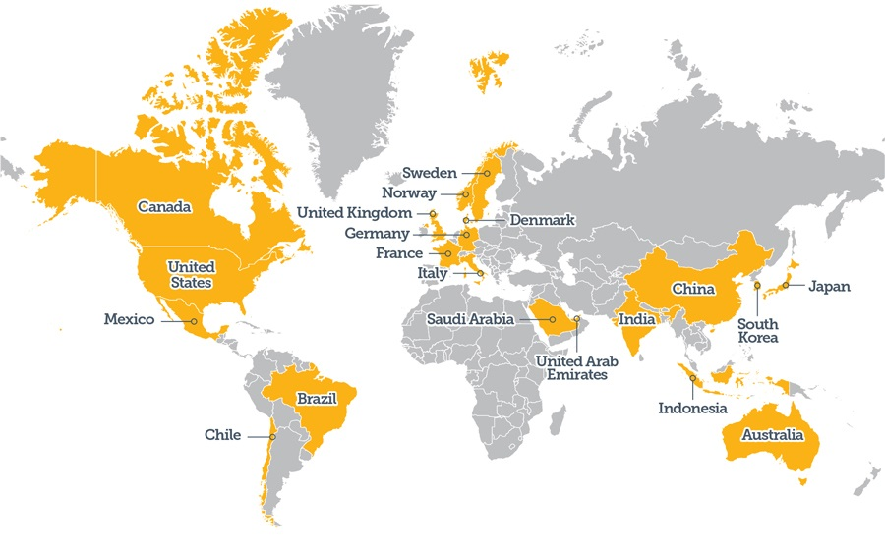
MISSION INNOVATION
Accelerating the Clean Energy Revolution
Mission Innovation (MI) – A global initiative of 23 countries and the European Union to dramatically accelerate global clean energy innovation.
World leaders came together in Paris to undertake ambitious efforts to combat climate changes in November, 2015.
Joint Statement
“Come together to reinvigorate and accelerate public and private global clean energy innovation to make clean energy widely affordable”

Slide 3
MISSION INNOVATION
Accelerating the Clean Energy Revolution
Develop and scale-up breakthrough technologies and achieve substantial cost reductions to strengthen global efforts in clean energy innovation.
Double public clean energy R&D investment over baseline in five years.
Catalyzing global research efforts to provide significant benefits in reducing greenhouse gas emissions, increasing energy security, and creating new opportunities for clean economic growth.
Enhance public and private partnerships via engagement, knowledge sharing, collaborative programmes and investments.

Slide 4
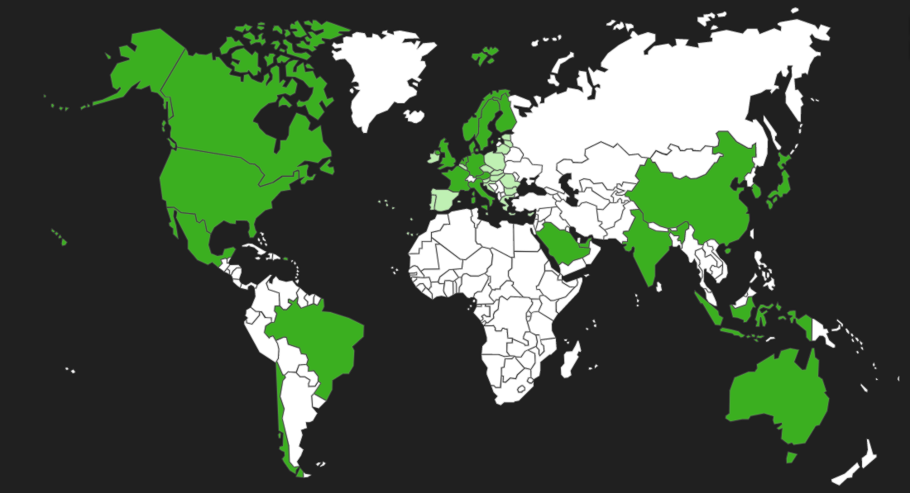























Mission Innovation: Member Countries

Slide 5

Mission Innovation: Portfolio of Activities
Information Sharing:
Sharing data, priorities and plans promotes transparency and integrity.
Facilitates stakeholder engagement, reveals collaboration opportunities, and can inspire and inform private sector investment decisions.
Analysis and Joint Research
Leveraging the combined knowledge, capabilities, and resources of members helps accelerate progress and amplify outcomes .
Mission Innovation
Portfolio
Business and Investor Engagement
Assists MI countries in identifying opportunities and engaging the private sector by exchanging information to improve understanding of clean energy innovation needs and perspectives.
Ministerial Planning Team
Review progress, encourage further collaboration in both the public and private sectors, report on impact and update the MI Action Plan, and commit to concrete deliverables to accelerate the pace of clean energy innovation.

Slide 6
Mission Innovation Challenges
Global calls to action aimed at accelerating research, development and demonstration (RD&D) in technology areas that could provide significant benefits
Mounting global collaborative research efforts to provide significant benefits in reducing greenhouse gas emissions, increasing energy security, and creating new opportunities for clean economic growth.
Launched at the United Nations Conference of Parties in Morocco (COP22)
Cover the entire spectrum from early-stage research needs assessments to technology demonstration projects.
Global network of policymakers, scientists and innovators working towards a common objective and built around a coalition of interested MI members.
Aim to encourage increased engagement from the global research community, industry and investors, while also providing opportunities for new collaborations between MI members.

Slide 7
Eight Mission Innovation Challenges
Smart Grids Innovation Challenge
Off-Grid
Access to Electricity Innovation Challenge
IC1
IC2
Carbon Capture Innovation Challenge
IC3
IC4
Sustainable Biofuels Innovation Challenge
Clean Energy Materials
Innovation Challenge
Converting Sunlight Innovation Challenge
IC5
IC6
Affordable Heating and Cooling of Buildings Innovation Challenge
IC7
Renewable and Clean Hydrogen
Innovation Challenge
IC8
India is co-lead for the three innovation challenges

Slide 8
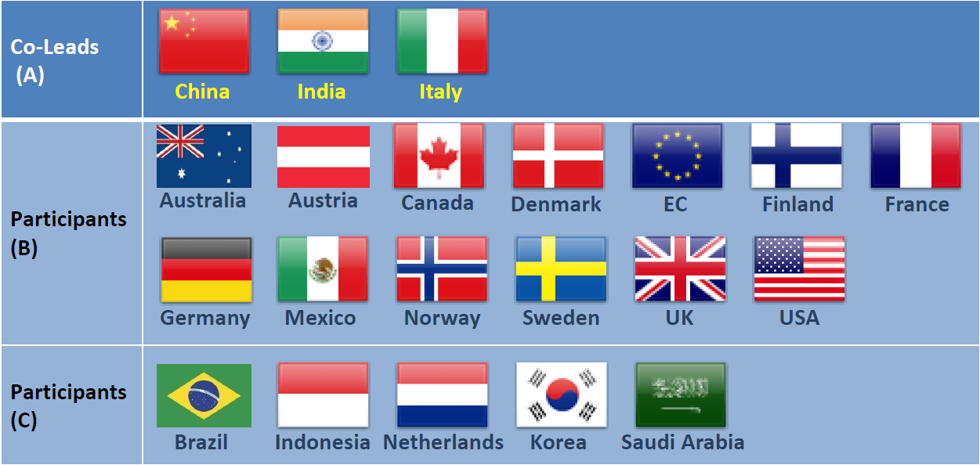
About IC1: Smart Grid
Objective: To enable future robust, resilient and flexible grids that can be fully powered by affordable, reliable, decentralized renewable electricity systems

Slide 9









IC1 Smart Grid: India’s Contribution
Collaboration:
17 Projects
Funding:
USD 60.6 Millions
Indo – UK (7)
Indo – US (1)
MI IC1 - Multilateral (9)
Collaboration
Funding
DST Funded
Manpower:
Smart Grids
Stake-Holder Events
Events
202 with 68 Ph.D.
17 Smart grids projects
Manpower
Smart Grids R&D Conclave (New Delhi)
India – UK JVCEC conference (UK)
Institutes
Publications
Total academic Institutes, Industries and Utilities
Publications: 424
Technology developed: 45
Patents: 23
Conference: 207
Journal: 183
Indian Institutes: 27
International institutes: 39
Industry/utility: 45

Slide 10
IC2: Off Grid Access to Electricity
Objective:
For individual homes:- To support significant reduction in price and increase performance of renewable power systems by 2020.
For remote communities:- To demonstrate in diverse geographic and climate conditions, the robust, reliable, autonomous operation of renewable power systems less than at a significant lower cost than today by 2020.
The Off Grid Access to Electricity Innovation Challenge is co-led by France and India.
Other participating members include: Australia, Brazil, Canada, China, European Commission, Finland, Germany, Indonesia, Italy, Mexico, Norway, Saudi Arabia, South Korea, Sweden, Netherlands, United Kingdom, USA.

Slide 11
IC2: India’s Contribution
9 Field Projects are being implement across India
30 Indian institutions and 16 foreign institutions networked in selected project
Collaboration across 9 MI countries: Australia, Canada, France, Germany, Italy, Norway, Sweden, United Kingdom and United States of America
Research led Solution for diverse community in different geographic location covering: Island, Cold high altitude mountains, High temp zones, Forest habitations, Agricultural habitations etc.
India Off Grid solution envisaged integration of renewable resources like micro hydel, Solar PV, Bio Gas ,Wind, Flow battery system, Fuel cell with DC /AC micro grid using internet of things technologies for meeting the local level need including health and mobility requirement.

Slide 12
IC3: Carbon Capture Innovation Challenge
Aim:
  To identify and prioritize breakthrough CCUS technologies; and
  To recommend RD&D pathways and collaboration mechanisms
The United States and Saudi Arabia co-lead this Challenge
Indian Main lead is DST
A Joint Funding Opportunity Announcement (FOA) in Carbon Capture Innovation Challenge announced in July, 2018
The Opportunity
One of the only technologies able to achieve significant decarbonisation of our fossil fuel based economies, particularly in carbon-intensive industries such as cement, iron and steel production.
Offer important insight into the technical capabilities, policy and financing mechanisms, and permitting frameworks that could enable the successful deployment of CCUS.

Slide 13
IC4: Sustainable Biofuel Innovation Challenge
Aim: To develop ways to produce, at scale, widely affordable, advanced biofuels for transportation and industrial applications.
Objective: To accelerate biofuels research, development and demonstration in order to achieve performance breakthroughs and cost reductions with the potential to substantially lower GHG emissions..
Indian Main lead is DBT.
  An international Conference on Sustainable Biofuels under Mission Innovation was convened in Feb 2018 in New Delhi.
  A call for proposals for Sustainable biofuels has been launched under the Mission Innovation by DBT.
DST’s Priority is Biomass sustainability and sources. Eg. Environmental Issues caused due to massive biomass crop burning in Punjab is one such problem DST would like to work on and explore sustainability models for taking care of the issue.
DST to identify areas in Biomass where academics & Research community can join hands with the industry for identifying and developing the sustainable technologies and options. Between Research/academic community and industry a bridge needs to be developed for translation of technologies.

Slide 14
IC5: Converting Sunlight Innovation Challenge
Aim: To discover affordable ways to convert sunlight into storable solar fuels.
Objective: The production of clean fuels (including other forms of storable chemical energy) from sunlight. The transition has been hindered by the high cost of conversion technologies. To deploy solar fuel technologies at large scale, performance breakthroughs and cost reductions are a must. For this to happen, the Converting Sunlight Innovation Challenge invites governments and the private sector to focus their research and innovation efforts in this direction
The Converting Sunlight Innovation Challenge intends to strengthen and expand collaboration nationally and internationally including the private sector engagement. The key challenge ranges from development of stable and cost effective materials to studies on process economics, to an efficient reactor design and process scale-up with demonstration of technology
Joint endeavour of DST and DBT.
  A Joint Funding Opportunity Announcement (FOA) in Converting Sunlight to Storable Fuels, Energy-rich chemicals and Biochemicals (IC#5) announced in June, 2018. 20 Proposals recommended for support.
  A Brainstorming Meeting on CCUS being organised by DST to develop R&D roadmap for Indian context in August 2019 involving Academia, Industry, Industry Associations, lined ministries, other stake holders etc.
To deploy solar fuel technologies at large scale, performance breakthroughs and cost reductions are a must.
Converting Sunlight Innovation Challenge invites governments and the private sector to focus their research and innovation efforts in this direction.

Slide 15
IC6: Clean Energy Materials Innovation Challenge
Aim: To accelerate the innovation process for high-performance, low-cost clean energy materials and automate the processes needed to integrate these materials into new technologies.
Specific application areas for new materials include, for example, advanced batteries and solar cells, low energy semiconductors, thermal storage, coatings for various applications, structural materials, and catalysts for the conversion and capture of CO2.
The Clean Energy Materials Innovation Challenge is led by Mexico and co-led by the United States.
Other participating countries include: Canada, Denmark, the European Commission, France, Germany, India, Italy, the United Arab Emirates, Finland, Norway, Republic of Korea, Saudi Arabia, Sweden, the Netherlands, and the United Kingdom.
Will combine advanced theoretical and applied physical chemistry/materials science with next-generation computing, artificial intelligence (machine learning), and robotics tools, with the aim of creating a more fully integrated approach.

Slide 16
IC7- Affordable Heating and Cooling of Buildings
Led by the UK, UAE and The European Commission. India is active Partner for this challenge.
Other MI Member Countries Participating in IC7: Australia, Brazil, Canada, China, Denmark, Finland, France, Germany, Italy, Mexico, Norway, Saudi Arabia, Sweden, the Netherlands and USA
Objective: Develop low carbon heating and cooling affordable for everyone.
Main areas of focus:
Energy savings & energy efficient technologies and materials to reduce demand for heating and cooling.
Low-carbon integrated equipment and systems to provide heating and cooling.
Storage solutions to match energy supply to heating and cooling demand.
Efficient transfer of heat from point of production/ storage to point of use

Slide 17

India’s Contribution
01
Global cooling prize| Intended to prevent up to 100 gigatons of CO2-equivalent emissions by
2050, and put the world on a pathway to mitigate up to 0.5˚C of global
warming by 2100
02
IC 7 Resource Center| Will leverage the Mission Innovation Challenge activities and
spearhead India’s contribution to IC#7
03
Action Plan on | Present the status of technology readiness in this priority
Physiological studies area of IC 7 and provide a road map for the MI member
countries
04
Research Grants| More than INR 40 Cr funding for international projects (Indo-US, Indo-UK) and
about INR 35 Cr funding for national projects in IC 7 priority area

Slide 18
IC8- Renewable and Clean Hydrogen Innovation Challenge
Aim: To accelerate the development of a global hydrogen market by identifying and overcoming key technology barriers to the production, distribution, storage, and use of hydrogen at gigawatt scale.
Focus on multinational research and large scale demonstration efforts from both public and private sectors on industry-directed breakthroughs underpinning commercial renewable and clean hydrogen industries (and implied target prices) within the next 5 years
Backed by Mission Innovation Governments’ commitment to double clean energy R&D funding by 2020, the Challenge will provide a platform to understand and progress selected technical issues around how a global hydrogen market would function as a system.
Opportunities under IC8:
  Public-private research collaborations
  Technical knowledge exchanges with researchers
  Field testing of new technologies
  Innovation prizes to encourage greater efforts and collaborations by researchers to solve important problems

Slide 19
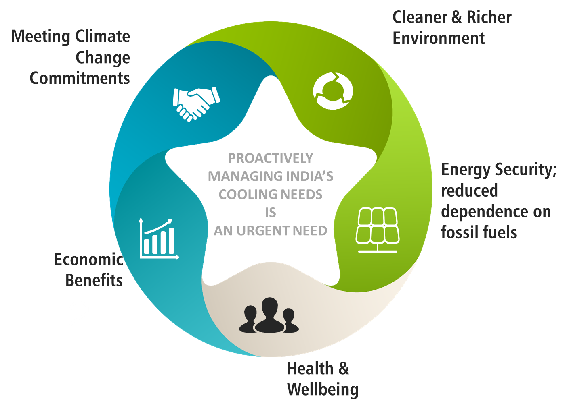
Clean Energy
through
Innovative, Collaborative
and Interdisciplinary Research
Thank You !

