Slide 1






Slide 2
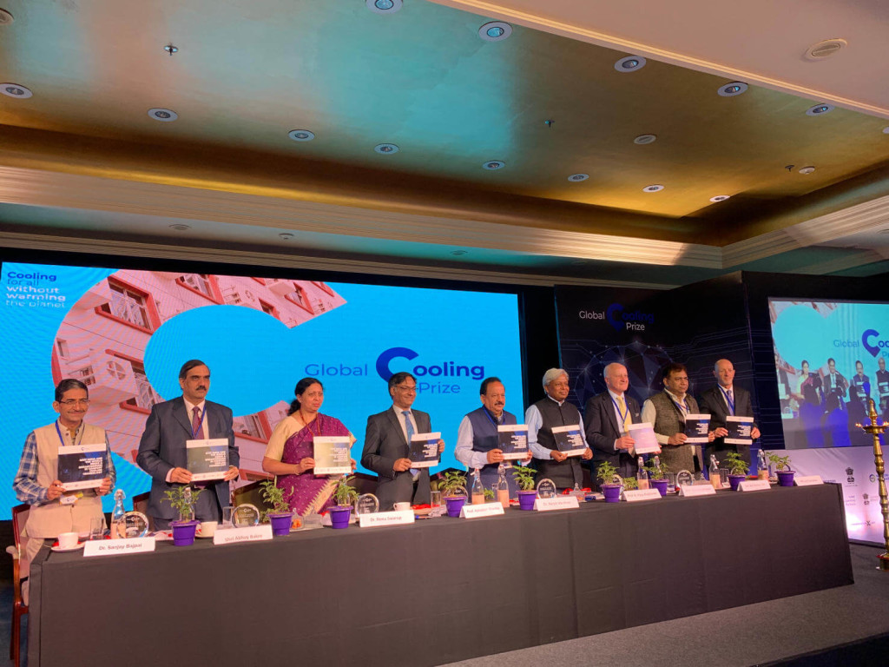
GCP- Launching Ceremony
Global Cooling Prize (GCP) was launched on 12th November, 2018 by Hon’ble Union Minister for Science & Technology and Earth Sciences and Environment, Forest & Climate Change.
GCP is the first of its kind global competition that aims to identify low energy cooling technologies for Indian climatic conditions.

Slide 3


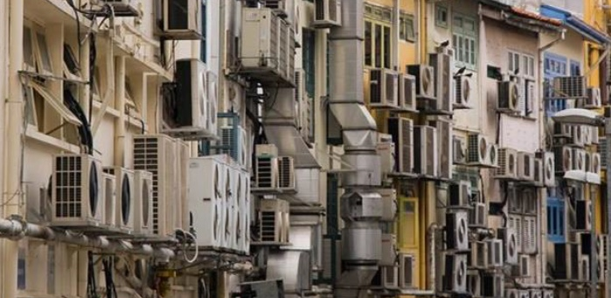
Why Global Cooling Prize
Comfort cooling is vitally important in today’s lifestyle and is directly linked with occupants’ health, wellbeing and productivity!!
By 2030 over 1/2 of the world’s population will live in hot climates with increasing exposure to potentially dangerous heat conditions.
Global cooling demand will increase upto 4.5 billion units by 2050 from today’s 1.2 billion units.
India's Room Air Conditioners will increase to approximately145 million units by 2030 from today’s 38 million units.
Source:
www.rmi.org/insight/solving_the_global_cooling_challenge
India Cooling Action Plan, March, 2019

Slide 4
Significance of GCP
01
GCP acts as a nexus for inter-ministerial collaboration in providing affordable cooling for all.
02
This Prize will draw global talent to design a cooling solution for a typical housing unit in a highly populous cities like India.
03
Promote strategic partnerships to jointly tackle the climate change challenge and curtail the carbon foot print of active cooling.

Slide 5

Primary Criteria of GCP
Five times more efficient per unit of cooling
The cost should not be more than twice of the AC baseline unit
GCP welcomes participation in this call from Industries, academic institutes, Research labs, Incumbents, Start-ups and individuals from India as well as global
Baseline unit is a 1.5 TR, 3 star AC in 2018 equivalent to EER 3.5
To Apply and Learn More, visit https://globalcoolingprize.org/

Slide 6
Total Investment
Contribution from GOI – US$ 2 million
US$ 3 million
Prize Money
Total Investment
US$ 5 Million
US$ 2 million
Implementation and Testing of Prototypes
Contribution from RMI – US$ 3 million

Slide 7
Prize Money
Contribution from GOI – US$ 1 million
Only for India-based teams
in developing working prototypes
Prize Money
US$ 3 Million
US$ 1 million
For winning technology to incubate and commercialize.
Contribution from RMI – US$ 1 million
For global finalists
in developing working prototypes.

Slide 8
GCP Timelines
Timelines
Launch of Global Cooling Prize | 12th November, 2018
Intent to Apply Deadline | 30th June, 2019
Technical Application Deadline | 31st August, 2019
Announcement of finalists (Up to 10 finalists) | November, 2019
Testing of prototypes | May, 2020
Announcement of awards | November, 2020

Slide 9
Thank You!
Dr. Sanjay Bajpai / Dr. J B V Reddy
DST

