Slide 1
C – PENTANE UPDATE
C5H10
ROHIT DHIMAN
Director projects
Whirlpool Corporation ▪ Confidential

Slide 2
TASK IN HAND FOR PLANTS
FRO
PRO
Approved Investment : 4.8 M USD
Approved Investment : 3.9 M USD
Timelines : 1 Year
Timelines : 1 Year
Basic Testing SKUs : 28
Basic Testing SKUs : 67
Production Start : Jan’ 15
Production Start : Dec’ 14
Lines : 3 Cabinet Lines and
3 Door Drums
Lines : 2 Cabinet Lines and
4 Door Drums
Supplier : Krauss Maffei, Germany
Supplier : Cannon, Italy
Huge & complex project, big challenge for execution with limited resources
Execution on time with aggressive investment targets
Conversion on running lines without impact on production

Slide 3
SPECIFIC FOCUS AREAS
SAFETY FIRST
BOP ADHERENCE
CAPITAL OPTIMIZATION
COST OPTIMIZATION
PROCESS IMPROVEMNTS
INVESTMENT DONE – BE FUTURE READY
KNOWLEDGE MANAGEMENT
CHALLENGES FACED & KEY LEARNINGS
MAJOR CHANGE FOR PLANTS – 360 DEG APPROACH

Slide 4
C-PENTANE CONVERSION : AGGRESSIVE CAPEX
Proposals from multiple suppliers and through techno commercial comparisons
Final Quote
Million USD
Negotiated Cost
Million USD
Suppliers
Two suppliers to keep competitive pressure for future.
Specs for equipments are standard & are interchangeable
FRO
3.8
2.5
Krauss Maffei, Germany
PRO
3.27
2.0
Cannon, Italy
Detailed upfront specifications post involving all including global SMEs
Use suppliers competitive pressure to our advantage
Divided the project in two parts local and import, to take advantage of local low cost for general fabrications.
Hard negotiations and leveraged Global Capital Group

Slide 5
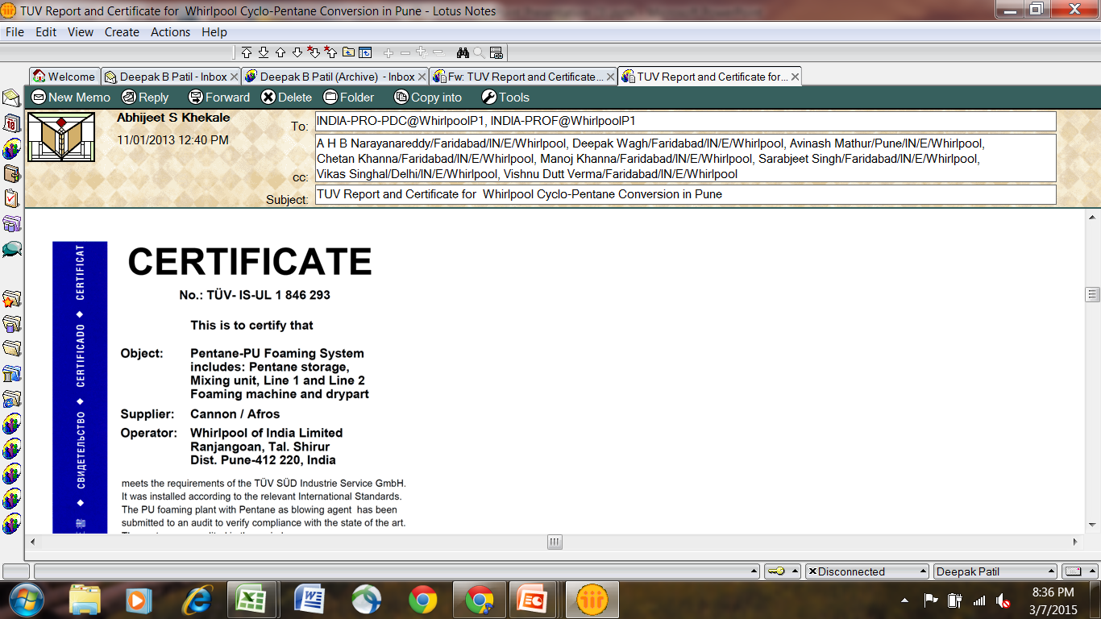
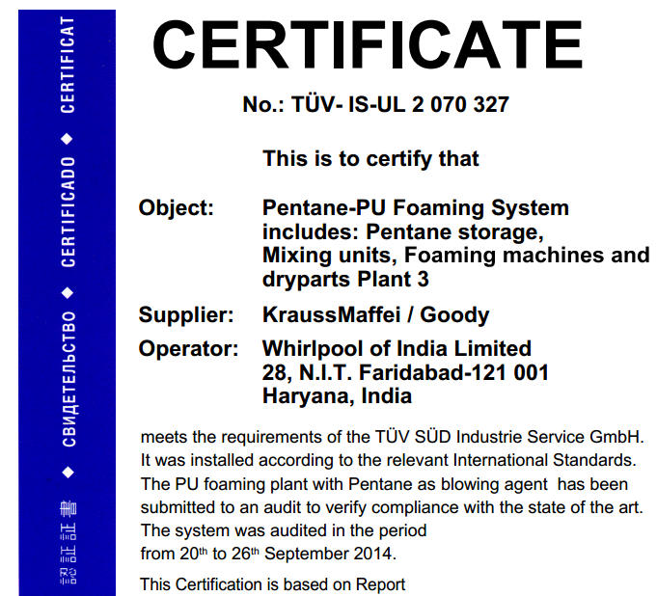
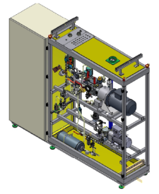
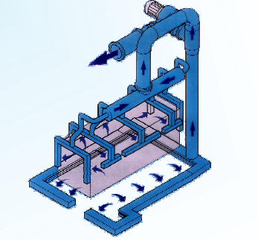
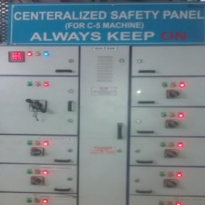
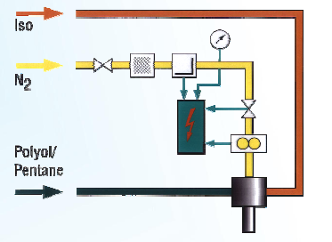
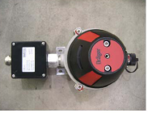
WORLD CLASS SAFETY STANDARDS
Robust Safety Built
Exhaust System
Staff Training
Underground C5 Storage
Double Speed Exhaust
Argon Weld Pipe
Test for 25 Bar
Temp Auto Control
Centralized Safety Panel
N2 Purging System
Natural Ventilation
Safety Panel
N2 Purging
Gas Sensors
100% Compliance with BOP, TUV audit specifications and Local government regulations.
Clean Certification and approval from TUV Germany & local government authorities
Acknowledgement of best work from Global Team, BOP Lead, TUV Auditors, local government officers and auditors
Designed operating procedures and Detailed training to engineers and operators to follow operating procedures

Slide 6
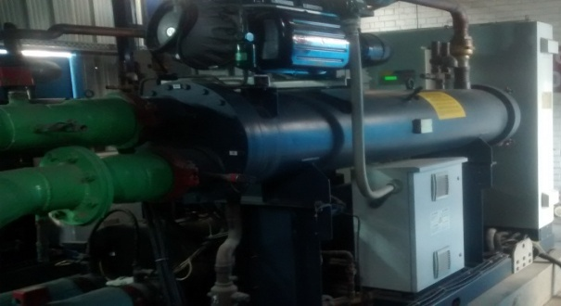
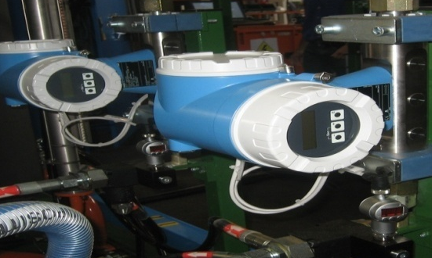
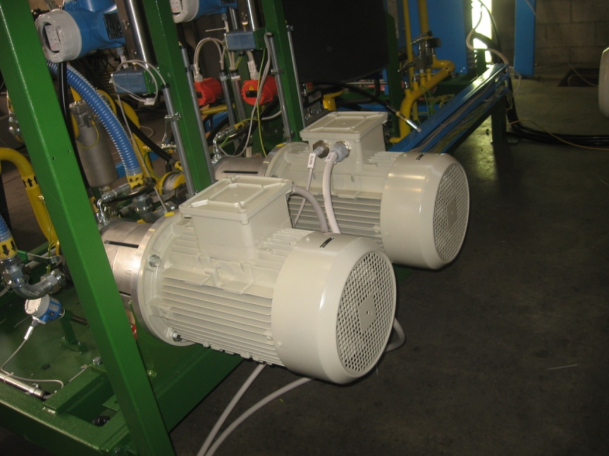

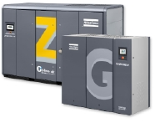
focus on cost
PRO Readiness in Dec’13 and FRO Sep’14, This leads to immense pressure to stabilize the C5 prod. In short time
Equipment Standardization
Savings on spare cost
Centralized Turbo Chiller
Savings on power Cost
Weight Accuracy
BOM cost savings
Optimized Capacity Motors
Savings on running Cost
In-house Nitrogen Generator
BOM Cost Savings
VFD screw air compressor
Savings on running cost
Approach is to reduce cost while we do any investment

Slide 7
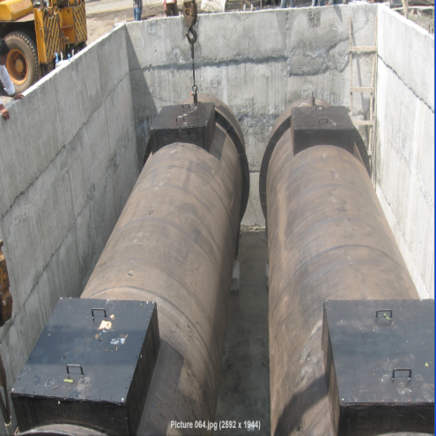
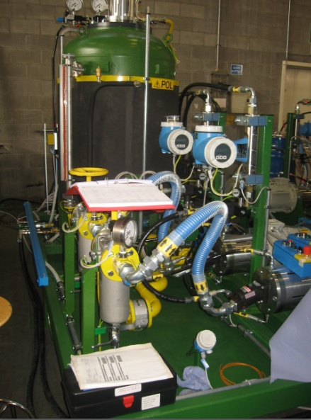
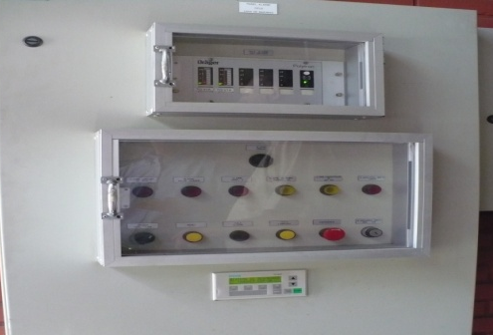
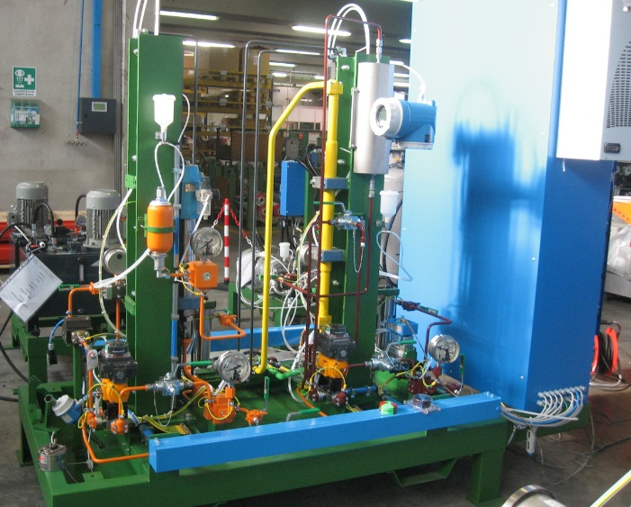
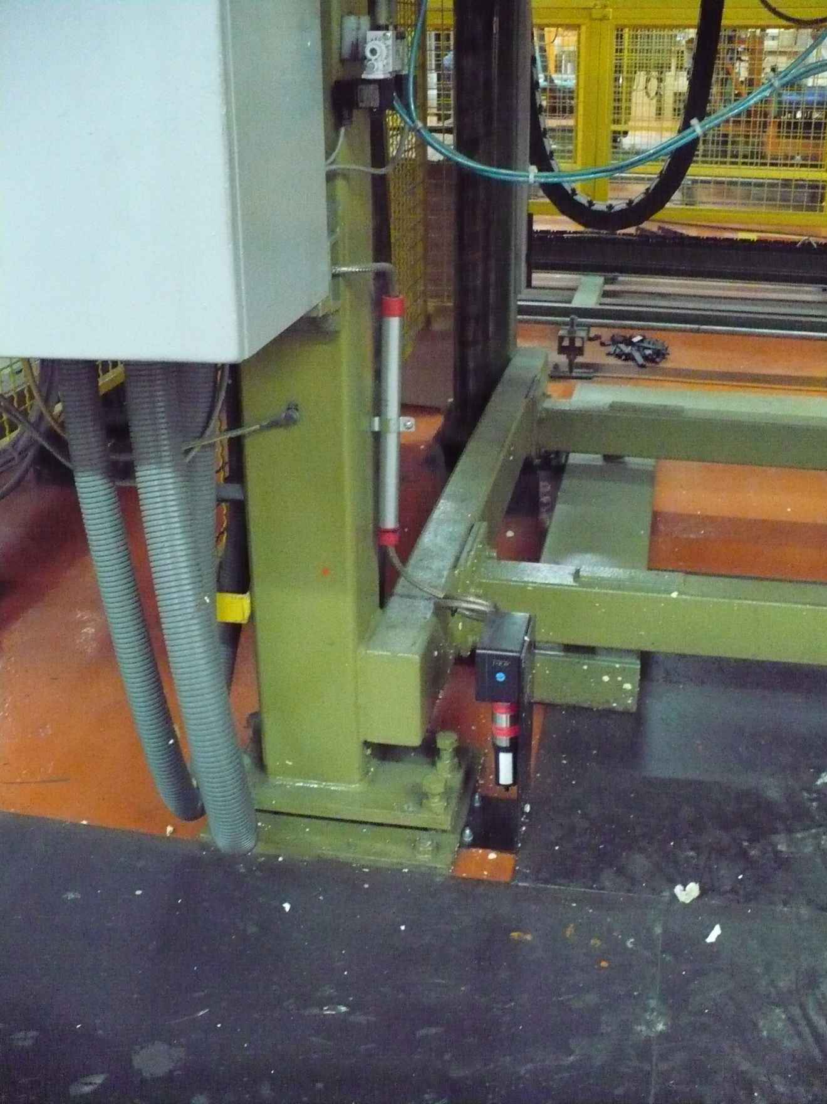
BEST IN CLASS TECHNOLOGY
C5 Storage Tanks
Double jacketed
Underground tanks
Mass flow meters
Shot weight accuracy
: ±2 Gms
Foam property
Consistency
Safety Systems
Control System for
Gas level Monitoring
Premix Station
3 Components Mixing Facility (Future Flexibility)
Liquid / spillage
sensors in
usage areas

Slide 8
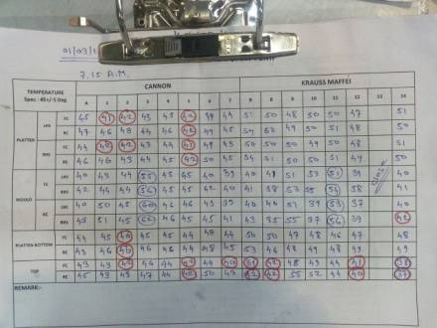
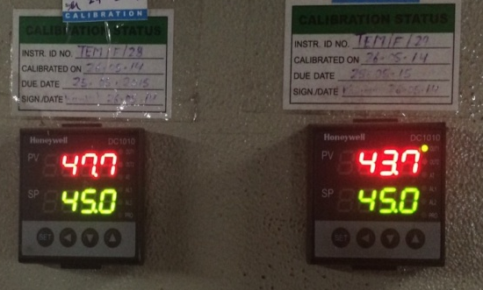
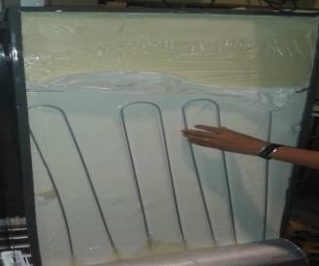
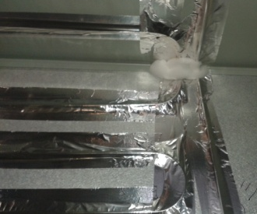
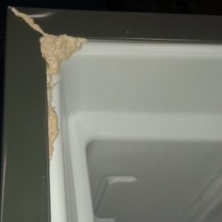
KNOWLEDGE MANAGEMENT
Product level , Process level and Equipment Learning's getting captured
Mould/ fixture wall Temperature sensitiveness – Started with manual control and then speedily established auto control system
Internal Temperature rise profile -PE Tape use inside Pre foaming – Change PE tape to Al tape, Optimized Al tape width and thickness, Manpower increase 18 Nos. Optimized the process and reduced the 18 manpower by 1st Mar’15
Foam Leak reduction - Sealing Process Imp.
Higher pressure resulting in liner bulging - Liner thickness imp. in thermoforming
Solutions towards separation of C5
Foam property variations – product wise/line wise/day wise/supplier wise
Equipment Preventive Maintenance
PE Tape
Al Tape
Foam Leakage
On Line data Monitoring
Cross plant – cross function learning's captured

Slide 9
MINIMIZING PRODUCTION DISTURBANCE FOR INSTALLATION
Completion of offline works before receipt of equipments
C5 Storage Tanks Installation and Commissioning
C5 Piping
Premix Building Readiness
Exhaust Systems
Platforms and Fabrications
Retrofitting of Existing Fixtures
Faridabad way of converting the lines without impacting the production
At all time plant was producing 66 % to capacity meeting Market requirement
Seamless work between Project Team with Manufacturing

Slide 10
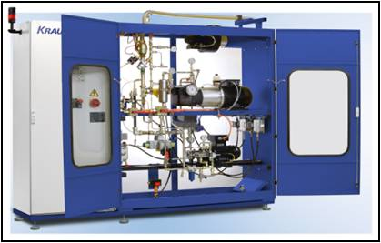
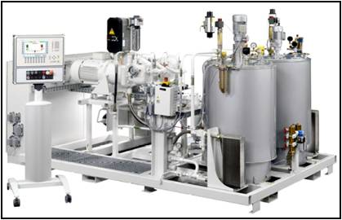
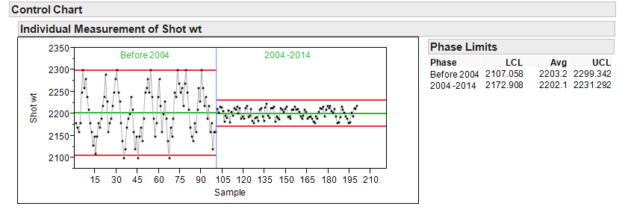
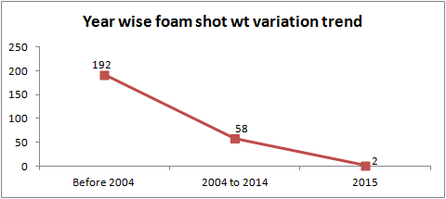
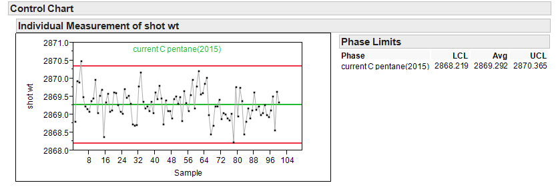
PROCESS ROBUSTNESS : CYCLOPENTANE
MIXING : Precise & uniform mixing of POL & C5 by
Mass Flow Meters with Closed Loop Control System.
FOAMING WET PART : Mixing Heads with Temp &
pressure monitoring at pouring point . Data
Acquisition for I/P ratio, Press, Temp & Shot weight.

Slide 11
SUMMARY
PROJECT HANDLED WITH COMPREHENSIVE APPROACH
RETROFITTED WHAT ALL WAS POSSIBLE, WITHOUT COMPROMIZING SAFETY
WORKED WITH MUTIPLE SUPPLIERSS TO GET BEST SOLUTIONS
MANY NEW THINGS TRIED SUCCESSFULLY
AND LOT OF LEARNINGS CAPTURED FOR FUTURE USE
ONE TEAM – PRODUCT /PROCESS / PROJECT TEAM WORKING SEAMLESSLY ACROSS BOTH PLANTS
PLAY TO WIN – DESIRE FOR EXCELLENCE
JOB WELL DONE – BASE FOR FUTURE ENERGY MIGRATION

Slide 12
Back up

Slide 13
C-5 project FRO & PRO
All BOP and Local laws are incorporated

Slide 14
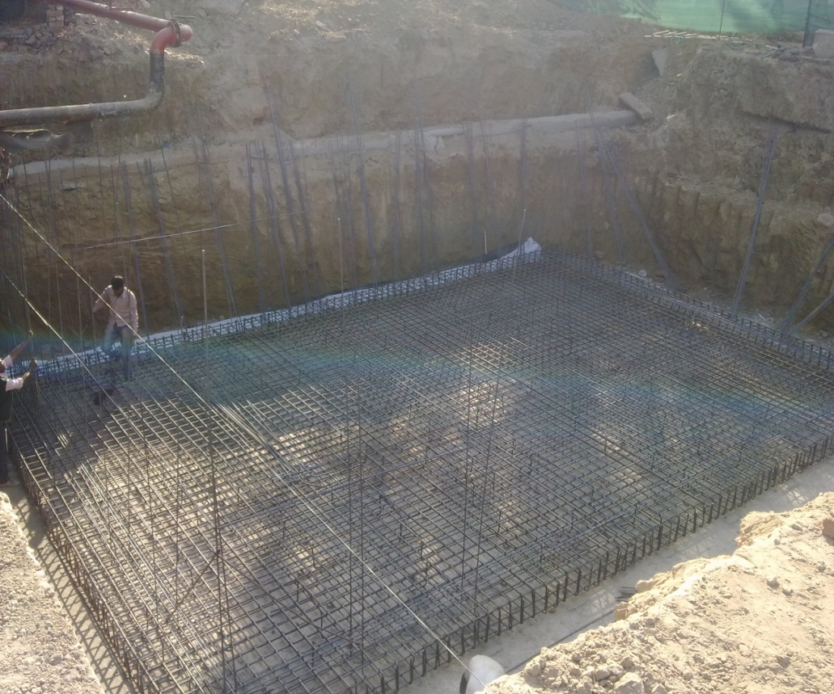
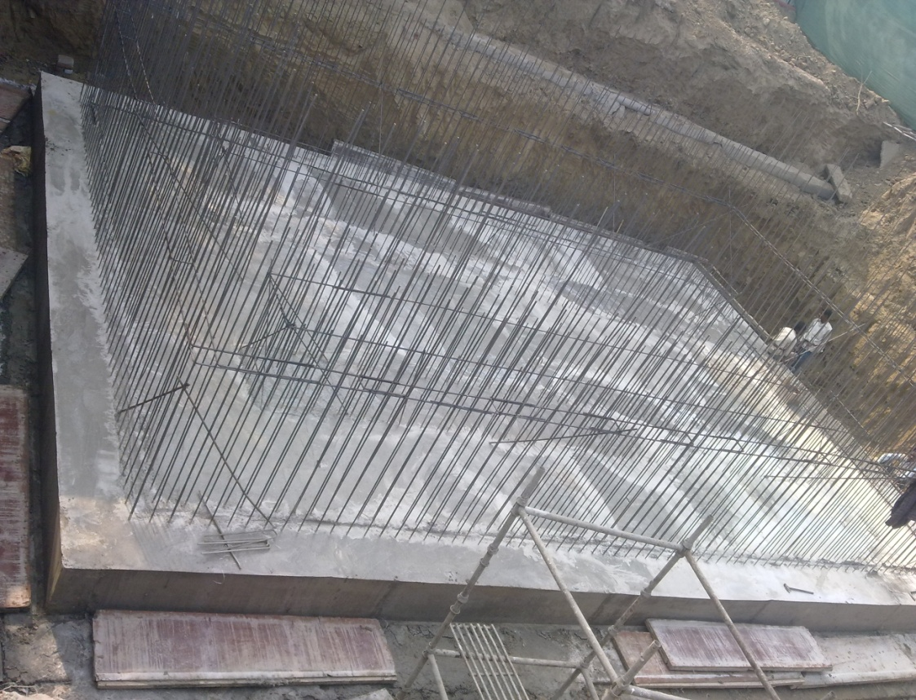
C-5 storage tanks pit
Very strong concrete base & foundation made for C-5 pit, to withstand earthquakes

Slide 15
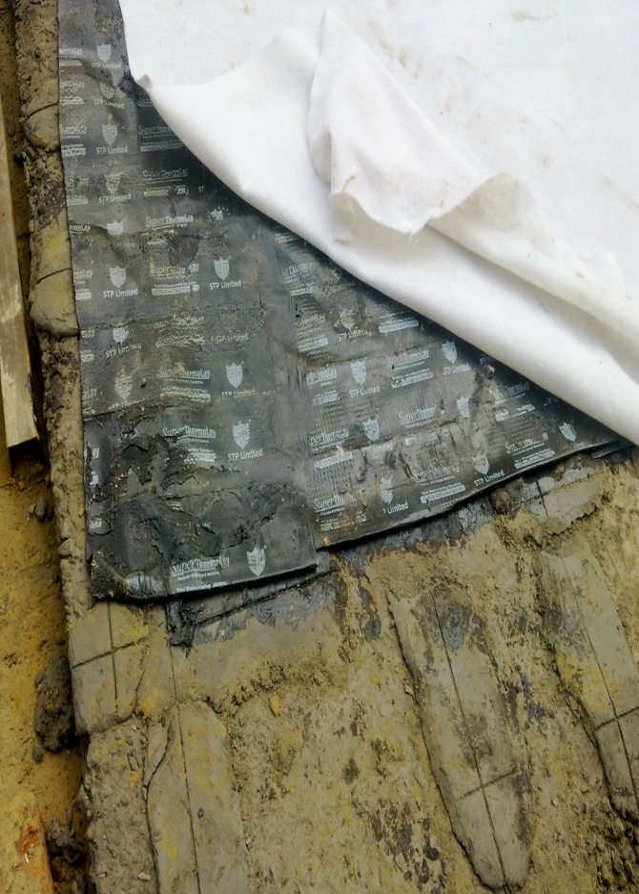
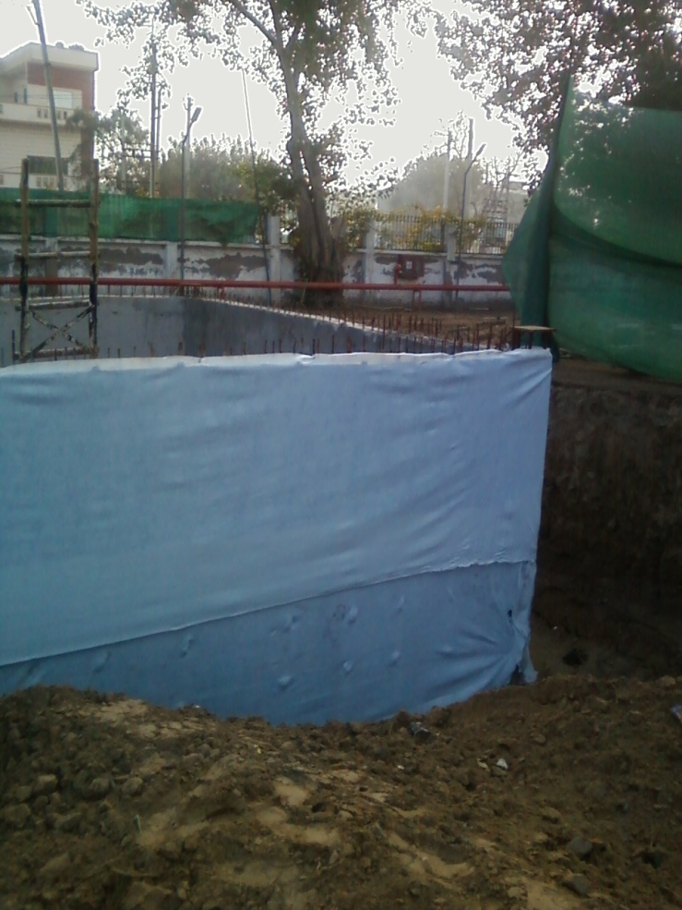
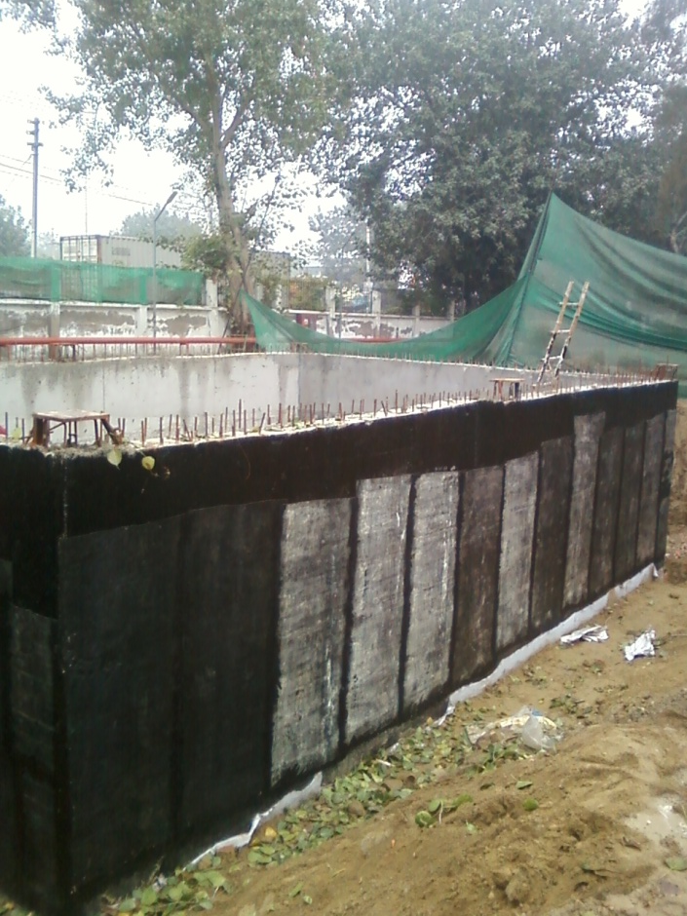
C-5 storage tanks pit
High level of waterproofing done to prevent water seepage from outside, in C-5 pit

Slide 16
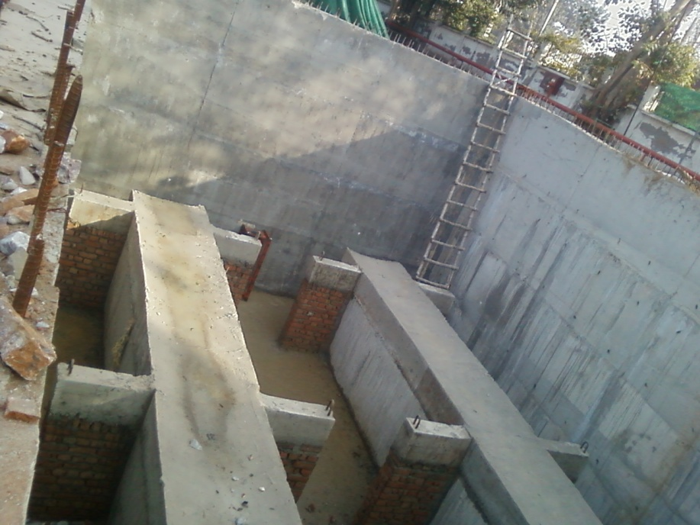
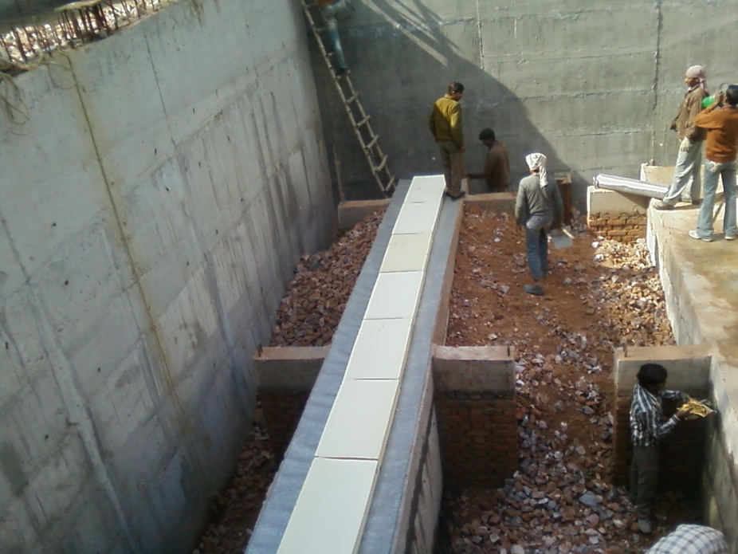
C-5 storage tanks pit
Concrete pedestal made to keep the tank 1.7M above bottom level & moisture. Tank rests on it’s belly, with more area of contact & hence, lesser load

Slide 17
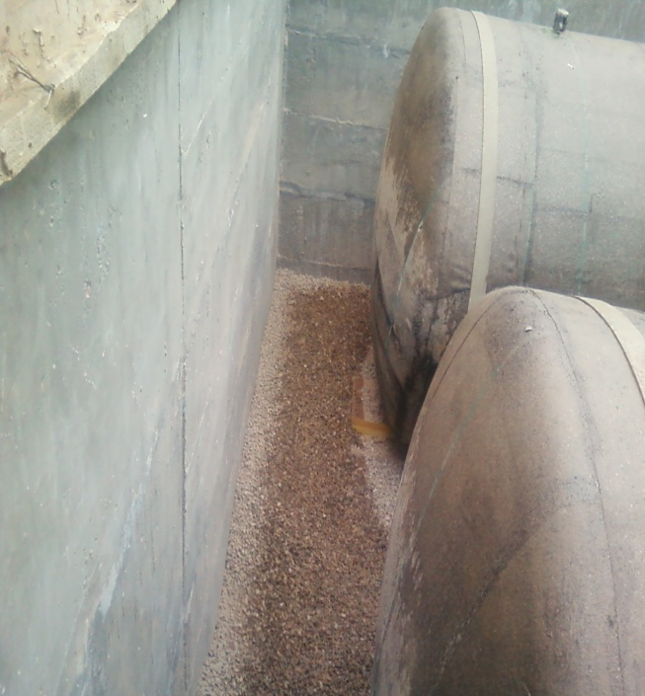
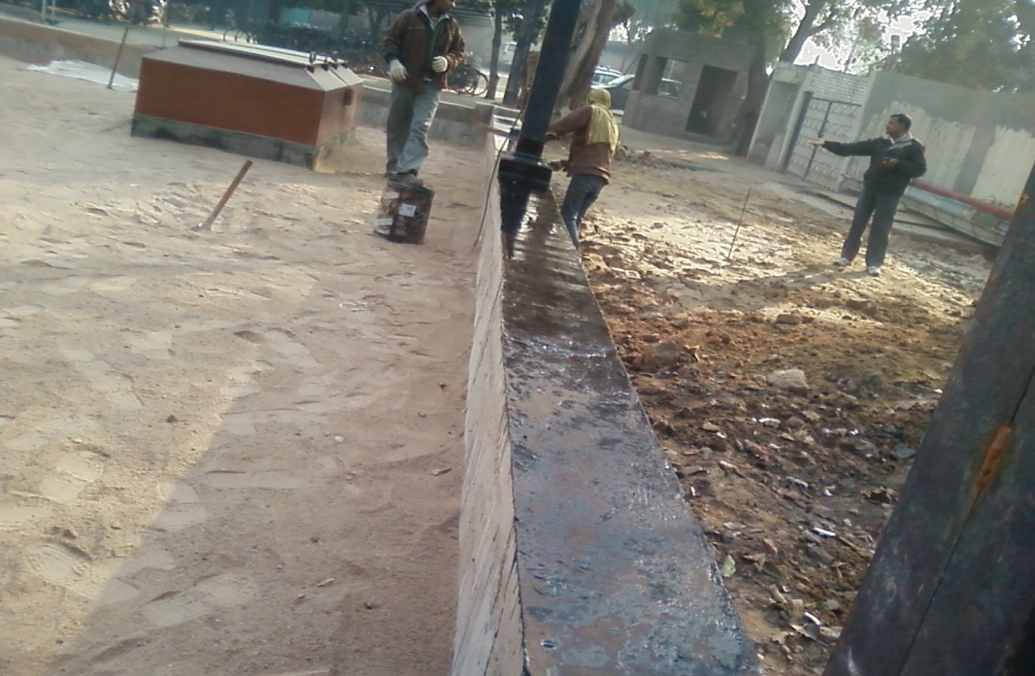
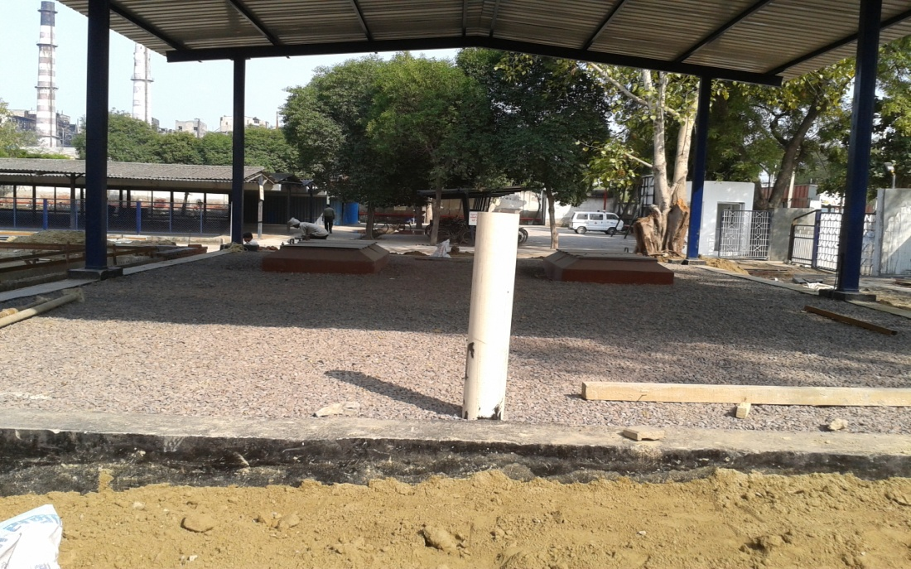
C-5 storage pit
After tanks installation, the filling of pit is done as follows:
(From bottom to top)
1.7 mtrs (till tank bottom level): 2-4 inch stones
3 mtrs (covering tank dia) :Fine stone dust
0.7 mtrs (till tank manhole neck): Grey river bed sand
0.3 mtrs (top portion): 1-2 inch stone pcs
The bottom part is for water collection (for removal), mid part is to keep tank cool, and top part is to preserve the sand layers below.

Slide 18
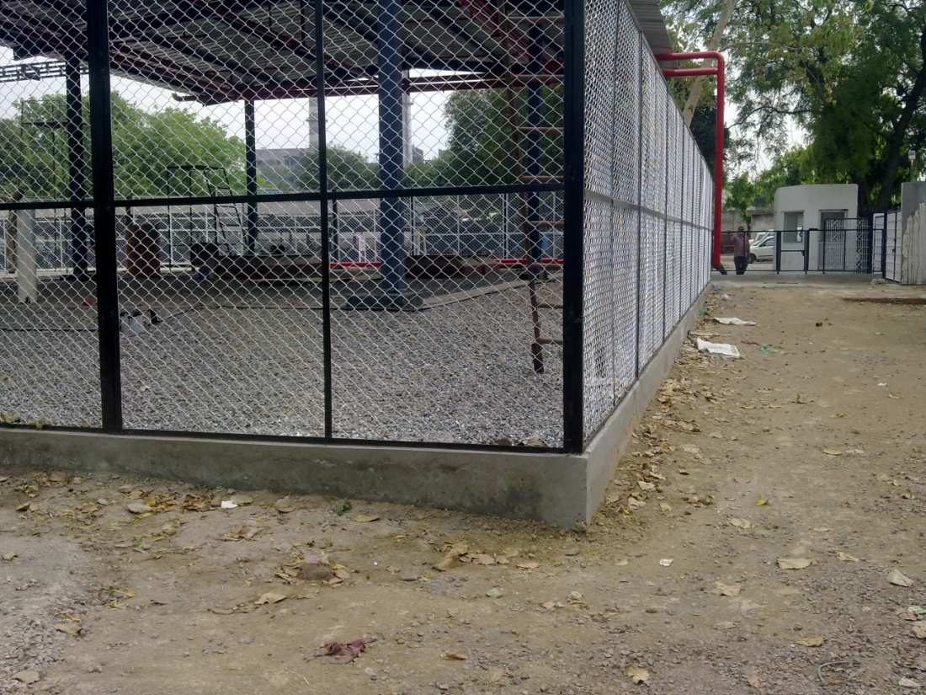
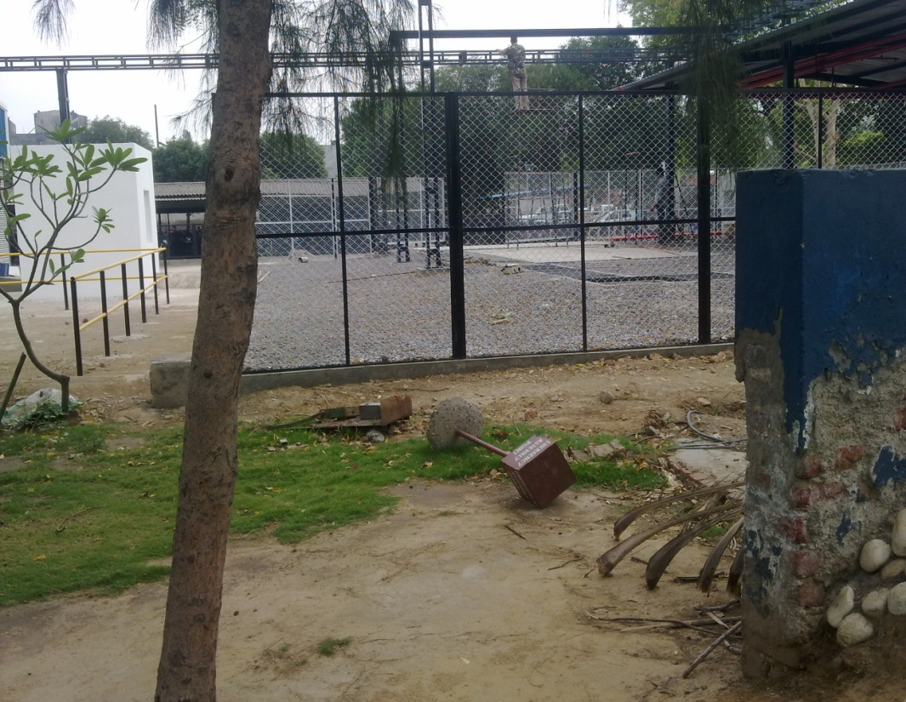
C-5 storage pit
The level of C-5 storage pit is raised by 1 mtr above ground level and slopes provided on all sides for easy dispersion of C-5 vapours and preventing any chance of floods water entering in C-5 storage area

Slide 19
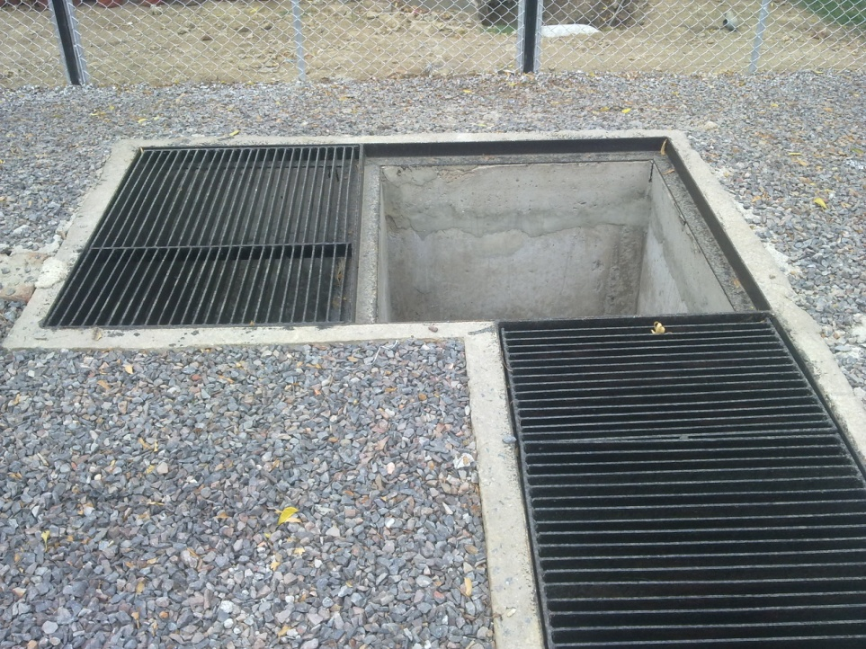
C-5 storage
In addition to ball valve , a water separator is added in the drain of tanker spill containment trench, to block C-5 , due to it’s specific gravity
Separator wall
From containment trench
Out
Trapped
Water

Slide 20
C-5 storage area
After unloading, truck will be pushed out by a hoist, outside 20mtr fencing area, and only then, allowed to start the engine, to eliminate any chance of engine/ starter/ battery spark.
During C-5 unloading, every 30 sec actuation of Dead man’s switch is mandatory to continue, else, unloading will stop.
All the lights of C-5 storage area are outside the fencing, to eliminate any possible risk
The size of containment pit has to be more than the overall capacity of C-5 tanker (20T)

Slide 21
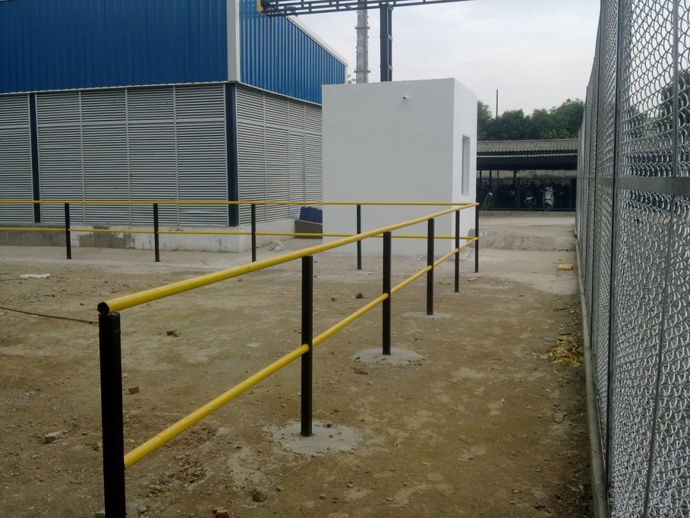
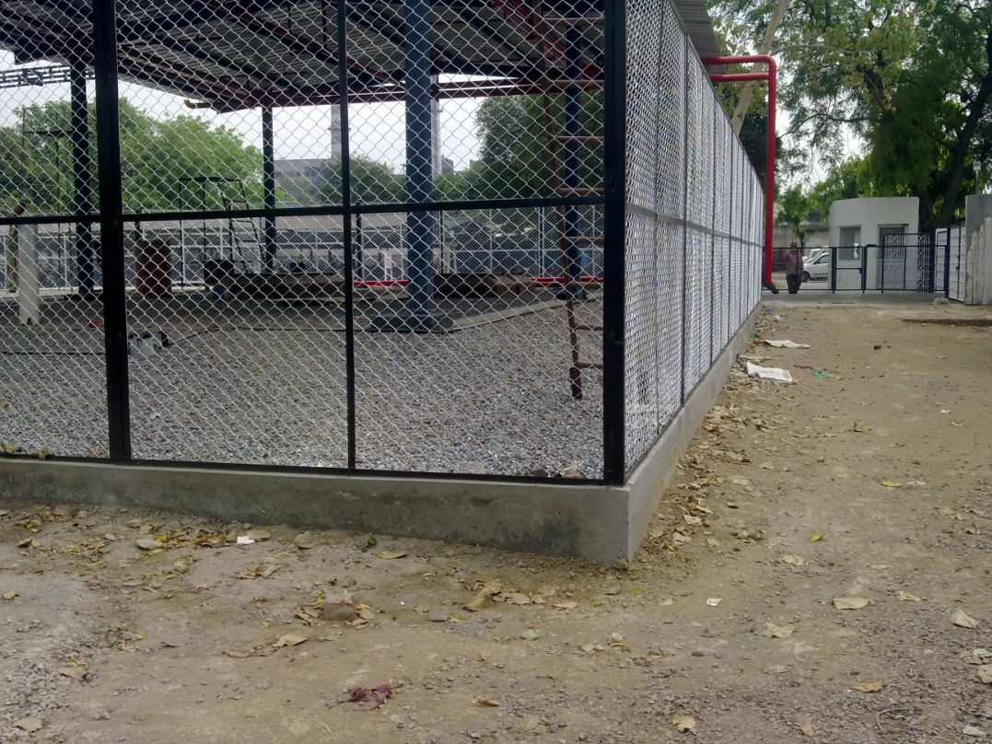
C-5 storage area
Outside 20 mtr fencing, another 1.5 mtr gap is created as safe zone, thru barricades.
Fire Tender vehicle has 3 sides accessibility.

Slide 22
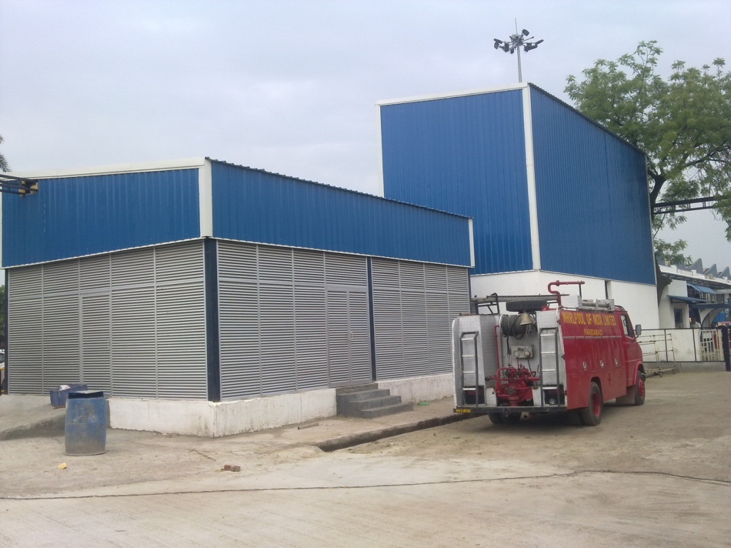
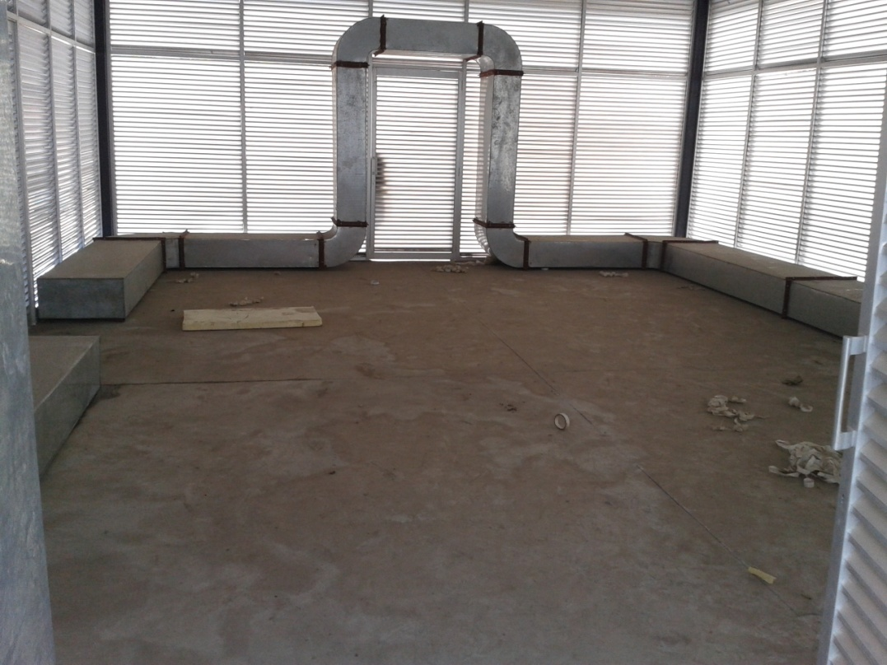
Premix room
Fully ventilated premix room,
Made with metal & concrete, no inflammable material
Dedicated 5000M3 exhaustion for premix room, at floor level.

Slide 23
Cabinet foaming fixtures
All OMS fixture control panels are re-designed as follows:
There is no opening at the bottom side (sealed). All cables enter at top left/ right side
On lower side of control panel, there is no heat or spark generating component. All MCBs. Relays, Contactors, Power supply and transformers at mounted up.
Panels are positioned > 2mtrs away from mixing head & all wiring is overhead: Nothing on floor

Slide 24
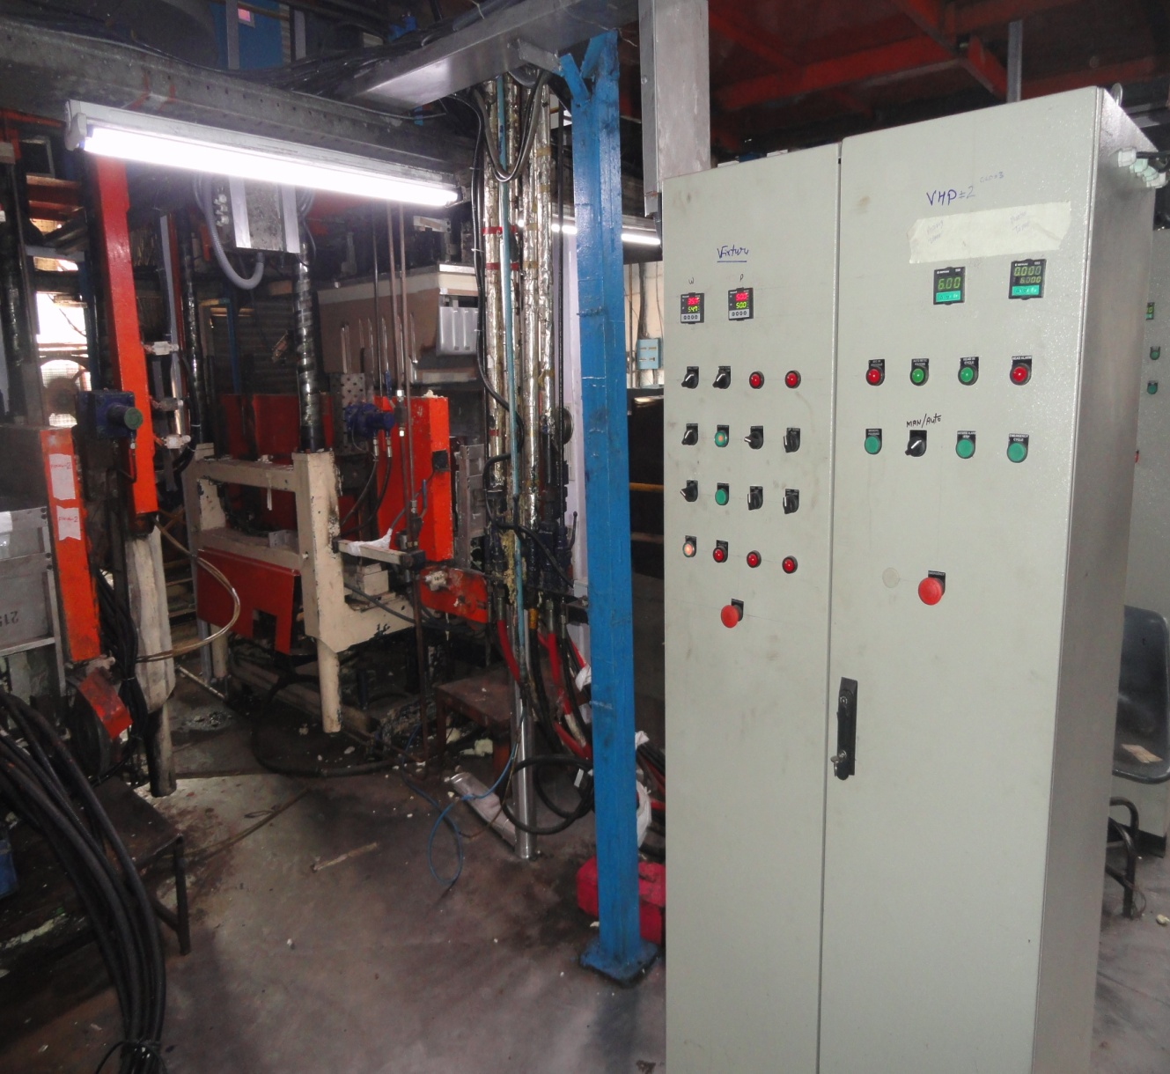
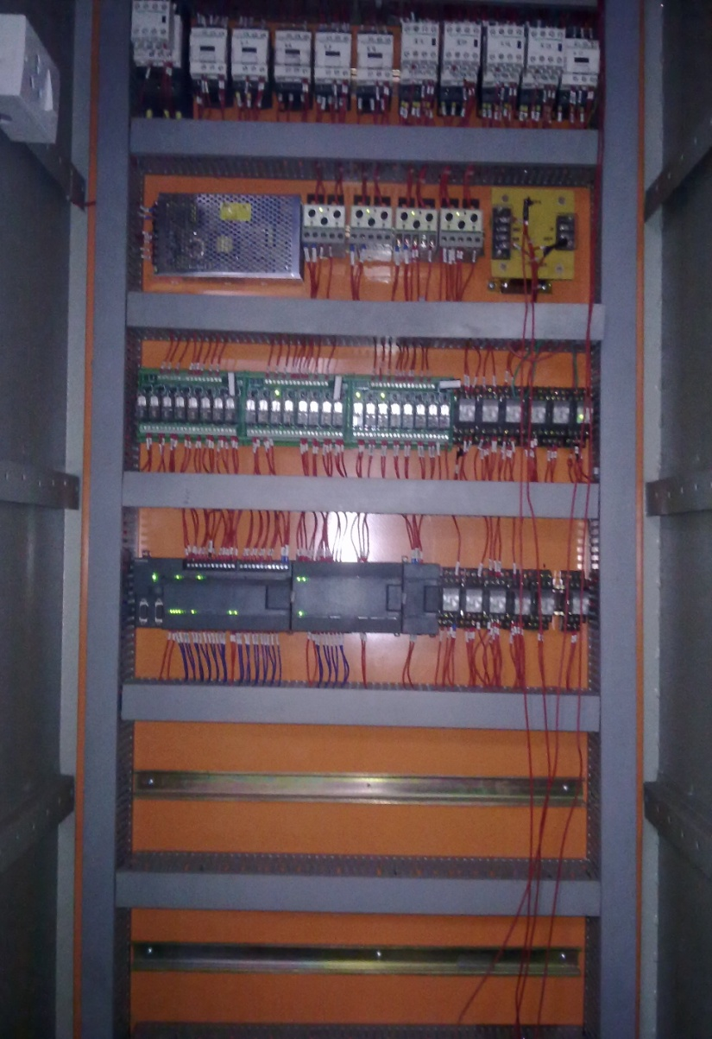
Free space at panel bottom
& heat generating components
at top side in the panel
All field cabling overhead & cable entry at the top side of the panel

Slide 25
Others
There is no electrical heating, anywhere in foaming dry or wet part. It is done by hot water line.
For chiller water, plastic pipes are used for non corrosion, better insulation & longer life
Centralized energy efficient Turbomizer chiller is used for entire foaming, 0.4Kw/ton
Hot water generator has Waste heat recovery line from the paint shop burners exhaust

