Slide 1
HCFC-141b phase out in
PU foam
Delhi, 8 February 2019

Slide 2
Alternatives to HCFC-141b
Application | Blowing Agent | GWP | Cost of investment | Operating Cost | Energy Impact | Track Records
Domestic Appliance | HC
 | HFO
 | HFC
Appliances | HC
 | Ecomate
 | Water
Disc. Panels | Ecomate
 | HFO
 | HFC
Spray | ecomate
 | HFO
 | HFC
Pipe Insulation | HC
Integral Skin | HC
 | ecomate
 | water
 | HFC

Slide 3
HCFC phase out in PU foam
Transition from HCFC-141b to Methyl Formate (ecomate®)
Delhi, 8 February 2019

Slide 4
The ideal Physical Blowing Agent
Not toxic
Not flammable
Not explosive
No Ozone Depleting Potential
No Global Warming Potential
No VOCs
Low Gas Thermal Conductivity
Low Diffusion coefficient
Liquid at ambient temperature
Easy to use
Balanced Solubility and great stability in any formulated polyol blend
Suitable for any PU application
Compatible with existing processing equipments
Cost effective
Available on global basis

Slide 5
The ideal Physical Blowing Agent
Not toxic
Not flammable
Not explosive
No Ozone Depleting Potential
No Global Warming Potential
No VOCs
Low Gas Thermal Conductivity
Low Diffusion coefficient
Liquid at ambient temperature
Easy to use
Balanced Solubility and great stability in any formulated polyol blend
Suitable for any PU application
Compatible with existing processing equipments
Cost effective
Available on global basis
There is NO Perfect Product

Slide 6
Blowing Agents comparison
 | HCFC 141b | Methyl Formate | 134a | 245fa | 365mfc | Pentanes
ODP | 0.11 | 0 | 0 | 0 | 0 | 0
GWP | 725 | 0 | 1430 | 1030 | 960 | 11
VOC | Exempt | Exempt | Exempt | Exempt | N/A | Yes
MW | 117 | 60 | 102 | 134 | 150 | 70 – 72
Boiling Point, °C | 32.2 | 32 | -26.2 | 10 | 30 | 28 – 49
lambda | 10 | 10.7 | 14 | 12 | 10.7 | 11 – 14
Flash Point, °C | None | -19 | None | None | None | -37 – -51
Specific Gravity | 1.24 | 0.982 | 1.22 | 1.32 | 1.28 | 0.624 – 0.75
Kyoto Compliant | No | Yes | No | No | No | Yes
Montreal Compliant | No | Yes | Yes | Yes | Yes | Yes
Vapor Pressure @ 20°C [mmHg] | 517 | 476 | 4432 | 923 | 600 | 338 – 580
Flammability LEL | 7.6% | 5% | None | None | 3.8 | 1.1% – 1.5%

Slide 7
What ecomate® is?
The use of Methyl Formate in PU foams constitutes proprietary technology.
The technology using MF in PU foam is owned and marketed by Foam Supplies, Inc. (FSI) in the USA.
The MF is marketed under the commercial name of “ecomate®”.

Slide 8
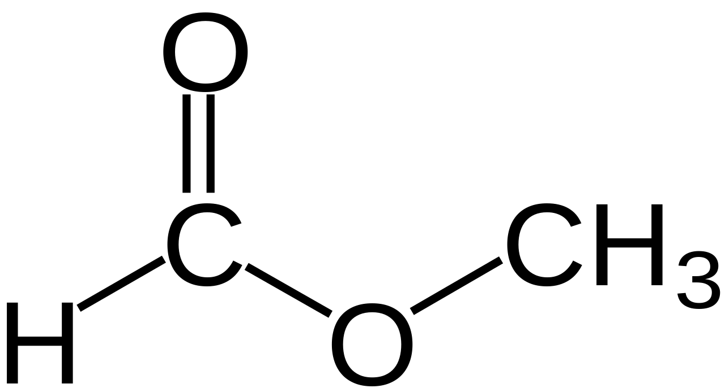
What ecomate® is?
ecomate® is:
Liqiud Blowing Agent
An ester
Methyl Formiate:
ecomate® is not:
CFC
HCFC
HFC
Hydrocarbon
HFO
An acid

Slide 9
ecomate® compliance
Montreal & Kyoto Protocol Compliant
US EPA SNAP Approved
RoHS and WEEE Compliant
GRAS (Generally Regarded As Safe) Approved
Non-Toxic
VOC-Exempt
UL, FM & USCG Classified Systems

Slide 10
End use applications of ecomate®
Rigid Foam
Rigid Spray Foam
Integral Skin Foams
Flexible Foams
Pour in Place Applications
Appliances/White Goods
Automotive
Boardstock & Continuous Panel Mfg.
Commercial Foodservice
Refrigerated Transportation

Slide 11
MF vs HCFC-141b
Similar to HCFC-141b.
Liquid at room temperature.
No special equipment needed when handling.
Non-ozone depleting.
Negligible GWP.
successfully transitioned in many foam applications.
Property | Methyl Formate | HCFC-141b
Appearance | Clear liquid | Clear liquid
Boiling point | 31.3°C | 32°C
LEL/UEL | 5-23% | 7.6-17.7%
Vapor pressure | 586 mm Hg @ 25°C | 593 mm Hg @ 25°C
Lambda, gas | 10.7 mW/mk @ 25°C | 10.0 mW/mk @ 25°C
Auto ignition | >450°C | >200°C
Specific gravity | 0.982 | 1.24
Molecular weight | 60 | 117
GWP | Negligible | 630
ODP | 0 | 0.11

Slide 12
Transition from HCFC-141b to ecomate®: advantages
ecomate® is environmentally friendly:
Zero ODP
Negligible GWP
VOC-exempt
ecomate® has Low Gas Lambda, similar to HCFC-141b (10.7 vs 10)
ecomate® has Boiling Point similar to HCFC-141b (32°C vs 32,2 °C)

Slide 13
Transition from HCFC-141b to ecomate®: advantages
4. ecomate® is cost efficient:
MW is the half (60 g/mol vs 117 g/mol), less level to achievd the same density
Is not expensive
Minimal capital expense, fractional compared to HC
5. ecomate® has high solubility with most PU raw materials:
No need of special polyols or expensive additives
Lower viscosity, better flowability
6. Minimal to no change in equipment as it an process through standard
and/or existing equipment
7. Available worldwide

Slide 14
Transition from HCFC-141b to ecomate®: constraints
ecomate® is more flammable than HCFC-141b:
the neat form has LFL=50000 ppm vs 76000 ppm of HCFC-141b
max amount into polyol shall be established in order to have a not flammable blend
ecomate® is an ester and therefore it can hydrolize shortening the shelf life of the polyol blend
FSI can provide detailed instructions to stabilize under signed NDA
FSI can provide specific additives developed to stabilize
ecomate® has more solvency than HCFC-141b:
it can lead foam to shrinkage
It makes fine cells foam
To overcome the above potential issues it is requested an optimization process to reformulate (slight changes).

Slide 15
Transition from HCFC-141b to ecomate®: flammability
Neat ecomate is flammable.
• System House Concern.
Ecomate Systems mostly Combustible
• SMEs handle as they do today [141b].
Flash Point
ecomate – pure form flammable -19⁰C flash point
ecomate – polyol blend nonflammable >35⁰C flash point
ecomate – mdi blend nonflammable >35⁰C flash point

Slide 16
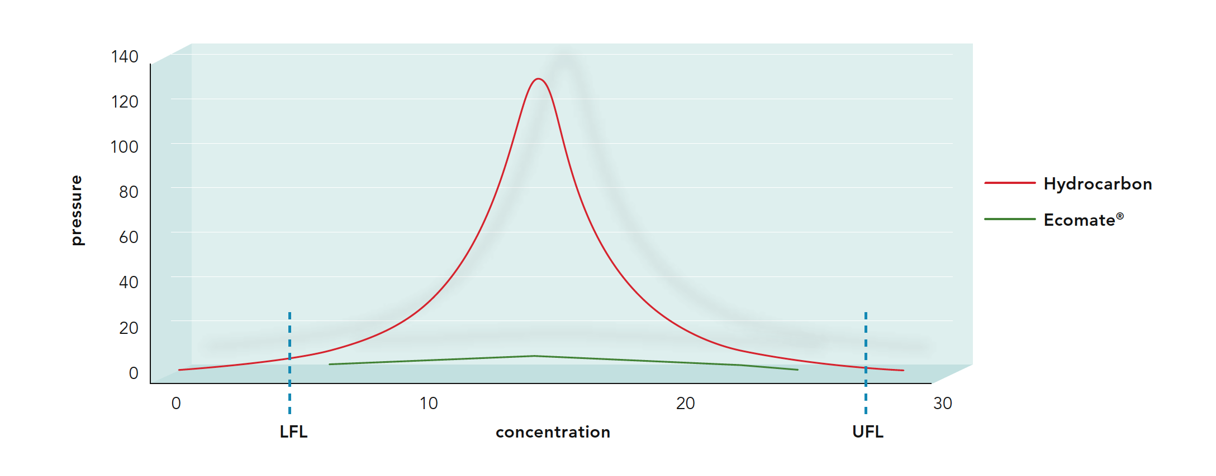
Transition from HCFC-141b to ecomate®: flammability
Methyl Formate, is a liquid flammable, it burns with a low heat of combustion:
Low heat of combustion decreases the explosion pressure and the maximum rate of pressure rise.
Blowing Agent | Heat of Combustion (kcal/g)
HCFC-141b | 1.88
Methyl Formate | 3.88
Pentane (commercial mix) | 11.5
Courtesy of Foam Supplies Inc.

Slide 17
Transition from HCFC-141b to ecomate®: flammability
Methyl Formate
LEL = 5% in air by volume = 125 g/m3 = 50,000 ppm
Maximum concentration allowed by OSHA.NIOSH/ACGIH:
TWA = 100 ppm = 250 mg/m3 = 0.20% of LFL
STEL = 150 ppm = 375 mg/m3 = 0.30% of LFL
HCFC-141b
LEL = 7.4% in air by volume = 925 g/m3 = 193,000 ppm
Maximum concentration allowed (WEEL):
TWA = 500 ppm = 2,4 g/m3 = 0.26% of LFL
STEL = 3,000 ppm = 14.4 g/m3 = 1.56% of LFL

Slide 18
Transition from HCFC-141b to ecomate®: flammability
Methyl formate as a pure liquid is very flammable and requires proper safeguards. The risk of explosion is, however, remote because its low heat of combustion. (*)
A PU system based on methyl formate can be formulated as a low combustible liquid and will not reach the LFL even in the drum’s head space. (*)
There is no reason to treat methyl formate differently from HFCF-141b. (*)
Ecomate® systems have been proven to not sustain combustion according to ASTM D4206.
(*) UNDP - Methyl Formate assessment - 62nd executive committee meeting, October 2010

Slide 19
Transition from HCFC-141b to ecomate®: emissions
SPRAY FOAM EMISSIONS
Spray Foams are “worst case” scenarios for emissions.
Multiple third party emissions and hygiene testing on ecomate® spray systems have proven very favorable.
Spray equipment sampling taken indoors about 61 cm from point of application.
ppm over the foaming area | At the spray head
23 | 10
23 | 12
20 | 10

Slide 20
Transition from HCFC-141b to ecomate®: emissions
HI/LOW PRESSURE MACHINE
Standard Panel System gel time ~150s
Standard Refrigeration System ~ 90s
ppm at injection point | 600 mm from head
2.85 | 0.59
3.00 | 0.71
2.95 | 0.73
2.26 | 0.63

Slide 21
Transition from HCFC-141b to ecomate®: optimization
Increase index of about 10 points.
Increase the water content while decreasing ecomate®.
Increase cross-link density of the polymer or increase the averge functionality of the blend.
Evaluate the kind of polyol.
Change the surfactant type and amount.

Slide 22
Transition from HCFC-141b to ecomate®: optimization
To speed up the transition process FSI can provide specific additives.
Ecosil family - Ecosil 1000, Ecosil 1070, Ecosil 1060
Imparts excellent shelf life (8-12 months) & Provides excellent cell structure
Maintains density over shelf life
Ecoadd family – ecoadd+ EX14M9, ecoadd+ EX14M8
Overcomes issues commonly faced by formulators
Reaction profile changes over time OR Density changes/ drifts over time
Foam quality and cell are not uniform
Typical dosage is 2% - 5% depending on the formulation

Slide 23
How ecomate® can be used
Blended into the polyol mixture
Blended into the isocyanate
Third component, high pressure mixing head
Co-blown with other blowing agents

Slide 24
How ecomate® can be used: processing reccomendations
TRANSFER (Pressure): Use Nitrogen not Air. Closed loop transfer recommended with ecomate® in neat form.
PUMPS – for Metering: Brass/SS pumps with PTFE/EPDM diaphragms. Gear pumps do not work well due to low viscosity of ecomate®. Electric grounding for transfer as ecomate® vapor can be flammable during transfer.
SEALS: PTFE & Kalrez seals recommended, EPDM.
METERING: SS turbine flow-meters with tungsten carbide bearings.
HOSES: Convoluted Stainless Steel hoses with SS braiding.
PIPING: SS with Stainless compression fittings, valves SS with Teflon seals.
STORAGE: Steel drums in covered area i.e. Protection from rain and sun.

Slide 25
How ecomate® can be used: processing reccomendations
BATCH BLENDING
Injected from drums by pumps through check valve to prevent back flow.
In-situ blending with in line static mixer prior drumming.
Introduce ecomate® to other ingredients in the bottom of tank with agitation N2 blanket on blending preferred.
Pre-blend ecomate® in a major polyol stream and pumped into mixing vessel.

Slide 26
How ecomate® can be used: processing reccomendations
DRUMMING
Formulations should be designed that ecomate® content in polyol is ≤ 6%. This ensures that blend is not flammable.
Anticipated flash point or the blend should be verified.
Preferred ecomate® content in Isocyanate should be below 2%.

Slide 27
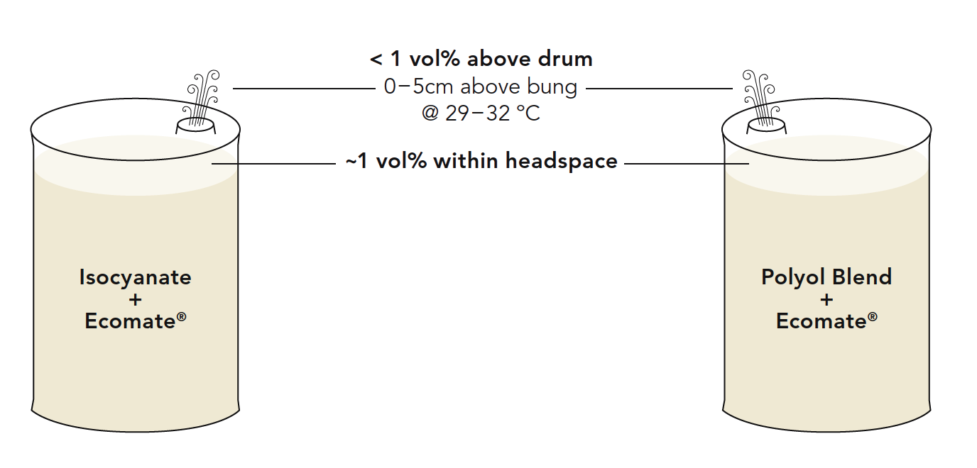
How ecomate® can be used: drumming
Courtesy of Foam Supplies Inc.

Slide 28
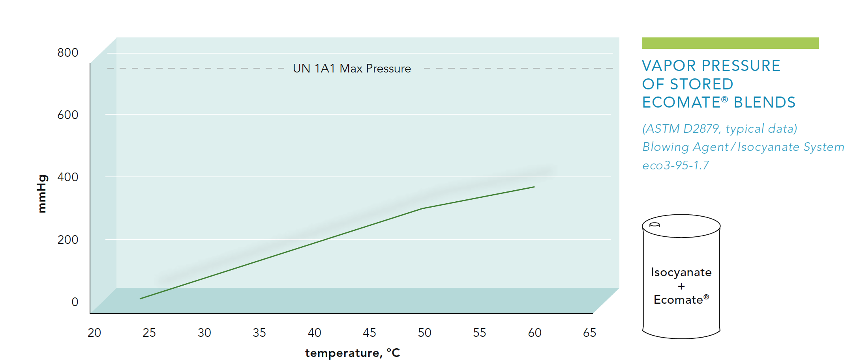
How ecomate® can be used: drumming
Courtesy of Foam Supplies Inc.

Slide 29
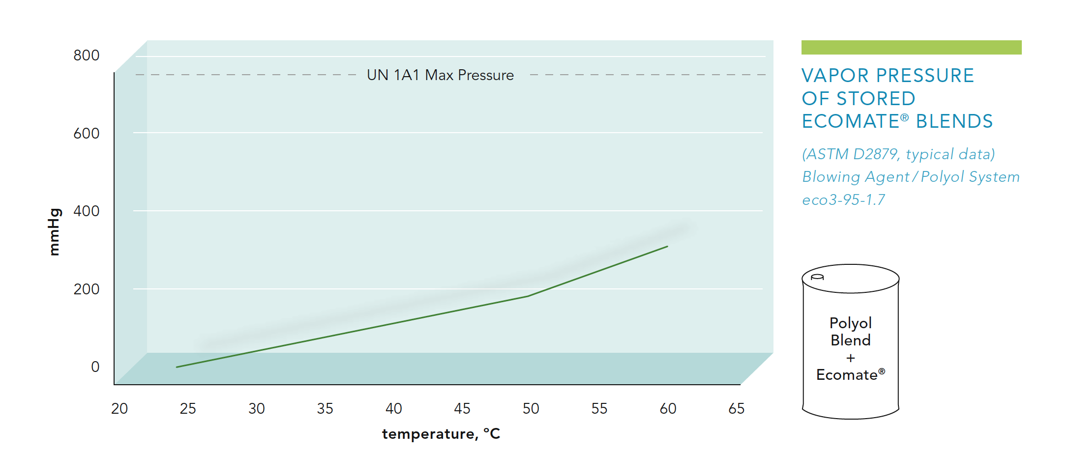
How ecomate® can be used: drumming
Courtesy of Foam Supplies Inc.

Slide 30
Properties of flammable substances
Flash point: the lowest temperature at which vapors above the liquid will "flash" when exposed to a flame in a standard test apparatus.
Auto-ignition temperature: the temperature at which a flammable substance will burn spontaneously (without an external ignition source).
Flammable limits: concentrations range where a flame will propagate away from an ignition source.
Maximum explosion pressure: highest buildup of pressure after ignition in a closed vessel.
Maximum rate of pressure rise: maximum slope of the plot of pressure versus time, after ignition, up to maximum pressure.
Minimum ignition energy: smallest amount of energy in an electric spark which will ignite a flammable mixture.
Heat of combustion: the energy released as heat when a compound undergoes complete combustion with oxygen under standard conditions.

Slide 31
HCFC phase out in PU foam
Transition from HCFC-141b to Hydrocarbons (HC)
Delhi, 3-8 February 2019

Slide 32
The ideal Physical Blowing Agent
Not toxic
Not flammable
Not explosive
No Ozone Depleting Potential
No Global Warming Potential
No VOCs
Low Gas Thermal Conductivity
Low Diffusion coefficient
Liquid at ambient temperature
Easy to use
Balanced Solubility and great stability in any formulated polyol blend
Suitable for any PU application
Compatible with existing processing equipments
Cost effective
Available on global basis

Slide 33
The ideal Physical Blowing Agent
Not toxic
Not flammable
Not explosive
No Ozone Depleting Potential
No Global Warming Potential
No VOCs
Low Gas Thermal Conductivity
Low Diffusion coefficient
Liquid at ambient temperature
Easy to use
Balanced Solubility and great stability in any formulated polyol blend
Suitable for any PU application
Compatible with existing processing equipments
Cost effective
Available on global basis
There is NO Perfect Product

Slide 34
HC comparison
 | 141b | n-pentane | c-pentane | i-pentane | i-butane
Molecular weight | 117 | 72 | 70 | 72 | 58
Boiling Point °C | 31,9 | 36,1 | 49 | 28 | -11,7
Flash Point °C | none | -49 | -42 | -57 | -107
LEL/UEL (vol% in air) | 5,6-17,7 | 1,4-8,0 | 1,5-8,7 | 1,4-8,3 | 1,8-8,4
ODP | 0,1 | 0 | 0 | 0 | 0
GWP | 725 | <25 | <25 | <25 | <25
Lambda @ 25°C [mW/(mK)] | 9,7 (25°C) | 14,0 (10°) | 11,0 (10°) | 13,0 (10°) | 15,9 (20°)

Slide 35
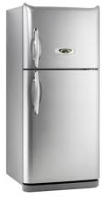
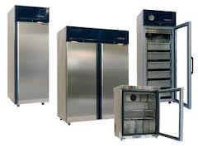
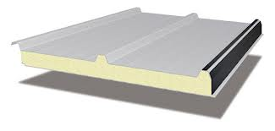
End use applications of HC
Continuous panels
Discontinuous panels
Appliances (refrigerators, water heaters)
Reefer containers
Pipe insulation
Refrigerated Transportation

Slide 36
Transition from HCFC-141b to HC
ADVANTAGES CONCERNS
Environmentally friendly
Zero ODP
Negligible GWP
Low cost raw material, worldwide available
Low operating cost solution long-term
Definitive solution
Successfull track record
Flammable and explosive
Low solubility
Aesthetics issues: bubble and voids
Worsen Thermal conductivity

Slide 37
HC comparison
 | 141b | n-pentane | c-pentane | i-pentane | i-butane
Molecular weight | 117 | 72 | 70 | 72 | 58
Boiling Point °C | 31,9 | 36,1 | 49 | 28 | -11,7
Flash Point °C | none | -49 | -42 | -57 | -107
LEL/UEL (vol% in air) | 5,6-17,7 | 1,4-8,0 | 1,5-8,7 | 1,4-8,3 | 1,8-8,4
ODP | 0,1 | 0 | 0 | 0 | 0
GWP | 725 | <25 | <25 | <25 | <25
Lambda @ 25°C [mW/(mK)] | 9,7 (25°C) | 14,0 (10°) | 11,0 (10°) | 13,0 (10°) | 15,9 (20°)
Higher foam strength
Better foam stability
Better flow-ability
Better processability
The highest Boiling Point
Lower Density
The lower Lambda
The better solubility in polyols
The more expensive

Slide 38
HC comparison
c-pentane is best performing in terms of thermal insulation (36-38 Kg/m³).
c-/i-pentane=70/30 (or 65/35) is used in appliance, the blend is the compromise cost/performance (thermal insulation and dimensional stability at 35-36 Kg/m³).
n-pentane is the cheapest HC isomer but is less performing in terms of thermal insulation property (38-40 Kg/m³).
n-Pentane is used in PU/PIR panel/board.

Slide 39
Processing with HC
Three solutions:
2 components system: HC pre-blended into the polyol at S.H.
Discontinuous process, pour in place
3 components system: HC Batch System at customer
In the discontinuous process for panels, cold chain and more
3 components system: HC added as Third stream into HP mixing head
at customer
In the discontinuous process for panels, cold chain and more

Slide 40
Processing with HC
2 components system
S.H.
blends HC into the polyol
Delivers
Customer (small enterp.)
uses 2 component system
Investment costs for HC storage and blending
Comply with regulations for drumming and transportation
About 3,000 MT of blended system delivered in Europe as flammable liquid
S.L. of c-pentane up to 6 months
S.L. of n-pentane < 2 months
Nate HC not used (storage, blending)
Low cost: retrofit or replacement of existing equipments
Higher cost of PU system
Use of flammable liquid

Slide 41
Processing with HC
3 components system
S.H.
Provide system w/o HC
Delivers
Customer
Adds H.C. - Batch System
No Investment for HC
No issues with polyol stability and S.L.
Higher degree of freedom in formulating
High Investment for handling HC (storage, blending)
Retrofit or replacement of existing equipments
Lower PU system cost

Slide 42
Processing with HC
3 components system
S.H.
Provide system w/o HC
Delivers
Customer (SMEs)
Adds H.C. – Third Stream
No Investment for HC
No issues with polyol stability and S.L.
Higher degree of freedom in formulating
Lower Investment for handling HC (storage)
Retrofit or replacement of existing equipments
Lower PU system cost

Slide 43
Transition from HCFC-141b to HC retrofit
Main reasons for retrofit with HC are safety issues.
Change to updated proven technology, commercially available and safe.
Is the modification of equipment and facilities that are in service installing parts developed to use hydrocarbons.
The retrofit is typically customized based on existing equipment, production and facilities.

Slide 44
Transition from HCFC-141b to HC retrofit
Facilities
Equipment
Factory layout
Working areas
Environment conditions
Existing electrical system
Raw material storage systems
Storage tanks availability
Existing Fire protection systems
Machine type
components, heating system
Foaming method
Automatic or manual pouring process

Slide 45
Transition from HCFC-141b to HC safety
Classification of hazard places
Zone 0
Zone 1
Zone 2
Area in which ignitable concentrations of flammable gases, are present continuously or for long periods of time or with high frequency.
Area in which ignitable concentrations of flammable gases, are likely to occur under normal operating conditions
Area in which ignitable concentrations of flammable gases, are not likely to occur under normal operating conditions, if occur persist for a short period.

Slide 46
Transition from HCFC-141b to HC safety
Reclassify or restrict as many areas as possible by the application of engineered solutions such as ventilation, etc.
Safeguard areas that cannot be reclassified, through explosion proofing
Provide additional safeguarding with sensors at designated potential emission points and a portable gas detector to be used as part of a formal monitoring plan for areas that do not have continuous monitoring
Provide adequate emergency response gear such as firefighting equipment
Train personnel in safe operating procedures, preventive maintenance and emergency response
Use an external expert or a technology transfer agreement to supervise all designs, the implementation and the start-up. The initial production start-up after conversion should be attended by experienced operating personnel.
With the help of this safety concept, it is possible to design actual modifications that have to be made to implement the transfer from HCFCs to HCs.
Implementation can differ, depending on equipment, plant layout and surroundings.

Slide 47
Transition from HCFC-141b to HC typical conversion for batch system
CENTRAL SAFETY AND CONTROL SYSTEMS
Gas Sensing and Alarm System
Exhaust System
Grounding
Procedures
HC STORAGE AND TRANSFER
PREBLENDER
FOAM DISPENSER
MOLDS, FIXTURES, PRESSES

Slide 48
Transition from HCFC-141b to HC exhaust system, grounding
EXHAUST SYSTEM
The plant shall have installed a centralized or sufficient localized emission extraction systems of sufficient capacity serving locations where the possibility of emissions or leakage of pentane exists.
The system(s) shall have a two stage capacity and back-up power.
The system(s) shall be interlocked with the sensor and alarm system.
The system(s) shall have an independent power back-up.
GROUNDING
All equipment in areas where HC emissions or leakage can occur shall be connected to a central electrical grounding system.
The grounding shall conform to internationally accepted specifications e.g. NFPA 77.
Courtesy of SAIP Advanced Polyurethane Equipments

Slide 49
Transition from HCFC-141b to HC gas sensing and alarm system
The plant shall have installed gas sensors on locations where the possibility of emissions or leakage of HC exist.
The system shall be capable to trigger two consecutive visual/acoustical alarm levels, related to the percentage LEL reached.
Recommended is a first level alarm on 15% LEL and a second alarm level at 30% LEL.
The acoustical alarm shall be a minimum of 85 Db, or at least 15 Db over plant noise level.
The visual alarm shall be in the pouring area.
The first alarm shall be for warning purposes only.
The second alarm shall shut down the pouring operation and the pentane supply, while increasing the process exhaust.
The system shall have an independent power back-up.
An auxiliary portable gas sensor with calibration unit shall be kept on site.
Courtesy of SAIP Advanced Polyurethane Equipments

Slide 50
Transition from HCFC-141b to HC procedures
The enterprise shall provide the necessary operational safety and emergency response instruction and training to staff and personnel involved in the operations using HC.
A Safety Manager shall be appointed in the factory. The manager will receiver appropriate training and education and be properly certified.
Hazardous areas shall be clearly marked by signs indicating the Area Zoning.
Piping shall be color coded.
No smoking shall be allowed in the factory and its immediate surroundings. The no smoking policy shall be properly marked by signs.
Periodic safety audits shall be effected. The audits shall include measuring of HC concentrations in areas not covered by permanent sensors through the use of the portable sensor by a qualified person.
A Safety Manual shall be developed and maintained. The manual should as a minimum address:
Safety Organization and Responsibilities
Standard Procedures for Work in Hazardous Areas
Response to Emergency Alarms
Start-up procedures after Emergency Shutdown
Courtesy of SAIP Advanced Polyurethane Equipments

Slide 51
Transition from HCFC-141b to HC storage and transfer
Location and installation of storage systems for HCs are subject to local regulations.
Design of tank, piping, valves shall comply with internationally recognized standards.
Tanks shall have an electrically/pneumatically operated shutoff control valve on the outlet pipe of the tank that can be activated from within the plant. In addition, it shall be possible to shutoff the electrical power supply to the tank from within the plant as well as at the tank.
Nitrogen blanketing shall be provided.
All components shall be properly grounded.
Protection against lightning may be required depending on location.
All installations within 4 m radius of the tank shall meet Zone 1 requirements.
Minimal one gas detector, connected to the central gas sensing and alarm system, shall be installed.
Portable fire extinguishers shall be installed.
The tank shall be underground in a concrete (spill) containment of sufficient size in a fenced, locked area, preferable with a cover to protect against direct sunlight.
The HC transfer pump shall be explosion proof with backflow protection.

Slide 52
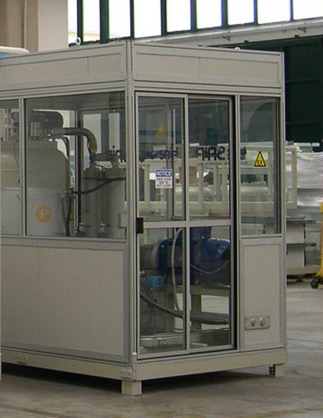
Transition from HCFC-141b to HC Pre-blending of HC/polyol
Spill containment shall be installed under pre-blender.
It shall be placed in an enclosure, connected to an adequately sized two stage air extraction system.
One gas detector shall be installed, attached to the central gas sensing and alarm system.
The pre-blender shall be connected to a polyol buffer tank through a pump with backflow protection and to the HC storage and transfer system through an explosion proof pump with back flow protection.
All equipment inside the enclosure shall meet Zone 1 requirements.
All equipment shall be properly grounded.
Courtesy of SAIP Advanced Polyurethane Equipments

Slide 53
Transition from HCFC-141b to HC Moulds, fixtures, presses
Cavities in closed molds, fixtures and presses shall be inherted by nitrogen prior to the foam pouring operation.
Emissions from molds, fixtures and presses shall be removed through an adequately sized two staged extraction system. Calculation of the lower stage ventilation capacity should be based on the emission of 5% of the HC injected.
Generation of static electricity should be minimized through proper grounding.
Courtesy of SAIP Advanced Polyurethane Equipments

Slide 54
Transition from HCFC-141b to HC HC added as third stream
Direct head injection of pentane as third stream in high pressure foaming units.
Low cost HC solution for SMEs.
3 component dispensing unit.
It can works as:
Bi-component
HC/polyol + Isocyanate
Tri-component
HC + polyol + Isocyanate
Courtesy of SAIP Advanced Polyurethane Equipments

Slide 55
Transition from HCFC-141b to HC HC added as third stream
Isocyanate
line
Polyol /
HC blend line
HC line
Standard configuration
No enclosure
No ventilation
No detection syste
No Ex-proof
Enclosure and ventilation
Drip pan
Pipes, hoses, fittings leakage free
Tank blanketing with nitrogen
Grounding
Detection system (sensors)
EX–proof components (tank levels, tank, heating elements, etc.)
Magnetic coupling for the dosing pump with motor
Magnetic coupling for the tank stirrer with motor
Closed loop mixing device (static mixer)
The polyol line meets European standard ATEX
94/9/EC and is in conformity to II 2 Gc IIB T4
Enclosure and ventilation
Drip pan
Pipes, hoses, fittings leakage
free
Tank blanketing with nitrogen
Grounding
Detection system (sensors)
EX – proof components
Magnetic coupling for the dosing pump with motor
Magnetic coupling for the tank stirrer with motor
Courtesy of SAIP Advanced Polyurethane Equipments

Slide 56
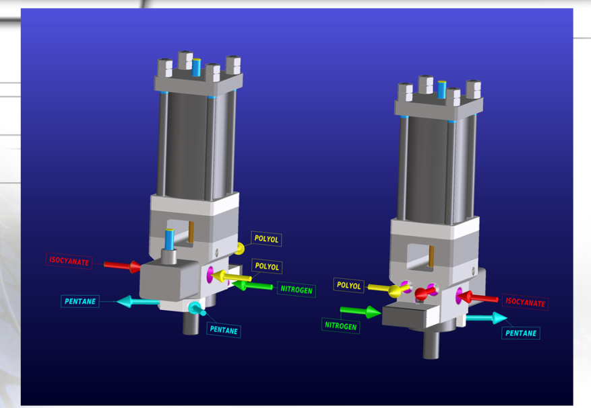
Transition from HCFC-141b to HC HC added as third stream
Mixing head
High pressure self cleaning laminar flow at three components and provided with nitrogen flushing device.
All the electric components assembled on the mixing head are ATEX standard.
Courtesy of SAIP Advanced Polyurethane Equipments

Slide 57
Transition from HCFC-141b to HC HC added as third stream
The technology allows:
to retrofit existing equipment to the use of HC as a third stream, where applicable, with a cost saving investment and with proper results and performances.
to avoid an HC premixer with auxiliaries by using properly stabilized preblended
Courtesy of SAIP Advanced Polyurethane Equipments

Slide 58
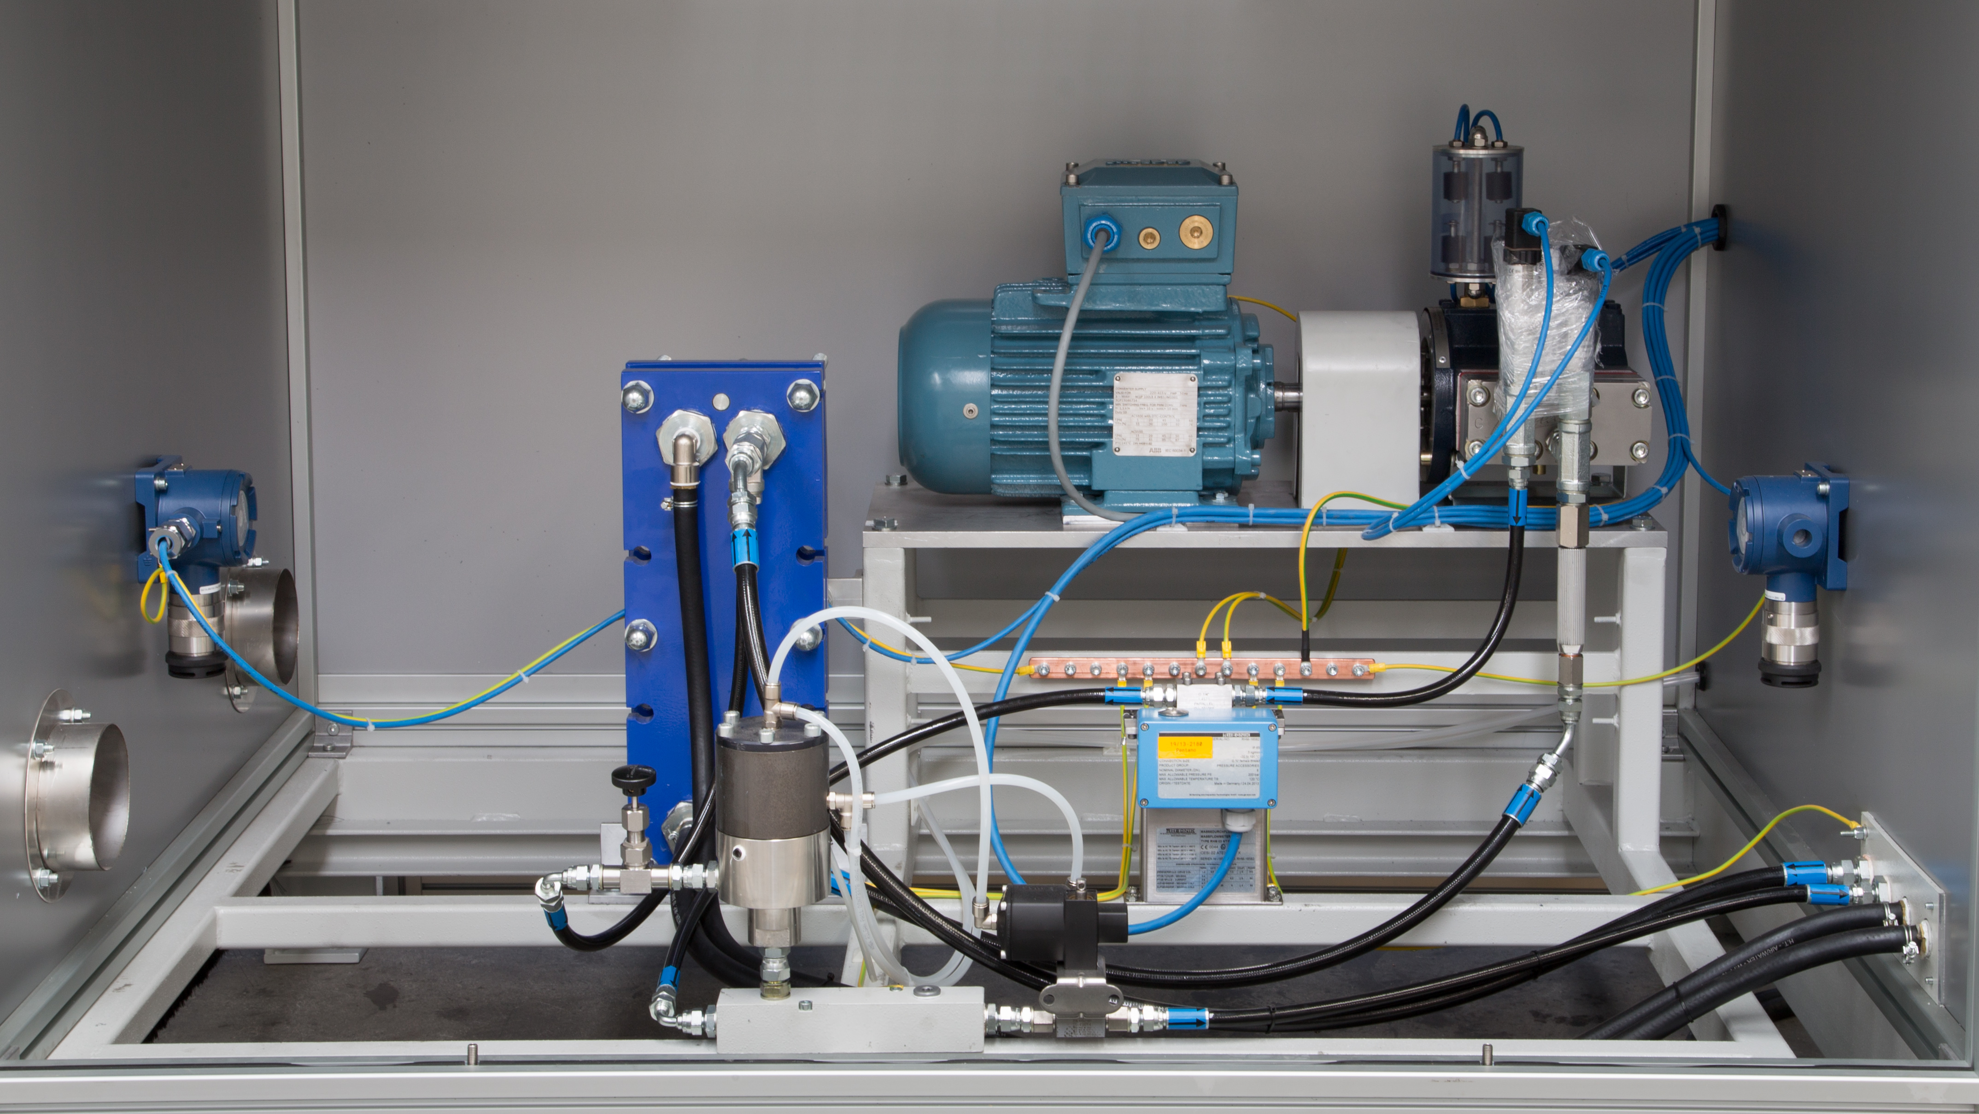
Transition from HCFC-141b to HC HC metering & mixing with Polyol (DBL process)
Spill containment shall be installed under the HC metering.
It shall be placed in an enclosure, connected to an adequately sized two stage air extraction system.
One gas detector shall be installed, attached to the central gas sensing and alarm system.
All equipment inside the enclosure shall meet Zone 1 requirements.
All equipment shall be properly grounded
Courtesy of SAIP Advanced Polyurethane Equipments

Slide 59
Thank you!

