Slide 1
Low-GWP blowing agents as alternatives of HCFC-141b
in the PU Foam Industry
Delhi, 3-8 February 2019
Module 1

Slide 2
Main blowing agents evolution – Polyurethane foam applications
GEN 4
HFOs
Zero ODP
Low GWP
HFO-1233zd ; HFO-1336mzz
Oxygenated Hydrocarbons
Methyl Formate
Ecomate®
Methylal
GEN 3
HFCs
Zero ODP
High GWP
HFC 134a
HFC 245fa
HFC365mfc/HFC227ea
GEN
2
HCFs
Low ODP
High GWP
HCFC-141b
Usage of Hydrocarbons and Water
GEN 1
CFCs
High ODP
High GWP
CFC-11

Slide 3
Blowing agents evolution - Foams applications
*The evolution of BAs technologies, driven by regulation and market trends moved far from Generation 1 BAs (CFCs)
*Uses of Gen 1 and 2 are regulated by Montreal Protocol (Ozone Depletion Potential ODP)
*HFCs usage are regulated by Montreal Protocol after Kigali Amendment
(Oct 2016 – In action Jan 2019)
*On top of Hydrocarbons (HC) and water, Gen 4, (HFOs = Hydrofluorolefines) represents a viable Low GWP alternative to HCFCs and HFCs elimination

Slide 4
Kigali amendment
• The HFC phasedown
is expected to avoid up to 0.5 degree Celsius of global temperature rise by 2100, while continuing to protect the ozone layer
(Source: Ozone Secretariat)

Slide 5
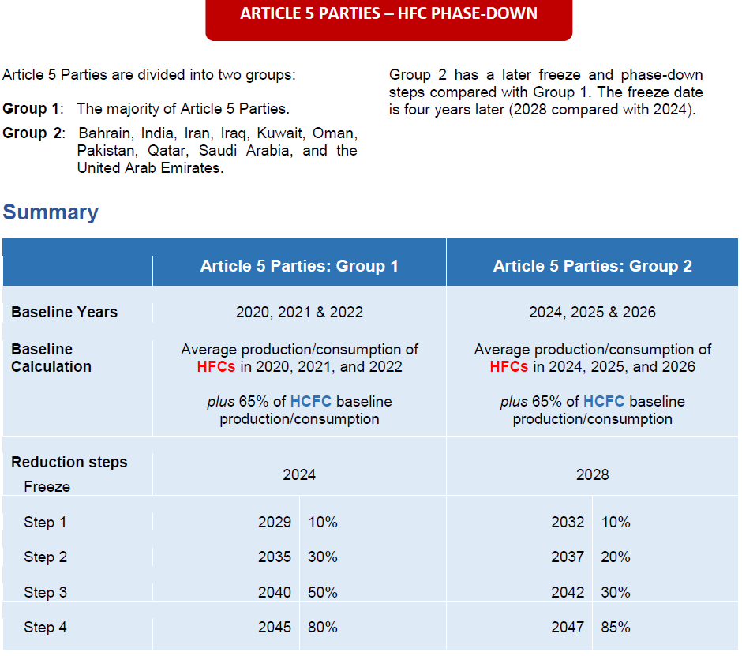
Kigali amendment – Summary → New base line with ODP/GWP
Phase-down schedule
Latin American countries included in Group 1

Slide 6
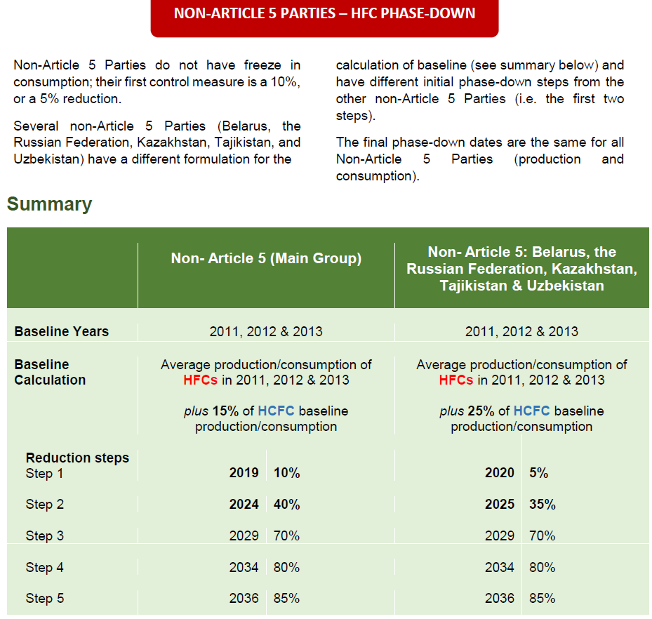
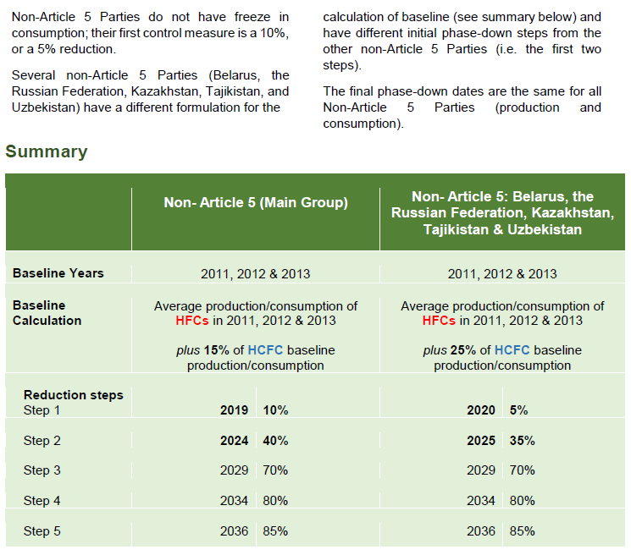
Kigali amendment – Summary → New base line with ODP/GWP
Phase-down schedule

Slide 7
HCFC Transition and Kigali Amendment
Foams Technical Options Committee (FTOC) is monitoring the interaction of the Kigali Amendment with the HCFC-141b phase out and variables that may influence the rate of transition in Article 5 parties:
Directly to zero ODP and low global warming potential (GWP);
As a second conversion via high GWP HFCs;
Variables include:
Cost and availability of HFOs
Cost and availability of high GWP HFCs (e.g. HFC-245fa, HFC-365mfc/HFC-227ea)
Progress on technology and formulation science to address issues related to system stability as well as storage, handling, machinery, processing and safety for flammable blowing agents

Slide 8
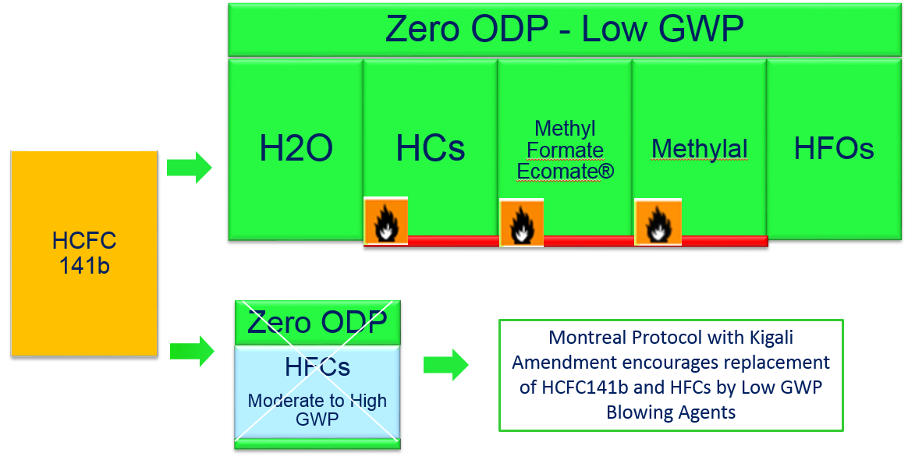
Blowing Agent Selection – Polyurethane Foam Applications

Slide 9

Blowing agent gas properties – alternatives to HCFC-141b elimination
* Solstice® LBA – Honeywell; Forane® LBA 1233zd - Arkema
** Opteon 1100 – Chemours

Slide 10
Some important factors to consider on blowing agent selection…
Sustainability
ODP, GWP
Productivity
Demould time
Scrap rate
Product Yield
Applied density
Thermal Conductivity
Energy consumption
Insulation thickness
Blowing Agent handling
Boiling Point
Storage
Packaging
Economics
Better cost/unit
Country Regulations
Montreal & Kyoto Protocols
SNAP rule…
Equipment investment
Safety
Process
Mixing
Product Availability
Offering/Demand/cost
Process ability
Material flow
Mould temperatures
Flammability
Safety, storage, transportation
handling, processing…
B.A. solubility in polyol

Slide 11
Important Factors to consider on blowing agent selection…
Thermal Conductivity
Energy consumption
Insulation thickness
Gas thermal conductivity of blowing agents is a key element for insulation efficiency
Selection of appropriate blowing agent, either pure or blends can provide best balance of cost x performance for specific application
Usage of flammable blowing agent implies additional cost per unit with different payback for investment, depending on volume of foam converted
Fully water blown formulation are feasible for applications where thermal insulation is not so critical

Slide 12
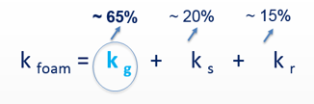
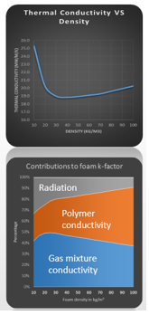
Thermal conductivity factors – PU Foam
Gas mixture inside cells – thermal conductivity ( k g )
Polymer thermal conductivity ( K s)
Radiation between gas cells ( k r )

Slide 13
Important Factors to consider on blowing agent selection…
Economics
Better cost/unit
The challenge is to find the best cost per unit (*) while maintaining high foam performance
Ecomate® (Methyl Formate), Methylal and Hydrocarbons are less expensive, but add costs via safety precautions in storage, handling, machinery and processing
Unsaturated BA - HCFO 1233zd and HFO 1336mzz are more expensive, but can provide viable solutions when blended with water and other blowing agents
Unsaturated BA – HCFO 1233zd requires special surfactants and catalyst to provide stable fully blended formulation, which will add cost per unit
(*) cost per unit: kg of foam; or part produced; or equipment produced

Slide 14
Important Factors to consider on blowing agent selection…
Flammability
Safety, storage, transportation
handling, processing…
Hydrocarbons and Oxygenated Hydrocarbons
Incremental costs and safety considerations have to taken seriously in the whole chain: Transportation, storage, handling and processing
Implementation of Flammable Blowing Agents
Requires substantial investment
Payback depends very much on volume of foam processed
Hydrocarbons and Methylal can’t provide non flammable fully formulated polyols
Methyl Formate, combined with water and or Unsaturated BA (HFOs) can provide non flammable fully formulated polyols
Third stream of flammable BA in PU injection machines can only minimize risks on processing

Slide 15
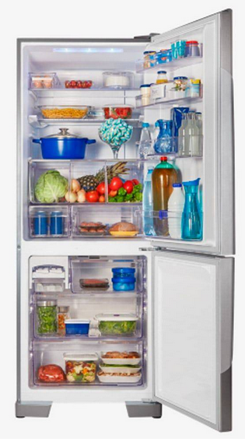
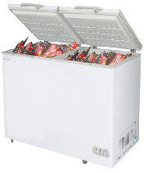
PU Foam Applications and Options
Appliances → Domestic - energy efficiency high production volume
Hydrocarbons and Hydrocarbon blends - Investment $$$
Flammable - good compromise of cost and energy efficiency
HFOs - excellent energy efficiency, high foam cost $$$
Commercial
Hydrocarbons and Hydrocarbon blends
HFOs and blends
Ecomate ® - safety measures for flammable systems
Water Blown – lower energy efficiency

Slide 16
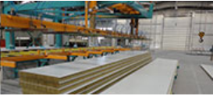
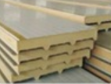
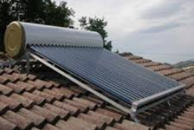
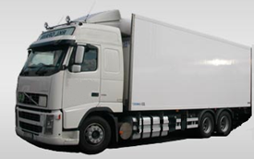
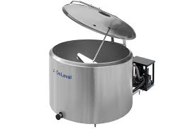
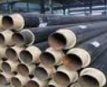
PU Foam Applications and Options
Panels
Continuous – PUR - PIR
Hydrocarbons dominant technology
Discontinuous
Hydrocarbons
HFOs - with high water content
Ecomate ®
Insulated Trucks – Tanks - Boilers … pipes
Hydrocarbons [and Hydrocarbon blends
HFOs - with high water content
Ecomate ®
Water Blown

Slide 17
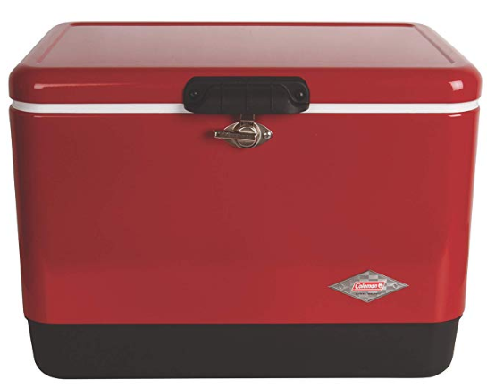
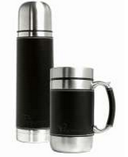
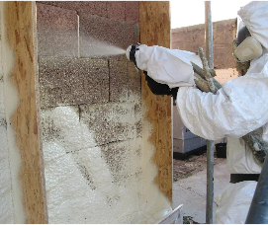
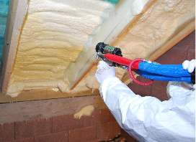

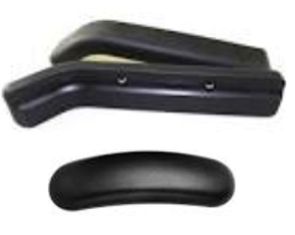
PU Foam Applications an Options
Thermal ware
ecomate ®
Water blown
HFOs with high water content
[ Hydrocarbon with high water ]
Spray
HFOs and with high water content
Water Blown
ecomate ®
Integral skin – Market in transition
ecomate ®
Water blown – in mold coating
HFOs
Less hydrocarbon

Slide 18
Final Comments
*There is single no solution to phase out HCFC14b
*Each blowing agent chosen to replace HCFC 141b represents a challenge
*Hydrocarbons: Flammable, requires high investment in plant modification, machinery, handling. Safety is very important. Pre-blended represents risks in transportation, handling and processing. Very competitive foam cost and proven technology
*HFOs (Hydrofluor olefins ) are non flammable and provide very good foam performance, but formulations can be very expensive if they are not blended with high water content. Boiling point of 1233zd is low (19C) that requires care in processing. It also requires formulation adjustment with new catalyst package to provide better blend stability. Availability has to be checked!
*ecomate: Easily available, very competitive foam formulation and can provide non flammable system. However come formulation are flammable and all requirement to handle it as flammable system has to be taken.
* Water: Excellent blowing agent and it is largely used as co-blown with other blowing agents. High water content formulation can provide very good products, but they have to be adjusted to avoid friable foams and processing requires strict temperature control

Slide 19
Thank You

