Slide 1

STAKEHOLDERS WORKSHOP
ON ALTERNATIVES TO HCFC-141b IN
PU FOAM MANUFACTURING SECTOR
Montreal Protocol/Chemical Unit (MPU)
United Nations Development Programme (UNDP)
Gulmohar Hall, Convention Centre
India Habitat Centre, Lodhi Road, New Delhi
Date : 8 February 2019

Slide 2

The Montreal Protocol on Substances that Deplete the Ozone Layer
Its objective is to phase-out the ozone depleting substances (ODSs);
Focus on the elimination of the sources of the ODS: their production and consumption;
Was agreed upon on 16 September 1987 - entered into force on 1 January 1989;
Most of the ODS covered are very potent greenhouse gases (GHG);
The ODS phase-out activitied have provided considerable co-benefits to the climate change mitigation;
The total avoided net annual ODS emissions by 2010 is estimated to be equivalent to about 10 Gt CO₂/year. (Velders et. al, 2007)

Slide 3
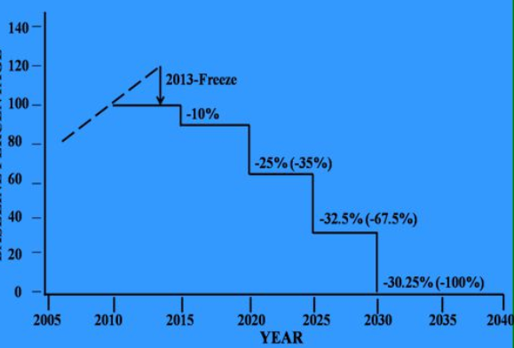
Assistance provided to date by the Multilateral Fund (MLF)
The MLF also supports projects to convert of manufacturing enterprises, large and small, that rely on the use of ozone-depleting substance to support the Article 5 country in achieving the phase-out goals.
Staggered Approach;
India has succesfully completed
the Stage I of its HCFCs Phase-
out Management Plan (HPMP).
India is now implementing the
Stage II of its HPMP, scheduled to
completed by the year 2023.

Slide 4
Global Perspectives in the PU Foam Sector
UNDP supports several A-5 countries to implement their PU Foam Sector Plans as integral part of their HPMPs:
India;
Malaysia;
Iran;
Brazil;
Mexico;
Caribbean countries;
Peru;
Colombia;
Egypt.
Among others.

Slide 5
Challenges for the Implementation of PU Sector Plans
Barriers for the Manufacturing Sector:
Patents and Royalties;
Introduction of flammable/toxic alternatives;
Determination of ICC and IOCs;
Competition with imports of preblended polyols/fully formulated systems (including with HCFC-141b).
Drivers of Change:
PU Sector Plans under the HPMP;
Policy, Standards and Institutional Framework strengthened;
Increased control over imports with support of portable analysers for Polyols.

Slide 6
Global Technology Uptake Scenario
HFCs limited by high GWP and cost (245fa and/or 365mfc/227ea).
HFOs still suffering of limitations in large commercial scale supply as well as high costs.
Methylal is flammable as pure substance and as well blended in polyols
Ecomate® (Methyl Formate) is flammable as pure, formulated system can be not flammable. Patented.
Water-based BA: pose some limitations in use, but feasible alternative in some applications.
Hydrocarbons: consolidated and well-known BA, wide use in several applications. Is explosive and flammable, so high capital cost is observed.
Pre-blended hydrocarbons.
3rd Stream injection in the mixing head.

Slide 7
Global Technology Uptake Scenario
No “one fits all” solution;
Different applications may require different Blowing Agents;
Co-blending of BAs as way to mitigate some “negative” features;
No “drop in”, whichever BA chosen, intense re-formulation work must be done;
System Houses to keep “open mind” and be ready to use all Bas (meaning develop formulations for all BAs).
System House play key role as driver of change and “technology hub” for the end-user.
End-user to be keen to issues regarding flammability of fully formulated systems: evaluate and reduce risks.
Large clients may wish to pre-blend BAs.

Slide 8
Key decisions and guidelines impacting the Stage II implementation in India
Cut-off Date: 21 September 2007 (Decision 60/54)
Eligible Incremental Costs (Decision 60/54)
Cost-effectiveness tresholds to different sectors and applications;
Limitation on Operational Costs.
Agreement between the MLF and the Government of India for the Implementation of the Stage II:
C/E capped at USD 7.58/Kg
Need to obtain detailed baseline information from beneficiary companies to report back to the ExCom.
Commitment to ban use and imports of HCFC-141b by 1/Jan/2020.
Penalties and return of unused funds for PU Foam.
Principles also apply to Air Conditioning Sector assisted under the HPMP.

