Slide 1



HCFC PHASE OUT IN FOAM MANUFACTURING SECTOR
OZONE CELL
MINISTRY OF ENVIRONMENT, FOREST & CLIMATE CHANGE
GOVERNMENT OF INDIA

Slide 2
VIENNA CONVENTION AND MONTREAL PROTOCOL
The Vienna Convention for the Protection of the Ozone Layer was signed in March 1985.
The Montreal Protocol on Substances that Deplete the Ozone Layer was signed on 16 September, 1987.
The Montreal Protocol is the most successful multi-environment agreement
The Montreal Protocol has achieved universal ratification. 197 United Nations countries have ratified the Montreal Protocol.
Protocol has already phased out 98 % ODP equivalent ODS, the Ozone Layer is on path of recovery .
2
Notes:
2

Slide 3
MONTREAL PROTOCOL FRAME WORK
Meeting of the Parties
Role : Decision making & guidance
Advisory Panels
Ozone Secretariat
TEAP
SAP
EEAP
Executive Committee
Role : Approval of funds & operational decisions
Multilateral Fund Secretariat
Implementing Agencies
World Bank
UNEP
UNDP
UNIDO
BILATERAL
3

Slide 4
INDIA’S COMMITMENT TO THE MONTREAL PROTOCOL
18th March 1991: India became a Party to the Vienna Convention
19th June 1992: India became a Party to the Montreal Protocol.
17th September 1992 : India ratified the London Amendment (1990).
November 1993: India’s Country Programme was prepared for implementation of the Montreal Protocol.
3rd March 2003 : India ratified the Copenhagen Amendment (1992), Montreal Amendment (1997) and Beijing Amendment (1999).
January 2006: India’s Country Programme was updated.
September 2007 : Accelerated Phase-out of HCFCs
October 2016: Phase–down of HFCs
4
Notes:
4

Slide 5
INSTITUTIONAL FRAMEWORK IN INDIA
Ozone Cell is established under the Ministry of Environment, Forest & Climate Change (MoEF&CC) for undertaking activities relating to implementation of Vienna Convention and Montreal Protocol.
Empowered Steering Committee (ESC) consitituted in the MoEF&CC with the approval of Cabinet with Secretary (EF&CC) as Chairperson, it is the apex body to take policy decisions.
The Two Standing Committees set up to provide assistance on specific implementation issues to ESC are:-
Technology and Finance Standing Committee.
Standing Committee on Monitoring.
Notes:
5

Slide 6
REGULATORY FRAMEWORK IN INDIA: OZONE DEPLETING SUBSTANCES (REGULATION AND CONTROL) RULES,2000
These Rules are in accordance with the Montreal Protocol ODS Phase-out Obligations and National Strategy on ODS phase-out.
MoEF&CC, GOI under the Environment (Protection) Act, 1986 notified “Ozone Depleting Substances (Regulation and Control) Rules, 2000” on 19th July 2000; .

Slide 7
SALIENT FEATURES OF ODS
(REGULATION AND CONTROL) RULES 2000
AND ITS AMENDMENTS
- Control of Production and consumption;
- Ban on trade with non-Parties to the Montreal Protocol;
- Ban on creation of new capacity/expansion of ODS based industry/facilities from specified date;
- Freeze on Domestic Production Capacity of HCFC-22 since July, 2000;

Slide 8
SALIENT FEATURES OF ODS
(REGULATION AND CONTROL) RULES 2000
AND ITS AMENDMENTS (Cont.)
Mandatory Registration for the following:
- Producers of ODSs, manufacturers of equipment/ products using ODSs;
- Importer and Exporter of ODS Compressors
Import and Export of ODS are subject to License issued by the Directorate General of Foreign Trade (DGFT) with the consent from MoEF&CC .
- Recycling, recovery, reclamation and destruction of ODSs;

Slide 9
INDIA’S ACHIEVEMENTS IN PHASE-OUT OF CFCS, CTC AND HALONS
India ratified the Montreal Protocol in June,1992;
Implemented 373 Multilateral Fund (MLF) funded projects since 1993 and achieved the following:
Total phase-out of production and consumption of CFCs, CTC and halons from 1st January, 2010,
HCFCs are being successfully phased-out under the HPMP Stage-I and on going HPMP Stage-II.
Phase-out of production and consumption of CFCs, CTC and halons

Slide 10
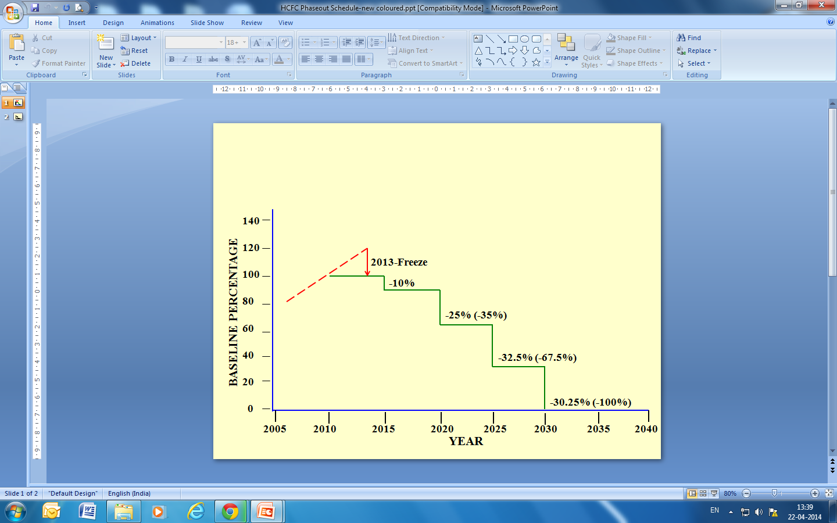
TIMELINE
ACCELERATED PHASE-OUT OF
HCFCs – ARTICLE 5 PARTIES
Accelerated phase-out of HCFCs vide decision XIX/6 of 19th MOP held during September, 2007.
Baseline : average of 2009 and 2010 production and consumption
Freeze : 2013
10% reduction of baseline in 2015
35% reduction of baseline in 2020
67.5% reduction of baseline in 2025
100% phase-out in 2030
Allowing for servicing an annual average of 2.5% during the period 2030-2040

Slide 11
SALIENT FEATURES OF HCFC PHASEOUT (REGULATION AND CONTROL) RULES
- ODS Rules have been amended in 2014 to align with the accelerated phase-out of HCFCs and National Implementation Policies for phase-out of HCFCs
- Control of production and consumption of HCFCs from the date of publication of Amendment Rules 2014, to 1st January, 2040 as per the accelerated phase-out schedule of HCFCs;
- Licensing system for import and export of HCFCs;
Prohibition of:
- Introduction of quota system for the domestic producers for production and supply to the domestic market of HCFC-22 for non-feedstock application;
- Import of pre-blended polyols containing HCFCs from January 2013;
- Import of blends containing ODSs including HCFCs.

Slide 12
SALIENT FEATURES OF THE ODS (REGULATION AND CONTROL) AMENDMENT RULES, 2014 (Cont.)
Prohibition Of the Following:
- Import of HCFC based Air-conditioners from 1st July, 2015
- Creation of new capacities to manufacture products with HCFCs from the date of publication of Amendment Rules, 2014;
- Manufacturing of Foam products from 1st January, 2020.
- Manufacturing of Air-conditioners and other RAC products/equipment from 1st January, 2025.
Mandatory registration for all those handling ODSs including producers, manufacturers, importers, exporters, traders, recovery/ recycling/reclamation centers. Servicing technicians are exempted from registration;

Slide 13
IMPLEMENTATION OF HCFC PHASE-OUT MANAGEMENT PLAN (HPMP) STAGE-I
HPMP Stage-I was approved by the 66th Ex-Com held in April, 2012 to meet 2013 and 2015 phase-out targets of HCFCs as per the accelerated phase-out Schedule of the Montreal Protocol;
The Stage-I is aimed to phase-out 310.53 ODP tonnes (2823 MT) of HCFC-141b in foam manufacturing sector and 31.24 ODP tonnes (568 MT) of HCFC-22 in RAC Servicing sector;
The HPMP Stage-I provided assistance to the Systems Houses for developing formulations with low-GWP non-HCFC and non-HFC blowing agents;
HPMP Stage-I has been successfully implemented and achieved requisite targets.

Slide 14
HPMP STAGE-II
HPMP Stage-II Objectives:
Phase-out of HCFCs for achieving compliance with the 2020 and beyond (2023) Phase-out targets of the Montreal Protocol.
Phase-out in the following Sectors/Sub-Sectors:
Foam Manufacturing Sector: Complete Phase-out of HCFC-141b by 2020
Room Air-Conditioning Sector: Conversion of 10 lines by 2023;
Servicing Sector
14
Notes:
14

Slide 15
IMPLEMENTING AGENCIES
(INDIA HPMP STAGE-II)
UNDP
Lead Agency, Implementing Agency: Responsible for implantation of HPMP Stage-II- Polyurethane Foams Sector
UNEP
Enabling activities, Awareness, Communication and Policy/Enforcement Training
GIZ
Servicing Sector (shared with UNEP)

Slide 16
SECTOR LEVEL PHASE OUT TARGETS
HPMP STAGE-II
Sector | Metric Tonne | ODP Tonne
Foam Manufacturing | 5800 | 638.00
Airconditioning Manufacturing | 1140 | 62.73
RAC Servicing | 1250 | 68.76
Total | 8190 | 769.49

Slide 17
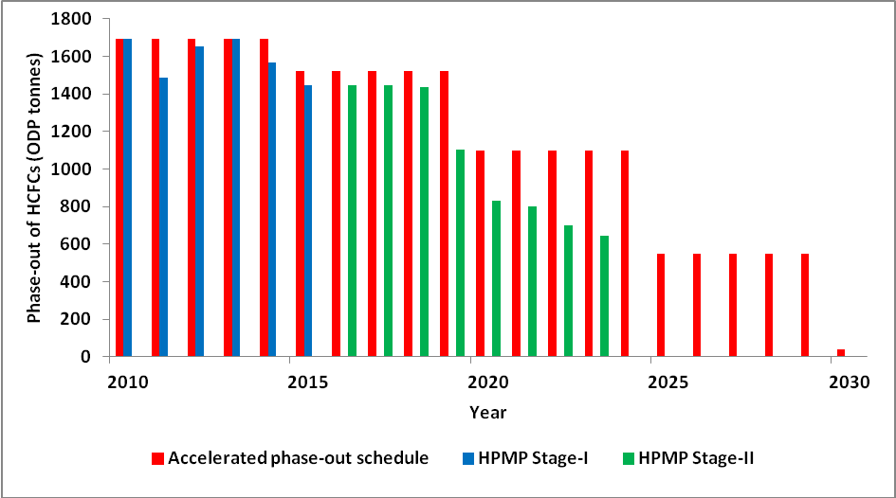
IMPACT OF HPMP STAGE-I & HPMP STAGE-II
Phase-out of HCFC consumption by 60% of the baseline in 2023;
Complete phase-out of consumption of HCFC-141b by 2020;
Conversion of 10 RAC manufacturing lines from HCFC-22 to HFC-32
Training of more than 17,000 RAC technicians on Good Servicing Practices;
Creating awareness and Training of Enforcement Officers.

Slide 18
Who are eligible for MLF Funding in Changeover from HCFC to non- HCFC Technologies?
Manufacturing facility established on OR before 21st September, 2007.
Manufacturing foam product (s) using HCFC on OR before 21st September, 2007

Slide 19
Documents required for participation in HPMP Stage-II
Proof of enterprise in operation :
In case of companies – Registration certificate.
In case of partnership firm – Partnership deed.
In case of proprietary concerns – Registration with concerned authority (District Industries Centre, Sales Tax/GST registration).
Proof of use of HCFC-141b and OR pre-blended polyols containing HCFC141b for manufacturing of foam product(s) on OR prior to 21st September, 2007;
Polyol bill (containing HCFC-141b) prior to 21st Sept, 2007
Bill of foam dispensing machine on or before 21st September, 2007
In case bill is not available fixed asset schedule forming part of balance sheet along with ledger copy.
Documentary evidence in case of change of manufacturing facility after 21st September, 2007 :
Letter from the concerned local authority
Sales tax registration for the manufacturing facility.

Slide 20
Other Documents required for participation in HPMP Stage-II
Registration certificate under Ozone Depleting Substances (Regulation and Control) Rules, 2000 and its amendments;
For capital investment of less than 1 crore – MSME
For capital investment of more than 1 crore – Ozone Cell
Consumption data for preceding three years for quantification of consumption of HCFCs (along with polyol bills containing HCFC-141b).
Certificate from all suppliers of pre-blended polyol indicating percentage of HCFC-141b in pre-blended polyol.

Slide 21

THANK YOU
21
Notes:
21

