Slide 1


24th May, 2017 - Agra
Overview of Challenges in the Network for Introduction of ODS alternative Technologies in Foam Sector
Presentation by:
Samir Arora
INDIAN POLYURETHANE ASSOCIATION ( IPUA )

Slide 2

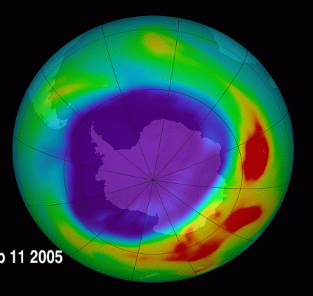
Polyols
Isocyanates
Isocyanates
Polyurethane
Polyol
Mixed
Fire retardant (Optional)
Surface active agent
Polyols
Accelerating agent
Water
Blowing agent

Slide 3

India - HCFC Phase Out
Commercial Refrigeration
Thermoware
Discontinues
Panels
PHASE - II
Cyclopentane Methyl Formate HFCs HFOs Methylal
Ecomate
General Insulation
Integral Skin
Continuous Panel & Sheets
Water Heater

Slide 4

Transitioning from HCFC 141b
Domestic Refrigeration
Article V Countries
245fa and Blends (water, pentane, 365mfc, others
Cyclopentane
HCFC 141 B
HCFC 141 b
Methyl Formate/ Ecomate
HFOs & Blends

Slide 5
Transitioning from HCFC 141b
Current: Transition to:
Assessment Future Impact
Performance Cost-effective Environment
Safety
Long term solution already
Available. For energy may need improvement which can lead to use of blends of CP and HFOs
Cyclopentane
Domestic Refrigeration
HCFC 141 B
Performance Cost-effective Environment
Safety
Methyl Formate/ Ecomate
Environment friendly blowing
agent, can easily replace
HCFC 141 b. dynamically priced which can be adopted easily by SMEs.
Article V Countries
Innovating to Enable Industry growth

Slide 6
Transitioning from HCFC 141b
Current: Transition to:
Assessment Future Impact
Performance Cost-effective Environment
Safety
245fa and Blends (water, pentane, 365mfc, others
Medium term solution, can
meet energy standards, may
need transition to 4th
generation BA future to meet
GWP standards
Domestic Refrigeration
HCFC 141 B
PHASE - I
Article V Countries
Performance Cost-effective Environment
Safety
Energy efficient blowing
agent with very low GWP.
In the best position
for future
HFOs & Blends
Innovating to Enable Industry growth

Slide 7
Cyclopentane – a proven solution
Universally accepted for rigid foams productions for Medium and Large Industries
In use for many years in refrigerating appliances
Good availability as it is a by product of refineries
lower molecular weight thus less required
No toxicity related issues
Though highly flammable can be handled safely with properly designed equipment
Polyol and C5 blend does not posses high fire risk
Initial capital cost is high but running cost is low , as it is the lowest cost BA
Domestic Refrigeration
PHASE - I
Innovating to Enable Industry growth

Slide 8
Challenges
Various blowing agents are in offering as alternative- making selection confusing
New technologies are not fully adoptable because of high capital cost
Phase-II stakeholders will be competing against large units using Cyclopentane technology
Not easy for them to adopt Cyclopentane technology due to lack of fund or infrastructure, Whereas cyclopentane is Fire Hazardous.
Due to high capital cost and Fire hazardous properties it is challenging for micro & small enterprises to adopt to cyclopentane technology.
Domestic Refrigeration
PHASE - I
Innovating to Enable Industry growth

Slide 9
– a proven solution
In the world market for more than a decade. Proven in wide range of applications since 2002, including refrigeration, marine, automotive, construction , sandwich panels, spray foam and many more
A very good thermal efficient Blowing agent
Can replace HCFCs, HFCs, HCs & HFOs Environmentally Benign and Economically advantageous
Regulator compliant - US EPA, SNAP, MONTREAL AND KYOTO Protocol
Properties similar to 141-b with half the molecular weight, hence less quantities for same density. Hence cost effective
Ease of change over with minimal capital expenses. Means very ideal for change over for SMEs. Can be processed through standard and/existing equipments
ECOMATE is stored and shipped in metal containers.
Excellent miscibility with all major Polyols and compatible with most PU raw materials
No need to emulsify blowing agent
Blended POLYOL does not possess any fire risk
Available worldwide

Slide 10
- Challenges
Apprehensions
Corrosive? NO. It is stored and transported in MS Drums. It is just an apprehension.
Shrinkage: Expert guidance & Proper formulation is required to eliminate any such possibility
Seal Compatability: Change of SEAL is a MUST. EPDM is acceptable. For Polyol /Resin PU systems with ~5% ecomate®, PTFE, Kalrez, EPDM, Butyl, Viton, Neoprene and silicone have proven acceptable.
Pure form is flammable: Yes, but in blended form it is 100% safe and transported normally.

Slide 11
HFOs
Domestic Refrigeration
This is another alternate tried and tested but have two main challenges
Foam Sector is not aware of the price
Availability of HFOs still not known
PHASE - I
Innovating to Enable Industry growth

Slide 12
Water
Domestic Refrigeration
This is another alternate tried and tested but have two main challenges
It does not work in low density foam manufacturing
Does not have good insulation properties thus has limitation in many sectors
PHASE - I
Innovating to Enable Industry growth

Slide 13
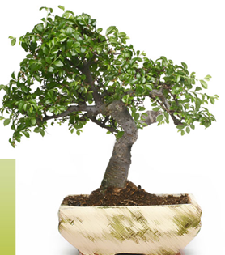
Overall Challenges – Medium Sector
To adopt the new Technology
The larger the selection of Blowing Agents – more the confusion
Unfortunately newer Technologies are not being adopted because of awarness
Medium sectors have challenges vis-a-vis Enterprises who have already adopted the Pentane technology
Pentane technology is not easily adoptable due to lack of Funds and infrastructure coupled with huge capital cost, fire safety issues etc. The Pentane technology operating cost are reportedly low.
Even HFOs will be out of reach of many Enterprises due to cost and availability.
This segment should be prioritized first.
There is no one alternate that fits all segments

Slide 14
Overall Challenges -Small Scale Sector
Majority of them are not aware that there is a BA which needs replacement
This is because they buy pre-blended Polyol and suppliers do not disclose
Low consumption of BA limits -adapting to Pentanes/HFOs
High prices of HFO results in high cost of the final product.
Pre-blended pentane is safe & successful –however miscibility with polyol is an issue
Suppliers of Systems have to guide small scale sector correctly

Slide 15
Conclusion - Large Sector
Large Sector : This sector will have a fairly smoother transition to go to HCFC free alternate as the technology is well adapted now.
Although safety still remains challenge even for this sector.

Slide 16
Conclusion - SME Sector
This sector will face challenges as to which technology they will need to adopt. To overcome these challenges , they will need to be supported with :-
Regular awareness program.
System Houses from whom they buy System will need to support them in HCFC free technology.
SMEs from each sector need to visit other manufacturing units where HCFC free Technology is being used.
Demonstration of using new HCFC Free technology is a must
Suppliers of HCFC free alternates need to provide free consultation.

Slide 17



THANK YOU FOR YOUR ATTENTION

