Slide 1

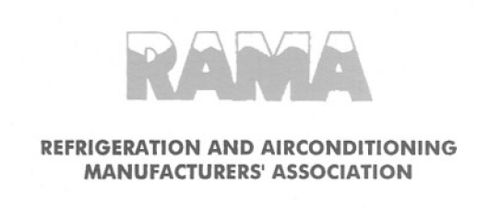
Challenges & Opportunities to Improve the Energy Efficiency in Air conditioning Sector
Jitendra Bhambure
Executive Vice President
Blue Star

Slide 2
Growth factors post liberalization
Indian government took steps to liberalize economy in 1992
The growth in IT sector fuelled by Y2K and in the first decade of twenty first century by the economic growth, created a demand for comfort Air-conditioning in commercial followed by residential segments

Slide 3
India Electricity Status
The Consumption per capita is half of the world average
As a country we are the sixth largest energy consumer
The growth is around 10% per annum and is one of the highest in the world
70 % of the buildings are yet to be built in next 35 years and will require Air conditioning
Penetration of Air conditioning is around 4 %

Slide 4
India energy efficiency needs
The immediate needs of the country are to optimum utilization of resources to generate Energy ,improve productivity, meet aspirations of citizens, create jobs , reduce food wastage, develop cold chain and create infrastructure for exports
Air conditioning and Refrigeration will play a key role
as Air-conditioners utilize > 60 % of energy in any building. Energy Efficiency has become a focus

Slide 5
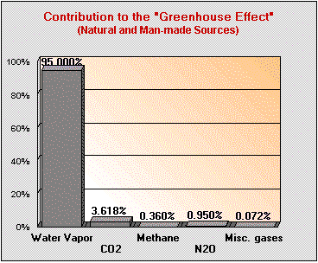
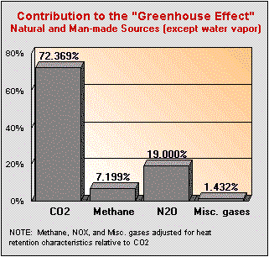
GWP contributors
Refrigerants
Fossil fuel based Energy Generation
The Important Greenhouse Gases (except water vapour)
U.S. Department of Energy, (October, 2000)

Slide 6
Integrated approach
Safety
Toxicity
Flammability
Environment
Ozone
GWP & LCCP
Performance
Physical Properties
Energy (Annual/ Peak Capacity)
Economics
Technology Changes
Total Cost
Integrated Evaluation is needed for conserving energy along with selection of Refrigerant
6
Source: Emerson Climate Technologies, Inc.

Slide 7
Life Cycle Climate Performance (LCCP) - To Measure Environment Impact
LCCP
Direct Global Warming
Indirect Global Warming
Holistic Approach:
Safety
Performance
Environment
Economics
Energy Consumption
Refrigerant Leakage
1. Leak Rate
2. Charge Amount
3. Refrigerant GWP
Energy Consumed
Energy Consumption has 95 to 98 % impact on Environment
7
Source: Emerson Climate Technologies, Inc.

Slide 8
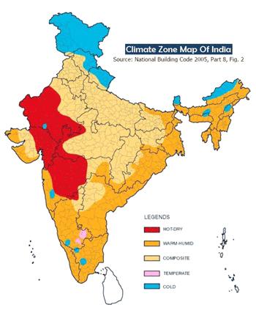
India Temperature Map
Cold
Hot & Dry
Composite
Temperate
Warm & Humid

Slide 9
Indian Market
Indian Industry is addressing energy efficiency requirements and path is laid down for the next 5 years
The efficiency requirements are made specific for the Indian climatic conditions
The fastest growing product segments are with Inverter technology
Industry believes that efficiency is critical wrt to Global warming as it contributes 95 to 97 %
Room AC efficiencies are up by 30 % from 2010 and will further go up by 20 to 40 % in 3 to 5 years. The efficiencies of Chillers are at par with global players .
Product like VRF which have high efficiency, is the fastest growing segment.

Slide 10
Technologies introduced in India in the last 10 yrs to improve energy efficiency
With sustained growth in India, and demand from customers for energy efficient products latest technologies were adopted:
  Inverter in VRF, Room AC and Chillers
  Heat Exchangers in Water cooled Chillers: Falling film and Flooded
  Heat Exchangers Air cooled : Micro channel
  Controllers : Micro-channel
  Oil free Chillers
Indian manufacturers adopted the technologies and we are at par with the developed world
We will have to think out of Box to conserve energy

Slide 11
Top 4 contributors to energy in India
Segment | Approx Energy consumption Mega Units/ Yr | Five Yr CAGR Growth | Five year projection
Room AC | 6600 | 10 ~ 12 | Changeover to Inverter approx 40~50%
Ducted | 1200 | ~ 5 | Started changing over to Inverter
VRF | 550 | 12 ~ 15 | Will continue to grow
Chillers | 2200 | Flat ~ 5 | High efficiency technologies will be 40 to 50%

Slide 12
Energy consumption
Efficient products
Efficient usage
Energy saving
Engineering
Behavior
Installation
Maintenance

Slide 13
Product Energy efficiency : We have made good progress, has reached saturation
Room AC
Labelling +30%
CSPF +20~40 %
Chillers
Flooded +25%
Inverter +30%
VRF
+ 25%
All Inv + 25%
Ducted
No Change
Inv + 10 to 15 %
No break thru technology like LED
Present
2018 to 2020

Slide 14
Energy efficiency should be seen in tandem with Refrigerants
No feasible option based on Evaluation criteria
HFC32 :Is it a true LOW GWP or transient
HC290
High Flammability, handling, Storage, Commissioning , Service is a concern. Transportation of refrigerants for service. Challenges in using in SPLIT units which form approx 80 % of Room Ac market. Charge limitation for larger systems
HFC 446A / 447
Commercially not available
Are these also true LOW GWP refrigerants or transient
HFO
Commercially not available. Few manufacturers have decided not to adopt in MAC due to safety.
Long term impact on environment not known
Cost and Application Patents

Slide 15
Energy efficiency perspective new Refrigerants
Alternative to R22 Systems
  N20 B with GWP 988 is A1 non toxic and non flammable
  R290 GWP 3 A3 highly flammable
  DR 3 , ARMA 20-B and R444B are A2L mildly flammable with GWP between 148 to 295
Test results show that all refrigerants had a reduced capacity by (-) 3 to (-)14 % and efficiency (-) 11 to (-)16 % other than R290 which had increased by 7 % and similar trends are observed at 52 and 55 Deg C
Though R290 has higher efficiency, has limitations due to charge limits and Safety

Slide 16
Challenges in adopting new Refrigerants
Addressing design platforms
  Non clarity of long term perspective on acceptable Refrigerant. 20 years history has shown that new refrigerants have lower efficiencies
  Patents and cost of technology
  Meeting Efficiency requirements under high ambient conditions
Skill development
  Constantly migration from HVAC technicians to other reliable income source hinders the knowledge absorption
  The growth is in tier two and three towns
To best of our knowledge no country has initiated using HC as handling of flammable refrigerants is not possible in field installed units

Slide 17
Factors affecting high energy consumption
Refrigerants : In high ambient conditions the de-rating of capacity of HFC is higher resulting in higher energy consumption
The Modern Architecture and material has increased the heat load
With high density of high-rise buildings the Urban heat index is between 3 to 6 Deg C
Improper installation and inadequate maintenance

Slide 18
Challenges in reducing energy consumption
Maintenance of the Heat exchangers
Corrosion in the Indian context
Competency of Service technicians
Installation practices
Poor quality of Power specially voltage fluctuations

Slide 19

Beyond Energy efficient products
Our ancestors had knowledge of reducing heat load
Architects will have to play a lead role
Our behaviour has to be changed
M East has regulated lowest set temperature
Research needs to be enhanced in this field

Slide 20
Integrated approach
Energy Saving
Behaviour
Energy Efficient
Products
Service
Regulatory
Control &
Monitoring
Architecture

Slide 21
Few avenues to save energy
Stratification of Air conditioned space
Temperature settings
Planning and control of unintended use & Monitoring
Installation practices , Competency of technicians
Maintenance of Heat exchangers
Stabilized Voltage
Corrosion of Heat Exchangers

Slide 22
Policies short term
In place
  Room AC programme finalized up-to 31st Dec 2019. This is one of the most stringent programme in the world.
  ECBC ( Energy Conservation Building Code ) is being finalized and will be made mandatory in 2017.
What next
  Address the existing population of ACs and have interventions to migrate to Efficient products

Slide 23
Policies long term
Have solutions to suit Indian conditions
1
2
3
4

Slide 24
Long term opportunities
Comfort has to be suitable for Indian climatic conditions and hence the equipment and solutions have to be India specific
Only relying on Air-conditioning will not be a good approach
Research is needed in Air Coolers, Chemical based dehumidifiers
Building Architecture will play a major role, India is has embraced Green building movement

Slide 25
cont
Need to study corrosion and its impact on heat exchangers. Corrosion can impact efficiency as high as 20 %
Urban heat index and steps to reduce
To bring Policy makers, Regulators, Academia, Architect, HVAC consultants, Manufacturers and Customers on one platform

Slide 26
Thank you

