Slide 1

India’s Cold-chain capacity status and development
Ministry of Agriculture initiative
HFC phase out Cold-chain Perspective
23 - May - 2017
Pawanexh Kohli
Chief Advisor & CEO

Slide 2
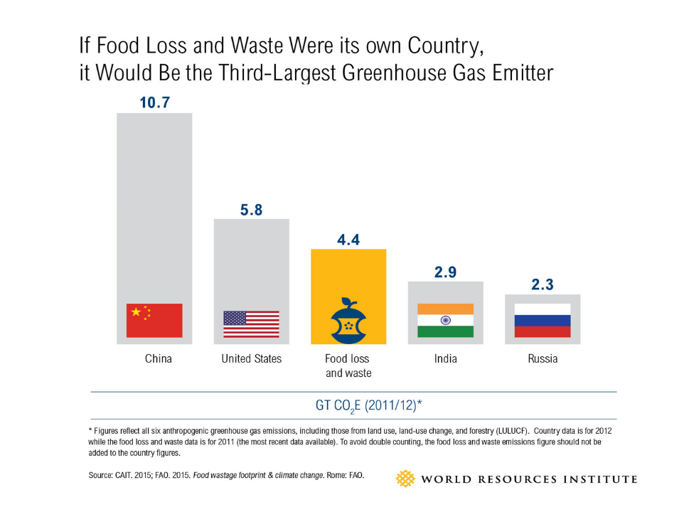
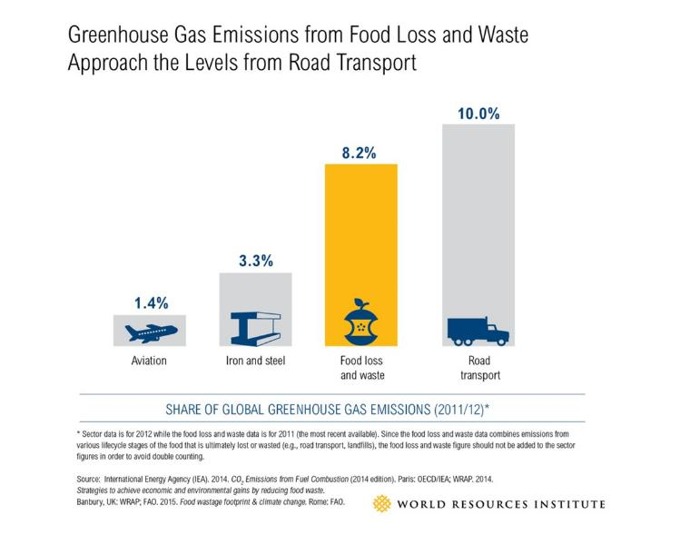
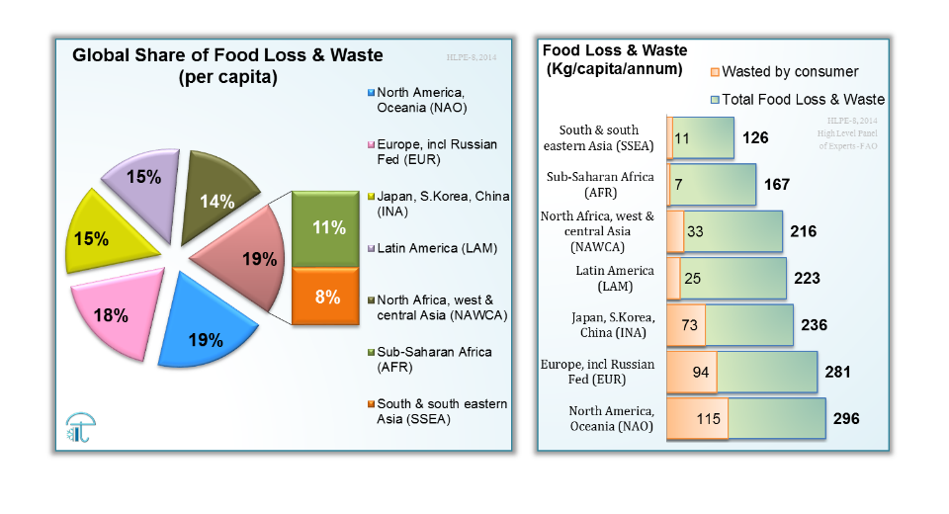
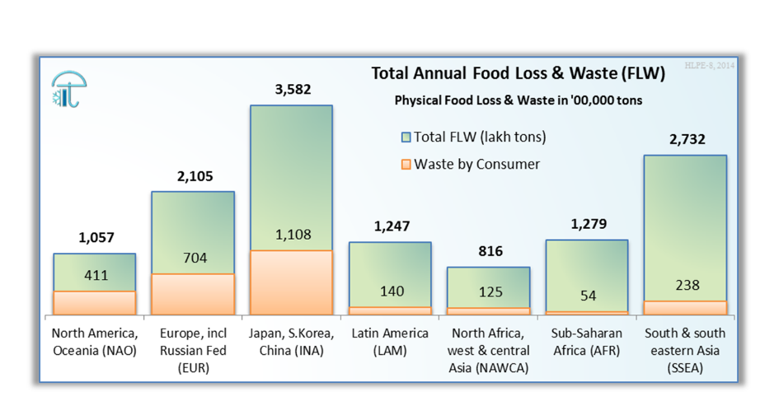
Food Loss is NOT Sustainable
Notes:
Methane density 0.67 kg/m3

Slide 3

Food Loss - wasted effort
When harvested produce escapes its end use !
How does our food escape ?
By perishing before it can reach gainful use !
Because markets are too inaccessible !
Why are markets inaccessible ?
Because food is perishable and needs post-harvest care !
Because Post-harvest care is not market linked !
Because such Care requires working tools !
Because such Tools require skills to use !
Because some stakeholders do not care !
Food Loss occurs when food escapes its intended use: to be eaten!
Cold-chain mitigates loss of perishable food by taking it to more consumers …
by reaching food to shelves … securely, safely and in quality!
“Food Loss”
Post-Harvest

Slide 4



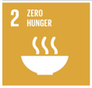





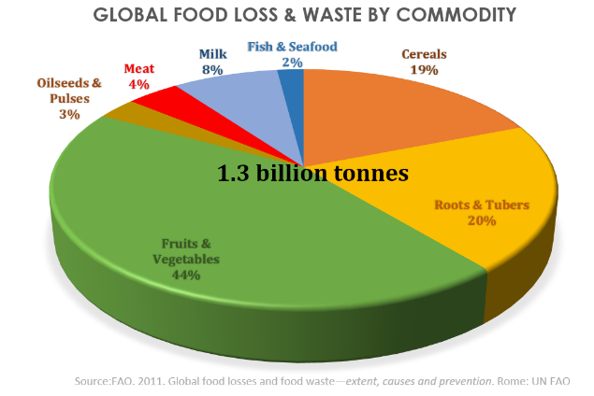






Inefficiencies
Disruptive thinking
It is not that we lose only 30% of our food production …
we lose 100% of what we are incapable of handling.
… need to be result oriented when building capacity in thinking & infrastructure …
Notes:
Capacity in technology, infrastructure, understanding

Slide 5


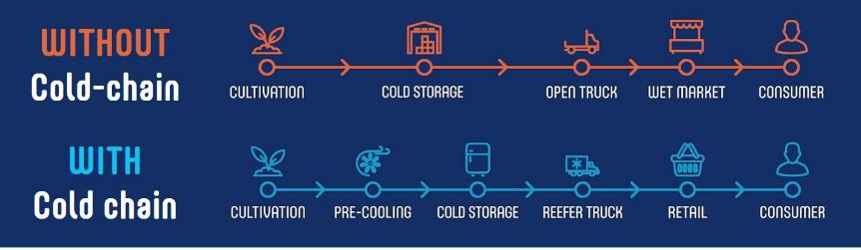
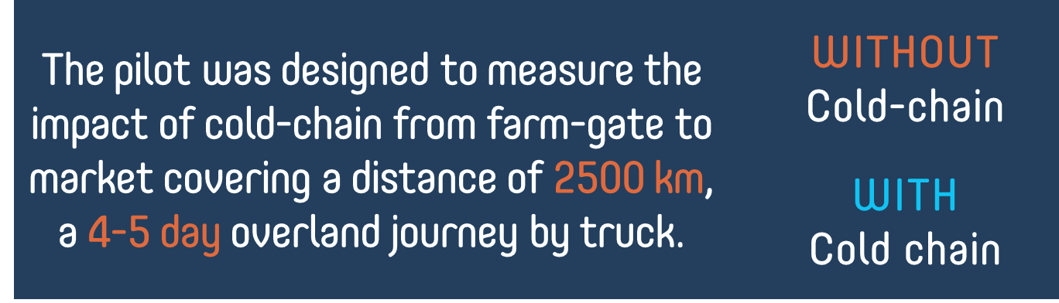
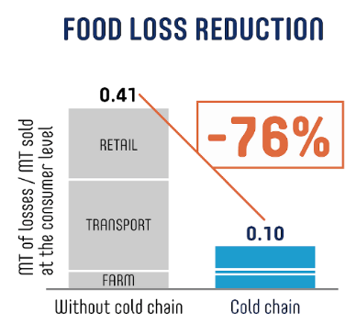
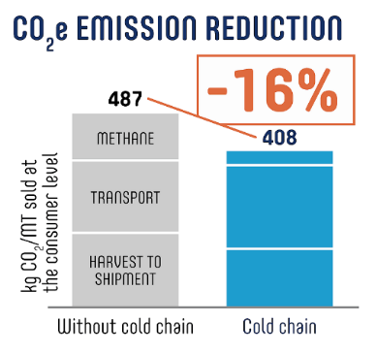
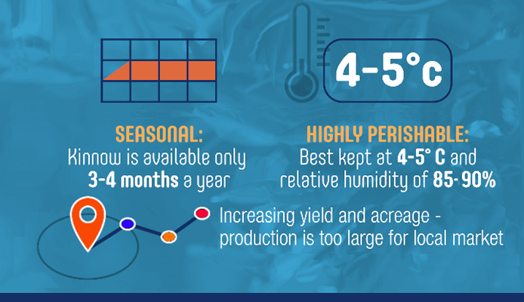

Understanding the Cold-chain
In the region, 9 pack-houses and pre-coolers have been set-up in recent months.
About 250 reefer vehicles deployed and more markets brought under reach, with access opened to more consumers.
Abohar area farmers have since connected with London, Dubai, and Bangladesh.
Aggregators report sales up 4 fold with earnings multiplied.

Slide 6
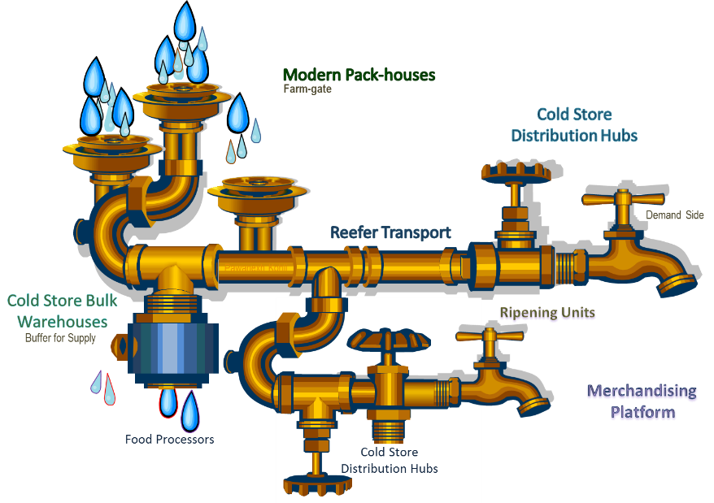
Infrastructure Capacities required
Nationwide Requirement (2015)
70,080 units(HFC)
9,36,251 MT
61,826 units(HFC)
9,131 chambers(HFC)
420,35,196 MT
~1,90,000 MT(HFC)

Slide 7
Overall Investment
Component | Requirement All India | Unit Cost Rs Lakhs | Investment Rs Crores | Remarks
Integrated Pack-houses (units) | 70,000 | 95 | 66,339 | For preconditioning 16 tons a day for cold-chain transit. Includes a pre-cooler and staging cold room with dispatch area for trucks. Facility will handle larger volume of incoming goods to segregate for local market also.
Reefer Transport (units) | 62,000 | 30 | 15,848 | Cost considered for 30 foot vehicles. Vehicle is insulated and refrigerated, capable of full range of temperature (-25 to +15 °C). Each vehicle to have a GPS and temperature/humidity data logging. Smaller vehicles will have lower costs.
Cold Store (Bulk) (units) | 650 | 400 | 2,600 | Cold store (Bulk) with large chambers for long term storing of certain produce, for periodic sale to markets over months. Average size of 5000 tons is considered.
Cold Store (Hub) (units) | 360 | 350 | 1,260 | Cold store (Hub) with chambers of less than 250 tons each with multiple docks and doors, racking and fork lift systems. Average size of 2500 tons is considered.
Ripening Chambers (units) | 8,000 | 40 | 3,328 | Ripening units with daily handling of 10 tons after a 4 day ripening cycle.
Total Investment |  |  | 89,375 | Rs Crores
Additionally for modernising retail end in cold-chain (for fruits, vegetables, processed foods), an investment of Rs 10-15,000 crores can be estimated at last mile.

Slide 8
Infrastructure Status
Country | Refrigerated Capacity, mill-m3 | Remarks
Afghanistan | 0.024 (2o14) | Each Country will require to build associated integration in their cold-chain capacity – necessary care to promote compliance with Montreal Protocol and Kigali Agreement is recommended.
Bangladesh | 0.129 (2o14)
India | 135.00 (2o16)
Indonesia | 12.320 (2o14)
Nepal | 0.259 (2o14)
Notes:
4.04 million tons added in 12th plan till Dec 2014
Per annum domestic movement of 50,000 tons of frozen potatoes (french fries), 3.4 million tons of meat, 110000 tons of frozen vegetables, 300000 tons of fresh produce (mostly 100000 tons of apple), this excludes imports of 135000 tons and exports of 47000MT

Slide 9


Technology used in each component
Infrastructure Item | Total Requirement | All India Gap | Refrigerant | Alternative
Modern Pack-house | 70080 units | 69831 units | HFC (R134a, 404) | Eutectics, Geo-thermal, VAR
Cold Storage (Bulk) | 34164411 MT | 3276962 MT | NH3 | NH3, Solar thermal, Geo-thermal
Cold Storage (Hub) | 936251 MT
Reefer Transport | 61826 units | 52826 units | HFC | CO2, Liquid Air, Eutectics
Ripening Chamber | 9131 units | 8319 units | HFC | Eutectics, VAR
Assistance by Govt. or by Multilateral agencies to achieve the shortfall of infrastructure must be in compliance with Montreal Protocol.
All future investments must promote technologies that bring greater energy efficiency. Applied research must be done to test hybrid technologies to minimize the dependence on refrigerant based cooling.
Government already supports modernization of infrastructure in the cold-chain, combined efforts and resources may be put to best use to fill the infrastructure gap while ensuring climate security.

Slide 10
Strategy for Phase out and Planning to Induct alternatives in upcoming Infrastructure
Capacity building on assessed need
Program awareness
Prioritize assistance
Application based research
Expansion and scale up of existing
Feedback on activities
Develop implementing agencies
Implementing agencies to promote awareness, projectise needs to adopt alternatives
Priority to ones phasing out( modernisation) or for new projects with alternatives
Applied research for low cost, low energy options for last mile and near-farm infrastructure
Modernisation and upgradation, increased assistance from Multilateral fund and state budget
Impact evaluation of Capacity building Initiatives

Slide 11
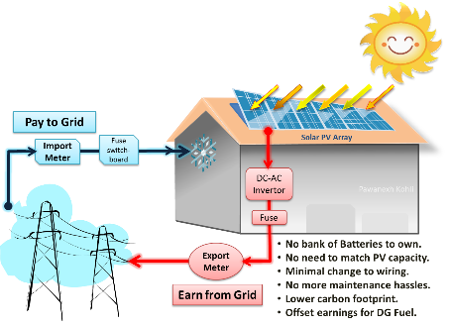
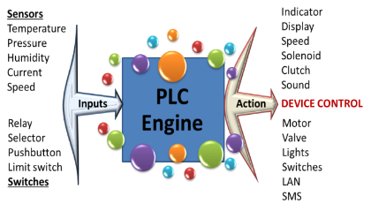
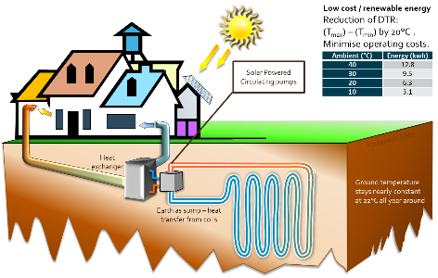
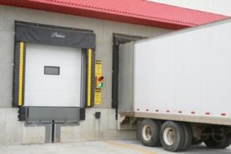
Add-On Components & Technology Induction

Slide 12
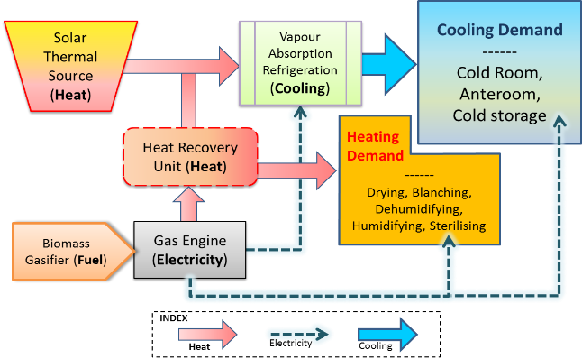
Hybrid solutions
Scope to buffer the flow of energy in thermal banks to be utilised as per need.

Slide 13
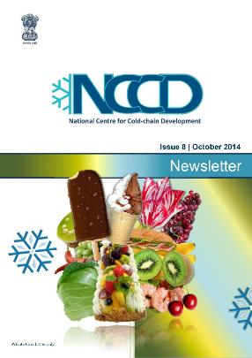
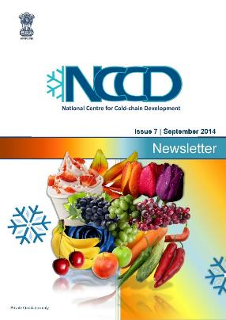
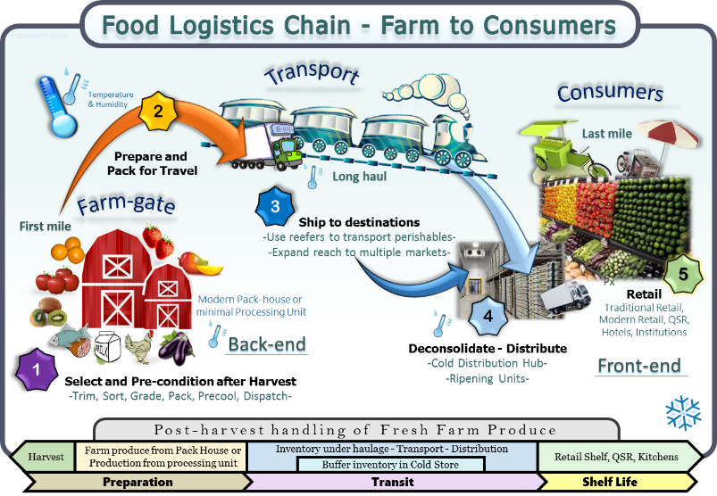
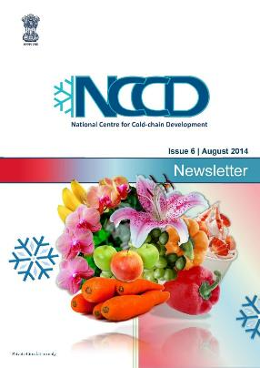
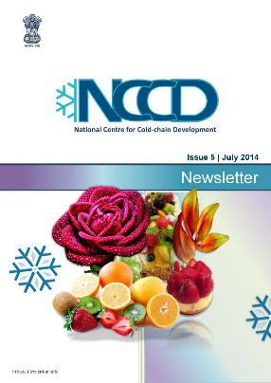
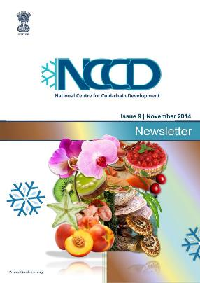
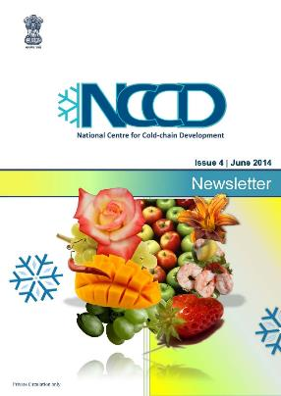
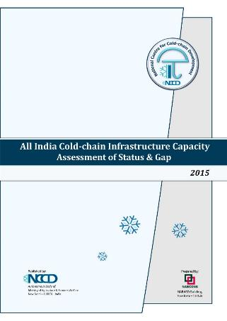
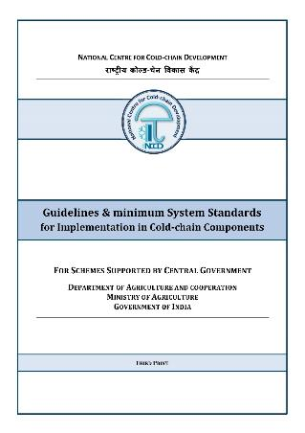
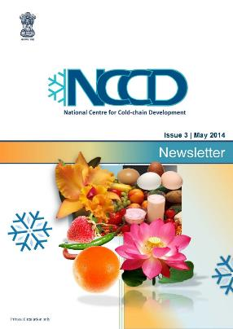
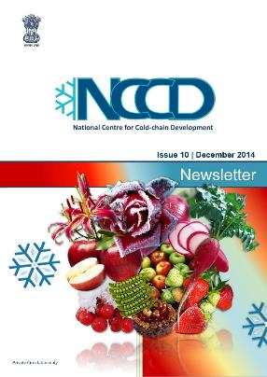

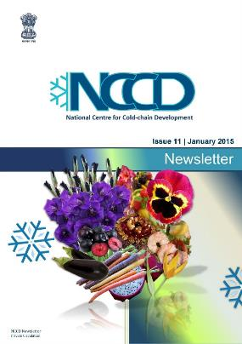
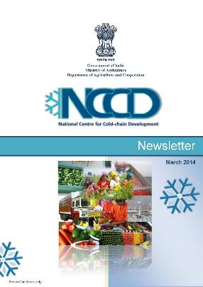
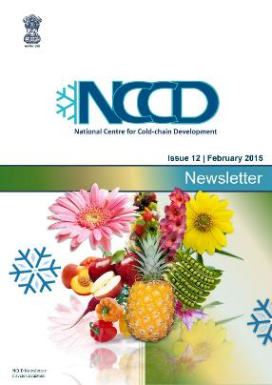
Knowledge Sharing

Slide 14


as nodal agency
Think tank to Govt on the subject of cold-chain and agribusiness. Engage with its members to translate industry needs into policy recommendation.
Manned by technocrats (industry leaders) and functions through member stakeholder consultation.
Provides an enabling environment and facilitates private investment in cold-chain sector.
Assist in developing and promoting future ready, energy efficient technologies and its adaption.
Capacity building and training activities to reduce the gap in skilled human resources.
Awareness programs on best practices for perishable product handling, indigenised for specific requirements and conditions.
Revise policies, approve new technologies, efficiencies when developed/understood.
Research and Monitor impact of policies and recommend any changes, if needed.
Stakeholder Members:
Groups (Self Help Associations)
Farmer Groups, Consumer Groups, Cooperatives, students
Resource (Academic Institutes)
Research, Academic &Training centres
Associates (Individuals)
Industry Chambers, PSU, Apex Bodies
Company (Commercial)
Food sector, equipment sector, Investors, Consultants, Logistics, etc.
Fellow (Individuals)
Senior Individuals as Fellows of NCCD
Individual associate members
Bodies (Industry or Government)
Design assistance patterns, Operators Trainings, Institutional Workshops and Conclaves, Field Studies, Appraisals, Redressals, Policy guidance.
Notes:
Cold-chain encompasses entire life cycle of majority of fresh produce and certain processed products. Processing is not cold-chain.

Slide 15
Thank You नमस्कार
II-Floor, B-Wing, Janpath Bhawan, New Delhi 110001
Email: Contact-NCCD@gov.in | Web: www.NCCD.gov.in
www.facebook.com/NCCD.India

Slide 16
NCCD involvement as per Decision XXVIII/2-Servicing Sector
As per guidance to the Executive Committee of the Multilateral Fund NCCD may be involved in the following in the service sector:-
Public awareness activities as is being done by NCCD already as part of MIDH.
Policy Development and Implementation-in the cold-chain sector, as is being done by NCCD for GOI and state Governments.
Certification programs and training of technicians- NCCD carries out similar activity with industry partners for Refrigeration Engineers and implementation agencies of states.
Training of Custom officers- may be carried out in association with Overseas partners such as Cemafroid.
Refrigerant testing equipment for refrigeration and air-conditioning sector- may be carried out in in house center of excellence or with a industry partner with in-house facility.

Slide 17
NCCD involvement as per Decision XXVIII/2
As per guidance to the Executive Committee of the Multilateral Fund NCCD may be involved in the following as part of enabling activities & institutional strengthening:-
Capacity building and training for the handling of HFC alternatives in the servicing, production, manufacturing sector.
Demonstration projects & applied R&D on alternatives with Industry partners.
Help in institutional strengthening in the cold-chain sector in the country.

