Slide 1

INTRODUCTION OF R-290 TECHNOLOGIES IN THE NETWORK COUNTRIES
HOT
SUMER
THIS YEAR

Slide 2
SIGNIFICANCE OF R290

Slide 3
Lowest GWP
(Global
Warming
Potential)
EPA SNAP
(Significant New
Alternatives
Policy)
Approved
Zero ODP
(Ozone
Depletion
Potential)
R 290
Applied in the
most efficient
appliances in Europe
in last few
years resulted
in a significant
Impact
Low charges
allowing smaller
heat exchangers
and piping
dimensions making it
more efficient
Excellent
thermodynamic
performance

Slide 4
OUR
JOURNEY
In collaboration with the German Federal Ministry, Godrej is the only brand that uses R290 refrigerant, thus making our ACs the most energy-efficient and the greenest.
GREEN benchmarks for
the industry including :

Slide 5
OUR
JOURNEY
Launch of the first green refrigerator in India (2001-02)
First 5 star range of DC refrigerators (2008)
In collaboration with the German Federal Ministry, Godrej is the only brand that uses R290 refrigerant, thus making our ACs the most energy-efficient and the greenest.
India’s first AC with 7-star performance (EER : 3.9)
India’s first Inverter AC with R290
(ISEER : 5.8)
First green AC in the world (2012)
GREEN benchmarks for
the industry including :

Slide 6
CUSTOMER BASE : 3.5 Lakh installations TECHNICIANS BASE : 4500 +

Slide 7
ADDRESSING THE SERVICING NEEDS OF R290 ACs
HOT
SUMER
THIS YEAR

Slide 8
FLAMABILITY
Refrigerants | ASHRAE safety designation
R 290 | A3
R22 | A1
R134a | A1
R410A | A1
R417A | A1
R407C | A1

Slide 9
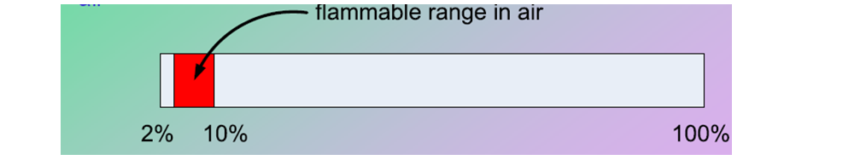
Refrigerant | Designation | Lower Flammability (LFL) |  | Auto Ignition Temperature (Degree Celsius)
 |  | By Volume (%) | By Mass (Kg/m3)
Propane | R 290 | 3.0 | 0.037 | 470
R 290 SAFETY CONSIDERATION
Flammability limits of Hydrocarbons are around 2%-10% when mixed in air

Slide 10
FLAMMABILITY
When HC’s burn they produce carbon and steam
When chemical refrigerants burn they ALL produce toxic fumes

Slide 11
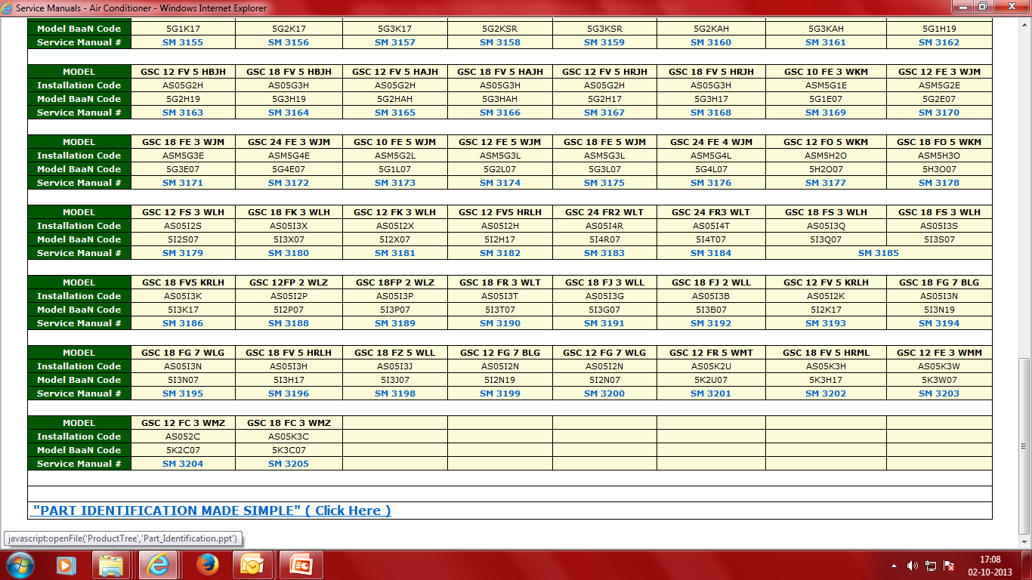
PRODUCT SERVICE MODULE
Service Manuals for R290 AC
are uploaded on Godrej Smart care website

Slide 12
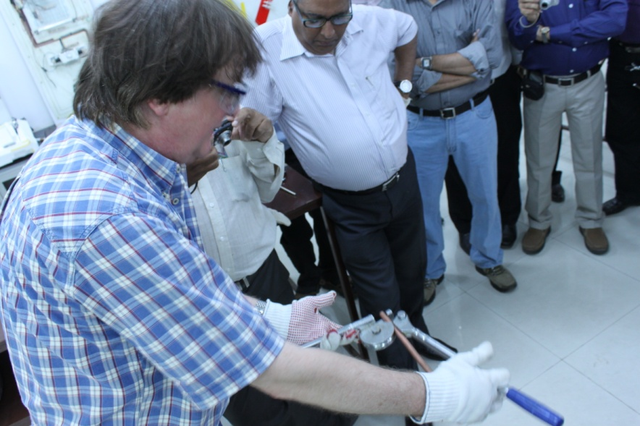
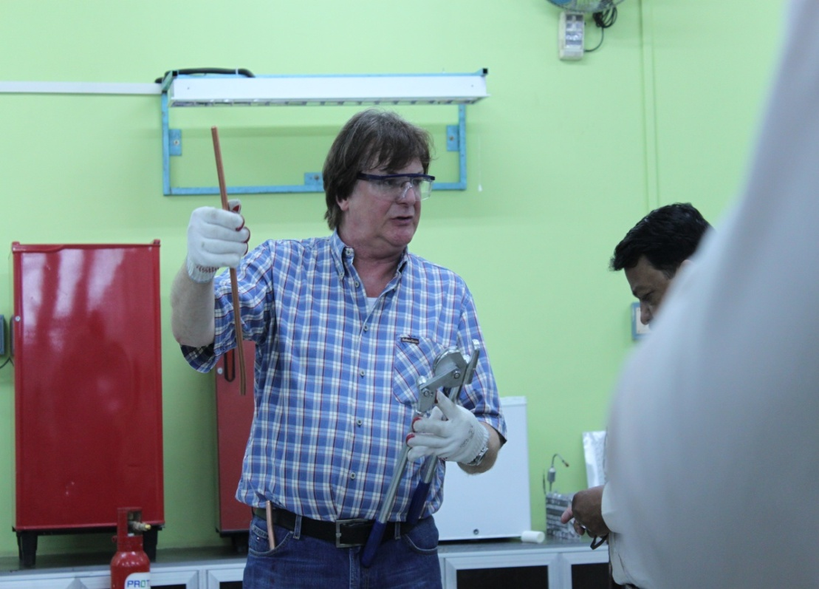
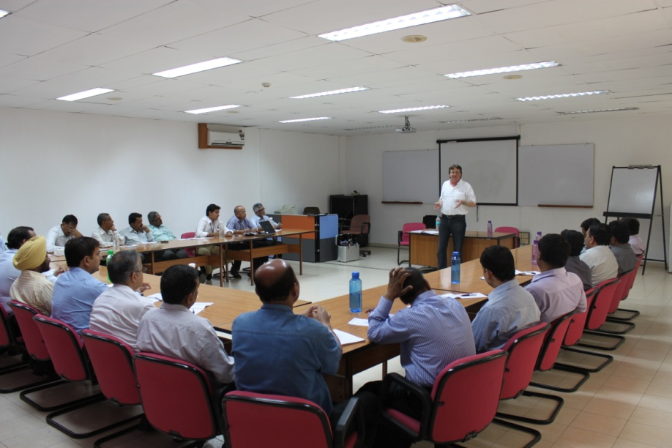
Competent Trainers to Train Technicians
Training Workshop organized by GIZ
for Godrej Trainers
TRAIN
THE
TRAINERS
(SUPPORTED
BY GIZ)
Fig: Theory and Practical training
being imparted to Godrej Trainers
by Mr. Rolf Huehren from GIZ

Slide 13
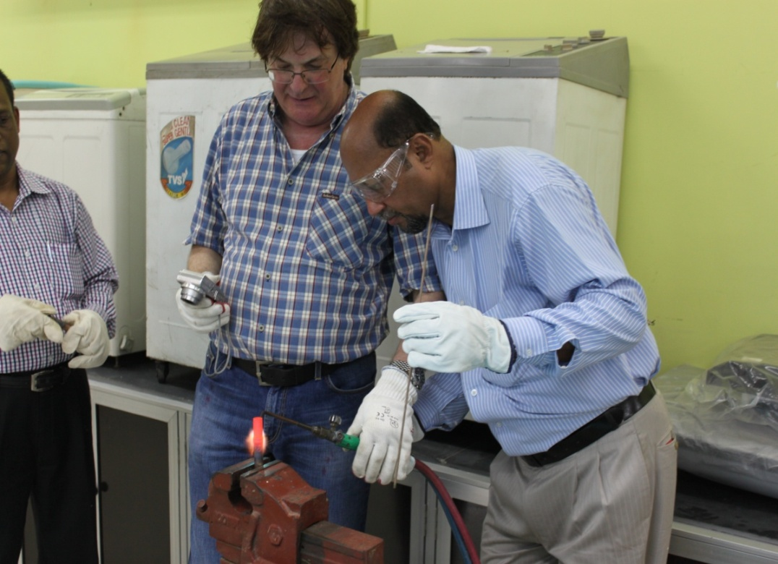
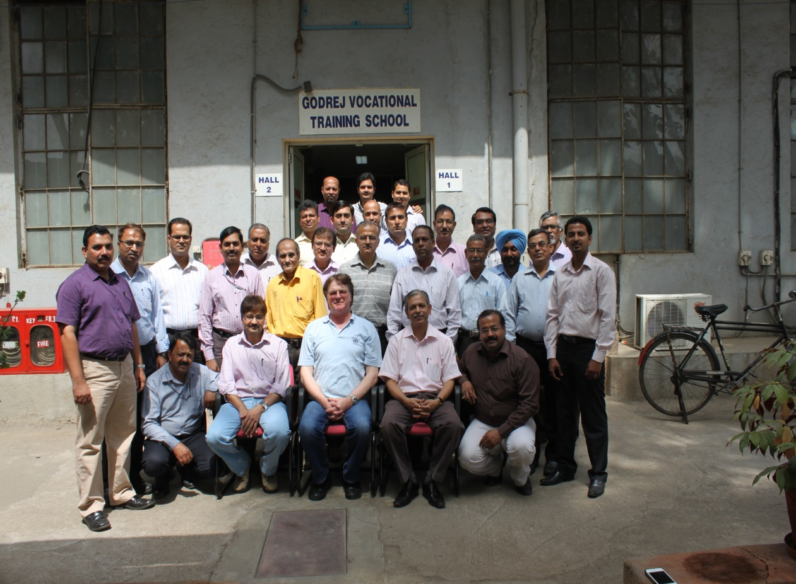
TRAIN
THE
TRAINERS -
COVERAGE
28 Trainers across the 5 Regions have been trained.
Currently there are more than 500 ASP’s pan India, with around 4500 Technicians
2300 technician have been trained in the service network across 28 branches in the entire country
Fig: Practical training been imparted
to Godrej Trainers by Mr. Rolf Huehren
from GIZ

Slide 14
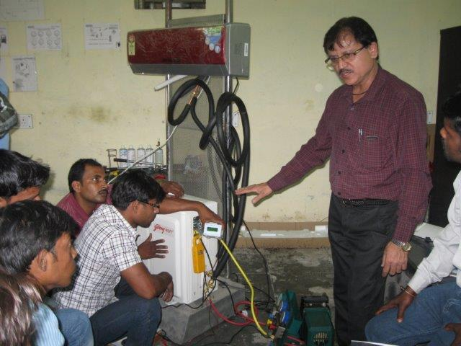
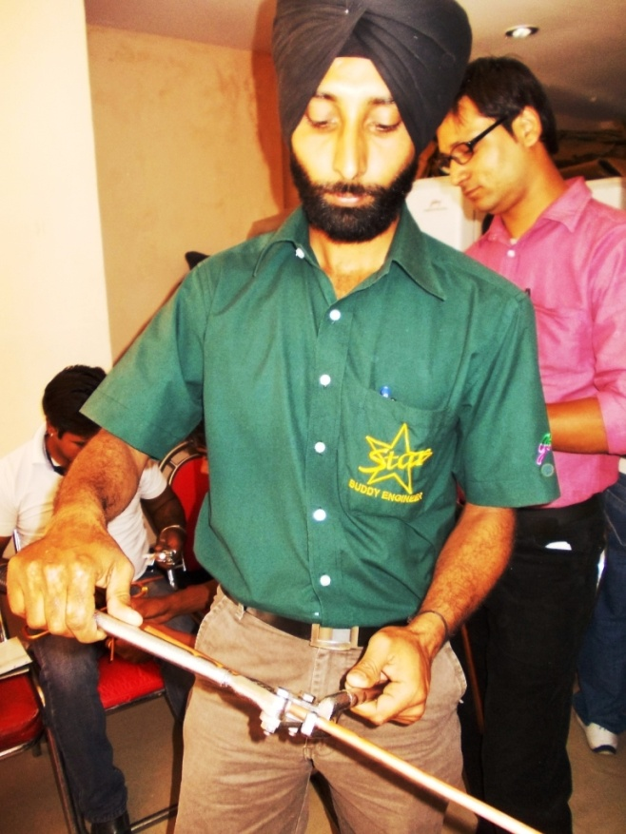
TRAIN
THE
TECHNICIANS
Fig: Practical training on installation been imparted to Godrej Technicians by Mr. K A Kazmii at Lucknow
Fig: Practical training on Tube bending to Godrej Technicians under the guidance of Mr. Tarun Karla at Faridabad

Slide 15
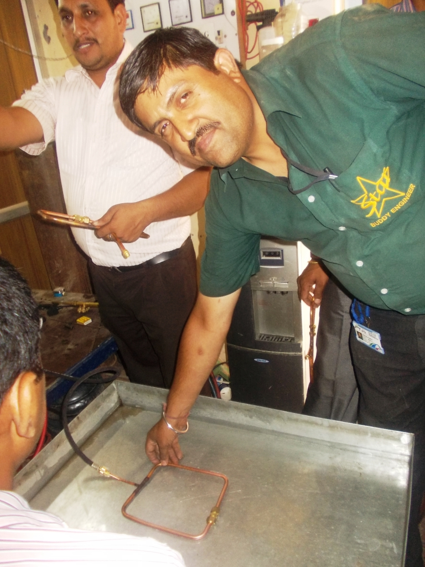
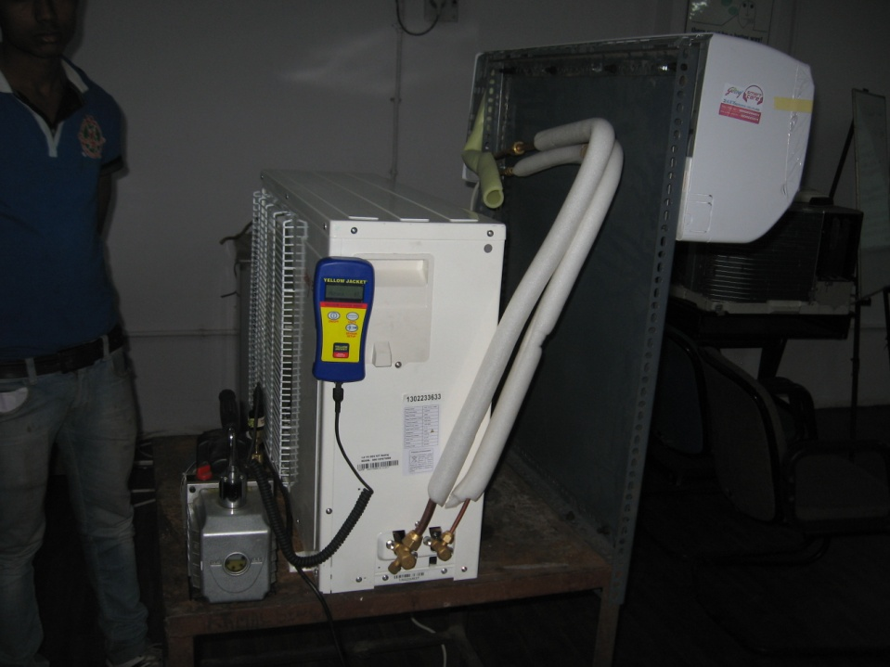
TRAIN THE TECHNICIAN
Fig: Practical training on Installation to Godrej Technicians at Delhi
Fig: Practical training on leak testing to Godrej Technicians at Faridabad

Slide 16
Only Trained and certified technicians attend to Green AC’s Installation and repairs
100%
SECURE
INSTALLATION
CYCLE
System allows call to be closed only through certified technicians
Free SAC Installation prominently marked on packaging
Call Centre directs call to Godrej ASPs having trained AC technicians
ASP allocates call only to trained techs

Slide 17
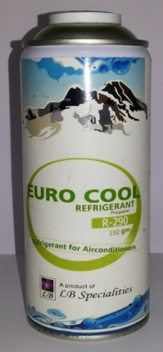
100%
SECURE
INSTALLATION
CYCLE
Handling Apprehension on HC gas
Safe handling and storage of refrigerant cans
Perform sealed system repairs to avoid refrigerant handling
Providing gas cans with150 grams charge which is as per the safety norms

Slide 18
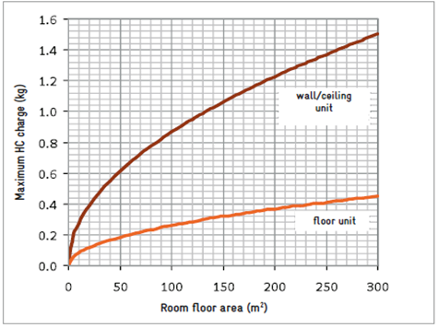
If volume of the room is lower than Specified,
Installation is not Carried out
and alternate non R 290 models are recommended in order to not exceed the safe limit of gas concentration
SAFETY
COMES
FIRST

Slide 19
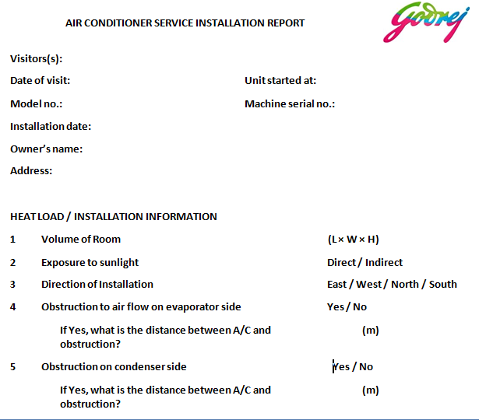
SAFETY
COMES
FIRST
Installation Checklist

Slide 20
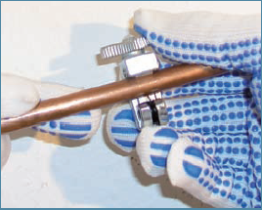
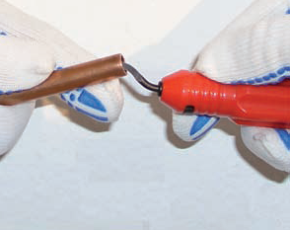
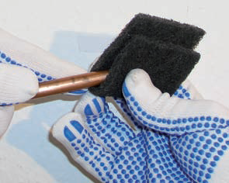
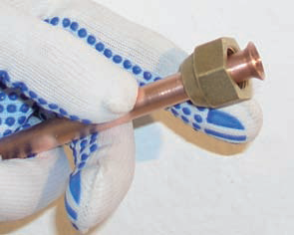
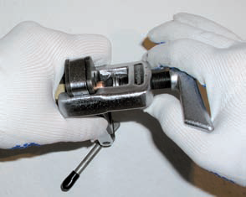
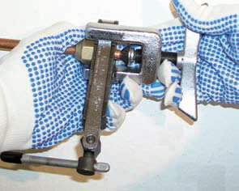
COUPLING
OF
JOINTS
Fig: Cutting of Copper Tubes with Tube cutter
Fig: Deburring using reamer
Fig: Surface cleaning
Fig : Good leak free Flare
Fig: Flaring
Fig: Locking of Flare Tool

Slide 21
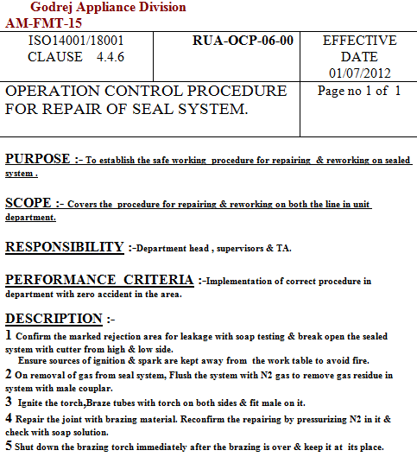
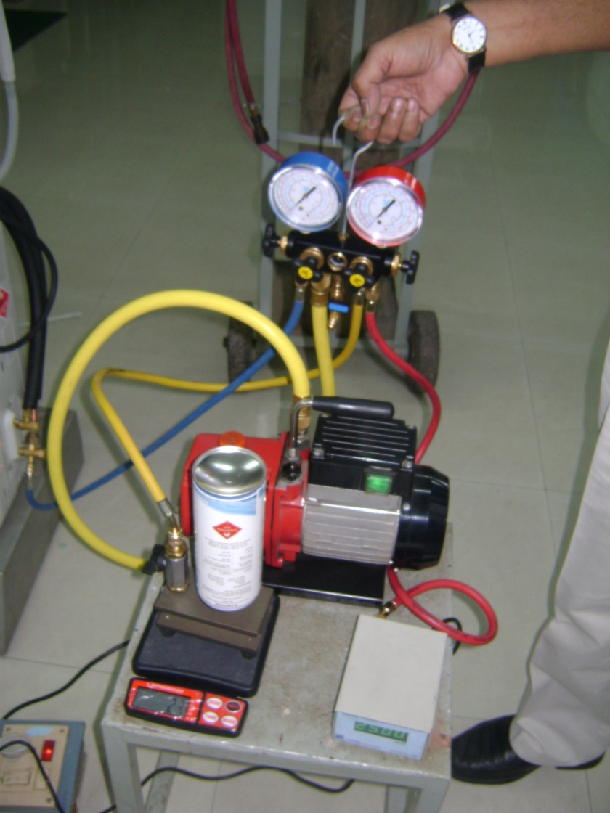
Standard Operating procedures for Sealed system repairs
Charging by Weight
Getting vacuum below 500 Microns
Leak testing with OFDN are mandatory procedures which have to be
followed by the technicians

Slide 22
SAFETY
COMES
FIRST
Monitoring Failures
Monitoring weekly repeat failure technician wise
All field failures are reported to design and manufacturing and discussed in the Cross Functional Meetings on weekly basis.

Slide 23
International Experiences with the use of Hydrocarbon Refrigerants
HOT
SUMER
THIS YEAR

Slide 24
Success of HCs in domestics can be extrapolated to other applications/systems >> Only minor technical hurdles, knowledge transfer, training
Safety an issue in some systems with some alternatives >> Safety standards, codes and experience used to overcome this
More and more products becoming available with HCs >> Product cost is rarely higher than HFC products
Many end-users are demanding natural refrigerants >> Feedback is that there is insufficient product availability and variety
BIRDS
EYE
VIEW

Slide 25
0 ACCIDENTS DUE TO THE USE OF R 290

Slide 26
BENEFITS OF PROPANE(R290) OVER OTHER REFRIGERANTS

Slide 27
TRANSPORT PROPERTIES OF R290
Refrigerants | Viscosity at 35° C liquid (Pa/s) | Viscosity at -20° C Vapour (Pa/s) | Thermal Conductivity at 35° C liquid (mW/mk) | Thermal Conductivity at -20 ° C vapour
R22 | 151.7 | 10.75 | 82.1 | 8.9
R290 | 87.19 | 7.07 | 99.2 | 14.38
R600 | 144.6 | 6.32 | 108.9 | 12.93
R 290 has lower viscosity and higher thermal conductivity compared to that of CFC and HCFs.
These superior transport properties are believed to contribute to the higher energy efficiency of hydrocarbons vis-a vis- CFCs and HCFCs
R290 reduces energy consumption by about 15% compared to similar R22 product

Slide 28
GVTS MODULE
GVTS (Godrej Vocational Training School) Module is a Non financial collaboration with NGO’s, Organizations, Educational Institute and ASP’s where Godrej Acts as a Knowledge Partner.
As a Knowledge Partner Godrej Provides
Training of Partner Trainers (15 days of training at Mumbai)
Provide Course content and training Material for trainers
Provide GVTS Book and Other Stationary to Students
Conduct Final Examination (Written, Practical and Viva)
Certifying the Passed out students

Slide 29
GVTS PARTNERSHIP PROCESS
Due Diligence
Partner Evaluation Checklist
Agreements Signoff
Infrastructure Set up
Training Of Trainers
GVTS Inauguration

Slide 30
GVTS PARTNERSHIP STRUCTURE
GVTS
NGO’s
Art of Living (SSRDP)
Training Institute
Don Bosco Society
M.S.Ramaiah Polytechnic
Organizations
Future Sharp
IL&FS
ASP
Sure Tech
J S Services
B-Able

Slide 31
COURSE DESIGN
40% Theory Classroom session
60% Practical In House training
Final Exam
Vocational Training
Proficiency Certificate
Issued By Godrej
Participation of Collaborative GVTS and Students
Conducted By Godrej
Branch Trainers

Slide 32
COURSE CONTENT
Advanced Home Appliances Training
3 Months
Basic Refrigeration, Repairs and Servicing of Refrigerators, Air conditioners, Washing machine, Microwave, Small home appliances, Engineering drawing, Communications and Customer handling
Advanced Refrigeration and Air-conditioning
1 Month
Basic Refrigeration, Repairs and Servicing of Refrigerators, Air conditioners.
Basic Refrigeration & Air Conditioning
15 days
Basic Refrigeration, Servicing of Refrigerators and Air conditioner
Repair & Maintenance of Air conditioners
15 days
Servicing and Repairs of Air conditioner
Advanced Washing Machine and Microwave
1 Month
Repairs and Servicing of Washing machine, Microwave, Small home appliances.
Repair & Maintenance of Washing machine and Microwave
15 Days
Servicing and Repairs of Washing machine and microwave
Repair & Maintenance of Refrigerators
15 days
Servicing and Repairs of Refrigerator
Basic Home Appliance Repairs
15 days
Repairs of Electric iron, hotplate, geyser, mixer grinder

Slide 33
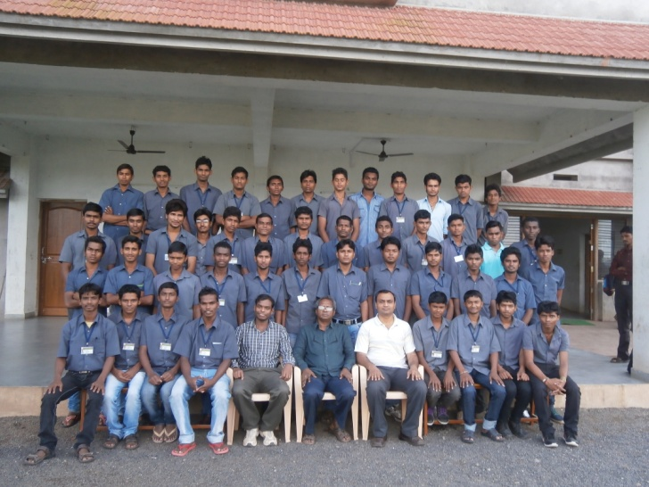

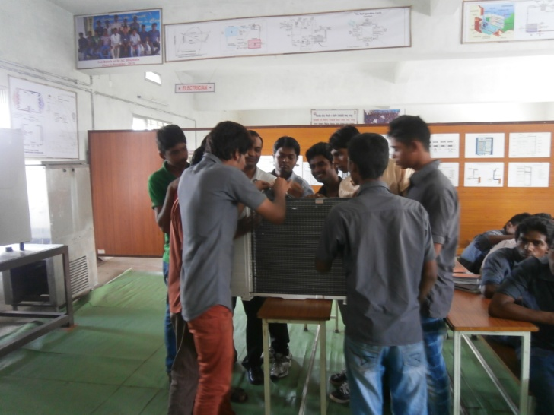

Model Center – MIEC, Nagpur
46 students attended training in first batch
1st batch
Guest lectures and practical's conducted by Godrej

Slide 34

Future Plans
Year | Target Plan
2012 | 2211
2013 | 2786
2014 | 3510
2015 | 4423
2016 | 5573
2017 | 7022
2018 | 8847
2019 | 11148
2020 | 14046
Total | 59566

Slide 35
ARE YOU READY TO JOIN US ON THIS GREEN JOURNEY?

