Slide 1


Leagls
Annual South Network Meeting of National Ozone Officers 2017
Atul Bagai and Liazzat Rabbiosi/ 23-26 May 2017 / Agra, India
Notes:
The objective of my presentation is to set the stage for this extensive rich and important session. In my presentation I will focus on what we mean by mainstreaming, why it is important and what can be specficially done in which areas the mainstreaming can be made

Slide 2
ECONOMY DIVISION
Director’s Office
Administrative Services
ENERGY & CLIMATE
RESOURCES & MARKETS
CHEMICALS & HEALTH
Cities Unit
Energy Unit
Finance Unit
Climate and Clean Air Coalition (Secretariat)
Climate Technology Centre and Network
Consumption and Production Unit
Economic and Fiscal Policy Unit
Environment and Trade Unit
Sustainable UN
Partnership for Action on the Green Economy
(Secretariat)
Green Growth Knowledge Platform
International Resource Panel (Secretariat)
Life-Cycle Initiative (Secretariat)
10 Year Framework of Programmes
on Sustainable Consumption and Production (Secretariat)
UNEP Finance Initiative
(Secretariat)
Pollution and Health Unit
Air Quality and Mobility Unit
OzonAction
Strategic Approach to International Chemicals Management (Secretariat)
Interim Secretariat of the Minamata Convention
Special Programme on Institutional Strengthening
(Secretariat)
Technology for Sustainable Development
(Collaborating centres/Technology Facilitation Mechanism)
Science and Knowledge Unit
Country Support and Partnership Unit
Global Environment Facility
Climate Mitigation Unit
Global Environment Facility
Chemicals and Waste Unit
International Environmental Technology Centre

Slide 3

OzonAction Branch
Mission
  Assist developing countries & countries with economies in transition (CEITs) to achieve & sustain compliance with the Montreal Protocol
Areas of work
  Developing countries - Implementing Agency of the Protocol’s Multilateral Fund, through a Compliance Assistance Programme (CAP)
  CEITs - Implementing Agency of the Global Environment Facility
  Specific partnerships with bilateral agencies
Notes:
Strategically reoriented in 2002
CAP staff now in Regional Offices
Close to the countries to support & sustain compliance
Direct policy & technical assistance to countries
MTS: UNEP-administered MEAs provide a vehicle for implementation of aspects of the MTS through their programmes of work, with the agreement of the relevant governing bodies, as appropriate.
BSP: Ours is a capacity building and technology transfer programme supporting MEA compliance, which fits squarely within Bali Strategic Plan. BSP calls for “Strengthening the regional presence of UNEP and enhancing the role of regional offices to facilitate UNEP-wide integrated support to countries”.

Slide 4
Compliance
Term “compliance” is not explicitly defined in the Montreal Protocol treaty
A Party demonstrating through its reported data & official documents that it fully meets a specific legal obligation under the MP, according to an agreed timetable
Compliance is the key macro performance indicator for entire Montreal Protocol by which international community will judge its success
Data reporting (Articles 5 & 7)
Phase-out of production & consumption of controlled substances
Trade in controlled substances with non-Parties (Article 4)
Establishment licensing systems for import & export of new, used, recycled & reclaimed controlled substances (Article 4B)
Biennial reporting on research on alternatives
MOP decides that a Party is in non-compliance

Slide 5
CAP regional delivery
UNEP CAP
CAP Paris
Major Roles: Coordination, policy-setting, Business Planning, monitoring, interfacing with ExCom, clearinghouse
CAP Regions
Major Roles: Compliance assistance, project implementation, reporting, assessing country needs, feedback on CAP implementation
Regional Networks
NOU
NOU
NOU
NOU
NOU
NOU

Slide 6
Services provided
Global
Information Clearinghouse
Regional
Regional Networks of Ozone Officers
Policy & technical advice
National
Institutional strengthening
National & sector strategies
Integrated management plans for ODS
South-South cooperation
Capacity building
Notes:
Strategically reoriented in 2002
CAP staff now in Regional Offices
Close to the countries to support & sustain compliance
Direct policy & technical assistance to countries
Strategy:
Deliver through Regional Offices
Promote South-South cooperation
Supplement & leverage expertise of other international organisations
Catalyze partnerships
Focus on small countries without diluting expressed needs of large countries

Slide 7
OzonAction Branch
Regional Networks
Information Clearinghouse
Capacity building
Technical & policy advice
South-South Cooperation
CAP
Projects
Institutional Strengthening
HPMP preparation
HPMP implementation
Technical assistance
Support for bilateral projects
Multilateral Fund
Co-financing (outside of MLF)
Projects
CCAC HFC initiative
US Regional Project HCFC/EE
UNEP-China Trust Fund project for the room air conditioner
Notes:
In some cases UNEP implements projects on behalf of bilateral agencies.

Slide 8
OzonAction’s clients
Very large volume
consuming countries
Brazil,
China, India,
Mexico, Korea RO,
Saudi Arabia, Thailand
Medium volume consuming countries
Afghanistan, Algeria,
Argentina, Bahrain, Bangladesh, Benin,
Burkina Faso, Cameroon, Chile, Colombia,
Côte d'Ivoire, Congo DR, Dominican Republic, Egypt,
Gabon, Ghana, Indonesia, Iran, Iraq, Jordan, Kenya, Korea DPR,
Korea Rep, Kuwait, Lebanon, Libya, Madagascar, Malaysia, Morocco,
Niger, Nigeria, Oman, Pakistan, Panama, Peru, Philippines, Qatar, Senegal,
Singapore, Somalia, South Africa, Sudan, Syria, Trinidad and Tobago, Tunisia,
Turkey, United Arab Emirates, Uruguay, Venezuela, Viet Nam, Yemen
LVCs
Albania, Angola, Antigua & Barbuda, Armenia, Bahamas, Barbados, Belize, Bhutan, Bolivia,
Bosnia & Herzegovina, Botswana, Brunei Darussalam, Burundi, Cambodia, Cape Verde, Central African Republic,
Chad, Comoros, Congo, Cook Islands, Costa Rica, Croatia, Cuba, Djibouti, Dominica, Ecuador, El Salvador, Equatorial
Guinea, Eritrea, Ethiopia, Fiji, Gambia, Georgia, Grenada, Guatemala, Guinea, Guinea-Bissau, Guyana, Haiti, Honduras,
Jamaica, Kiribati, Kyrgyzstan, Lao PDR, Lesotho, Liberia, Macedonia FYR, Malawi, Maldives, Mali, Marshall Islands, Mauritania,
Mauritius, Micronesia, Mongolia, Montenegro, Mozambique, Myanmar, Namibia, Nauru, Nepal, Nicaragua, Niue, Palau,
Papua New Guinea, Paraguay, Republic of Moldova, Rwanda, Saint Kitts and Nevis, Saint Lucia, Saint Vincent and the Grenadines,
Samoa, Sao Tome & Principe, Serbia, Seychelles, Sierra Leone, Solomon Islands, South Sudan, Sri Lanka, Suriname, Swaziland, Tanzania,
Timor-Leste, Togo, Tonga, Turkmenistan, Tuvalu, Uganda, Vanuatu, Zambia, Zimbabwe
UNEP implements project
Notes:
Data from Inventory
148 Article 5 countries
Categories are based on HCFC baselines, categories are LVC = 360 MT consumption or less; very large = 10,000 MT consumption and above.
LVCs countries = 91
Medium countries = 50
Very large countries = 7
CAP has the majority of IS projects under the MLF
For projects
UNEP has projects in all Article 5 countries except 25 (white)
UNEP has IS projects in

Slide 9
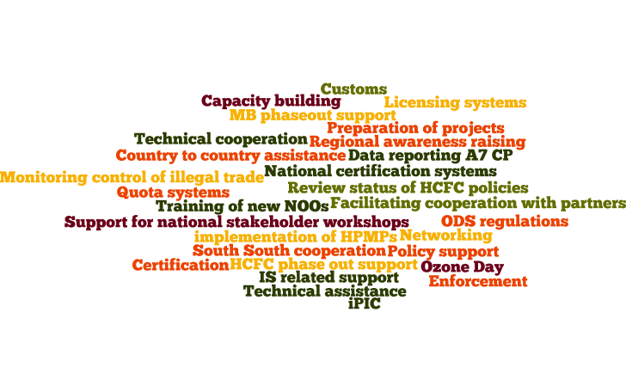
CAP services
Assist 134 Article 5 countries through ≈ 300 anticipated CAP services (plus ad hoc requests)

Slide 10
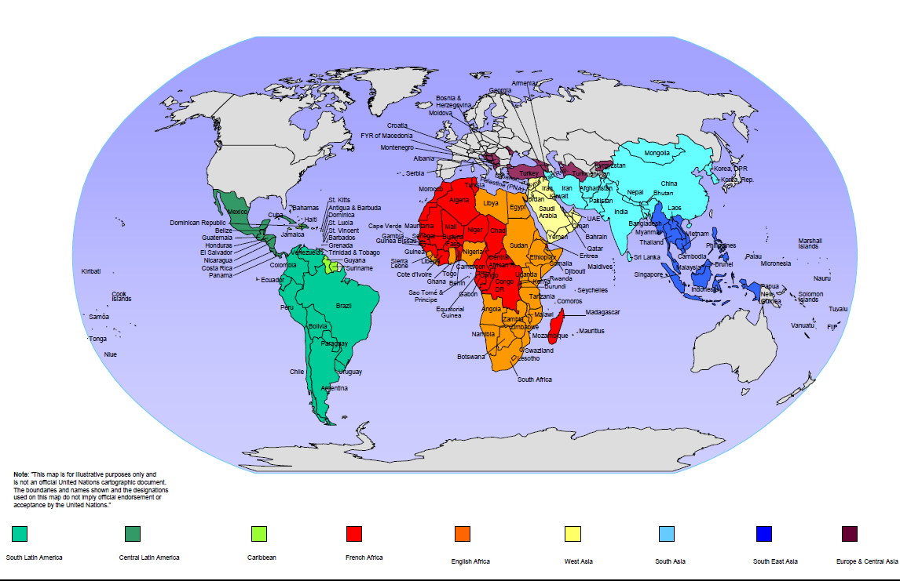
Regional Ozone Networks

Slide 11
Regional Network members
Region | Article 5 countries | Article 2 partners
Africa English-speaking | 28 | Germany
Africa French-speaking | 26 | Canada, France, Switzerland
Caribbean English speaking & Haiti | 14 | USA, Canada
Europe & Central Asia | 12 with participation of 7 self-funded non-Article 5 CEITs | Czech Republic, Hungary, Poland, EC
Latin America-Central | 9 | USA, Canada
Latin America-South | 10 | USA, Canada
Pacific Island Countries | 14 | Australia, New Zealand
South Asia | 13 | Japan
Southeast Asia | 11 | Australia, Sweden
West Asia | 11 | France, Germany

Slide 12
CAP Services
E-mail
Telephone / Skype
Country Mission
South-South Cooperation
Etc.
Meeting / Workshop
CAP Service
Network & Thematic Meeting
Compliance monitoring
Policy Support
Technical Assistance
Data Reporting
Awareness and Information
Monitoring and Control of ODS Trade
NOU Capacity Building
South-south Cooperation

Slide 13
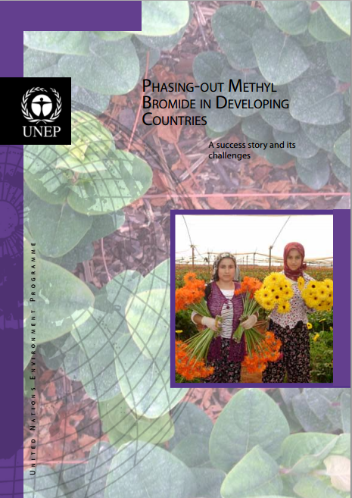
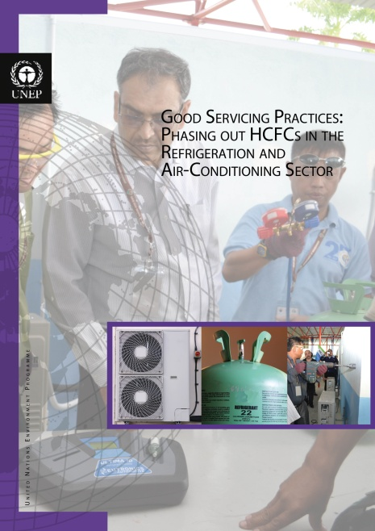

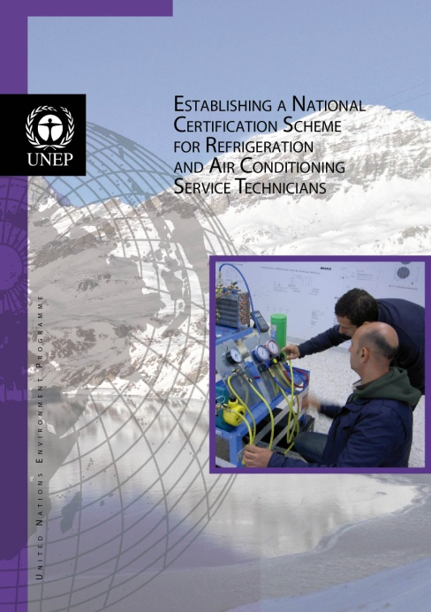
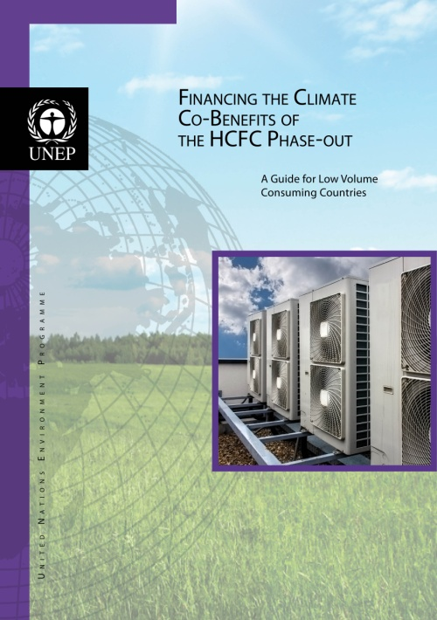


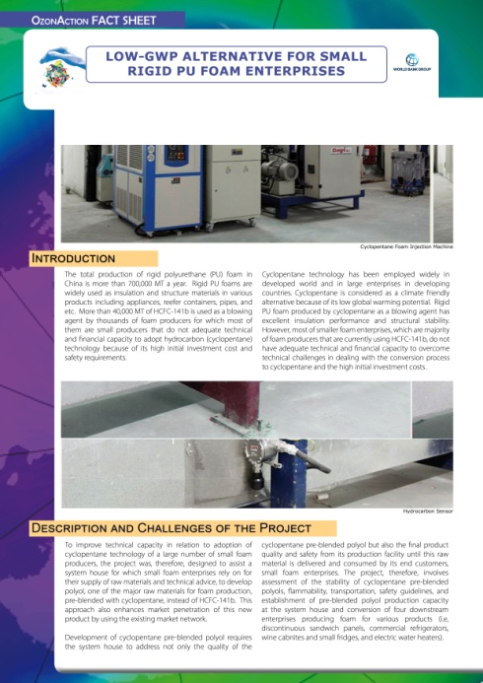

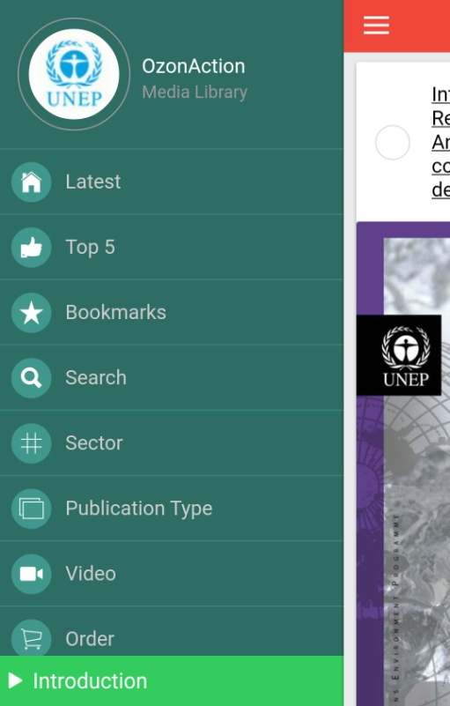
Information Clearinghouse

