Slide 1
South Asia National Ozone Officers’ Annual Network Meeting – 2017
Role of Customs Officers in Ensuring Compliance in India
P.K Dash
DG, NACEN

Slide 2
Key players – Enforcement & Compliance of Montreal Protocol
NOU
Customs
Licensing Agency
Environmental Inspection Agency
Police/Coast Guard/other LEAs
Industry and Trade representatives
General Public
Notes:
Key players in monitoring and regulating licit trade in ODS and checking illegal trade in ODS. This presentation focusses on the role of Customs

Slide 3
Role of Customs
First line in the chain of ‘Enforcement and Compliance’, enforces national ODS regulations and the licensing system
Specifically, Customs –
Verify documentation
Inspect/examine goods
Risk-based focussed approach (past history/known importers-exporters)
Special treatment in case of suspicion, screening for ODS - labelling/chemical analysis
Liaison with Licensing Agency and Environmental Inspection Agency

Slide 4
Role of Indian Customs
Indian Customs is sensitized to the hazards of illicit smuggling of ODS.
Capacity Building : NACEN
Enforcement : DRI
Intelligence/ RMS
Seizures & Investigation
Modus Operandi Alerts
Awards
Disposal of seized goods : only to the authorized entities.
Year | No. Cyl. | Weight (in Kg.)
2013-14 | 7238 | 98437
2014-15 | 20692 | 281411
2015-16 | 1593 | 21665

Slide 5
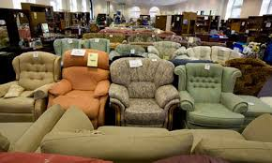
Case 1-Furniture
1100 refrigerant cylinder (13.6kg each)
Concealed between furniture
Investigations revealed that R22 cylinders were smuggled in the past in a similar manner.
China
Sea Port (Gujarat)
Dry Port
New Delhi

Slide 6
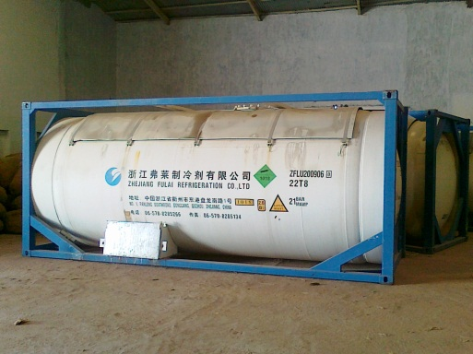
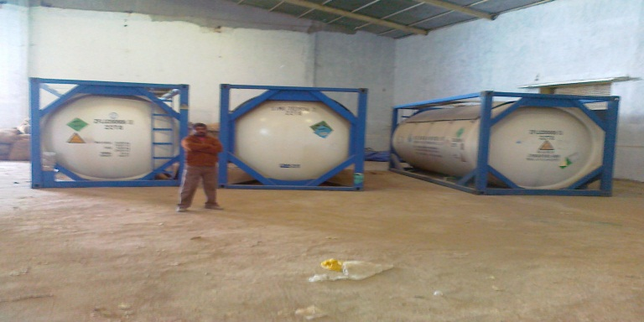
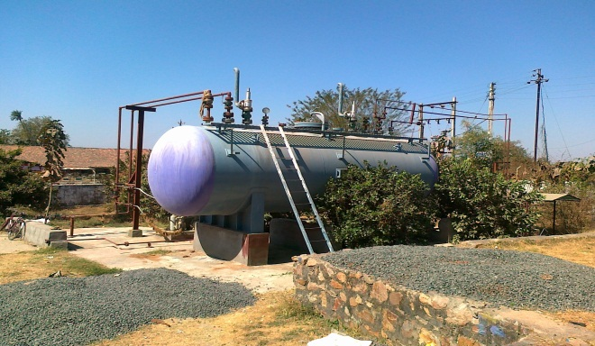
Case 2- Export Oriented Unit
R22 was imported under a license, for export after blending
However same was being diverted to local market.
182.9 MT of R22 kept in ISO storage tanks was seized
China
Mumbai Port
Factory in Gujarat

Slide 7

Case 3- Fabrics and Garment Accessories
Sea Port
Mumbai
Dry Port in Indore, MP
China
1702 R22 cylinder (13.6 kgs each)
Concealed with other consumer goods, like -
Garments, Electronics, Chatons

Slide 8
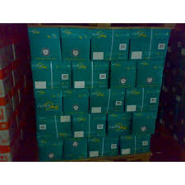
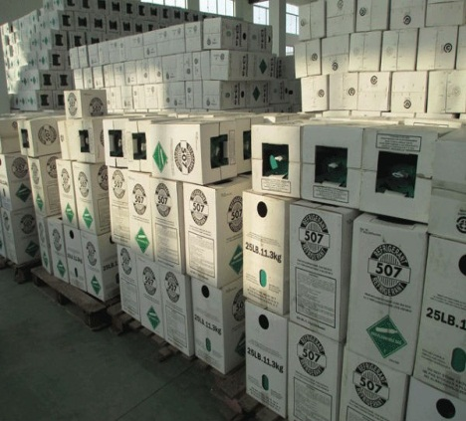
Case 4 - A4 Copier Paper
Sea Port
Mumbai
Dry Port
New Delhi
Goods concealed behind A4 copier paper.
Address of the importer fictitious.
Sea Port
Klang, Malaysia

Slide 9
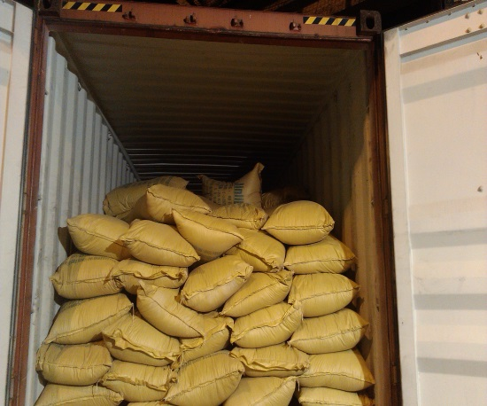
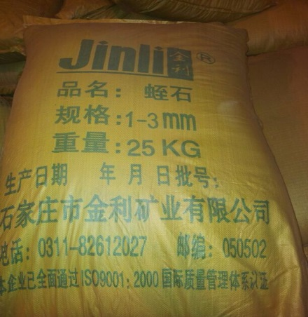
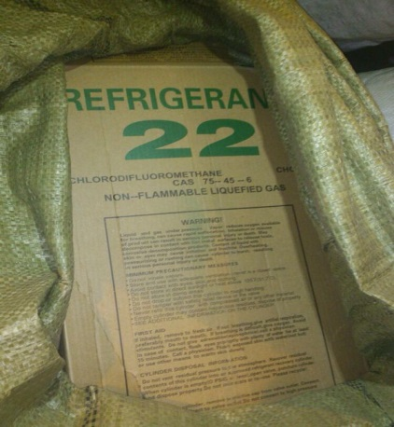
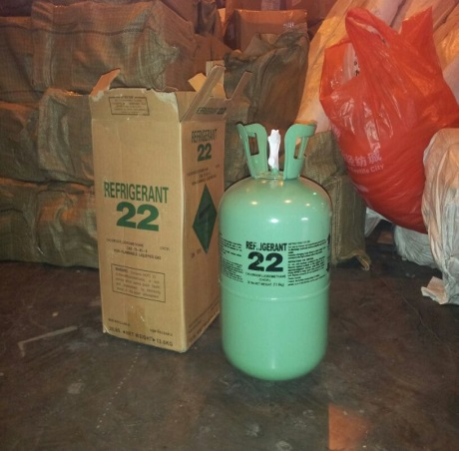
Case 5 : Vermiculite
China Mumbai (NS) Port
Declared Cargo : Vermiculite (Agriculture Grade)
40ft Contr., behind 4 rows of declared cargo, were 629 bags (x 2 Cyl of R22 gas 13.6 Kg each) = 17108.8Kg

Slide 10
NACEN - ODS Training
MoU with UNEP since 2003
Resource Center of UNEP in Asia-pacific Region,
Preparation of Training materials and organization of - ‘Train the Trainers Workshops to combat illegal trade in HCFCs’
2016 Performance:
Four Train the Trainers Workshops : 64 Indian officers from Customs, DRI, NIA & BSF + 9 Foreign participants (Afghanistan, Bhutan, Bangladesh, Nepal ).
Distribution of ODS identifiers to priority Ports, border check points, and training centers; and
Completion one enforcement study and one campaign in association with DRI to combat illegal trade in HCFCs
2017 Target : to train 400 officers

Slide 11
Feedbacks from Trainings …
Create or strengthen national and regional information networks
Clear definition and identification of the environmental authorities – role & responsibilities.
Indian contextual case studies

Slide 12
Thank You

