Slide 1


Legal instruments: PCA or SSFA
Annual South Network Meeting of National Ozone Officers 2017
Atul Bagai and Liazzat Rabbiosi/ 23-26 May 2017 / Agra, India
Notes:
The objective of my presentation is to set the stage for this extensive rich and important session. In my presentation I will focus on what we mean by mainstreaming, why it is important and what can be specficially done in which areas the mainstreaming can be made

Slide 2
Outlines
Overview of SSFA structure;
Understanding provisions under SSFA;
Reporting requirements under SSFA (progress, financial expenditure, cash advance and inventory of non-expendable equipment);
Payments procedures under SSFA.

Slide 3
Overview of SSFA structure

Slide 4
What is SSFA?
Small Scale Funding Agreement (SSFA) is a legal document between the Government and UNEP to cooperate in the implementation of project/programme;
SSFAs must clearly define the specific cooperation objectives, the roles and responsibilities of the parties, their financial and legal commitments, and other terms and conditions;
A detailed activity-based budget and timeframe-based implementation plan that is linked to an approved project document, must be attached in annex.

Slide 5
Structure of the SSFA of IS and HPMP
Main part – 19 clauses
Annexes as part of the SSFA
Annexes | Applicable to
Budget and format for expenditure statements | IS Project, HPMP
Project implementation plan | IS Project, HPMP
Progress Report format | IS Project, HPMP
Cash advance request form | IS Project, HPMP
Inventory of non-expendable equipment | IS Project, HPMP
Terms and conditions for IS Project | IS Project
Terminal report and request for extension of IS funding | IS Project

Slide 6
Main part
Some clauses require additional information to be filled;
No amendment shall be made to any of the standard texts given in the template;

Slide 7
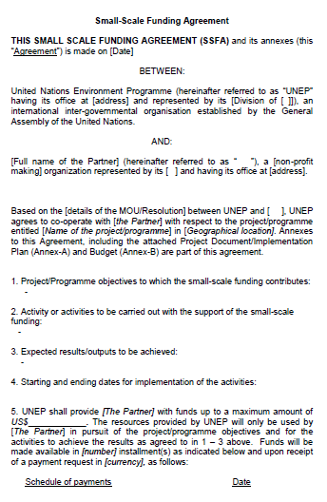
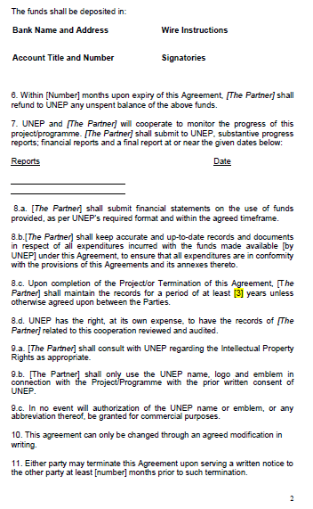

Slide 8
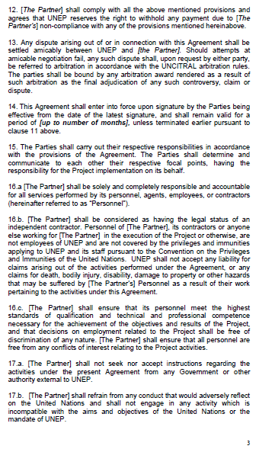
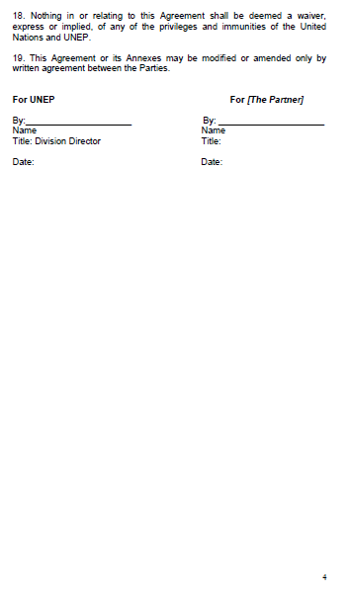

Slide 9
Understanding provisions under SSFA

Slide 10
Clauses in SSFA
Clause | About
Clause 1 | Project/Programme objectives to which the Agreement contributes
Clause 2 | Activity or activities to be carried out with the support of the Agreement – Refer to project implementation plan (annex)
Clause 3 | Expected results/outputs to be achieved
Clause 4 | Starting and ending dates for implementation of the activities
Clause 5 | Schedule of payments and conditions & funds deposit detail
Clause 7 | Project/programme monitoring – reporting requirement
Clause 14 | Effectiveness of the SSFA
Other clauses | Refunds of unspent balance, record keeping for at least 3 years after project completion, UNEP’s right to review and audit the record, only use the UNEP name, logo with the prior written consent of UNEP, termination of the agreement, dispute settlement, qualification of personnel, modification/amendment of agreement etc.

Slide 11
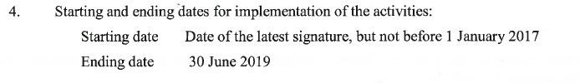

Starting and ending dates (Clause 4) VS Effectiveness date (Clause 14)

Slide 12
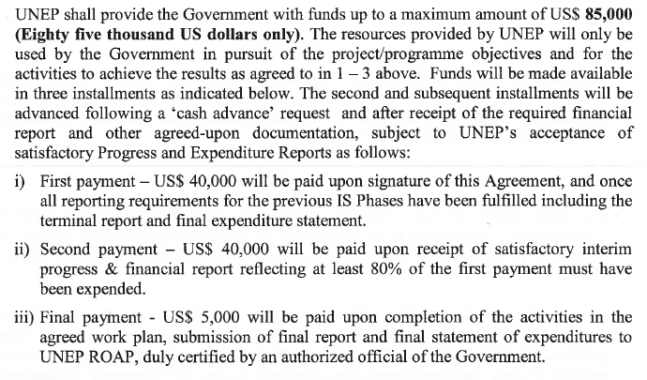
Clause 5: Schedule of payments and conditions & funds deposit detail

Slide 13
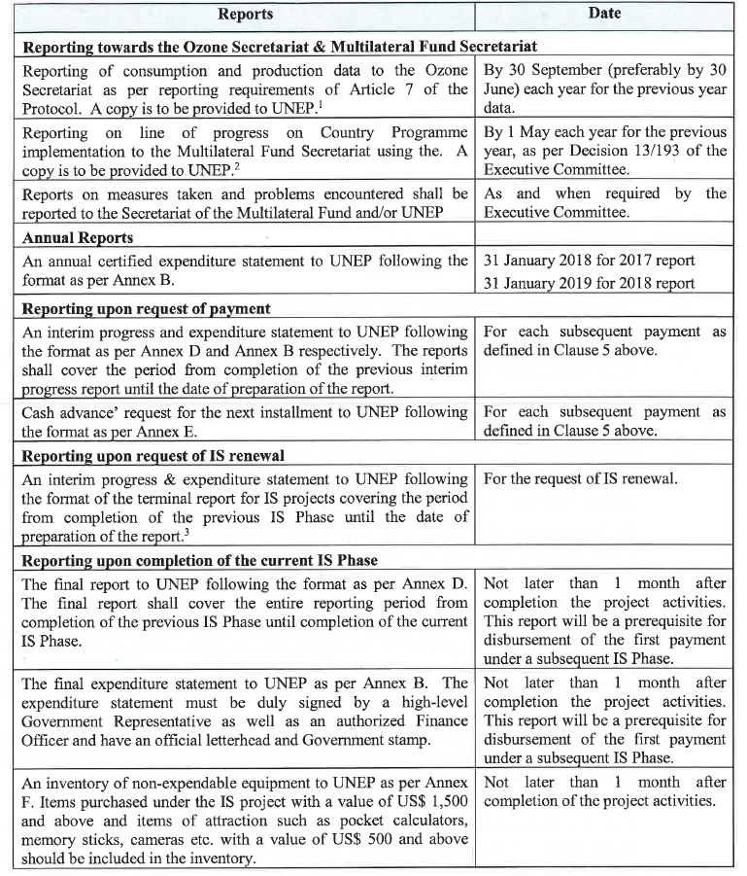
Clause 7: reporting requirement

Slide 14
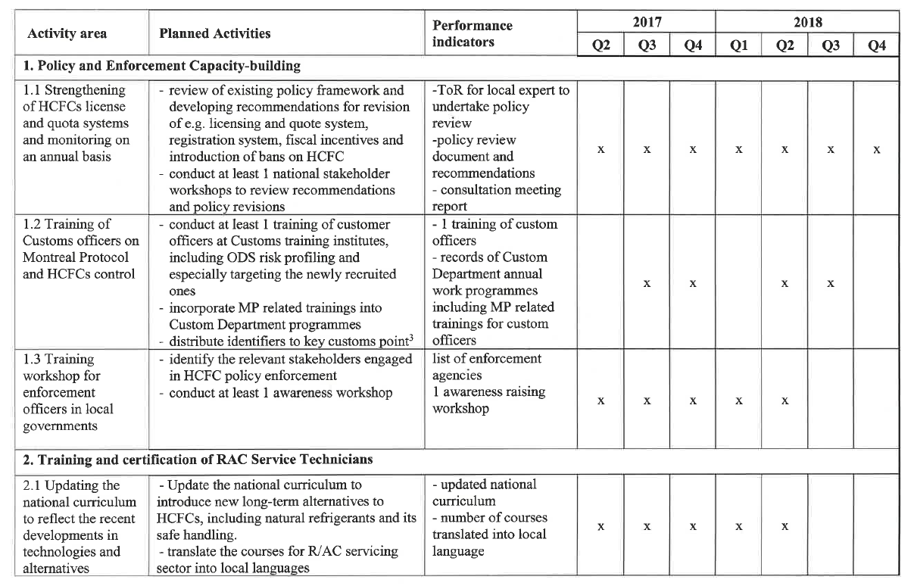
Implementation Plan

Slide 15
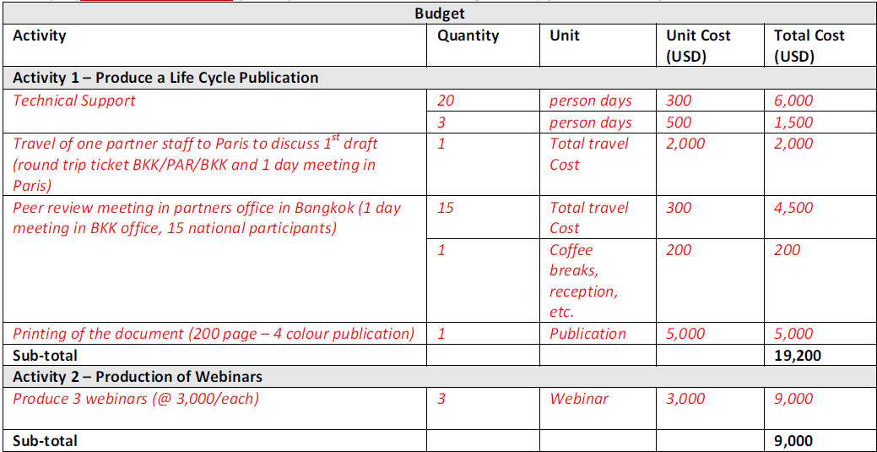
Budget

Slide 16
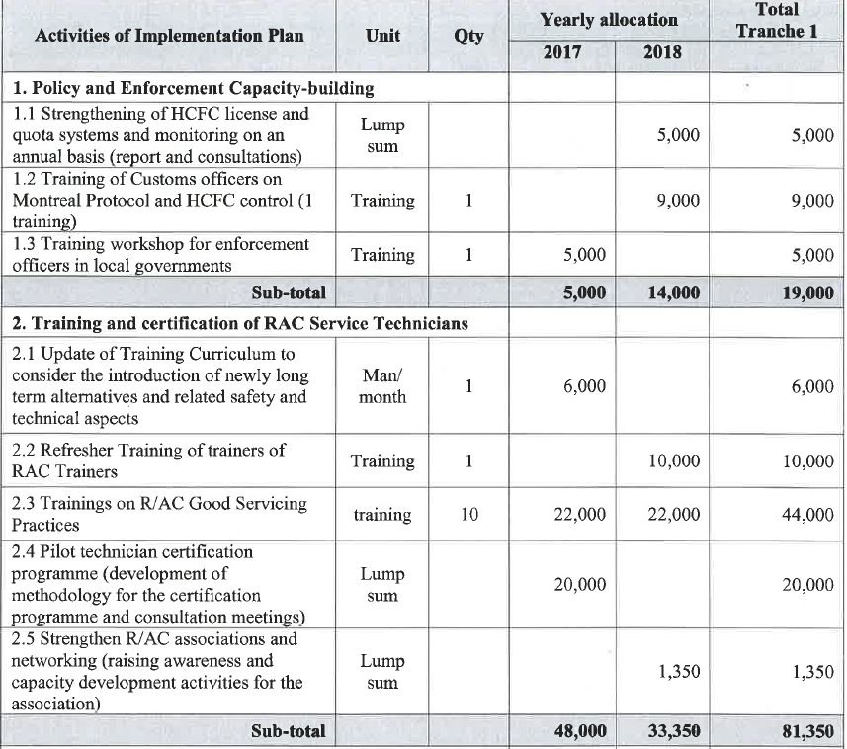
Example of the budget

Slide 17
Reporting requirements under SSFA (progress, financial expenditure, cash advance and inventory of non-expendable equipment)

Slide 18
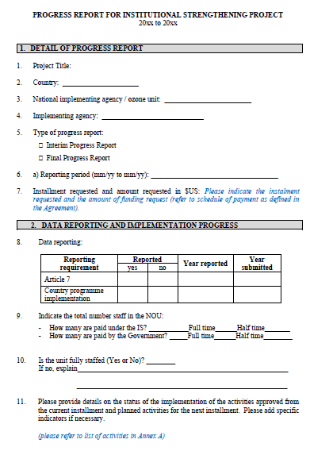
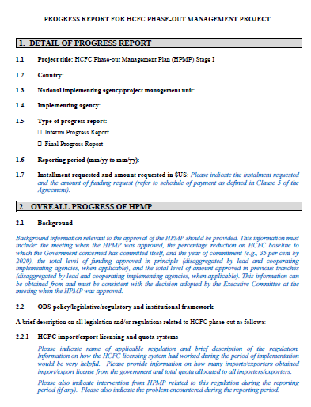
Template of interim/final progress report
Date of previous progress report until date of reporting
Can be obtained from Annex to SSFA
IS Project
HPMP

Slide 19
Difference between interim progress report and final progress report
Table of activities and achievements.
Consistent with activities listed in Project Implementation Plan
Project activities | Activities implemented during reporting period | Achievement during reporting period | Cumulative Achievements | Planned activities in the next installment | Expected result in the next installment
Interim Report
Project activities | Activities implemented during reporting period | Achievement during reporting period | Summary of activities implemented covering the entire reporting period under the Agreement | Summary of achievement covering the entire reporting period under the Agreement
Final Report

Slide 20
Activities and Achievements
Activities: NOU should elaborate details of implemented activities:
What was the activity and how relate to the Montreal Protocol;
Where and when the activity was implemented (specific date and venue);
How many and what type of participants (preferably providing gender profiles)
Achievement: The achievement is not the activity, but the results/output of the implementation of respective activities.
Training ⇨ number of trained technicians, better understanding or knowledge of good servicing practices
Production of awareness raising material ⇨ report or publication, better availability of information

Slide 21
Financial Expenditure Statements
As per SSFA
Accumulative Expenditures for Previous Reporting Period +
Expenditures for the Current Reporting Period
=
TOTAL Expenditure Report as of Reporting Date
Actual expenditures for each budget line to be within the allocated budget
Certified by Financial Officers
With Government rubber stamp and date of signing

Slide 22
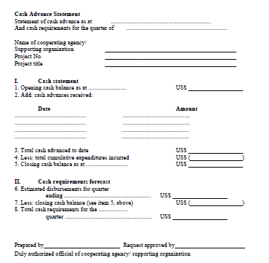
Cash advance
Certified by Financial Officers
With Government rubber stamp and date of signing

Slide 23
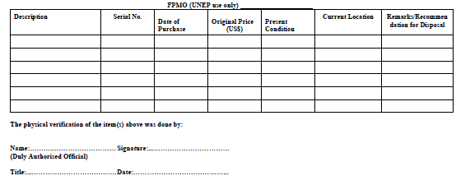
Inventory of non-expendable equipment
Items purchased under the project with a value of US$ 1,500 and above and items of attraction such as pocket calculators, memory sticks, cameras etc. with a value of US$ 500 and above should be included in the inventory.
With Government rubber stamp and date of signing

Slide 24
Payments procedures under SSFA

Slide 25
Payments procedures under SSFA
NOU
Submit required reports to UN Environment
UN Environment
Review and provide comments
NOU
Revise reports as per UN Environment comments
UN Environment
Request Paris for Approval (Internal)
UN Environment
Review, provide comments or approval
UN Environment
Process payment

Slide 26
Payment
Government account.
UNDP country office – with service fee (deductible from the total SSFA cost, to be included as miscellaneous costs)

Slide 27

30 Montreal Protocol
CARING FOR ALL LIFE UNDER THE SUN
Thank you!

