Slide 1



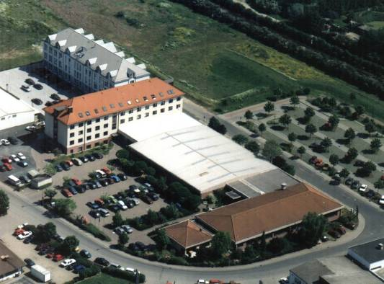
Bundesfachschule Kälte-Klima-Technik
Europäische Studienakademie Kälte Klima Lüftung

Slide 2
1965 – founded in Frankfurt, school board: Guild of Refrigeration Crafts
1986 – relocation to larger premises, 10,800 square metres
Educational Institutions
Private Vocational School
Bundesfachschule Kälte-Klima-Technik
Technical College
ESaK
European Academy of Refrigeration
and Air Conditioning
University of Cooperative Education
Initial vocational education
Mechatronic of refrigeration
technology
Advanced vocational education
- Master craftsperson in refrigeration
technology
- Certified engineer of refrigeration
- Workshops in refrigeration,
air conditioning engineering
- Tutorials in law, environment,
management, technology and
communication
- Certification of staff
- Corporate courses in initial
education
- International workshops and
seminars
Academic education
(chartered engineer)
Bachelor of Science in refrigeration
Bachelor of Science in
air conditioning

Slide 3
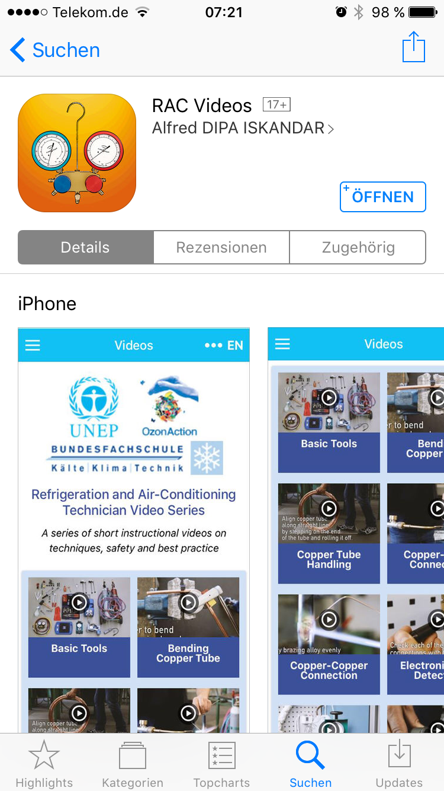


Slide 4
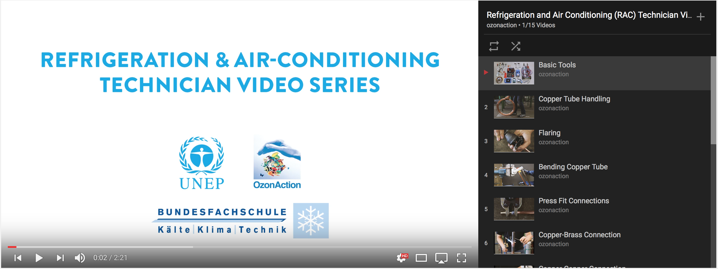
RAC Video APP
https://www.youtube.com/playlist?list=PLtIrv5041EuJfO5TKRcXaHiCNzc7oRC9N

Slide 5
Thank you for your attention!

