Slide 1
Scaling up of Energy Efficiency in India
Presentation to SA Network Meeting
Agra, May 2017
Saurabh Kumar
Energy Efficiency Services Limited

Slide 2
EESL – Vision 2020
A multinational company – world leader in clean energy and innovation
Turnover of $ 1.5b by 2020 from $ 300 m last year - public listed company
Sustained high growth rate – doubling of turnover every year till 2020
Investments in appliances, buildings, pumping and RESCO of $ 5 b
Thrust on significantly enhancing international operations
Improving and innovating the sustainable EESL business models to cover more sectors like SMEs, Industry

Slide 3
EESL – Strategy
Accelerate the adoption of super efficient appliances – LED lighting, Super Efficient ACs, Fans, Pumps, etc
Replicate the successes of existing programmes in other sectors like Buildings, Municipal Water and Sewage Pumps, Agriculture
Programme designed in a manner that has incentives for all stakeholders
Performance based service model (as against supply model) to obviate the need for allocation of budgets
Effective and timely implementation of projects – conducting social audits, dissemination and capacity building

Slide 4
EESL Business Models
Pay-As-You-Save (PAYS) model – no upfront cost – payment from savings with performance SLAs – On-Bill-Payment for appliances and Performance Contract (PC) for institutions over 2-10 years
All costs and a reasonable level profit part of annuity in case of PC. Similar model for appliances
Aggregation of demand and transparent procurement to achieve economies of scale
Demonstrated Deemed Savings Approach – annuity not linked to energy savings
Turnkey implementation of projects
Making EE ‘Visible’- Real time monitoring of performance through online dashboards – www.ujala.gov.in, www.eeslindia.org/slnp, etc.

Slide 5
LED Business Model
2-10 9 W LEDs given at price of Rs. 85-95 ($ 1.2 to 1.3)
Payment upfront or through easy instalment for 8-10 months
Distribution points near to consumers
Awareness about the benefits
Free replacements for 3 years against defects

Slide 6
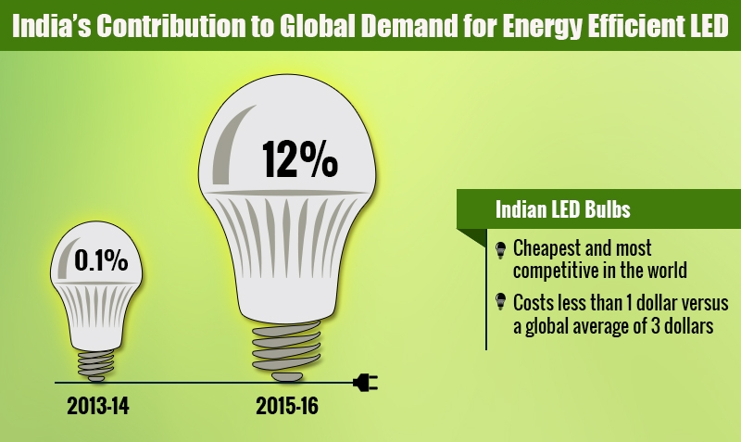
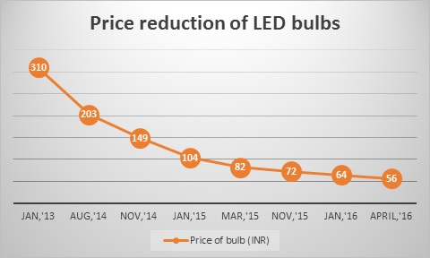
Market Aggregation - outcomes
Share of LEDs in Indian lighting market increased from less than 1% to 15% in 1 year
Retail prices reduced by 1/3rd in one year. Bulk prices reduced by over 80% in 2 years
Average price last year ~$ 5-7 – now between $ 1.5 - $ 4
Domestic manufacturing increased significantly
New jobs created – almost 25,000 in one year

Slide 7
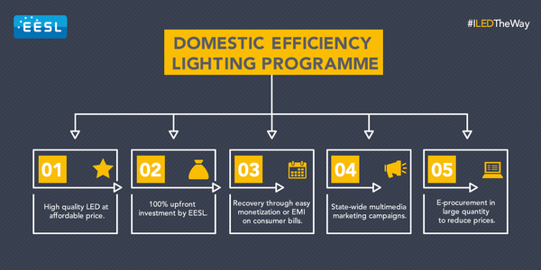
LED – Implementation Model
LED bulbs to households/ commercial establishment at $ 2.5 per 9 W LED – savings of more than $ 3 per year on each bulb – recovery from energy bills in 10 instalments

Slide 8
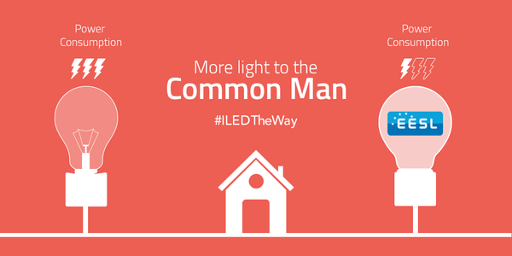
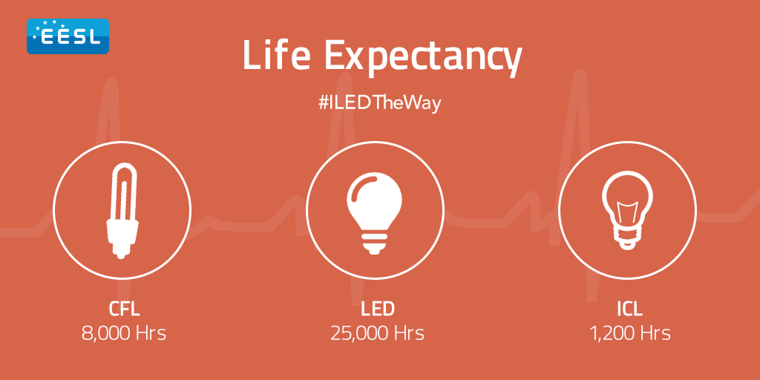
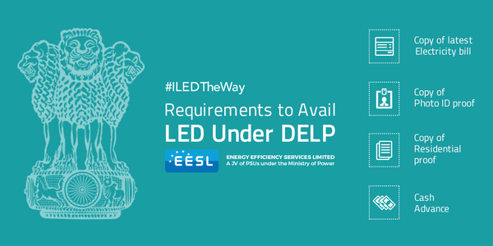
Awareness Strategy
High intensity campaign – national and city level to engage stakeholders
All media vehicles used – stress on digital media

Slide 9

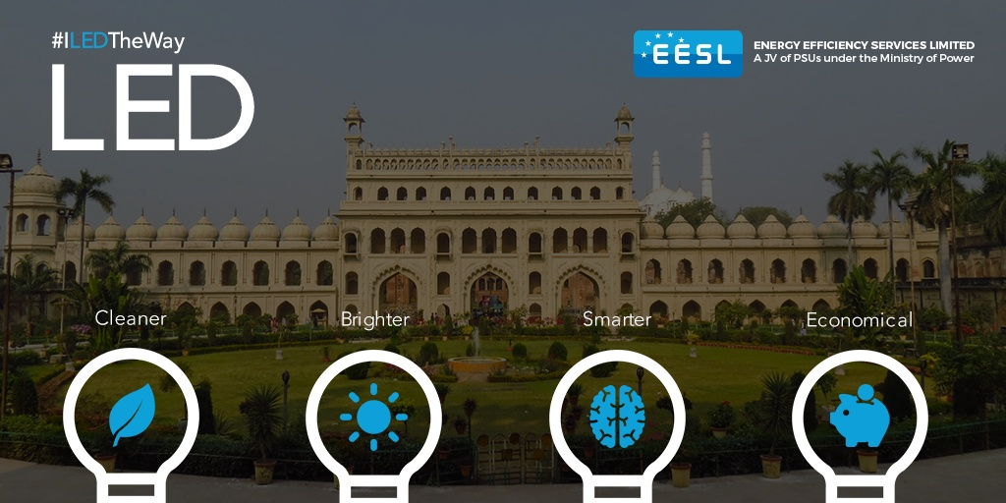
Awareness Strategy (2)

Slide 10
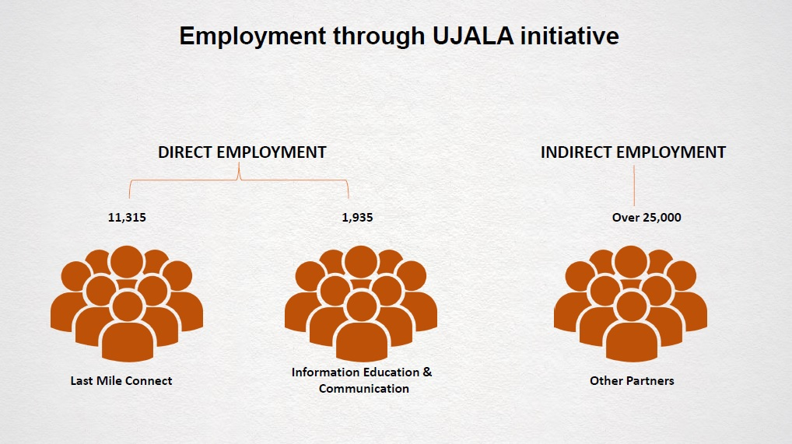
UJALA – Other Benefits
Encouraged Make In India – domestic manufacturing increased from about 100,000 per month to 30 m per month

Slide 11
EESL - Outcomes
UJALA – LED bulb programme – over 230 m LED bulbs distributed by EESL in 2 years – private sector sold 300 m in the same time – market transformation in 2 years – LEDs most preferred lighting source
Street Lights – About 2 m street lights replaced benefitting over 250 ULBs – total 4 m LED street lights out of 14 m in the country – complete replacement by 2019
Fans/ LED Tubes – Started 4 months ago – 600,000 fans and 1.6 m LED tubes distributed
Ag DSM – Agreement to replace 1.1 m agriculture pumps signed
Municipal Water/ Sewage Pumps – over 150 cities energy audit work started
Buildings – Agreements with large government facility owners signed – more than 2000 buildings beings aggregated

Slide 12
EESL Super Efficient AC Programme (ESEAP)
Load Curves on a Summer and Winter Day (Average) in Mumbai and Delhi
~700MW
(25%)
~1600 MW
(40%)
~850 MW
(40%)
~2200 MW
(60%)
Mumbai
Delhi
Space cooling demand makes the summer peak demand rise significantly in urban areas like Mumbai and Delhi
  Afternoon peak difference = ~40% (driven mainly by commercial AC demand)
  Night peak difference = ~60% (driven mainly by residential AC demand)
Source: Lawrence Berkeley National Lab (LBNL), USA

Slide 13
Significant contribution of ACs to peak demand in India
One AC
2 Ceiling Fans
2 Incandescent Bulbs
4 Tubelights
One TV
One Refrigerator
Preliminary estimates show that the additional demand from room ACs in India is equivalent to 200-300 large (500 MW) power plants by 2030 i.e. 100-150 GW and 10% of energy demand (~ 300 TWh)
This implies
  Significant addition to the coal capacity, OR
  Shortages continue with diesel generators or inverters on the margin
  Consumer tariffs may increase
Source: Lawrence Berkeley National Lab (LBNL), USA

Slide 14
ESEAP Status
Bids for 100,000 SE ACs finalised – ISEER 5.3
3 Bidders – lowest price at $ 540, next one at $ 630 and the third at $ 890
3 kinds of refrigerants offered
Gap between low GWP refrigerant and HFC at present is $ 90 per AC
Bidder | Price Quoted | Refrigerant
A | $ 540 | R 410
B | $ 630 | R-32
C | $ 890 | R 290

Slide 15
ESEAP Implementation
ACs to be used for building program (and not retail)
Aggregation of demand under progress
MoU with one state signed to upgrade 1500 buildings – offices, hospitals, schools, etc – total 21,000 ACs
MoU with Indian Railways for upgrading 900 railway stations – stock of 25,000 ACs to be replaced
MoU with 3 states under advanced stages – the entire lot of 100,000 ACs to be used
Banks and ATMs next target – next procurement in October, 2017

Slide 16
Thank You
For more information contact
skumar@eesl.co.in
www.eesl.co.in

