Slide 1
ODS AND ALTERNATIVES IN RAC SECTOR
Training of New NOOs
Agra, India, 23 -26 May 2017

Slide 2
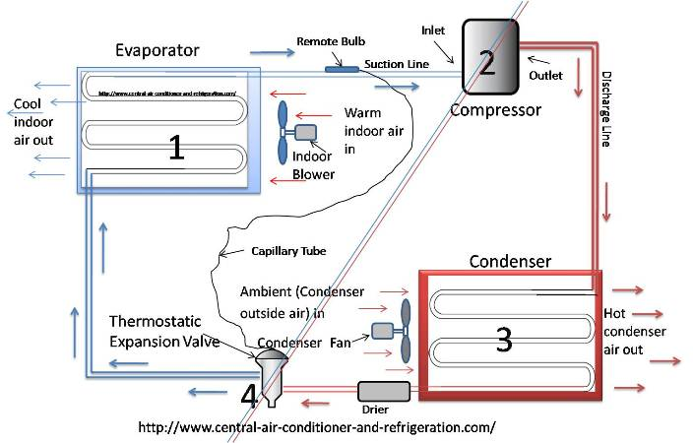
THE REFRIGERATION CYCLE

Slide 3
WHAT IS REFRIGERANT IN RAC
A chemical substance that absorbs heat from low-pressure, low temperature evaporator and condenses at a higher pressure, high temperature condenser
In the process of absorbing and condensing heat refrigerant will change state from liquid to vapour and back
The choice of refrigerant depends on design and purpose of RAC units

Slide 4
REFRIGERANTS IN RAC SECTOR
Refrigerant | ODP | GWP
R-22 | 0.055 | 1,820
R-123 | 0.02 | 93
R-134A | 0 | 1,300
R-407A | 0 | 1,770
R-407C | 0 | 1,530
R-410A | 0 | 2,090

Slide 5
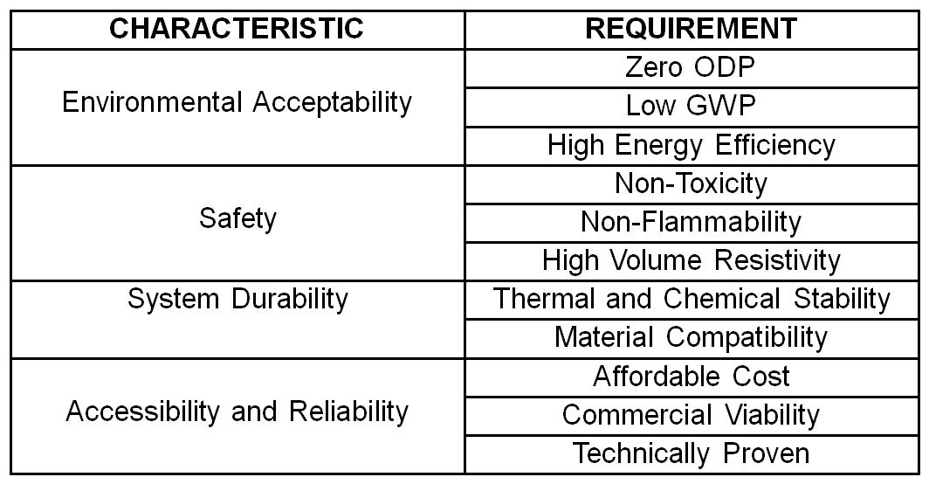
CRITERIA FOR ALTERNATIVES SELECTION

Slide 6
ALTERNATIVES TO ODS IN RAC
HFCs with low GWP – pure or in mixtures
Natural refrigerants
Unsaturated HFCs

Slide 7
LOW GWP HFCs: R-32
R-32 – difluoromethane - CH₂F₂
Either alone or as component of refrigerant blends (e.g. R-410C or R-407A) in industrial refrigeration
Efficiently conveys heat and thus can reduce electricity consumption up to 10% (compared to RAC equipment with R-22)
Global warming potential (GWP) one-third lower and is thus remarkable for its low environmental impact
Has a high discharge temperature that can lead to oil degradation which can cause compressor failure

Slide 8
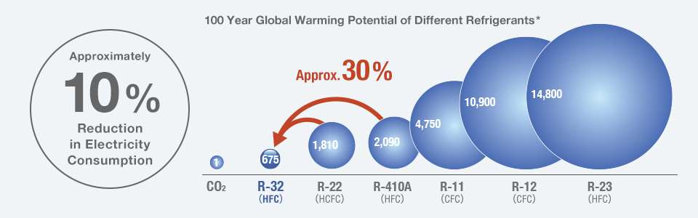
LOW GWP HFCs : R-32

Slide 9
ADVANTAGES OF R-32
R-410A is the refrigerant most commonly used in developed countries
R-32 has a similar pressure as R410A - this can ease the development on an R-32 system based on an R-410A platform
R-32 has a higher critical temperature which yields a higher COP of RAC equipment
If all R-410A were converted to R-32, the impact to global warming from HFCs in 2030 would be reduced by the CO₂equivalent of approximately 800 million tons (19%) compared to the continued use of R-410A

Slide 10
LOW GWP HFCs: R-152
R-152A – 1,1-Difluoroethane - CH₃CHF₂
Blend component of several refrigerant blends; potential application in mobile air conditioning
R152a is suitable for use in new equipment
Also used as the working fluid of temperature controllers
Besides RAC also can be used as blowing agent (XPS foams), cleaning agent and aerosol
Its flammability creates challenges thus limiting its use

Slide 11
LOW GWP HFCs: R-161
R-161 – Fluoroethane - C₂H₅F
Better COP, increased refrigeration effects and lower discharge temperatures
Power consumed found to be greater than other refrigerants hence issues of energy efficiency
In general has good performance characteristics but official safety classification is not yet established
Problems are flammability as well as thermal stability at high ambient temperatures

Slide 12
HFC BLENDS – R-407C
R-407C = mixture of (HFC-32/125/134a)
Retrofit candidate with HFCs;
Lower energy efficiency and capacity
Lubricant change needed
Material compatibility issues
Was used in developed countries for early phase out of HCFC-22 but is decreasing

Slide 13
HFC BLENDS – R-410A
R-410A = mixture of HFC-32 and HFC-125
Suitable for new systems
Significant design changes needed (e.g. new compressor, lubricant, capillary tube etc.)
Operates at higher pressures than other refrigerants thus R-410A systems require to use different tools, equipment, safety standards and techniques
Preferred for use in residential and commercial air conditioners in Japan, Europe and the United States
Only HFC blend extensively used in many countries

Slide 14
OTHER HFC BLENDS
R-417A (HFC-125/ HFC-134a/ HC-600): Retrofit candidate with HFCs; similar capacity but material compatibility issues; Not seriously considered in developed countries;
R-422A (HFC-123/HFC-134a/ HC-600a): Retrofit candidate with HFCs; Material compatibility issues; Drop in capacity; Not seriously considered in developed countries
R-433A (HC-290/HC-1270): Retrofit candidate; Drop in capacity, about 5% and 5-8% more energy efficiency than HCFC-22; Not seriously considered in developed countries due to safety issues

Slide 15
HFC BLENDS – PROS AND CONS
Non-flammable
Useable heat capacity close to HCFC 22 (e.g. R-407C)
COP less than HCFC
Reliability/Compatibility issues with the materials of system construction
System changes necessary

Slide 16
ALTERNATIVES TO ODS IN RAC
HFCs with low GWP – pure or in mixtures
Natural refrigerants
Unsaturated HFCs

Slide 17
NATURAL REFRIGERANTS - HYDROCARBONS
R- 290 – propane; R–600a - isobutane , R-1270 -propylene
R-290 suitable for residential and non- residential AC as well as commercial and industrial refrigeration applications (medium and low temp.)
R-600a widely-used for household refrigerators (lower working pressure compared to other HCs
R-1270 suitable for medium- and low-temperature commercial and industrial refrigeration as well as low temperature water-glycol chilling units for industrial applications

Slide 18
NATURAL REFRIGERANTS - HYDROCARBONS
Good compatibility with materials (mineral oil lubricants)
Well suited for high ambient temperatures
Price is lower than that of other synthetic refrigerants
Use for cooling/heating more efficient than with synthetic refrigerants
Flammability requires special care in design, manufacturing and service
Centralized systems have substantially higher ICC and increased energy demand

Slide 19
NATURAL REFRIGERANTS - HYDROCARBONS
Knowledge of legislation, regulations and standards relating to flammable refrigerants
Electrical devices attached to / close to system must be non-sparking (sealed type) or solid state or installed in separate/ adjacent room
Provision of adequate ventilation surrounding system/equipment
HC charge is lower by more than 50% of HCFC by weight
Safe manufacturing / servicing for refrigerant leakage prevention, handling of cylinders, charging, leak detection etc.

Slide 20
NATURAL REFRIGERANTS - CO₂
R- 744 – CO₂ - carbon dioxide`
Excellent thermodynamic properties make it suitable for a range of applications e.g. often the choice for the low temperature stage in commercial and industrial cascade refrigeration systems
Energy efficiency better than HFC systems below 24 C ambient
Lower material cost- allowing systems with small volumes
Stronger materials required (working pressures above 75 bar at ambient temperatures)
Loss of performance of the systems in high ambient climates
Special material and construction demands thus not suitable for retrofit

Slide 21
NATURAL REFRIGERANTS - NH₃
R-717 – Ammonia – NH₃
Highest refrigerating capacity per pound of any refrigerant
Less expensive than HFCs
Lower material cost- because of narrower diameter piping in ammonia-based refrigeration systems
Energy efficient - requires less electricity, resulting in lower operating costs than HFC systems
Corrosive to copper and brass (not to steel and aluminium)
Poisonous in high concentrations (but detectable at concentrations well below dangerous)

Slide 22
NATURAL REFRIGERANTS - NH₃
Standard refrigerant for industrial refrigeration systems for more than 125 years
Ammonia refrigeration systems for low temperature applications must be designed in two stages with intermediate cooling
Used with indirect systems in public access areas (systems with evaporating secondary refrigerant for the medium temperature and/or low temperature range)
Recently used as the higher temperature stage in CO2 cascade refrigeration systems

Slide 23
ALTERNATIVES TO ODS IN RAC
HFCs with low GWP – pure or in mixtures
Natural refrigerants
Unsaturated HFCs

Slide 24
UNSATURATED HFCs - HFOs
R-1234yf (DuPont and Honeywell) - a successor to R134a for mobile air-conditioning
Similar thermal properties to R134a, meaning there are only minor system layout and design differences; potential application in chillers
R-1234ze (Honeywell’s Solstice® ze) - alternative to traditional refrigerants for energy-efficient chillers and/or commercial air conditioning in supermarkets and commercial buildings
Also suitable for other medium-temperature applications e.g. heat pumps, refrigerators, vending machines beverage dispensers

Slide 25
UNSATURATED HFCs - HFOs
Very low GWP (<1) due to higher reactivity and thus shorter lifetimes in troposphere
Processes and by-products in the manufacture not well known (potentially HFC-23)
Health impact unclear due to variable toxicology
Flammability not well known
Problems of commercial availability and relatively high price

Slide 26
BARRIERS TO USE OF LOW-GWP ODS ALTERNATIVES
Technical design and safety design (additional cost)
Supply and availability (materials, equipment, components)
Commercial (investment, profit, financial incentives)
Market (customer, competing products)
Information resources (know-how, guidance, technical data)
Regulatory and quasi-regulatory (legislation, standards)
Psychological and sociological aspects

Slide 27
PROMOTION OF LOW-GWP ODS ALTERNATIVES
Use of low GWP alternatives driven primarily by commercial criteria (price, ICC, IOC, commercial availability of refrigerants)
Political decisions important factor for promotion of long term solutions (e.g. Kigali Amendment of MP)
Financial incentives trigger move to long term alternatives - e,g MP grants
Demonstration projects for specific alternative refrigerants entering the market (e.g. HFOs)

Slide 28
THANK YOUFOR YOUR ATTENTION!

