Slide 1
Reporting obligations under the Montreal Protocol and Multilateral Fund
The South Asia Network Meeting
Agra, India

Slide 2
Outline
Data reporting under Article 7 of the Montreal Protocol;
Data reporting on Country Programme for online submission;
Reporting consumption of ODS in blends/mixtures;
How the National Ozone Officer can ensure quality, accuracy and consistency of Article 7 data and Country Programme Implementation Progress.

Slide 3
Difference between Article 7 and Country Programme Reporting
 | Article 7 | Country Programme Reporting
What data to submit | Data on import, export, production, substance destroyed and trade with non-Parties (import/export) by controlled substance | Data on use by sector Total import, export and production amount by controlled substance and others
When to submit | By 31 September of following year (preferable 30 June) | By 1 May of following year (preferable Mar)
Who to submit | Ozone Secretariat | Multilateral Fund Secretariat
Why it must be submitted | Official country consumption Compliance/Non-compliance | Approval of Multilateral Fund Project (IS, HPMP tranche)
How to submit | E-mail to Ozone Secretariat cc to RNC | Online Portal E-mail to MLF Secretariat

Slide 4
Article 7 vs Country Programme
Article 7
Questionnaire
Imports
Exports
Production
Destroyed
Trade with non-Parties
Country Programme Reporting
Datasheet-Data on controlled substance in MT
Admin B-Regulatory, administrative and supportive actions (not required now)
Admin C-Quantitative Assessment of the Phase-out Programme
Admin D-Qualitative Assessment of the operation of HPMP
Admin E - Comment by bilateral/implementing agency(ies)

Slide 5
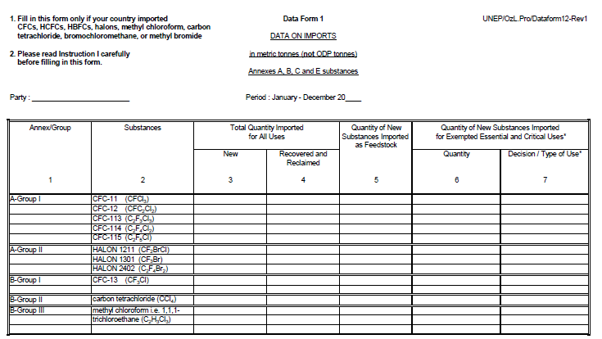
Article 7 Data

Slide 6
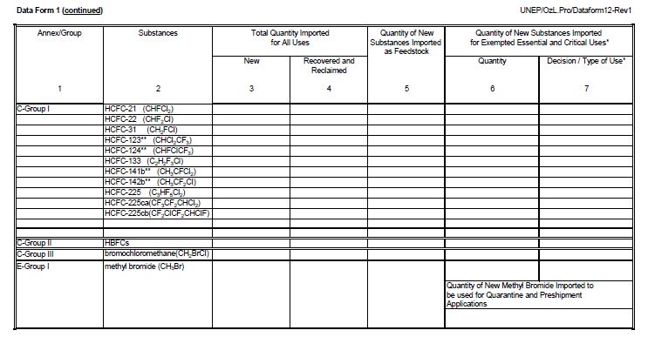
Article 7 Data
Article 7 Data

Slide 7
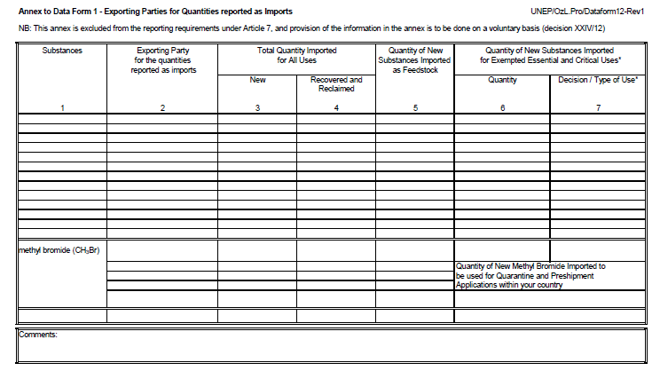
Voluntary Data

Slide 8
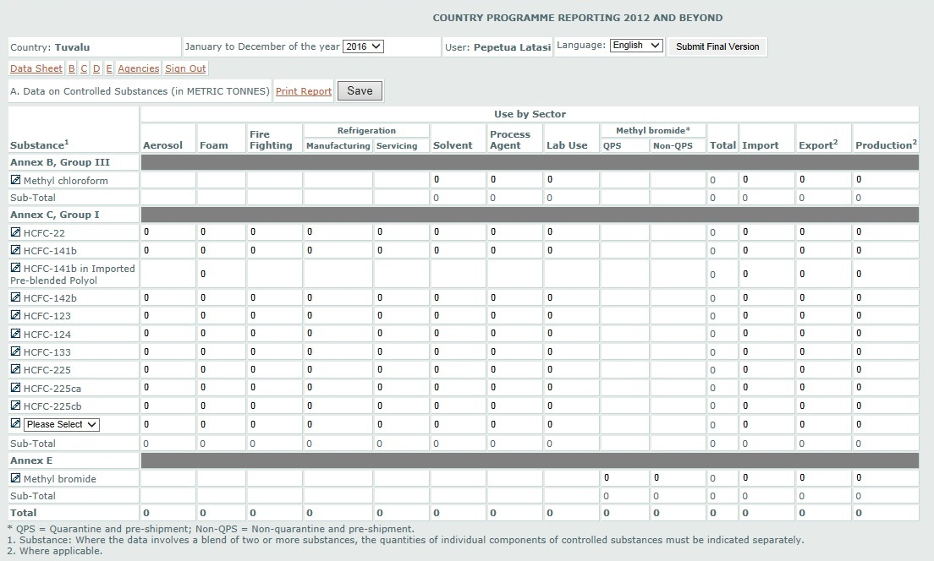
Country Programme Reporting-Datasheet

Slide 9
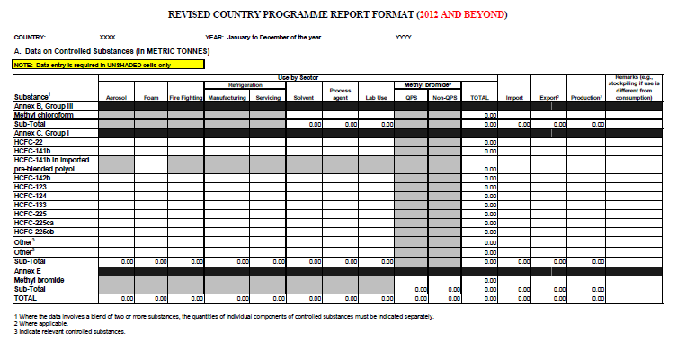
Country Programme Reporting - Paper Template

Slide 10
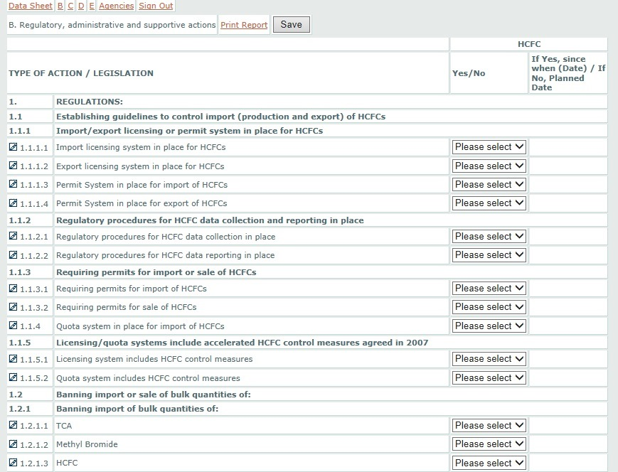
Country Programme Reporting-Admin B

Slide 11
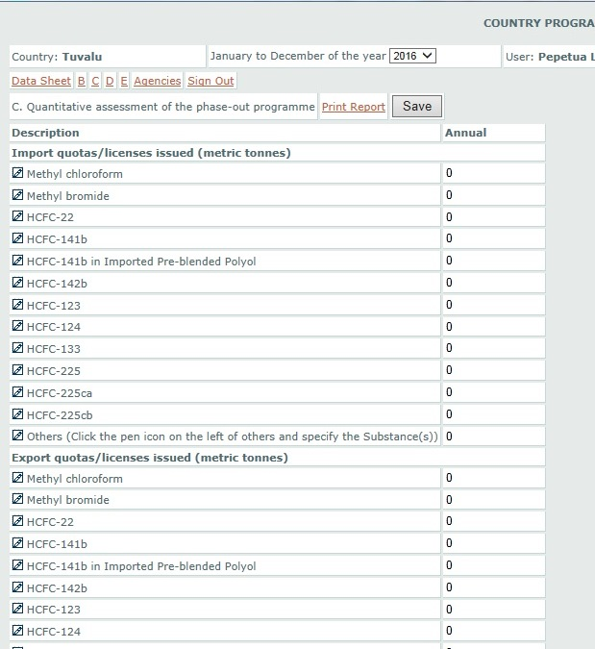
Country Programme Reporting – Admin C
Import quotas/licenses issued
Export quotas/licenses issued
Average estimated retail price of ODS/substitutes (US$/kg)
Training programmes (not required now)
Recovery/recycling/reused (not required now)

Slide 12
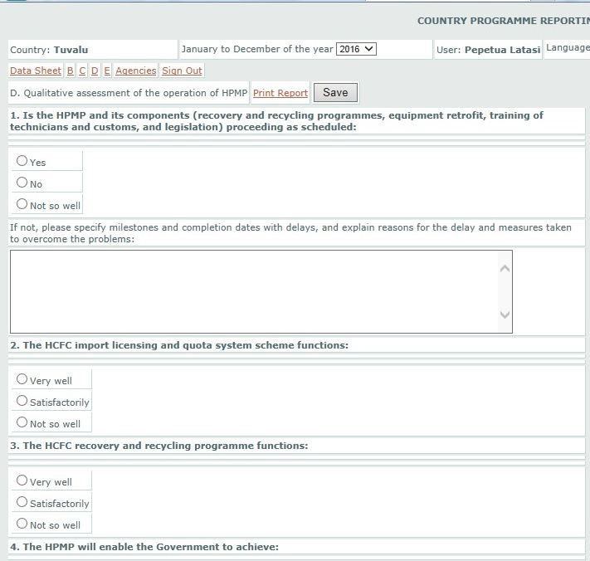
Country Programme Reporting – Admin D

Slide 13
Executive Committee Decision 76/7(c)
(c) To continue using the existing country programme data report format, noting that:
    Section B on regulatory, administrative and supportive actions was no longer needed, although such data might be needed if there were further adjustments or chemicals added;
    Section C on HCFC quotas issued and prices of ODS and alternatives (where available) was still relevant, although information on training and recovery, recycling and reuse was no longer needed;
    Section D on the status of implementation of the licence and quota system (qualitative assessment of operation of the HPMP) should continue to be provided, but other qualitative information in that section was no longer necessary;
(d) To consider revising the CP data report format at a future meeting, on the basis of the outcome of the surveys of ODS alternatives and the discussions on the HFC amendment

Slide 14
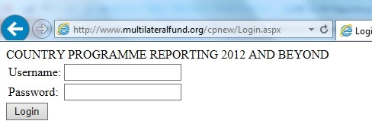
How to submit CP Reporting Online
1. Assess to http://www.multilateralfund.org/cpnew/login.aspx?ReturnUrl=%2fcpnew
Enter “Username” and “Password”
Country Username and Password is available at UN Environment, CAP

Slide 15
Reporting consumption of ODS in blends/mixtures
Where the data involves a blend of two or more substances, the quantities of individual components of controlled substances must be indicated separately.
For example, if the country imported R-406A
Therefore, in this case, the amount of HCFC-22 and HCFC-142b in R-406A must be calculated and included in A7 and Country Programme Reporting.
Composition of R-406A = HCFC-22 / R-600a / HCFC-142b
(55:4:41)

Slide 16
Example of Calculation
Country A import 3 MT of HCFC-22 and 2 MT of R-406A. How to report the import of controlled substances?
Breakdown of 2 MT of R-406A by component
  HCFC-22 = 55% x 2 MT = 1.1 MT
  R-600a = 4% x 2 MT = 0.08 MT
  HCFC-142b = 41% x 2 MT = 0.82 MT
Therefore, import of controlled substance will be reported as follows:
  HCFC-22 = 3 MT (HCFC-22) + 1.1 MT (R-406A) = 4.1 MT
  HCFC-142b = 0.82 MT (R-406A) = 0.82 MT

Slide 17
How the National Ozone Officer can ensure quality, accuracy and consistency of Article 7 data and Country Programme Reporting
Accuracy is determined by how well the NOO keep record;
Cross-checking with other concerns authority that maintain the import data to ensure consistency;
Advisable to be reviewed by UN Environment prior to final submission.

Slide 18
General observations
Report | Sheet | Observation
Country Programme | Data Sheet | Import and export amount not reported
 | Admin-B (Legislation) | Different from previous year – not required now Planned date not provided – not required now
 | Admin-C | Number of customs / RAC technician trained – inconsistency with the progress report – not required now
Article 7 | Export, Production, Destroyed, Non-parties | Although there was no export, production, destruction, trade with non-parties, country also needs to complete the sheet. Country Reporting year Put N/A or 0 in the row.

Slide 19

30 Montreal Protocol
CARING FOR ALL LIFE UNDER THE SUN
Thank you!

