Slide 1

National Cooling Action Plan Seminar
Indian Polyurethane Association 17 Jan 2018 New Delhi

Slide 2
Polyurethane Foam
Isocyanates
Isocyanates
Isocyanates
Polyurethane
Polyol
Mixed
Fire retardant (Optional)
Surface active agent
Polyols
Accelerating agent
Water
Blowing agent

Slide 3

India Insulation Forum (IIF)
India Insulation Forum (IIF ) was created as a sub unit under IPUA
to promote INSULATION in the building envelop/Cold Chain
industry to enhance and promote Energy Efficiency.
IIF is represented by reputed companies and processors who make different
materials for Insulation used for energy efficiency in buildings and Cold Storages.
IIF is heterogenous group , but is,
Technology NEUTRAL
Product NEUTRAL
Company NEUTRAL
Promotes the concept of Energy Efficiency

Slide 4

Spray Foam Alliance of India ( SFAI )
A sub-unit of IPUA created to address two important issues.
First – to bring into effect the simplest and most effective form of INSULATION –
Spray Polyurethane Foam
Second – to train the crucial link in the industry chain – the APPLICATOR
alongwith machinery manufacturers
INSULATION is a game changing factor in the Energy Efficiency program
Technical
Manual
A Guide to
Energy
Security
WORKING WITH SPRAY POLYURETHANE FOAM

Slide 5
Spray Foam Alliance of India( SFAI )
A comparison of Thermal Conductivity Co-efficient shows Spray Foam
the leader.
Insulation Material | Thermal Conductivity Coefficient
Spray Polyurethane Foam | 0,023 W/mK
Expanded Polystyrene EPS | 0,030 - 0,047 W/m K
Extruded Polystyrene XPS | 0,029 - 0,037 W/m K
Mineral Wool | 0,033 - 0,044 W/m K

Slide 6



Insulation Benefits
  Stops heat / cold ingress from outside
  Saves on fossil fuel
  Reduces emission of GHG.
  Lower energy losses; avoid the danger of oversized heating or cooling systems that works hard to compensate for the heat or cold losses through the building envelope.
  Effective insulation lowers heating or cooling bills, thus no longer being affected by rising energy costs
  Maintains controlled temperature for longer periods.
  Reduces wastage of perishables like Fruits and vegetables
  Human Comfort – improves the efficiency of occupier or user.
  Provides fungus-free and microbe-free healthier environment
Environmental
Economical
Social

Slide 7
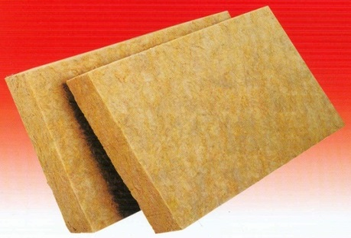
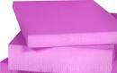
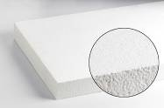
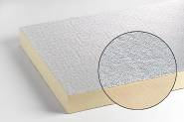


Efficient Insulation Products
Fibrous/Mineral Wool Materials
Rock wool
Glass Wool
Slag Wool
Rigid Insulation Materials
Expanded Polystyrene ( EPS )
Extruded Polystyrene (XPS )
Polyurethane Foam ( PU )
Polyisocyanurate Foam ( PIR )

Slide 8
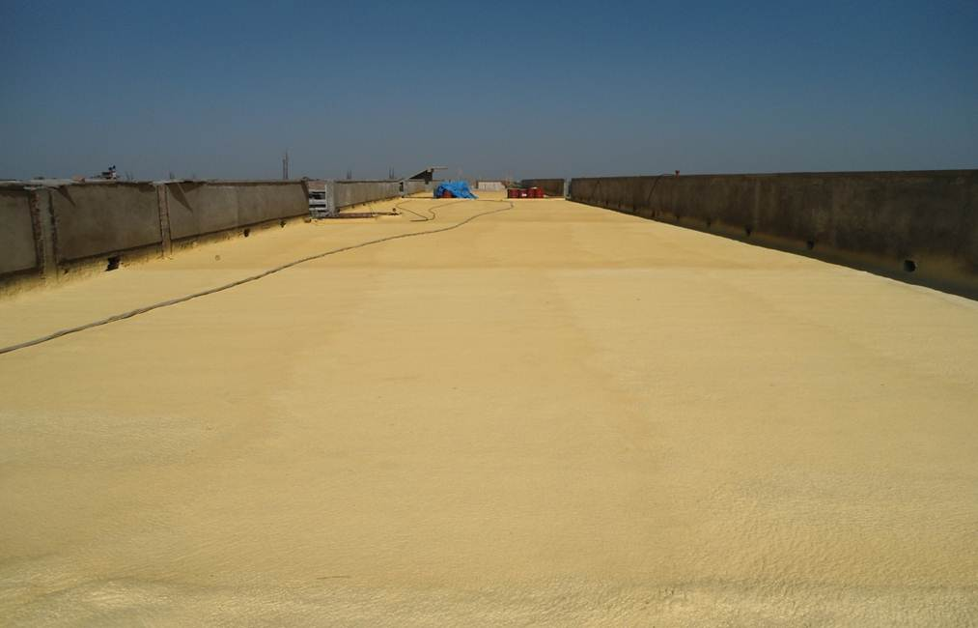
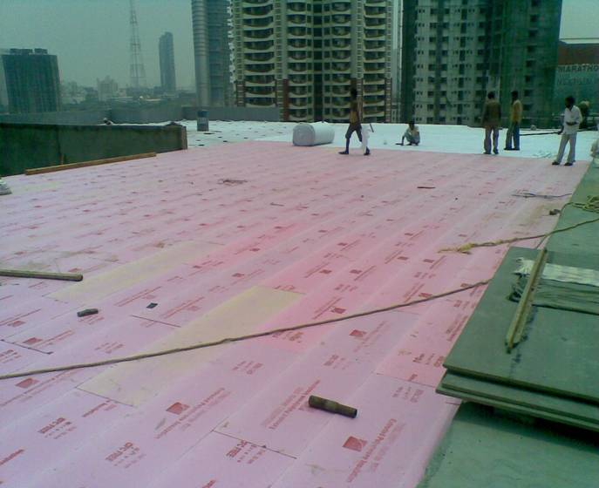
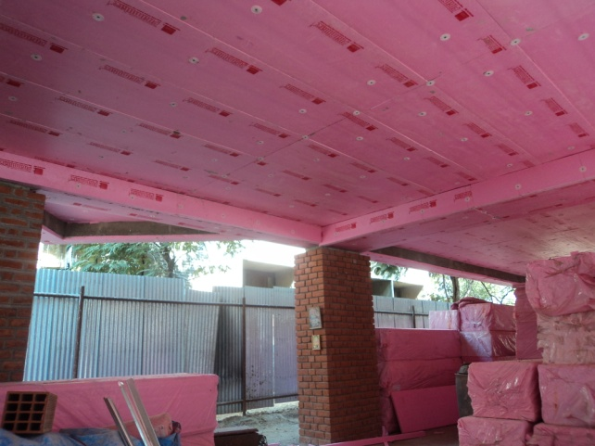
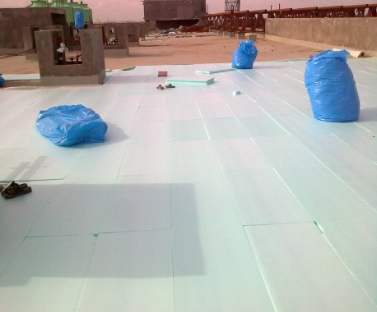
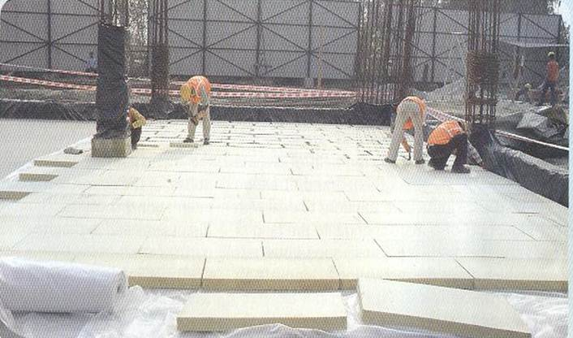
Roof Insulation ( Over Deck & Under Deck )
Over deck Insulation:
PU Spray Insulation on roof
Over deck Insulation XPS on Roof
Under deck Insulation:
XPS
Over deck Insulation: XPS & PUF slabs

Slide 9
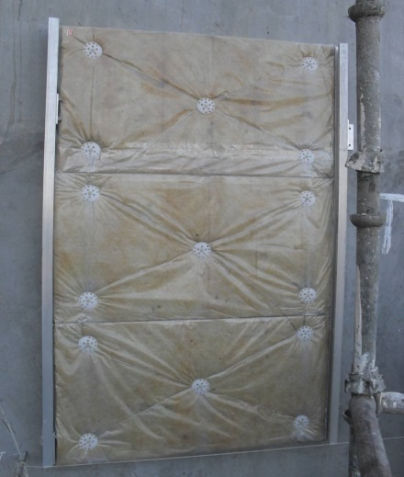
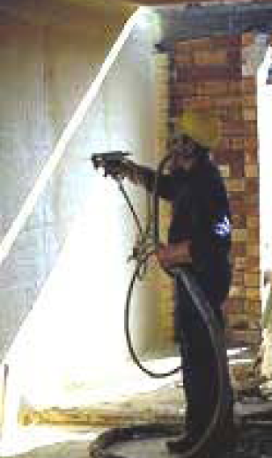
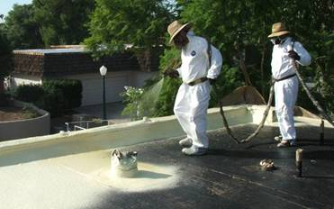
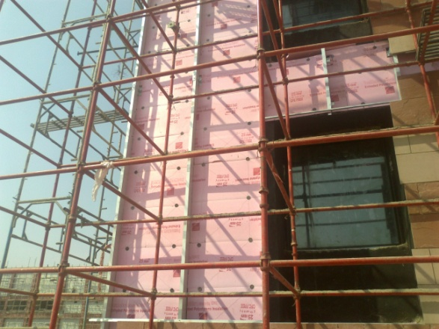
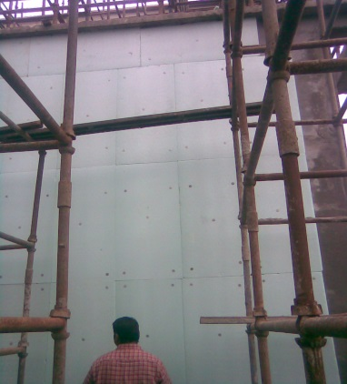
Wall Insulation – Internal & External
PU Spray Insulation- Interior Walls & Roof
Dry Wall Insulation with Mineral Wool
External Wall Insulation with XPS
Curtain Wall Insulation XPS (External Walls)

Slide 10
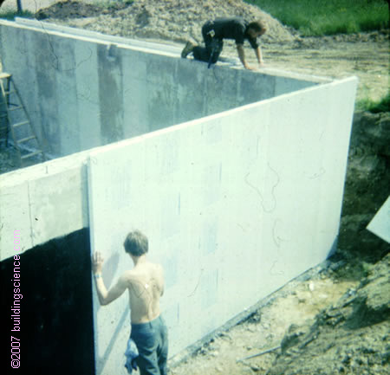
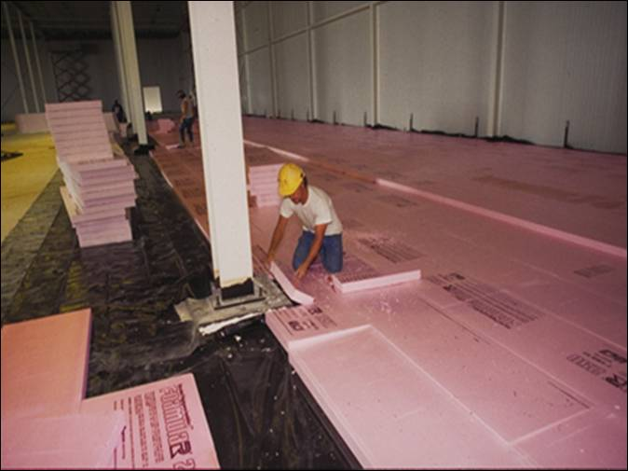
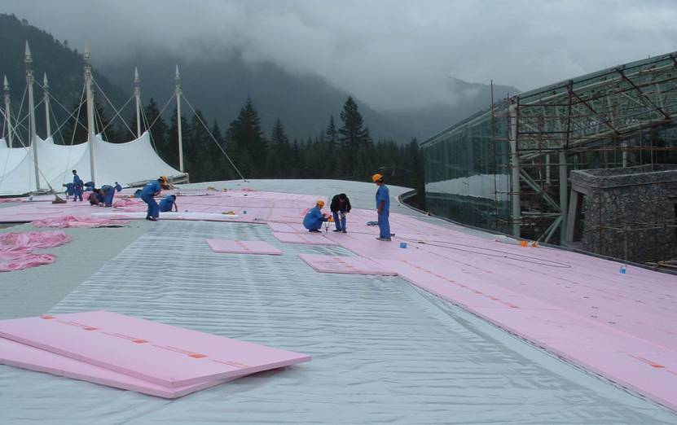
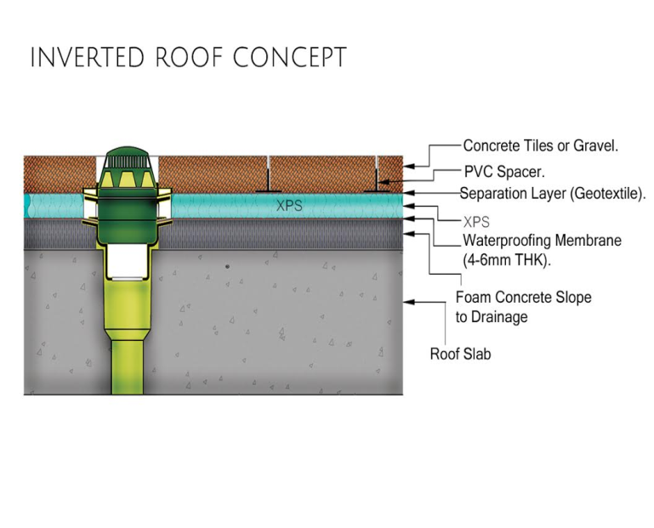
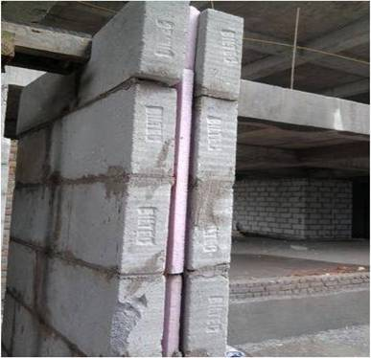
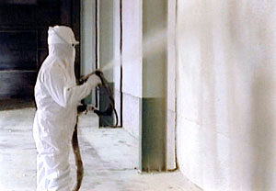
Different Application Methods
Basement Insulation
Floor Insulation
Direct to Deck Metal Roof
Inverted Roof Concept
Spray Foam
Cavity Wall Insulation- XPS

Slide 11
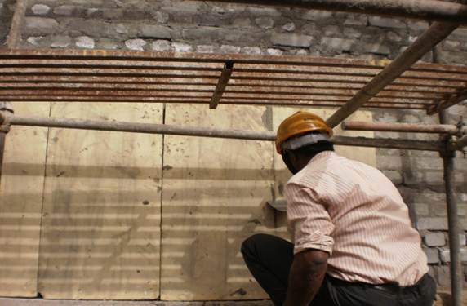
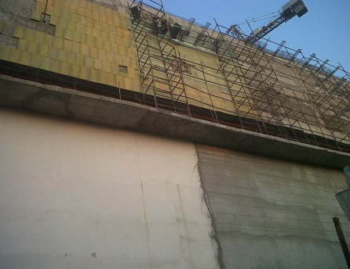
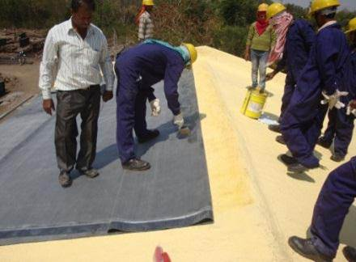
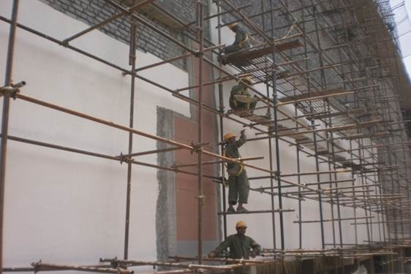
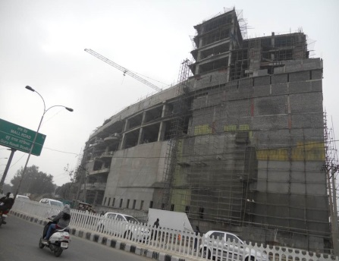
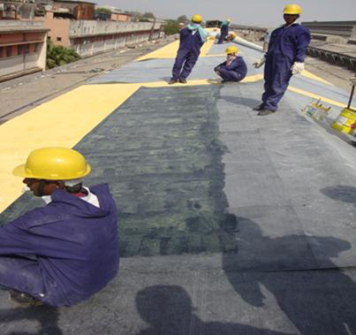
Different Application Methods - Polyurethane
PU External Thermal Insulation Composite System
PU Roof Insulation with
water proofing membrane

Slide 12
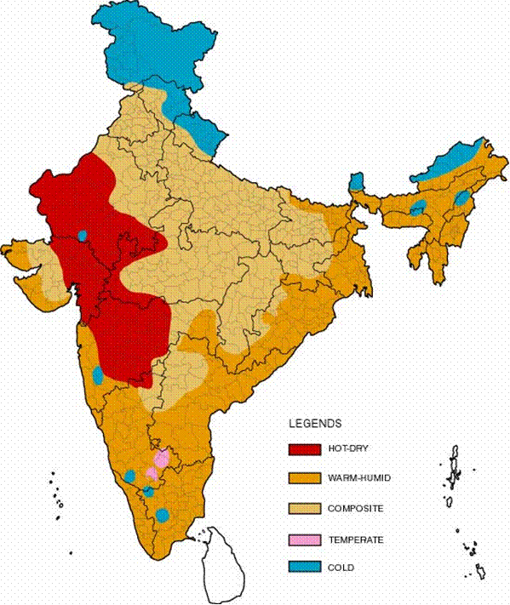
Climate Map of India
Five Climate Zones in India
ECBC refers to these and suggest different compliance for different zones
Hot – Dry
Warm – Humid
Composite
Temperate
Cold
R value Specified for all zones (roofs & walls)
Source : ECBC

Slide 13
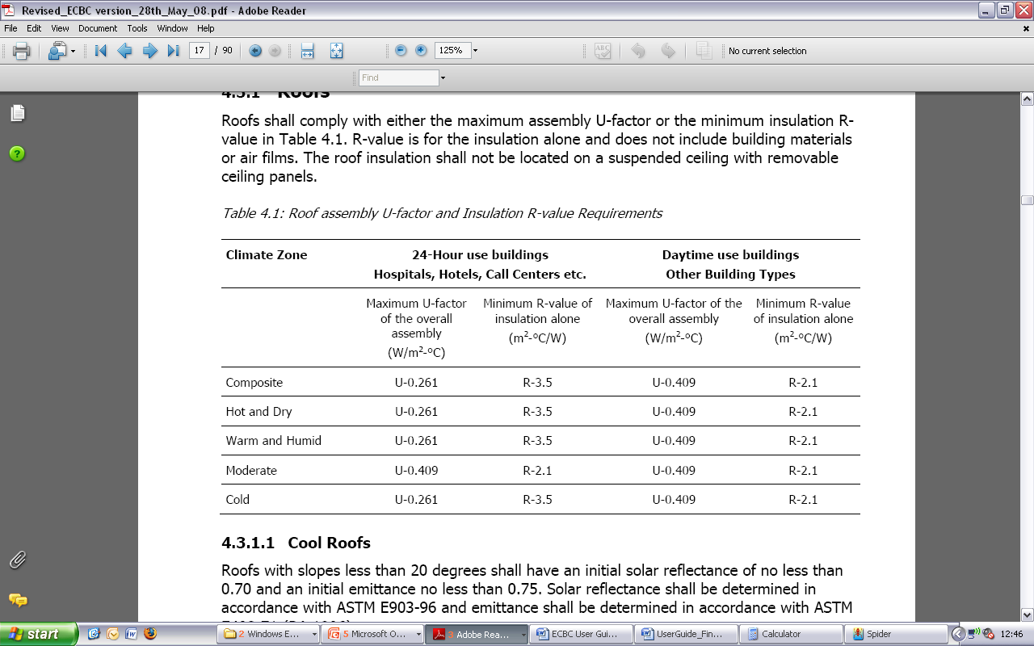
ECBC Requirements: Prescriptive (Roof)
Maximum U-factor is prescribed for the complete roof assembly.
Minimum R-value is prescribed for insulation alone (excluding air films)
Recommendations made for proper placement, installation and protection of insulation
Source : ECBC

Slide 14
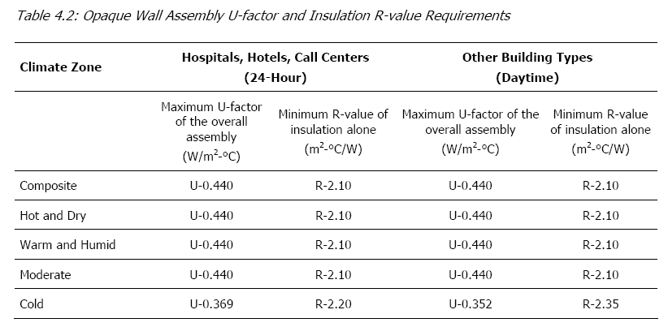
ECBC Requirements: Prescriptive ( Wall )
Maximum U-factor is prescribed for the complete wall assembly
Minimum R-value is prescribed for insulation alone (excluding air films)
Source : ECBC

Slide 15

Heat Load Components - Warm Humid Climate - Chennai
Roof: 25%
Summer Heat Flow (May)
Weather Conditions
Temperature | Min.: 18.7ºC, Max.: 42.6ºC, Avg.: ~32ºC
Relative Humidity | Min.: 13%, Max.: 97%, Avg.: ~50%
Wall: 32%
Windows: 36%
Net heat flow per unit area
Roof (15 m²) | 17.0 kWh/m²
Wall (47.6 m²) | 7.3 kWh/m²
Window (8.4 m²) | 44.5 kWh/m²
Infiltration (based on floor area 15 m²) | 4.9 kWh/m2
Infiltration: 7%
Source : BEEP

Slide 16
Heat Load Component – Composite Climate ( Delhi )
Summer Heat Flow (May)
Weather Conditions
Temperature | Min.: 18.7ºC, Max.: 42.6ºC, Avg.: ~32ºC
Relative Humidity | Min.: 13%, Max.: 97%, Avg.: ~50%
Roof: 31%
Wall: 32%
Windows: 31%
Summer Heat Flow (May)
Weather Conditions
Temperature | Min.: 18.7ºC, Max.: 42.6ºC, Avg.: ~32ºC
Relative Humidity | Min.: 13%, Max.: 97%, Avg.: ~50%
Infiltration: 6%
*Direct heat gain from windows not accounted
Source : BEEP

Slide 17
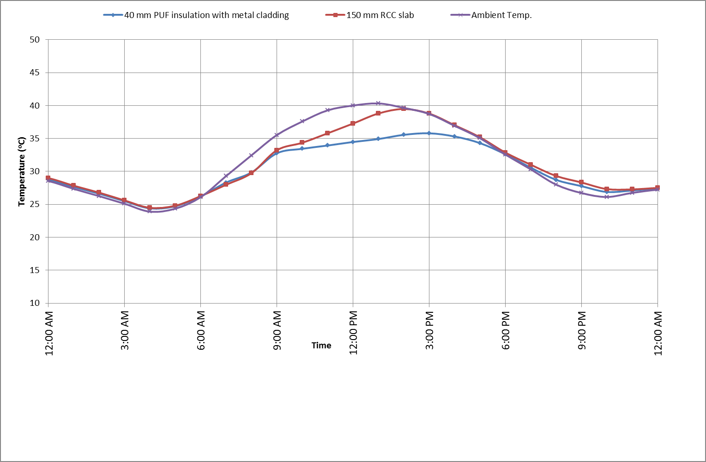
Impact of Roof Insulation
School building in a typical summer day in Composite climate (Indore, M.P.)
With a roof of 40mm insulation with metal cladding
  Up to 6-7ºC cooler than ambient
  Up to 4-5ºC cooler than RCC
Source : BEEP

Slide 18
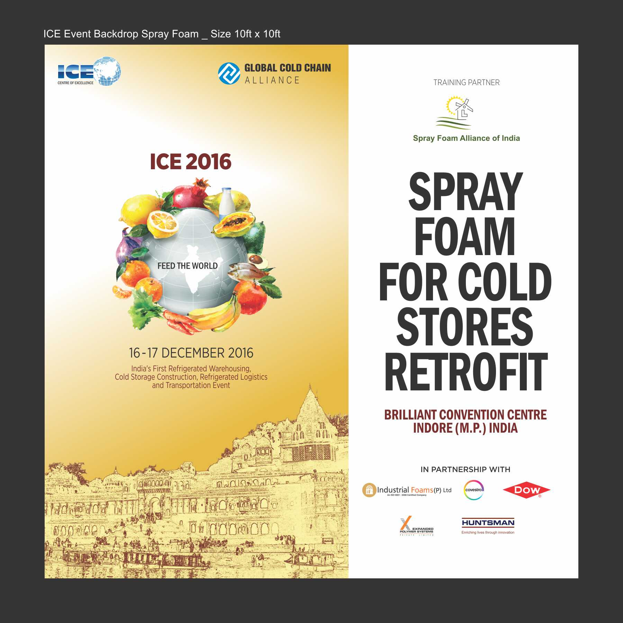

Slide 19
Challenges
Awareness
Mandatory
Implementation issues
Energy Guzzling Buildings
Life Cycle Analysis
Standardization

Slide 20
Conclusion
Indian Polyurethane Association in its own way tries to promote
Energy Efficiency through its sub-groups of IIF & SFAI.
IPUA conducts Training programs at different locations to
keep the industry abreast of the needs
IPUA conducts Seminars on Insulation with specialists
in the field of Energy Efficiency
IPUA conducts training programs on Insulation in Polytechnics

Slide 21
Thank You

