Slide 1
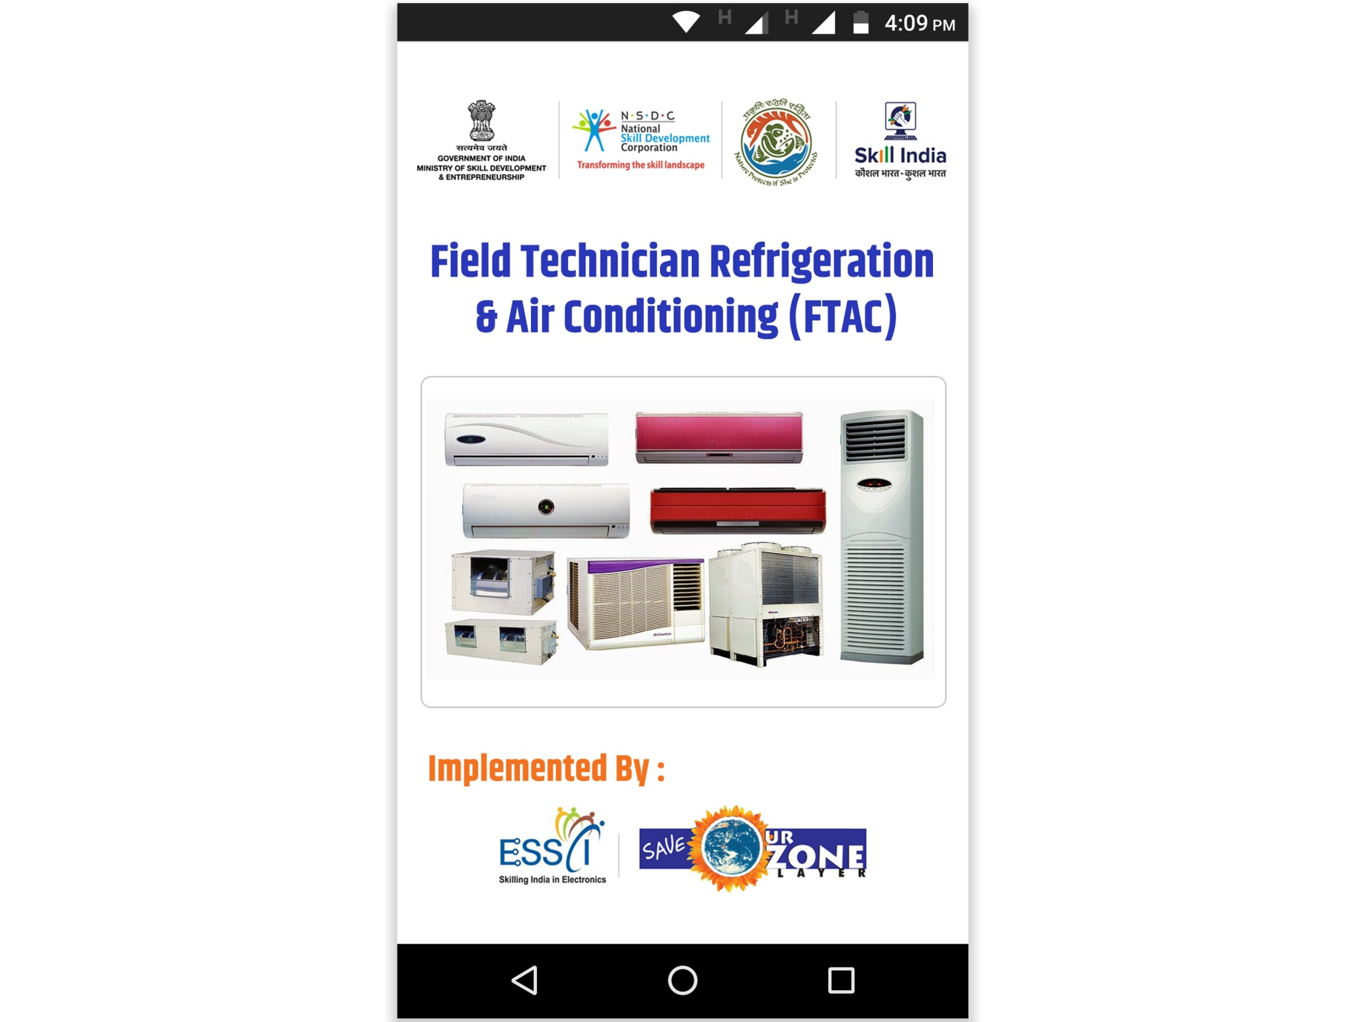
Field Technician – Air Conditioning
FTAC
Mobile App

