Slide 1
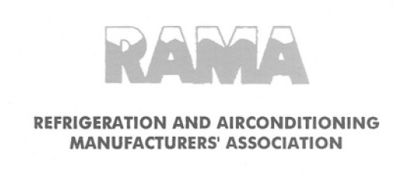
National Cooling action plan Air conditioning Residential, Commercial & Industrial applications
Jitendra Bhambure – ODS Chair RAMA

Slide 2
Thematic thrusts
Implications of HCFC Phase out, HFC Phase down & Kigali Amendment, inter-alia sectors & applications highlighting
Current qualitative and quantitative available information including reports, guidelines, regulations etc.
Past trends and growth projections with a 20 year time horizon
Technology options with respect to refrigerant transitions and energy efficiency
Current levels of energy efficiency and Efficiency enhancement options and related Benchmarks
Preparedness for transitions & related capital and operational costs
Some elements of the road map.
Topics that need detailed and additional study

Slide 3
Present status

Slide 4
Background
The penetration of Room AC is around 5 to 6 %, 70% of the buildings for commercial use are yet to be built which will require air-conditioning
The Regulation are being formulated at increasing pace like energy efficiency programs, up-gradation/development of IS Standards, refrigerants phase out and down , QCO, E-waste.
There is uncertainty in adoption of technologies to meet the regulations.
This has created immense pressure across the business chain

Slide 5
HCFC phase out & HFC phase down
HCFC 22 phase out as per MC 2025
HFC : Freeze 2028, Phase down to start in 2032
Status in India
Room AC is fast migrating from fix speed to inverter resulting in adoption of HFC 410A as refrigerant ( approx 25 % ), few manufacturers have adopted HFC 32 ( approx 15%) and HC 290 (approx 1%)
Large Chillers have adopted HFC 134a & VRF has adopted HFC 410A the technologies being brought in India by MNCs
There is no alternative as of today to HFC 410A in ducted, small chillers & VRF, few MNC’s are working to develop alternate refrigerants to R410A
The adoption of HC in room AC has challenges in terms of safety across the business chain

Slide 6
Room AC energy efficiency
The labeling program started in 2010, has been enhanced 4 times
The MEPS for FIVE star has increased by 45% (22% of the market) and by 29% in THREE star (55 % of the market) as per the BEE labeling program
The products are getting costlier & the technology is reaching a plateau
5 STAR 1.5 T | Copper wt(KG) | Alu wt (KG) | Compressor | Motor | Drive | Chassis
2010 | 2.10 | 1.95 | Fix speed | AC | NA | 500 mm
2018 | 2.78 | 3.10 | Inverter | DC | Required | 625 mm

Slide 7
Energy efficiency
The Energy Efficiency labeling Programs are pushing for higher and higher efficiency and has put the HVAC industry in a perpetual design cycle
The approach is focused on the products, being measurable, easy to implement, however the technology is reaching the limit
We feel that energy saving should be the focus and not product energy efficiency only. Reducing heat load, usage and maintenance of the equipment needs to be addressed.

Slide 8
Frequent non synchronized regulatory changes
The speed of adoption of new technologies to meet various technologies has strained the business cycle. To add to it, implementation of the various regulations is not synchronized.
This has impacted in abrupt changes in the product life cycle & premature ending the life of the product creating confusion in the market
The changes involve resources to be added in R&D, product management, supply chain, production, service of manufacturers and by the distributors & dealers
Capital and resource investments are not fully recovered which is not affordable in country like India with high interest rates

Slide 9
Training and competency development of service technicians
Customer dissatisfaction, power quality issues, frequent voltage fluctuation & outage (Tier II, Tier III Cities) which ultimately affect the product parts/life and repeated service calls are financial burden on the manufacturers
Competency of the distributor and dealer technicians who are spread across the country are unable to cope with the pace of the change of technologies such as invertor and refrigerants.

Slide 10
Long term

Slide 11
Multi prong approach
The final goal should be to save energy consumption and reduce impact due to refrigerants and ensure that the comfort to the human population and demand for the industrial cooling is met for the growth of the country
Present approach is narrow and is based on finding alternatives to refrigerants and increase in the efficiency, we should acknowledge that we may reach dead end
This is significant for India as against developed world as we have low penetration levels and we have to be on high growth path to come to the level of developed world standards in next 25 years
Develop codes for residential buildings in line with ECBC this will reduce the heat load by approx 25 % as seen in Green buildings

Slide 12
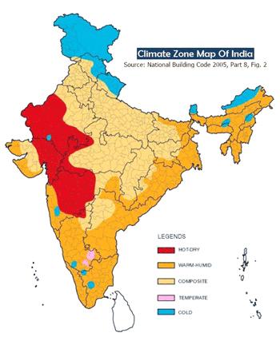
India climate map & cooling needs
Plan should be developed based on the climate zones
Considering that the plan is to be developed for 20 years plus, alternatives to vapor compression based cooling solutions needs to be developed
Study to be initiated to understand cooling requirement, estimated growth after considering techno social factors
Investment in research is needed
20 years is a long period and we should assume that disruptive technologies will emerge

Slide 13
Air conditioners capacity
AC Capacity = Heat Ingress + Internal heat generation
Ingress of heat depends on building design and construction material.
If we reduce ingress, air-conditioning capacity will reduce & will reduce refrigerant consumption per unit & energy consumption
India has rich history of addressing climate based construction to reduce heat load, integration of modern science is needed
Internal heat
generation
Ingress heat

Slide 14
Summary
Equipment energy efficiency has reached a plateau
Study of service and maintenance and its relation with energy consumption
Cost of products are higher as they are to be built to meet higher voltage fluctuations and voltage surge. This affects the efficiency of product. Need to address this issue at national level.
Adoptable solutions for refrigerants is still out of site
The present approach will deprive large mass of population from cooling, modern amenities as well industrial growth in the country
Multi prong approach is required based on India specific detail study & we should initiate work on Green residential buildings
Investments are required in research of India specific alternative cooling solutions

Slide 15
Jitendra Bhambure
Executive Vice President
R & D and Technology – Blue Star
Chair : RAMA ODS committee
jmbhambure@bluestarindia.com

