Slide 1
EESL’s Initiative in National Cooling Action Plan
17 January, 2018

Slide 2

EESL Super Efficient Air Conditioning Programme (ESEAP)
Bulk Procurement Mechanism

Slide 3
The Imperative- ACs contribute to peak demand
One AC
2 Incandescent Bulbs
2 Ceiling Fans
4 Tube lights
One TV
One Refrigerator
Studies show that the additional demand from room ACs in India is equivalent to 200-300 large (500 MW) power plants by 2030 i.e. 100-150 GW and 10% of energy demand (~ 300 TWh)
This implies
Significant addition to the grid generation capacity (read Coal based)
OR
Investing in in-situ diesel generators or battery inverters
Eventually increasing consumer tariffs
Source: Lawrence Berkeley National Lab (LBNL), USA

Slide 4
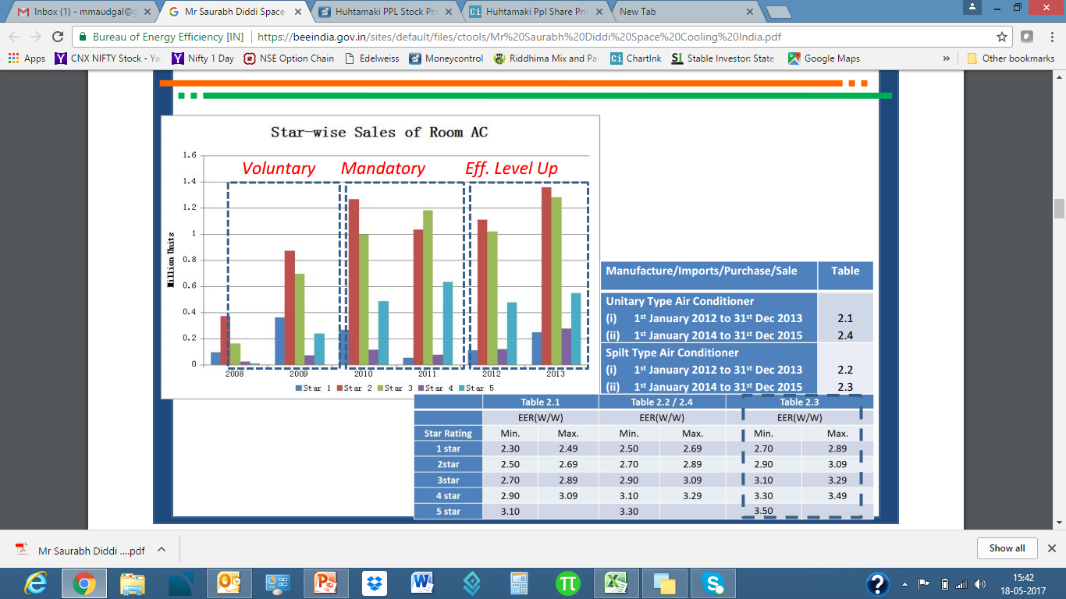
The Case for Market Side Intervention
Policy led rating programme has improved energy efficiency with time
Urbanization led rising AC demand (CAGR ~ 15%)
Yet
Slow inverter technology push (only 20% till date; major markets >75%)
Negligible low GWP options (HCFCs like R-290 / R-32/ R-410A/ blends)

Slide 5
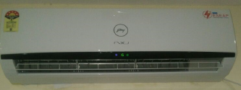
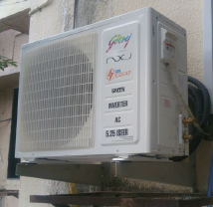
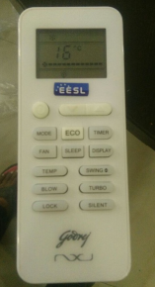
The ESEAP Product

Slide 6
Customers Want
ESEAP Offering
Product
First Costs & Running Costs
Warranty
After Sales experience
Easy Financing options
Super Efficiency (ISEER 5.2, 1.5 ton)
Split configuration Inverter technology
33% efficient from 5 Star
Low GWP
Assurance
Comprehensive warranty – 3 year; Compressor (5 years)
Tested to work in conditions like 52°C, Pollution
Convenience
Installation and 3 year annual service by brand
Buyback option
Financing options

Slide 7
Impact: Aggregation of AC market
100,000 ACs, rated ISEER 5.2 AC¹ at rational prices² with
3 year all comprehensive warranty
ACs supplied via institutional channels (and not retail)
Co-benefits
Higher uptake of Low GWP refrigerants (R-410A, R-290)
Design for India (works even at 52°C, polluted regions)
¹: 33% more efficient than the 5-Star rated AC with EER of 3.5
²: nearly 30% discount to expected open market prices
EESLs market led approach to
deliver cooling for India,
without heating up the planet

Slide 8

Cost Analysis
 | 3 Star Inverter AC | 5 Star Inverter AC | Super Efficient Inverter AC
ISEER | 3.2 | 4.2 | 5.2
Electricity Wattage | 1650 | 1250 | 1015
Market price | 40,000 | 45,000 | 54,500
5 year AMC | 20,000 | 20,000 | 3000
Annual operating days | 225 | 225 | 225
Operating Hours per day | 10 | 10 | 10
Annual Electricity Consumption Units | 3000 | 2275 | 1850
Annual Electricity Charges @ 8 Rs. | 24000 | 18200 | 14800
Electricity Charges for 5 years | 1,20,000 | 91,000 | 74,000
Total Cost for 5 years | 180K | 156K | 131K
Conclusion
Drop the idea of purchasing a 5 star rated AC today;
Simply purchase EESL super efficient AC.
ESEAP AC analysed against 5 star AC- 2014, 2015, (expected) 2018
Payback time based on expected consumer savings against incremental spend on 5 star product
All inclusive price includes installation , warranty and annual service
Source: EESL calculations,

Slide 9

Thank You

