Slide 1

Energy Efficient Cooling
Saurabh Diddi
Director

Slide 2
Bureau of Energy Efficiency
Energy Conservation (EC) Act 2001
Norms for Energy Intensive Industries
Standard & Labeling
Energy Conservation Building Code
Demand Side Management
Certification of Energy Professionals
BEE Established on
1st March 2002 under EC Act
Implement regulatory and promotional functions of EC Act.
Reduce Energy Intensity of our country
Has State Designated Agencies in each state for enforcement and awareness

Slide 3
India’s Energy Profile

Slide 4
Per Capita Energy Consumption

Slide 5
Growth in Building Sector

Slide 6
Growth in Building Sector

Slide 7
Cooling Profile - India
Air Conditioner Contribution:
Household: 20-30%
Commercial: 40-50%
70-80 GW connected load is only due to Cooling and consumes about 40-50 BU annually
Notes:
Surviving Stock: 25.67 million units of Room AC
Eq TR is 34.65 million TR (Average of Country is 1.35 TR per Room AC)
Average EER is 3.1
Hence 39.18 GW connected load due to Room Air Conditioner
RAC is 50% of total cooling Market, Hence 70-80 GW connected load due to cooling in India in 2014
Annual electricity consumption is based on 1200 hours of operation and 50% working out of total connected load, hence about 48 BU with 80GW connected load

Slide 8
Cooling Market

Slide 9
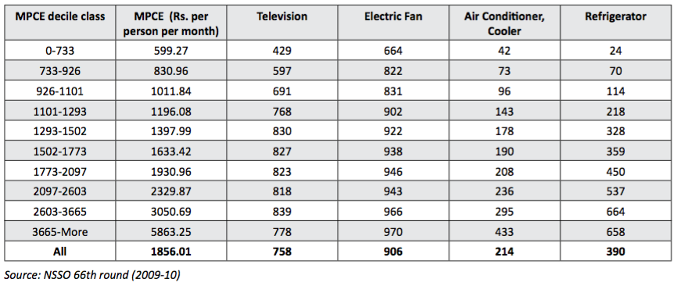
Urban Households Possessing Appliances per 1000 households
Approx. 6% in Urban Household
Notes:
214 AC & cooler per 1000 urban household, with assumption of 30% AC and 70% cooler in urban household. This ratio will be 64/1000 household which is about 6.4% penetration

Slide 10

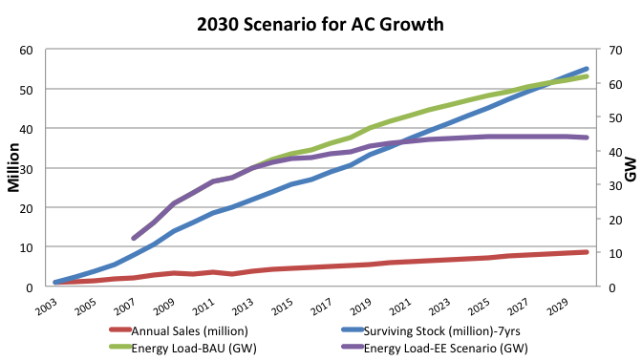
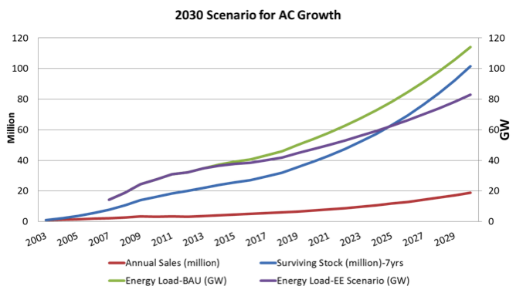

2030 Scenario
Challenge
Opportunity
Conservative Scenario
Aggressive Scenario

Slide 11
Opportunities & Challenges
Opportunity
Higher Penetration
Sales growth
More cooling requirement due to climate change & rise in incomes
Efficient Air Conditioners
Challenges
Significant peak load contribution due to cooling requirements
High Electricity consumption
High cost of Efficient Air Conditioners
Inefficient air conditioners installed
Maintenance & Power Supply issues

Slide 12
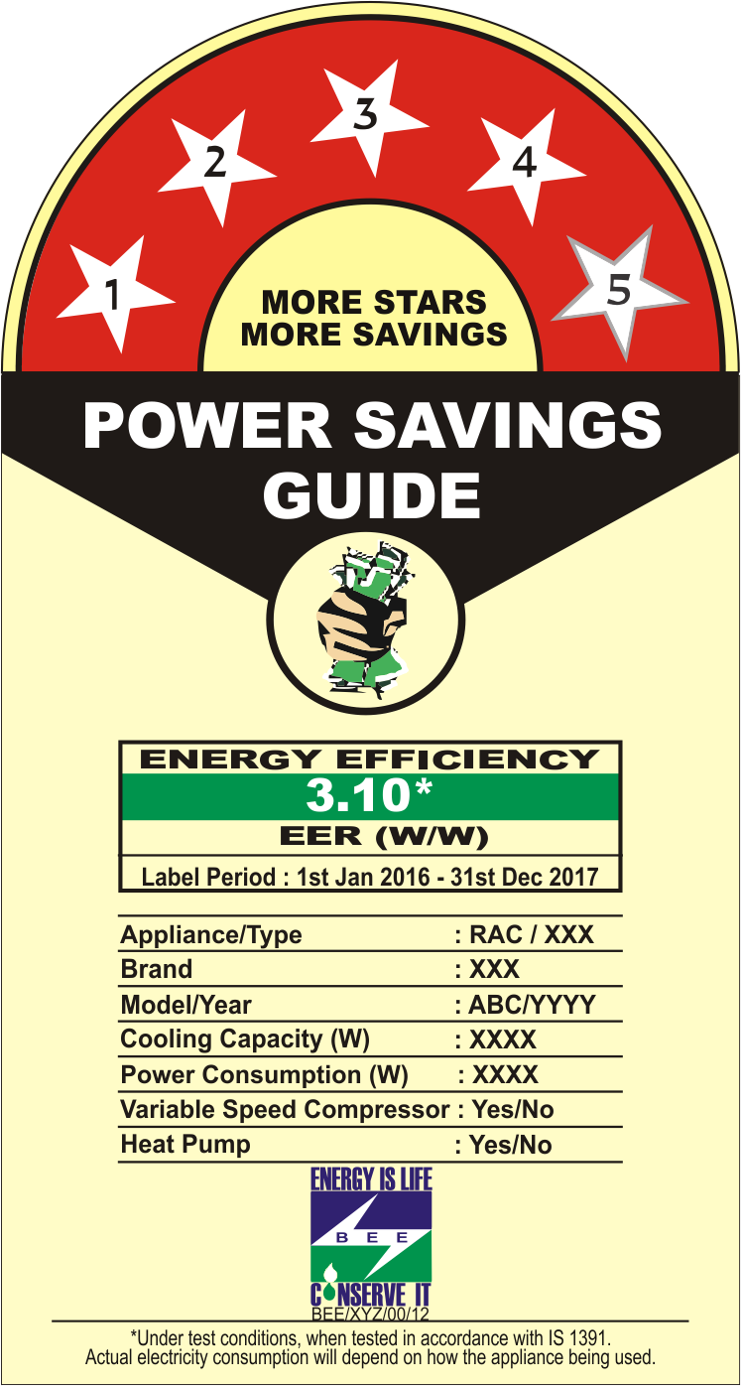
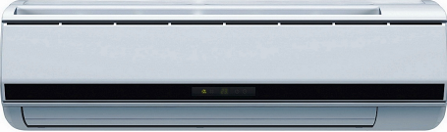

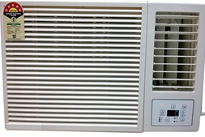
Room Air Conditioners
Mandatory Appliance
Split AC
Standard: IS 1391:1992
Section 14(b): S.O.180(E) dated 12.01.2009
Section 14 (a): S.O. 181 (E) dated 12.01.2009
Regulation: No.2 /11(5)/03-BEE dated 06.07.2009
Window AC
Star Labeling Parameter
Energy Efficiency Ratio
Higher is Better

Slide 13
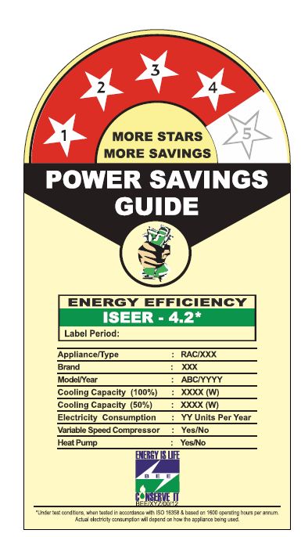
Inverter Air Conditioners
Voluntary Appliance
Standard: ISO 16358
Performance factor: Indian Seasonal Energy Efficiency Ratio (Higher is better)

Slide 14
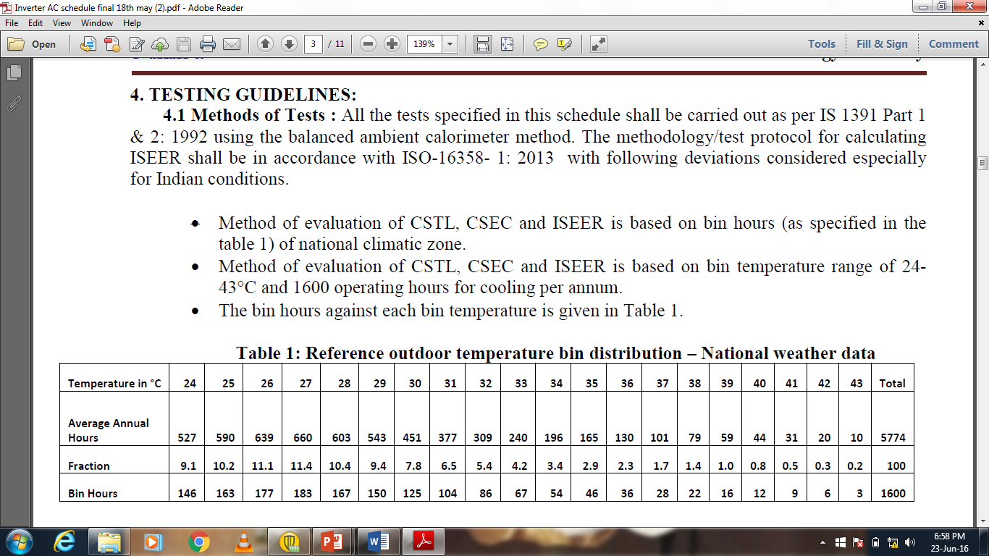
ISEER Methodology
ISEER – Indian Seasonal Energy Efficiency Ratio
Testing standard – IS 1391 Part II
Calculation procedure – ISO 16358
Weather profile for 54 cities across India were analysed to arrive bin temperature and hours
Bin Hours- 1600
Bin temperature - 24 – 43 °C.

Slide 15
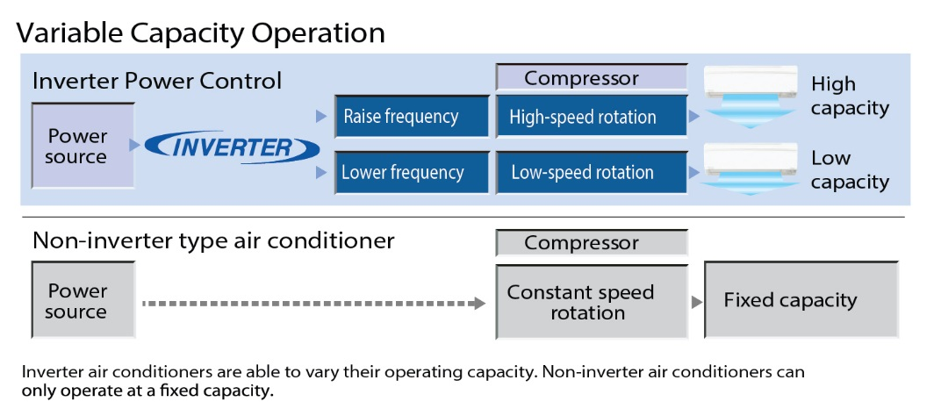
How Inverter AC Works?

Slide 16
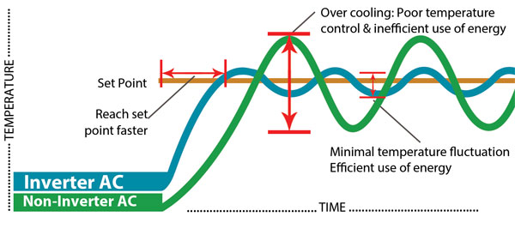
How Inverter ACs have more Energy saving potential?

Slide 17
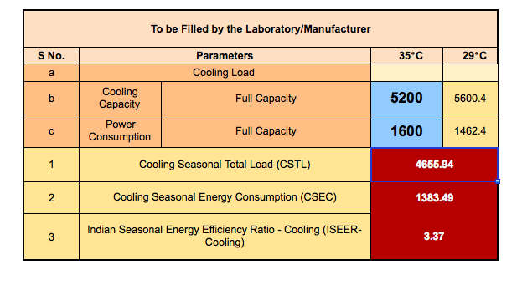
Fixed Speed AC

Slide 18
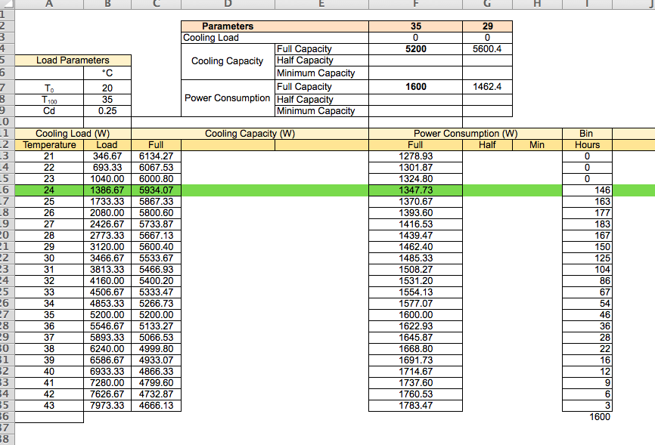
Fixed Speed AC

Slide 19
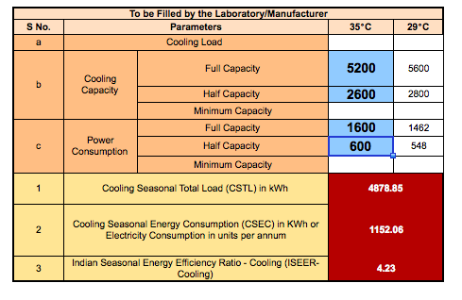
ISEER Methodology

Slide 20
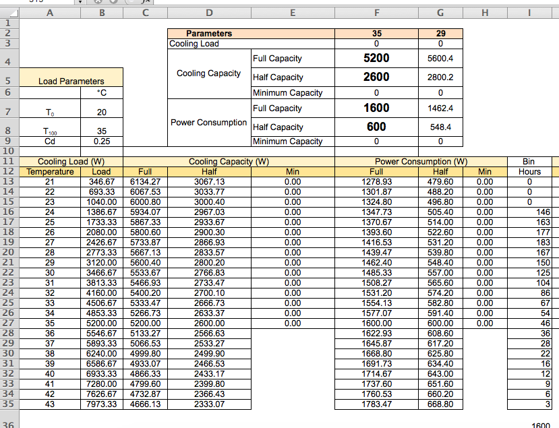
ISEER Calculations

Slide 21
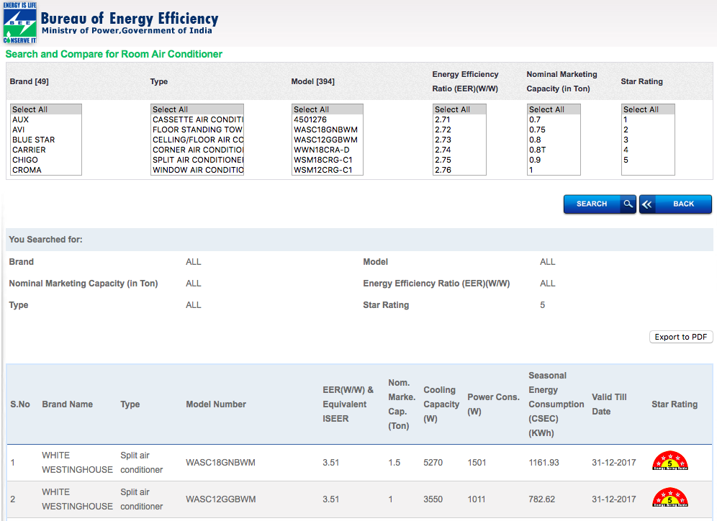
Comparison – Variable and Fixed speed AC

Slide 22
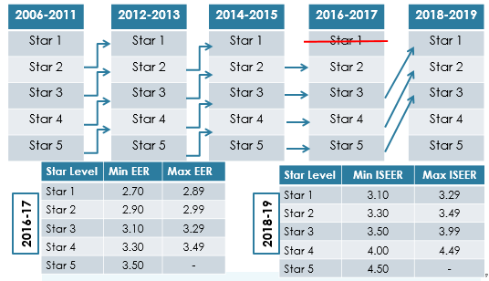
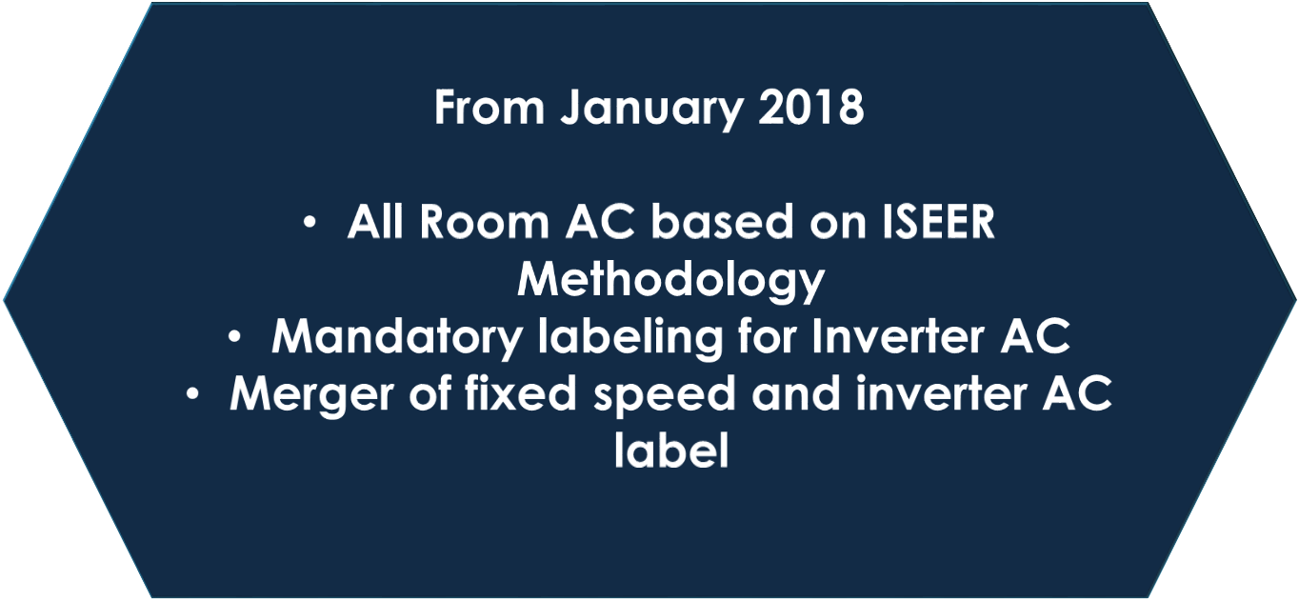
Star level up-gradation for Split AC (2006-11 to 2018-19)

Slide 23
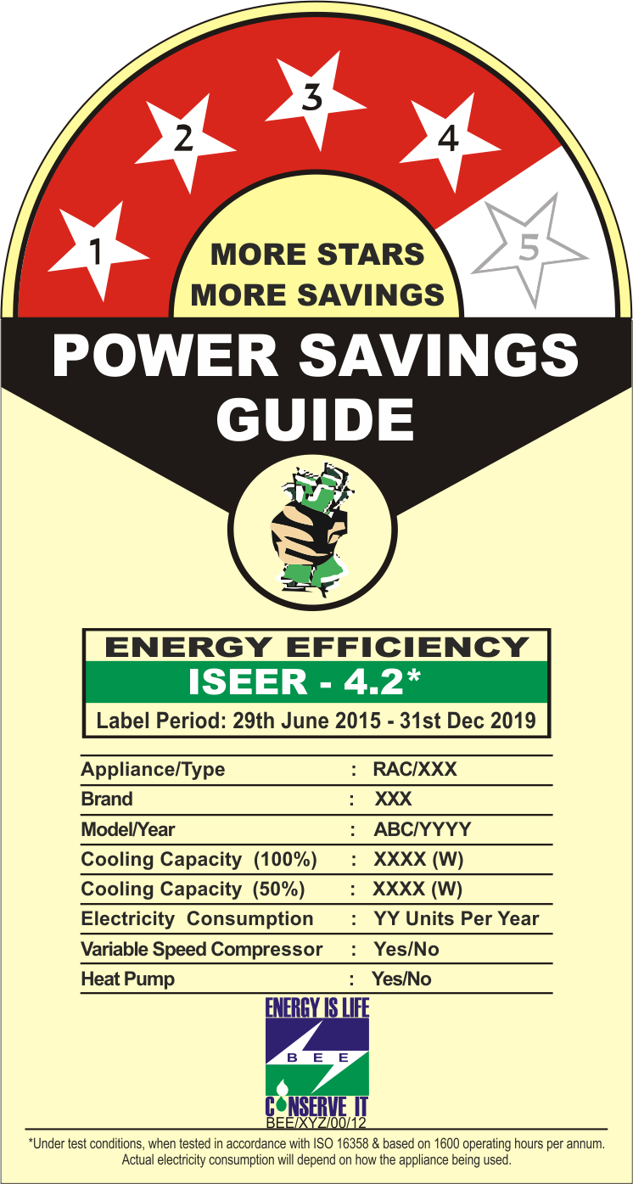
Change in Label
Jan 2018

Slide 24
Market Transformation
ISEER: 3.3

Slide 25
Market Transformation
ISEER: 3.9 - 4.0
Efficiency Improvement: 18-21%

Slide 26
Market Transformation

Slide 27
Key Items to look into for NCAP
Demand Reduction
Building Energy Efficiency
Commercial Building – Thermal Comfort & Appliance Efficiency
Residential Building – Thermal Comfort
Appliances
More reliability
Efficient Installation
Affordability
Efficient Appliances
District Cooling

Slide 28
Thank You for Your Kind Attention

