Slide 1

Development of Technologies for Alternatives to High Global warming HFCs
Dr. B. Narsaiah
Chief Scientist & Head
Fluoroorganic Division
CSIR-Indian Institute of Chemical Technology
Tarnaka, Hyderabad

Slide 2
Brief History

Slide 3
HCFCs and HFCs emission estimated in 2012 (CO₂ equivalent)

Slide 4
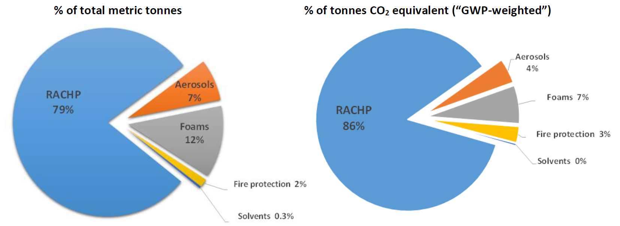

Slide 5
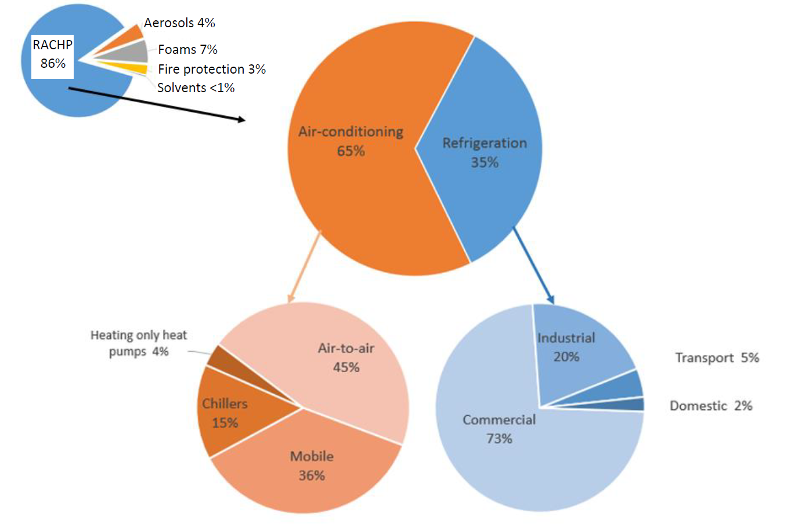

Slide 6
Expertise
Vapor phase fluorinations
Halex reactions
Reagent based synthesis
Building block method

Slide 7
HFCs
CF₃ – CH₂F
HFC-134a
CF₃ – CHF-CF₃
HFC-227ea
CH₃ – CHF₂
HFC-152a
CF₃ – CH₃
HFC-143a

Slide 8
Future generation Refrigerants and fire suppressing agents
Short Term Program (5 years)
HFCs to be phased out:
HFC-134a,HFC-23, HFC-32, HFC-227ea, HFC-125 and HFC-236fa

Slide 9
Medium Term Program (10 years)

Slide 10
Long Term Program (15 years)

Slide 11
THANK YOU

