Slide 1
Enhancing Energy Efficiency:
Opportunity through the Kigali Amendment
Karan Mangotra
Fellow, TERI, Karan.mangotra@teri.res.in

Slide 2
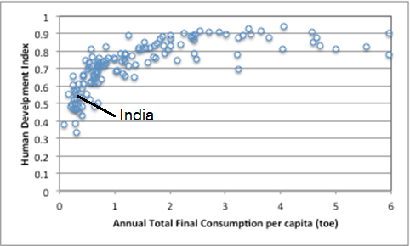
Quality of life improvements are paramount
Energy consumption increases are inevitable
Not enough energy or climate-space if energy use is 5 toe/capita;
Goal is to enable high quality of life at 1.5-2 toe/capita - requires accelerated energy efficiency

Slide 3
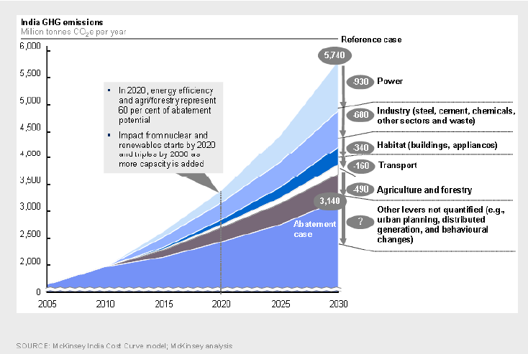
Managing Demand Growth
Economy is growing fast; vast fraction (~two-thirds) of energy supply and use infrastructure in 2030 has yet to be built
Future energy use and GHG emissions would largely depend on efficiency of built/installed infrastructure
Regulations, fiscal and financial policies, and business models would influence rate of efficiency increase

Slide 4
Well-trodden highways
Equipment and appliances
Standards and labeling;
Star label is a well-recognized brand; achieved reduction of over 25% in average energy use of new appliances
Buildings
Energy Conservation Building Code for new commercial buildings
Guidelines for residential buildings
Labelling of existing Buildings

Slide 5
Potential for Energy Efficiency Improvements
1) Equipment efficiency (60-70%)
High Efficiency Heat exchangers
Motors with variable speed drives
High Efficiency Compressors
Electronic controls for reduced standby loads
2) Buildings (50%)
Building design
Shading
Cool-roofs
3) Servicing, Management and Behaviour change (10-20%)
Pre-paid metering
Timely servicing
4) Refrigerant change (5-10%)

Slide 6
Kigali Amendment and Energy Efficiency
Kigali Decision on Energy Efficiency
Decision XXVIII/3 provides opportunity to enhancing energy efficiency of appliances
Energy Efficiency Within MLF
Need to develop cost guidelines associated with maintain or/and enhancing energy efficiency of replacement technology & equipment
TEAP report-Energy Efficiency:
Need to maximize climate benefits

Slide 7
Emerging Needs
Assessing the readiness of Article 5 (developing) countries to facilitate the implementation of energy efficiency measures (a list of relevant needs and methodologies to assess national baselines and performance metrics, measures to implement energy efficiency certification processes and testing)
options for attaching energy efficiency strictly to HFC phase-down activities,
options for verifying funded energy efficient products compliance during operation;
strategic planning under the Kigali Amendment
incorporating energy efficiency in cost guidelines would be a complicated work as evaluation criteria and standards for energy efficiency vary among countries

Slide 8
Towards a National Cooling Action Plan
Convergence between domestic policies to enhance EE while lowering GWP of refrigerants to maximise climate benefits
Prioritise “access to cooling” as a development goal
Framework involving the entire spectrum of energy consumption segments during HFC transition
Innovative implementation or business model to deliver efficient, affordable and low-GWP cooling together
International collaboration for testing and standards
Need for a short term(3 years), medium term (7 years) and long term (12 years) strategy with clearly defined indicators
Together these may culminate into a framework for the National Cooling Action Plan

Slide 9
Transitional Challenges
Honing in on the policy problem – data, analysis and options
Human capacity to support design, and to bring together stakeholders who have never worked together
Implementation Details – learning from global experience
Looking at strategy and implementation together
Institutional strengthening – of think tanks/academia, industry and government
Low-cost capital to enable faster uptake of energy-efficient, affordable and low GWP products

Slide 10
Thank You

