Slide 1

National Cooling Action Plan The Role of Servicing Sector
Dr. Vaibhav Chaturvedi
Research Fellow
Council on Energy, Environment and Water
New Delhi, India
17th January 2018
MoEFCC stakeholder consultation on Development of National Cooling Action Plan for India
New Delhi, India
© Council on Energy, Environment and Water, 2018

Slide 2
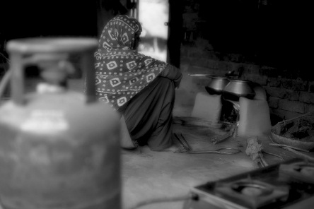
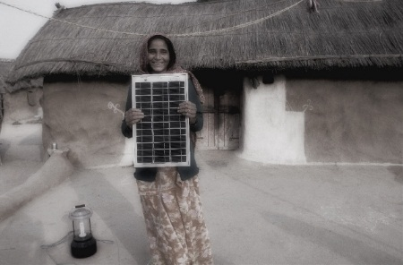




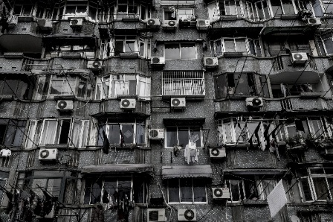
The Council: among the world’s leading policy research institutions
Our Existing Research Themes
^{Energy Access}
^{Renewables}
^{Power Sector}
Industrial Sustainability & Competitiveness
^{Low-Carbon Pathways}
^{Risks and Adaptation}
^{Technology, Finance & Trade}
SOURCE: CEEW

Slide 3
Some important potential objectives of the NCAP
Providing thermal comfort
Minimise refrigerant leakages
Maximise energy efficiency during operations
Providing secure and reliable jobs

Slide 4
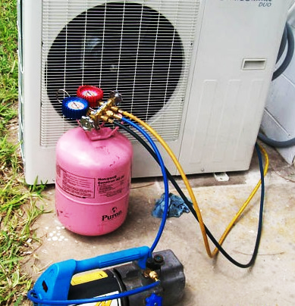
Setting the Context: How many AC technicians work in the country?
Residential AC
Industry estimate is 200,000
50%- 60% in the informal sector
Mobile AC
950,000 technicians overall;
smaller percentage of MAC technicians
50% informal sector
Commercial AC
No official estimates
Overlap between RAC and CAC
Smaller informal sector
SOURCES:
Industry Estimates [RAC];
CII-KPMG Study (2010) and FADA [MAC]
Industry sources [CAC]

Slide 5
Training is not common among service technicians across sectors
Source: Sridhar and Chaturvedi (2017)
ITI diploma a pre-requisite for joining many authorised service centres;
Several technicians dissatisfied with the low barrier to entry for AC servicing due to increased competition.

Slide 6
Not all good servicing practices are followed by technicians
Some methods like leak testing are low-tech while others like recovery require expensive equipment, the economics of which may not work for small enterprises.
Source: Sridhar and Chaturvedi (2017)
Notes:
Trained versus trained comparison– with GSPs (within the informal sector only)

Slide 7
Key Insights
Future of training for the servicing sector
Expansion of training and skill development programmes is extremely important
10% RAC technicians and 16% of CAC technicians who have received servicing training do not follow GSPs.
The National Occupational Standards are neither sufficiently in-depth nor up-to-date with the latest technology.
Customer Awareness Raising is Key to Improving Service Practices
Low customer awareness of GSPs, price sensitivity, and short turnaround affect customer choice of the service centre.
Many customers are unlikely to get the AC serviced regularly unless it is not working properly.
Encouraging early detection of problems important

Slide 8
Understanding the Current Dynamics
The Customer
Lack of technical understanding/ information
Price Sensitive
Informal Sector Service Technician
Formal Sector Service Technician
Low entry barriers
Low price point
Diffused market
Formally trained
Higher price point
Formal channel
Low energy efficiency
High leakage rate

Slide 9
Changing incentive structure of the consumer
The Customer
Customer awareness programme
Advertisements for informing about the economic benefits of proper maintenance
Best practices to be followed for proper servicing and their implications
Importance of certified technicians
Improved technical understanding/ information
Ready to pay higher service charges

Slide 10
Changing incentive structure of the servicing technician
The Technician
A big push towards formalising the sector
Democratising skill enhancement
Massive Open Online Courses (MOOCs) through internet media
Tightly controlled certification system
Trained professionals
Higher service charges

Slide 11
A big push towards formalisation of the AC servicing sector
There is a huge servicing sector
And this is growing
Can we estimate the workforce in this sector in 2030 and 2050?
As per CEEW estimates, India’s residential AC penetration will increase from 6% in 2015 to 24-33% in 2030 and 85-150% in 2050, depending on the economic growth
If RAC servicing sector technicians grow at the same pace, total workforce strength will be at least 800,000 by 2030 (75-100 Mn ACs), and at least 2.5 million by 2050 (250-450 Mn Acs)
Taking immediate steps towards formalising this high potential job sector is imperative
Can we create an enterprise led sector rather than an individual led servicing sector?

Slide 12
Challenges
Infrastructure for certification important, should be set up a bit prior to any MOOCs
Customer push towards certification should not lead to job losses in the near term, but a systemic overhaul could lead to short term challenges
Will be resource intensive

Slide 13
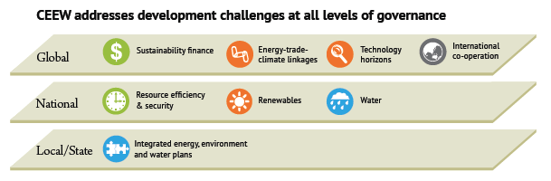





THANK YOU
http://ceew.in

